Slide 1
802E Privacy Mitigations
Date: 2016-03-23
Authors:
Abstract
This document discusses some potential privacy threats and proposes preliminary mitigation techniques that can be used in IEEE 802 protocols to protect against those threats.

Slide 2
Privacy Considerations
The purpose of the IEEE 802E specification is to promote a consistent approach by IEEE 802 protocol developers to mitigate privacy threats identified in the specified privacy threat model and provide privacy protection guidelines.
  Personal Identifiable Information (PII) elements in IEEE 802 protocols
  Privacy Threat Model
  Mitigation Techniques

Slide 3

Privacy Scope: Individuals
Narrow: focused on individuals
Broad: any information related to an individual that can identify him/her, directly or indirectly, may be relevant
Limited to what can be addressed in protocol design - vs. deployment and operation

Slide 4

Privacy Scope: Technical Only
Discussion without reference to any particular legal framework
Mitigating privacy threats strictly from the technical point of view (e.g. protecting PIIs), and regardless of the motivation of the attacker
    If the attacker does it for criminal reasons, privacy-unfriendly commercial reasons, legally or illegally, it is irrelevant
    The actions of the attacker are technically indistinguishable and they should be mitigated in the same way

Slide 5
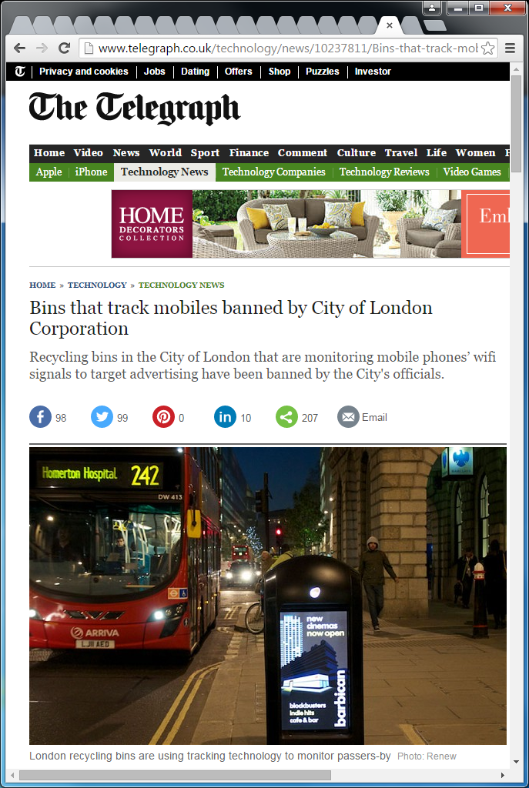
Privacy Threats: Identification
Tracking Wi-Fi mobile devices of by-passers is an easy job, even if devices are not actively connected to any Wi-Fi network
[REF: “Wi-Fi Internet connectivity and privacy: hiding your tracks on the wireless Internet”;
Bernardos, C.J., Zuniga, J.C., and O’Hanlon, P.; IEEE CSCN 2015]

Slide 6
Privacy Threats: Correlation
The combination of several pieces of information reveals patterns and behaviors that can be used to profile users
SSID list:
“ORD_Free_WiFi”,
“My_House_Is_Empty”,
“I_Work_Here”
[REF: https://mentor.ieee.org/802-ec/dcn/14/ec-14-0043-00-00EC-internet-privacy-tutorial.pdf]
Notes:
Coffee shop, hotel, shopping mall – APs all run by the same company, guy/device roaming from one to the next (dotted line path between them)

Slide 7








PIIs in the Internet of “Things”
Personally Identifiable Information (PII)

Slide 8
Privacy by Design (PbD)
Embrace PbD principles - applied specifically to Internet protocols
  Proactive not reactive; Preventative not remedial
  Privacy as the default setting
  Privacy embedded into design
  Full functionality – positive-sum, not zero-sum
  End-to-end security – full lifecycle protection
  Visibility and transparency – keep it open
  Respect for user privacy – keep it user-centric
[REF: https://www.ipc.on.ca/english/privacy/introduction-to-pbd/]

Slide 9
Key Mitigations
Data minimization
  Avoid as much as possible the collection, disclosure, sensitivity, and retention of PIIs
Privacy as the default
  When there are options in the protocol, Privacy features should be used by default
Allow user to opt-out - or rather opt-in!
  Users should be allowed to opt-out from providing personal information at any point in time

