Slide 1
IEEE 802 EC Privacy Recommendation Study Group April 15th, 2015, Conference Call
Juan Carlos Zuniga, InterDigital Labs
(EC SG Chair)

Slide 2
Conference Call Details
Wednesday, April 15th, 2015, 10:00-11:00am EDT
WebEX:
Meeting Number: 743 119 796
Meeting Password: privecsg
To join this meeting (also from mobile devices):
Go to https://premconf.webex.com/premconf/j.php?MTID=m03b8ceed0f420204c6c2528c7380741e
If requested, enter your name and email address.
3. If a password is required, enter the meeting password: privecsg
4. Click "Join".
5. Follow the instructions that appear on your screen.
Teleconference information
Provide your phone number when you join the meeting to receive a call back.
Alternatively, you can call:
Call-in number (Premiere): 1-719-867-1571 (US/Canada)
Show global numbers: https://www.myrcplus.com/cnums.asp?bwebid=8369444&ppc=542167&num=1&num2=1719-867-1571
Attendee access code: 542167

Slide 3
Guidelines for IEEE-SA Meetings
All IEEE-SA standards meetings shall be conducted in compliance with all applicable laws, including antitrust and competition laws.
Don’t discuss the interpretation, validity, or essentiality of patents/patent claims.
Don’t discuss specific license rates, terms, or conditions.
Relative costs, including licensing costs of essential patent claims, of different technical approaches may be discussed in standards development meetings.
Technical considerations remain primary focus
Don’t discuss or engage in the fixing of product prices, allocation of customers, or division of sales markets.
Don’t discuss the status or substance of ongoing or threatened litigation.
Don’t be silent if inappropriate topics are discussed… do formally object.
---------------------------------------------------------------
If you have questions, contact the IEEE-SA Standards Board Patent Committee Administrator at patcom@ieee.org or visit http://standards.ieee.org/about/sasb/patcom/index.html
See IEEE-SA Standards Board Operations Manual, clause 5.3.10 and “Promoting Competition and Innovation: What You Need to Know about the IEEE Standards Association's Antitrust and Competition Policy” for more details.
This slide set is available at https://development.standards.ieee.org/myproject/Public/mytools/mob/slideset.ppt

Slide 4
Resources – URLs
Link to IEEE Disclosure of Affiliation
http://standards.ieee.org/faqs/affiliationFAQ.html
Links to IEEE Antitrust Guidelines
http://standards.ieee.org/resources/antitrust-guidelines.pdf
Link to IEEE Code of Ethics
http://www.ieee.org/web/membership/ethics/code_ethics.html
Link to IEEE Patent Policy
http://standards.ieee.org/about/sasb/patcom/materials.html

Slide 5
Agenda
Welcome
Chair's slides
IEEE Slides
Call meeting to order
Group’s updates
Privacy EC SG PAR/CSD
IEEE802/IETF MAC Privacy Trials
Technical Topics
Threat Model for Privacy at Link Layer
IETF IAB Confidentiality Threat Model and Problem Statement
Privacy Issues at Link Layer
Proposals regarding functionalities in IEEE 802 protocols to improve Privacy
Proposals regarding measuring levels of Privacy on Internet protocols
Implications of MAC address changes
Other
Next Steps

Slide 6
Business#1
Call Meeting to Order
Meeting called to order by chair at
Minutes taker
Roll Call
Name | Affiliation |  | Name | Affiliation
Juan Carlos Zuniga (Chair) | InterDigital |  | Piers O’Hanlon | Oxford Internet Institute
Mathieu Cunche | INRIA |  | Walter Pienciak | IEEE-SA
Antonio de la Oliva | UC3M |  | Karen Randall | Randall-Consulting
Dan Harkins | Aruba Networks |  | Max Riegel | NSN
Paul Lambert | Marvell |  | Dan Romascanu | Avaya
Soo Bum Lee | Qualcomm |  | Rene Struik | Struik Security Consultancy
Robert Moskowitz | Verizon |  | Brian Weis | Cisco

Slide 7
Business#2
Agenda bashing
Approval of minutes
Reports
Group’s updates
Privacy EC SG PAR/CSD
IEEE802/IETF MAC Privacy Trials

Slide 8
IEEE 802 Privacy Rec PAR/CSD
Privacy Recommendation PAR/CSD proposal presented and discussed during Berlin’s interim meeting
PAR/CSD Presentation
https://mentor.ieee.org/privecsg/dcn/15/privecsg-15-0004-02-0000-privacy-recommendation-par-csd-proposal.pptx
PAR Text
https://mentor.ieee.org/privecsg/dcn/15/privecsg-15-0006-00-ecsg-privacy-recommendation-par-proposal.pdf

Slide 9
IEEE 802 Privacy Rec PAR/CSD
Received comments
https://mentor.ieee.org/privecsg/dcn/15/privecsg-15-0010-00-ecsg-par-csd-comments-received.pptx
Response to PAR CSD comments
https://mentor.ieee.org/privecsg/dcn/15/privecsg-15-0013-01-0000-response-to-par-csd-comments.pptx
Currently planning to pre-circulate PAR as an 802.1 WG project proposal
Deadline for consideration at July’s plenary is June 13, 2015

Slide 10
MAC Privacy Experiment - Overview
MAC Privacy trial carried out at both IEEE 802 Berlin plenary and IETF 92 Dallas meetings
IEEE 802 Plenary, Berlin, Germany, 8-13 March
IETF 92 meeting, Dallas, TX, USA, 23-27 March
Successful trial showed no major issues
Only minor configurations required for DHCP Server
IETF NOC considering including setup at all future IETF meetings
Next Steps
Document privacy leakage findings with DHCP identifiers

Slide 11
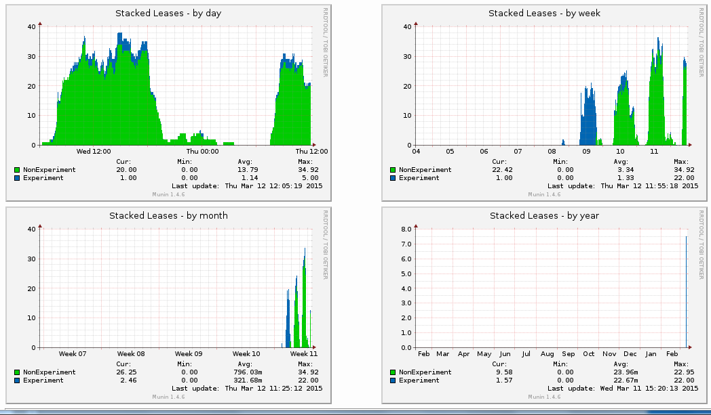
MAC Privacy Trial – Berlin Results
MAC address randomization experiment run on IEEE 802 wireless network during Berlin plenary meeting
[Strong support from Verilan and Warren Kumari (Google)]
More info available at the trial Wiki page: http://goo.gl/eFUM9h

Slide 12
MAC Privacy Trial - Setup
WLAN address randomization scripts developed and provided now for 4 different OSes:
Microsoft Windows (tested on Windows 7)
Apple Mac OS X (tested on Version 10.10, alias Yosemite)
GNU Linux (tested on Debian testing/unstable, Ubuntu 13.10, and Fedora 20)
Android (tested on Nexus 4, Jelly Bean 4.2.2, and Nexus 5, CyanoGen12 Android 5.0.2
Probes on DHCP and wireless network infrastructure

Slide 13
Business#3 Technical Presentations
W3C Privacy Interest Group (PING) meeting during IETF 92
=> Brief overview of the IEEE 802 Executive Committee Privacy Recommendation Study Group and the WiFi Privacy Experiment @ IETF 92 (Juan-Carlos Zuniga)
=> W3C TAG finding “Securing the Web” and Requirements for Powerful Features (Mark Nottingham)
=> Deprecating support for insecure origins for Geolocation and Proposed Edited Recommendation Geolocation API Specification (Giri Mandyam)
=> A intro to a privacy issue/requirement from Alibaba (Kepeng Li)
=> Ongoing PING work - privacy guidance, reviews, etc.
https://lists.w3.org/Archives/Public/public-privacy/2015AprJun/0009.html
Confidentiality in the Face of Pervasive Surveillance: A Threat Model and Problem Statement (IAB/IETF)
Document includes section on Tracking of MAC addresses
http://tools.ietf.org/html/draft-iab-privsec-confidentiality-threat
Max Riegel (Nokia Networks)
Initial thoughts about privacy aspects on P802.1CF specification
https://mentor.ieee.org/omniran/dcn/15/omniran-15-0015-00-CF00-privacy-engineered-access-network.pptx

Slide 14
Business#4
Next steps
Submit PAR for pre-circulation at IEEE 802 July plenary
Continue call for proposals to discuss technical topics
Threat Model for Privacy at Link Layer
Privacy Issues at Link Layer
Proposals regarding functionalities in IEEE 802 protocols to improve Privacy
Proposals regarding measuring levels of Privacy on Internet protocols
Implications of MAC address changes
Other…

Slide 15
Business#4
Upcoming meetings
3 June 2015, (10:00 AM ET), Teleconference
10 June 2015, (10:00 AM ET), Teleconference (if needed)
Potential PAR/CSD submission
1 July 2015, (10:00 AM ET), Teleconference
13-17 July 2015, IEEE 802 Plenary meeting in Waikoloa, HI, USA
Meeting adjourned at

