Slide 1
IEEE P802.1CF for vertical applications
IEEE 802.1 OmniRAN TG
Chair: Max Riegel (Nokia Bell Labs)
2018-03-08

Slide 2
Outline
Introduction and overview
  Rationale, approach, content
Concepts
  Network Reference Model, functional description and network virtualization
Applicability to vertical applications
  Addressing IoT device maintenance issues
Status

Slide 3
Introduction
IEEE P802.1CF for Vertical Applications

Slide 4
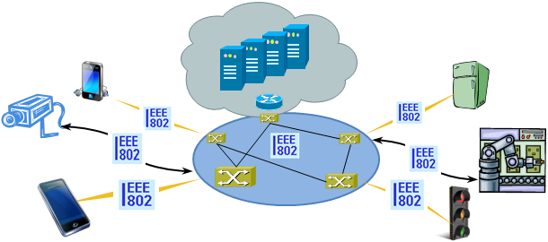
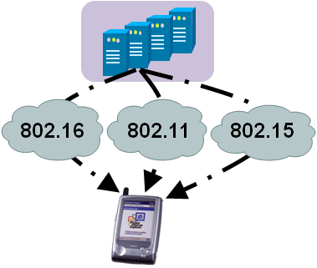
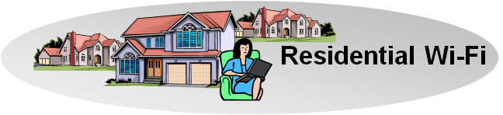
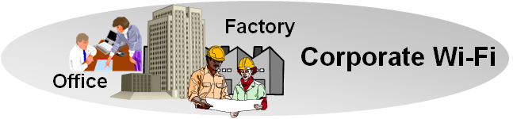
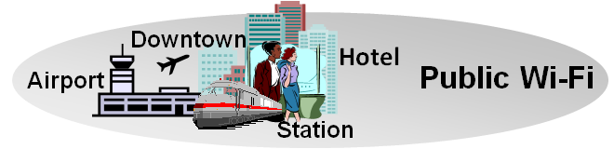
There is Evidence to consider Commonalities of IEEE 802 Access Networks
More (huge) networks are coming
up by everything gets connected
  e.g. SmartGrid, ITS, IoT, …
New markets for
IEEE 802 access technologies
  e.g. factory automation, in-car communication, home automation, …
IEEE 802 access is becoming more heterogeneous
  multiple network interfaces
    e.g. IEEE 802.3, IEEE 802.11, IEEE 802.15…
  multiple access network topologies
    e.g. IEEE802.11 in residential, corporate and public
  multiple network subscriptions
    e.g. multiple subscriptions for same interface
New emerging techniques, like SDN and virtualization

Slide 5
IEEE 802 demands a kind of ‘Stage 2’
Network Specification in 3 Stages
For the specification of the Integrated Services Digital Network the ITU-T defined in its Rec. I.130 a sequential 3 stage process,.
This process is nowadays commonly used in most telecommunication network standardization activities.
A ‘Stage 2’ specification would provide a mapping of the existing IEEE 802 protocols to a functional network model, which facilitates easier evaluation and better understanding of end-to-end behavior.
‘External’ requirements from the
service/deployment perspective
Develop a logical/functional model
for evaluation of those requirements;
Available IEEE 802 specifications
of protocols and attributes.
P 802.1CF

Slide 6
P802.1CF PAR
Project Title:
Network Reference Model and Functional Description of IEEE 802 Access Network
Scope:
This Recommended Practice specifies an access network, which connects terminals to their access routers, utilizing technologies based on the family of IEEE 802 Standards. It provides an access network reference model, including entities and reference points along with behavioral and functional descriptions of communications among those entities.
Purpose:
Heterogeneous networks may include multiple network interfaces, multiple network access technologies, and multiple network subscriptions. In some cases such heterogeneous functionality must be supported in a single user terminal.
This Recommended Practice supports the design and deployment of access networks based on IEEE 802 technologies, guides the developers of extensions to the existing standards in support of a heterogeneous access network, and enables the use of IEEE 802 standards in new network deployments by specifying the functions of the IEEE 802 technologies when deployed in access networks.

Slide 7
P802.1CF D1.0 ToC
Overview
Normative references
Definitions
Acronyms, abbreviations, and conventions
Conformance
Network Reference Model
  Basic architectural concepts and terms
  Overview of IEEE 802 Network Reference Model
  Basic Network Reference Model
  NRM with Coordination and Information Service
  Comprehensive Network Reference Model
  Operational roles
  Identifiers
  Network Virtualization
  Deployment scenarios
Functional Decomposition and Design
  Access network setup
  Access network discovery and selection
  Association and disassociation
  Authentication and trust establishment
  Datapath establishment, relocation and teardown
  Authorization, QoS and policy control
  Accounting and monitoring
  Fault diagnostics and maintenance
Network softwarization
  Information model
  Virtualized network instantiation
Annex:
  SDN functional decomposition
  Network Function Virtualization
  Information model notation

Slide 8
Concepts
IEEE P802.1CF for Vertical Applications

Slide 9
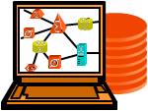

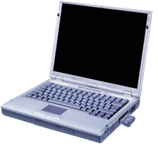
Network Reference Model design
Core functional entities were identified from a common topology figure of an access infrastructure
The portion of the access infrastructure in scope of IEEE 802 was defined according to the protocol layer architecture of the data path
IEEE 802 access network describes the layer 2 network between terminal and access router implemented through IEEE 802 technologies.
NMS
Subscription
Service
Information
Server
Terminal
Access Network
Backhaul
Access Router
Application
Application
Transport
Transport
Network
Network
Network
Network
Data Link
DL
DL
DL
DL
DL
DL
Data Link
Data Link
Data Link
Physical
Phy
Phy
Phy
Phy
Phy
Phy
Physical
Physical
Physical
Medium
Medium
Medium
Medium
Medium
Terminal
Interface
Node of
Attachment
Backhaul
Access Router
Interface
Scope of specification

Slide 10
Network Reference Model basics
The NRM denotes the functional entities and their relation to each others
Functional entities represented by rounded rectangles
Relations are shown by reference points indicating interfaces
  Reference points are denoted through R…
    Total of 12 reference points in the model
  Two different kind of reference points
    Forwarding path of Ethernet frames
      Represented by solid lines
    Control interfaces
      Represented by dotted lines
Subscription
Service
NMS
Terminal
R2
R11
R4
R12
Access Network
Access Router
R1
R3

Slide 11
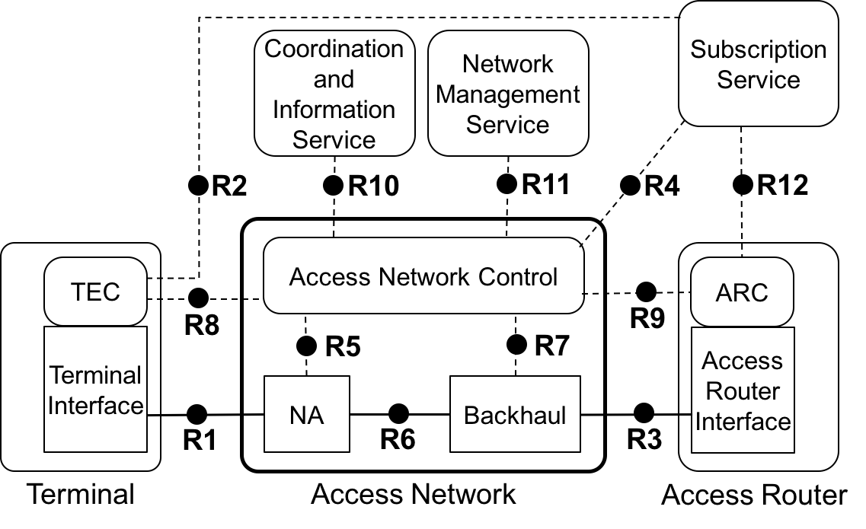
IEEE 802 Access Network Reference Model
Comprehensive NRM shows highest level of details
NRM represents an abstract view on an access network
  For the purpose to define interfaces
Control interfaces cover only attributes related to IEEE 802
  Protocol details on control interfaces are out of scope

Slide 12
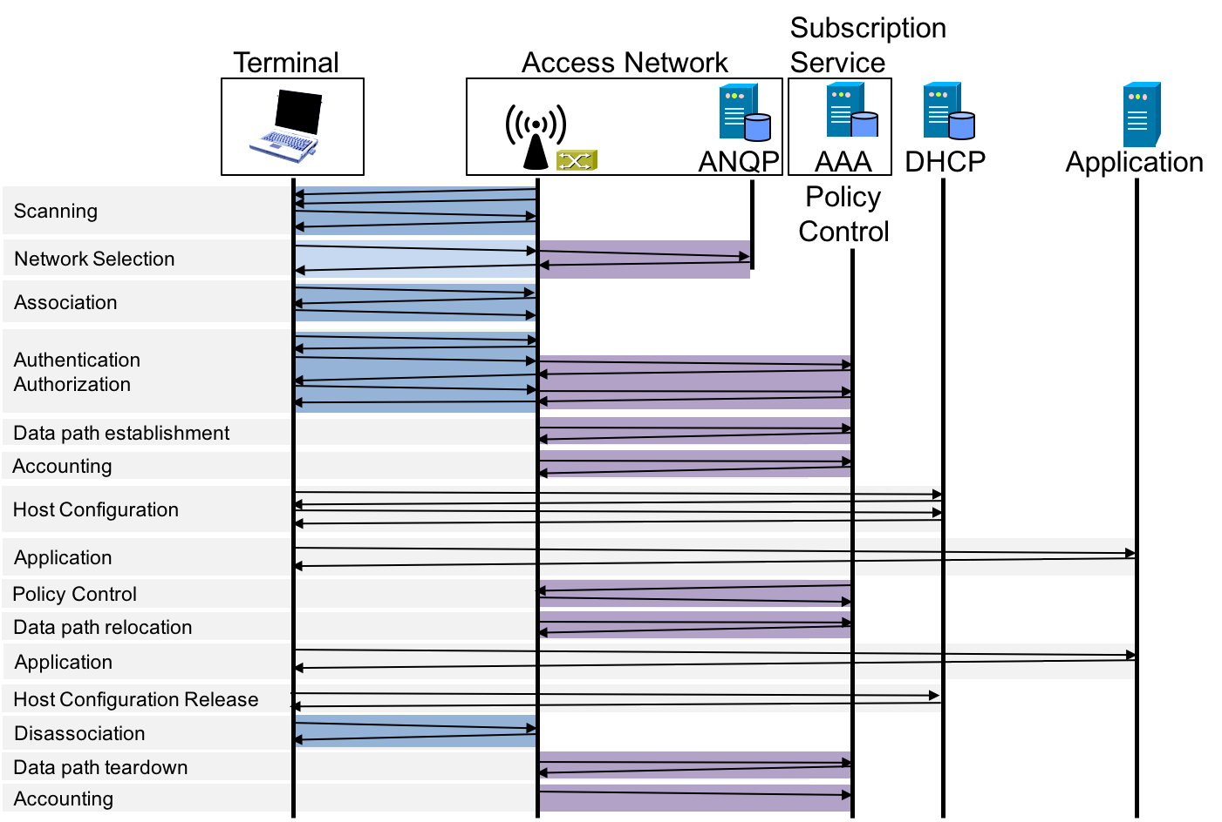
Functional Decomposition and Design
The life-cycle of an IEEE 802 session
IEEE 802 messaging over R1
IEEE 802 control messaging

Slide 13
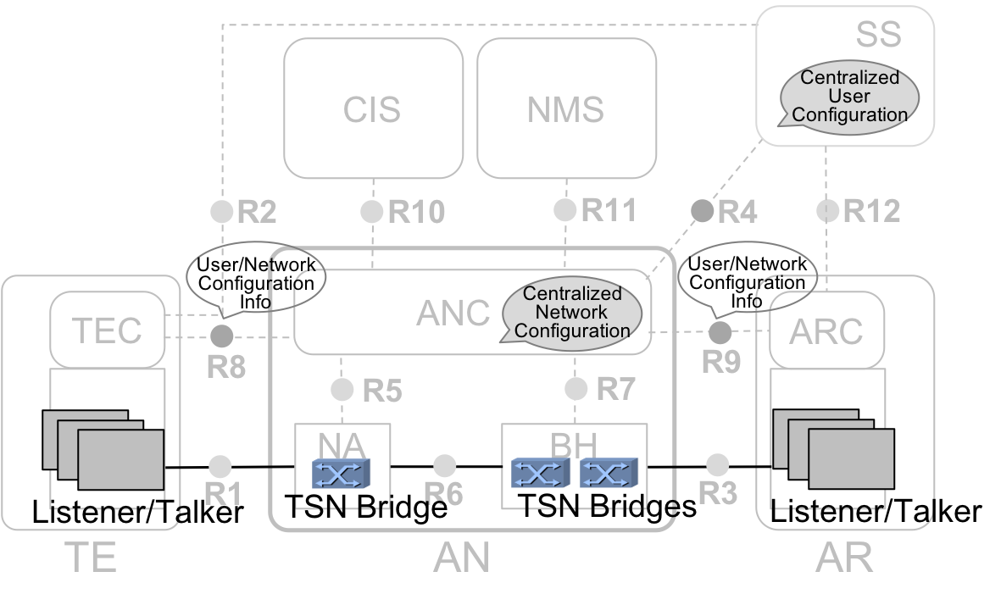
P802.1CF supports TSN
Mapping of TSN to P802.1CF NRM
P802.1CF access network represents the bridged connectivity between end stations
Access Network Control (ANC) provides centralized network configuration for TSN sessions
  CNC is contained in ANC
R8, R9, and ANC
provide means to
process User/Network
Configuration Info

Slide 14
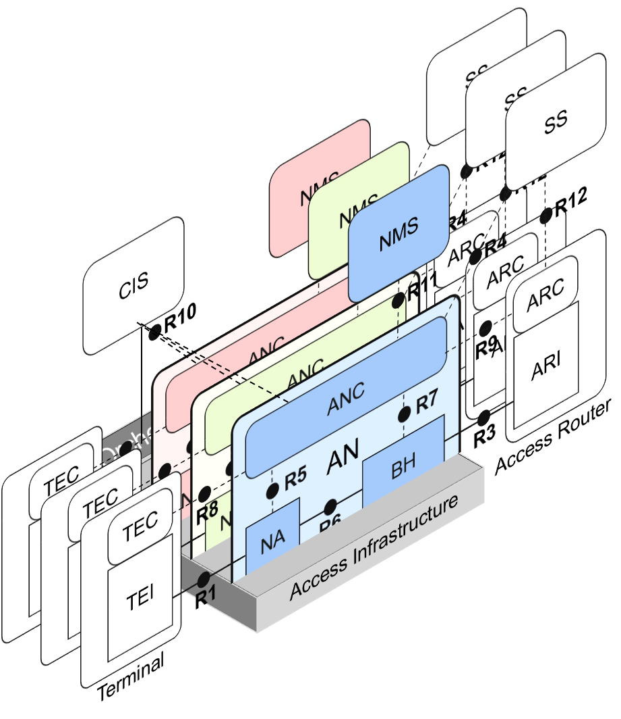
Network softwarization
Building networks through software
P802.1CF provides model for
network virtualization of
IEEE 802 access networks
Allows for realization of
several separate networks
on a common infrastructure
Virtualization establishes
separate control instances
for each of the networks
BTW: VLANs provide
separate datapaths
under a common
control

Slide 15
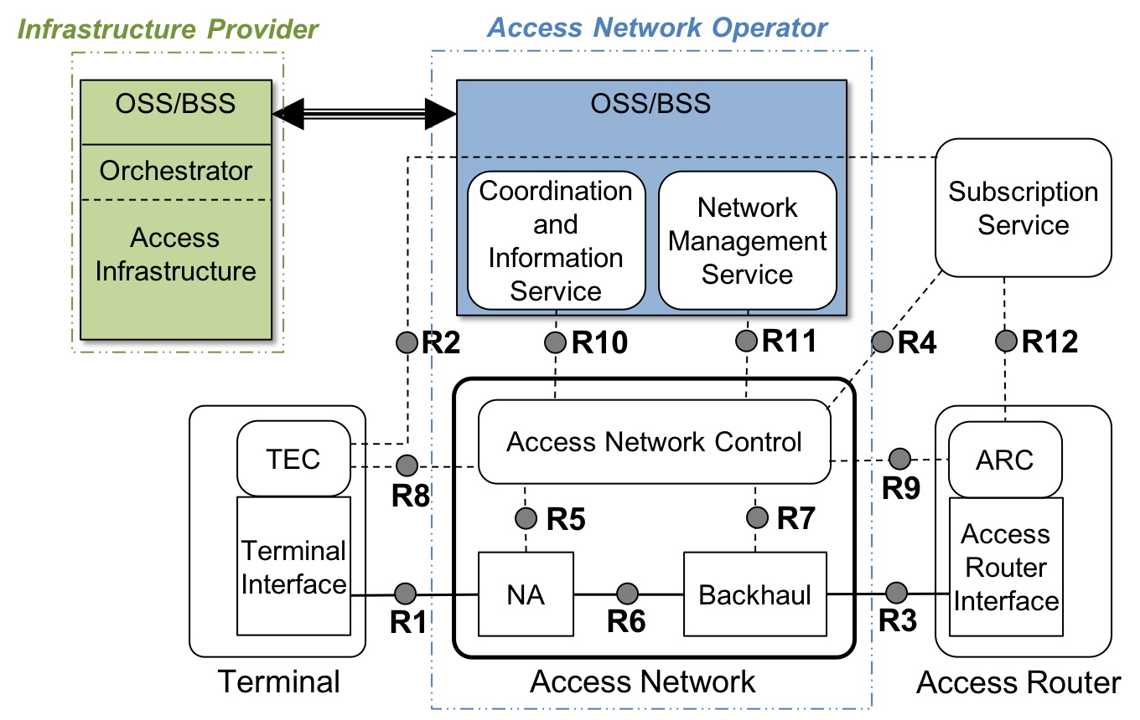
Realization of virtualized access network
Network softwarization requires an information model of access network
Has to cover full network life-cycle
  Operation
  Administration
  Maintenance
  Provisioning
NetworkOAM
Session
1+
1
ANConfig
1
NetManagement

Slide 16
Deployment Cases
IEEE P802.1CF for Vertical Applications

Slide 17
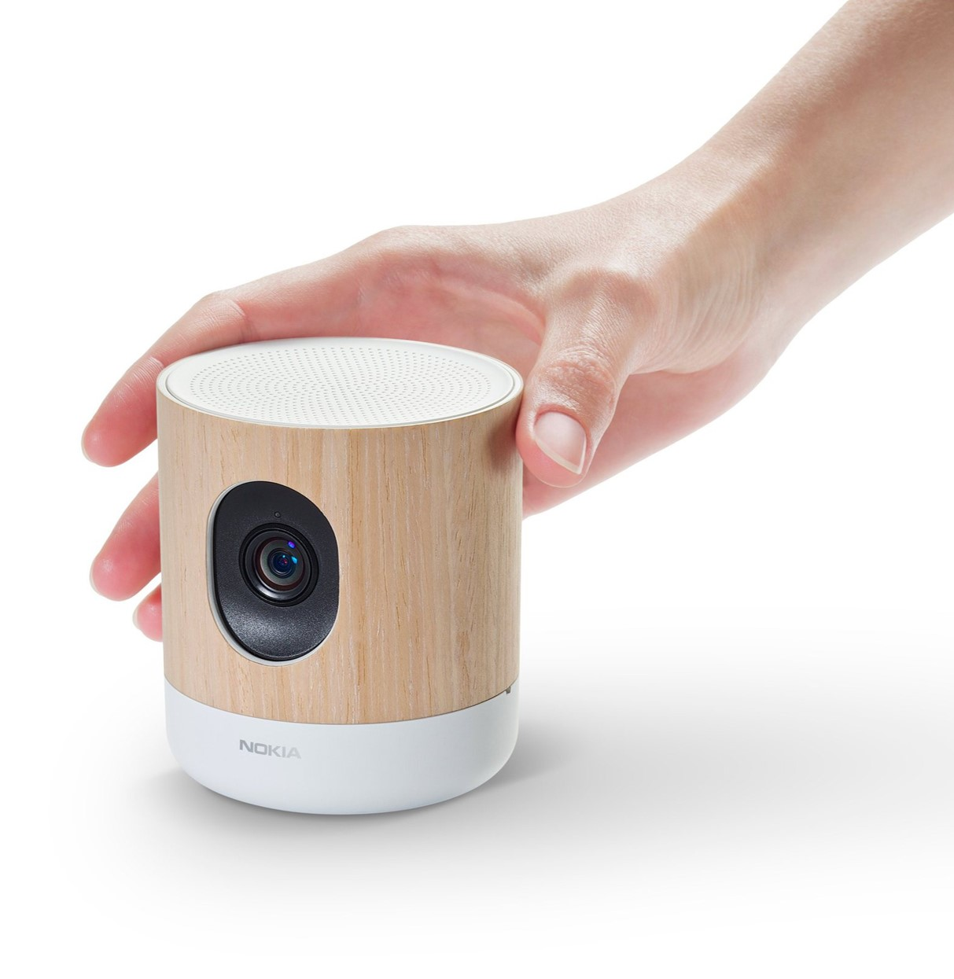
The long lasting life of IoT devices
IoT devices are installed once, and
might be kept running forever
  IoT devices are expected to operate
  10+ years
    Smartphones may be used for about 3 years,
    tablets and notebooks for 5 years
  Wi-Fi has long backward compatibility (20+ years)
How to maintain secure operation over (very) long periods
  Potentially, security bugs in the firmware will be discovered
  Maintenance may become difficult due to missing availability of firmware updates, in particular when the devices are getting older.
If you can’t correct it, you should protect it!

Slide 18

Protecting sensitive things in a hostile environment
Isolate, separate,
build walls around,
and gate access
  Proven principles of
  protection for ages
Protection of IoT
devices could follow
the same principles.
  Strictly control the communication of IoT devices.
  Operating IoT devices in a dedicated Wi-Fi access network might even allow for secure operation of vulnerable firmware.
By © MFSG / Wikimedia Commons, CC BY-SA 3.0

Slide 19
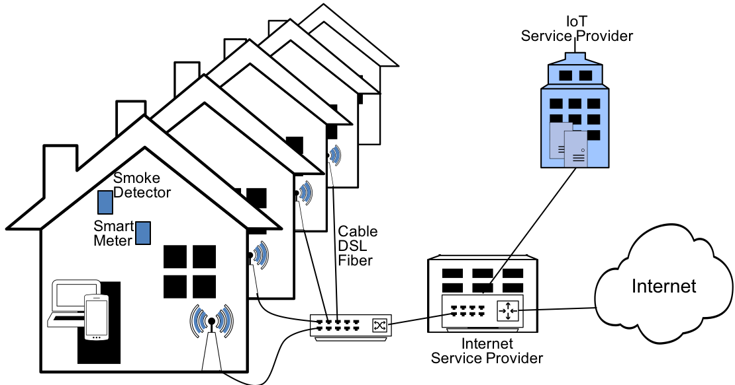
Virtualized Wi-Fi access networks
Multiple Wi-Fi accesses through ‘multi SSID’ configuration
  Wi-Fi has build-in virtualization capabilities.
Network virtualization allows for multiple separate access infrastructures on a common infrastructure.
  Network virtualization is promising technology to create ‘cloud economy’ also for network infrastructures.

Slide 20
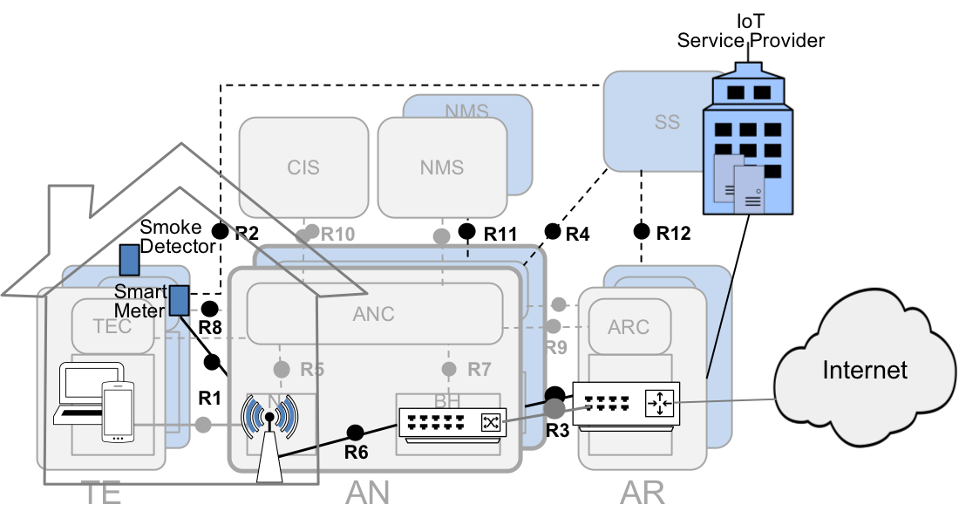
Wi-Fi access network virtualization
Enterprise Wi-Fi solutions and Community Wi-Fi are early examples of virtual Wi-Fi access networks.
  Not yet really virtualized,
  only secondary user planes
Virtualization of Wi-Fi access requires model of desired network.
  Covering complete network lifecycle: Operation, Administration, Maintenance, Provisioning
P802.1CF provides architecture and functional model of virtualized IEEE 802 access network, which can be applied to Wi-Fi.

Slide 21
Conclusion
IEEE P802.1CF for Vertical Applications

Slide 22
Status of P802.1CF
Initial WG ballot on P802.1CF completed
Next revision will undergo again comprehensive review
  Full text open for commenting
Forwarding for sponsor ballot planned for July 2018
Review and input from networking experts wanted to further enhance the document.
  OmniRAN TG strives for making the specification as comprehensible as possible
  Please contact me if you would like to get access to the latest specification to help us to achieve our goals.

