Slide 1
Time Sensitive Networking within P802.1CF
Date: 2017-11-09
Authors:
Name | Affiliation | Phone | Email
Max Riegel | Nokia | +49 173 293 8240 | maximilian.riegel@nokis.com
Notice: This document does not represent the agreed view of the IEEE 802.1 OmniRAN TG. It represents only the views of the participants listed in the ‘Authors:’ field above. It is offered as a basis for discussion. It is not binding on the contributor, who reserve the right to add, amend or withdraw material contained herein.
Copyright policy: The contributor is familiar with the IEEE-SA Copyright Policy <http://standards.ieee.org/IPR/copyrightpolicy.html>.
Patent policy: The contributor is familiar with the IEEE-SA Patent Policy and Procedures: <http://standards.ieee.org/guides/bylaws/sect6-7.html#6> and <http://standards.ieee.org/guides/opman/sect6.html#6.3>.
Abstract
The presentation provides a short introduction into how Time Sensitive Networking, will be described within the P802.1CF architectural network description.

Slide 2
Time Sensitive Networking within P802.1CF
Max Riegel
(Nokia)

Slide 3
P802.1CF supports TSN
P802.1CF access network represents the bridged connectivity between end stations
  Supports as well multicast behavior for single Talker forwarding to multiple Listener
P802.1CF datapath (solid line) can provide support for time-sensitive streams and real-time data
  Implementing TSN queuing and forwarding in the Bridges in NA and Backhaul
The TSN configuration models w/ centralized network configuration can be easily represented in the P802.1CF Network Reference Model

Slide 4
SHORT Introduction into TSN
TSN within P802.1CF

Slide 5
Motivation
Time Sensitive Networking is an enhancement to IEEE 802 networks enabling the convergence of real-time control with time-critical streaming and and bulk data into a single communication network.
It provides guaranteed latency, low-jitter and zero congestion loss for all critical control data of various data rates.
It reduces complexity and costs through convergence of multiple kind of applications into a single network.
It protects critical traffic to effects of converged, non-critical bulk traffic
It simplifies overall networking through common design, provisioning, and maintenance of a single infrastructure.

Slide 6
Traffic types
Best-effort (BE) traffic
  low-priority traffic without timing and delivery guarantees
Rate constrained (RC) traffic
  each flow has a bandwidth limit defined by two parameters:
    minimum inter-frame intervals, and
    maximal frame size
Time-trigger (TT) traffic
  each flow has a accurate time to be sent

Slide 7
Time sensitive networking for real-time and time-critical traffic
Two aspects:
Data must be delivered within a certain window, typically before a specified maximum delay,
Connected devices need to have a common sense of wall clock time for synchronization, coordination, phase locking, etc.
Both are mandated for time sensitive networking.

Slide 8
Time Sensitive Networking components

Slide 9
AVB: The foundation of TSN
IEEE Std. 802.1AS-2011 – generalized Precision Time Protocol (gPTP)
  A Layer 2 profile of the IEEE 1588 Precision Time Protocol (PTP)
IEEE Std. 802.1Qav – Forwarding and Queuing of Time-Sensitive Streams (FQTSS):
  Specifies Credit-Based Shaper (CBS)
IEEE Std. 802.1Qat – Stream Reservation Protocol (SRP)
  Registration and reservation of time-sensitive streams
IEEE Std. 802.1BA – AVB Systems
  Provides an overall AVB architecture and AVB profiles

Slide 10
TSN related specifications and projects
802.1Qbu – Frame Preemption
802.1Qbv – Enhancements for Scheduled Traffic
802.1Qca – IS-IS Path Control and Reservation (PCR)
802.1Qch – Cyclic Queuing and Forwarding
802.1Qci – Per-Stream Filtering and Policing
P802.1Qcc – Stream Reservation Protocol (SRP) Enhancements & Performance Improvements and TSN configuration
P802.1Qcj – Auto-attach to PBB services
P802.1Qcp – YANG Data Model
P802.1Qcr – Asynchronous Traffic Shaping (ATS)
P802.1AS-Rev – Timing and Synchronization - Revision
P802.1CB – Frame Replication and Elimination for Reliability
P802.1CM – Time-Sensitive Networking for Fronthaul
P802.1CS – Link-local Registration Protocol (LRP)

Slide 11
Clock Synchronization Protocol
Select a grandmaster from multiple grandmasters
  Receivers compare by “announce message”
Periodically synchronize to the grandmaster clock
  Distribute local time “preciseOrigininTimeStamp”
  “Sync message” and “Follow up message”
Measure the forwarding delays in the bridges
  Bridge delay (Transmission time - Reception time)
Measure the communication
delays:
  Time stamps:
    Client msg: C:t1 → S:t2;
    Server msg: S:t3 → C:t4
  Communication delay:
    [(t4-t1)-(t3-t2)]/2

Slide 12
Traffic Shaping
Each bridge decides how to schedule multiple packets serially
Mechanisms
  Best-effort traffic
    “Priority Scheduling Algorithm”
  Rate Constraints traffic
    “Credit based shaper”
  Time-trigger traffic
    “Time aware shaper”

Slide 13
Stream Specification
Stream Reservation Protocol (SRP)
  Register streams / reserve bandwidth
Talker Advertise Message information elements:
  StreamID
    Talker MAC address + 16 stream ID
  Data Frame Parameters
    Destination MAC address + VLAN ID
  Traffic Specification(Tspec)
    MaxFrameSize
    MaxIntervalFrame: max. number of frames
    in a measurement interval
    (e.g., 125 us, 250 us)
  Priority and ranking
  Accumulated latency
Listener sends confirmation message if specification can be met.
T
T
T
T
Bridge
Listener
L
L
Talker
Bridge
Bridge
T
T
L
L
L
Bridge
Listener
L

Slide 14
TSN Configuration
TSN within P802.1CF

Slide 15
TSN configuration basics
Addresses stream configuration transmitted by a Talker to one or more Listeners.
Talkers and Listeners are located within end stations.
Configuration information is exchanged over a User / Network Interface (UNI).
User side represents Talkers and Listeners.
Network side represents the Bridges forwarding the streams
User specifies requirements for its data transfer, but without detailed knowledge of the network.
The network obtains requirements from users, analyzes the topology and TSN capabilities of Bridges, and configures the Bridges to meet user requirements.
The network returns the success or failure of each Stream’s configuration to the user.
Subclause 46.2 specifies the user/network configuration information that is exchanged over the TSN UNI

Slide 16
Distributed TSN configuration model
End stations (i.e. Talkers and Listeners) communicate the user requirements directly over the TSN user/network protocol.
The network is configured in a fully distributed manner. without a centralized network configuration entity.
TSN user/network configuration information is propagated along the active topology for the Stream (i.e. Bridges in the tree from Talker to Listeners).
Bridge’s resources are effectively managed locally without knowledge of the entire network.

Slide 17
Centralized network / distributed user model
There are some TSN use cases that can benefit from a complete knowledge of all Streams in the network. A centralized entity can gather information for the entire network in order to find the best configuration.
Similar to the fully distributed model the end stations communicate their Talker/Listener requirements directly over the TSN UNI.
However, the configuration information is directed to/from a Centralized Network Configuration (CNC) entity. All configuration of Bridges for TSN Streams is performed by this CNC using a network management protocol.
The CNC has a complete view of the physical topology of the network, as well as the capabilities of each Bridge. This enables the CNC to centralize complex computations.
The edge Bridges are configured as proxy, transferring Talker/Listener information directly between the edge Bridge and the CNC, rather than propagate the information to the interior of the network.

Slide 18
Fully centralized TSN configuration model
Many TSN use cases require significant user configuration in the end stations that act as Talkers and Listeners.
The fully centralized model enables a Centralized User Configuration (CUC) entity to discover end stations, retrieve end station capabilities and user requirements, and configure TSN features in end stations.
All user requirements are exchanged between the CNC and CUC, locating the TSN UNI between the CNC and CUC.

Slide 19
Representation of TSN configuration models in P802.1CF NRM
SS
CIS
NMS
Centralized
User
Configuration
R2
R10
R11
R4
R12
User/Network
Configuration
info
User/Network
Configuration
info
ANC
TEC
Centralized
Network
Configuration
ARC
R8
R9
TEI
R5
R7
ARI
NA
BH
Listener/Talker
R1
Bridge
R6
Bridges
R3
Listener/Talker
TE
AN
AR

Slide 20
Adoption of TSN Functionality to P802.1CF
TSN within P802.1CF

Slide 21
Centralized network / distributed user configuration in P802.1CF NRM
Access Network Control (ANC) provides centralized network configuration for user sessions
  Basic network configuration delivered by Network Management Service (NMS)
  User session configuration info provided through
  R8 and R9 from/to end stations
CNC is contained in ANC
  ANC is control entity to align user demand with available network resources
R8, R9, and ANC provide means to process
User/ Network
Configuration Info
SS
CIS
NMS
R2
R10
R11
R4
R12
User/Network
Configuration
info
User/Network
Configuration
info
ANC
TEC
Centralized
Network
Configuration
ARC
R8
R9
TEI
R5
R7
ARI
NA
BH
Listener/Talker
R1
Bridge
R6
Bridges
R3
Listener/Talker
TE
AN
AR

Slide 22
Fully centralized TSN configuration in P802.1CF NRM
Access Network Control (ANC) provides centralized network configuration for user sessions
  Basic network
  configuration delivered by Network Management
  Service (NMS)
  User session configuration delivered by Subscription Service (SS)
CUC maps to SS
CNC maps to ANC
  ANC is control entity
  to align user demand
  with available network
  resources
No use of R8, R9
SS
CIS
NMS
Centralized
User
Configuration
User/Network
Configuration
info
R2
R10
R11
R4
R12
ANC
TEC
Centralized
Network
Configuration
ARC
R8
R9
TEI
R5
R7
ARI
NA
BH
Listener/Talker
R1
Bridge
R6
Bridges
R3
Listener/Talker
TE
AN
AR

Slide 23
Distributed TSN configuration model doesn’t work well in P802.1CF NRM
Access Network Control (ANC) doesn’t have any control role in TSN configuration
  User session configuration info provided through
  R8 and R9 from/to end stations
  ANC purely forwards configuration information to the bridges in NA and BH
No central knowledge about resource usage throughout the network.
Not really the scenario P802.1CF is designed for!
SS
CIS
NMS
R2
R10
R11
R4
R12
User/Network
Configuration
info
User/Network
Configuration
info
TEC
ANC
ARC
R8
R9
TEI
R5
R7
ARI
NA
BH
Listener/Talker
R1
Bridge
R6
Bridges
R3
Listener/Talker
TE
AN
AR

Slide 24
Amendments to P802.1CF Specification
TSN within P802.1CF

Slide 25
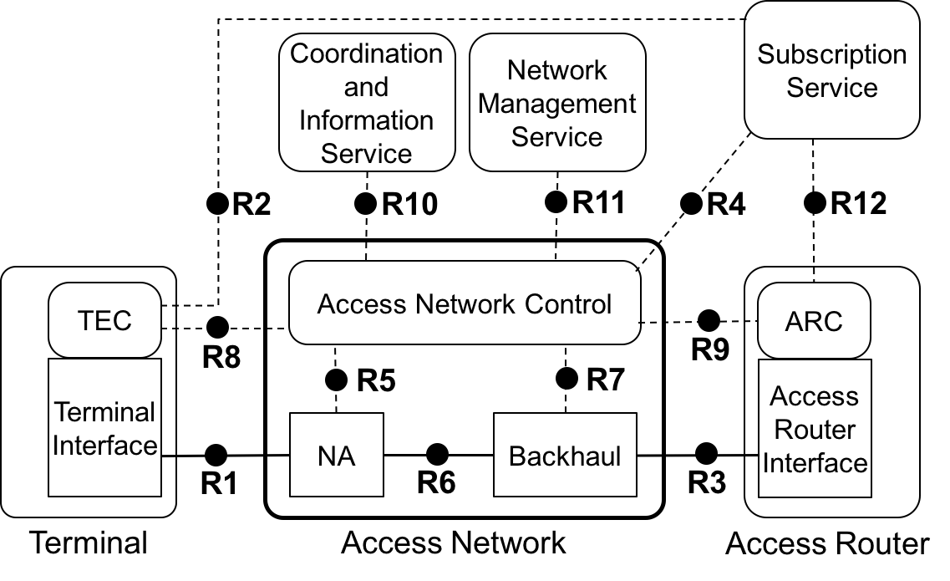
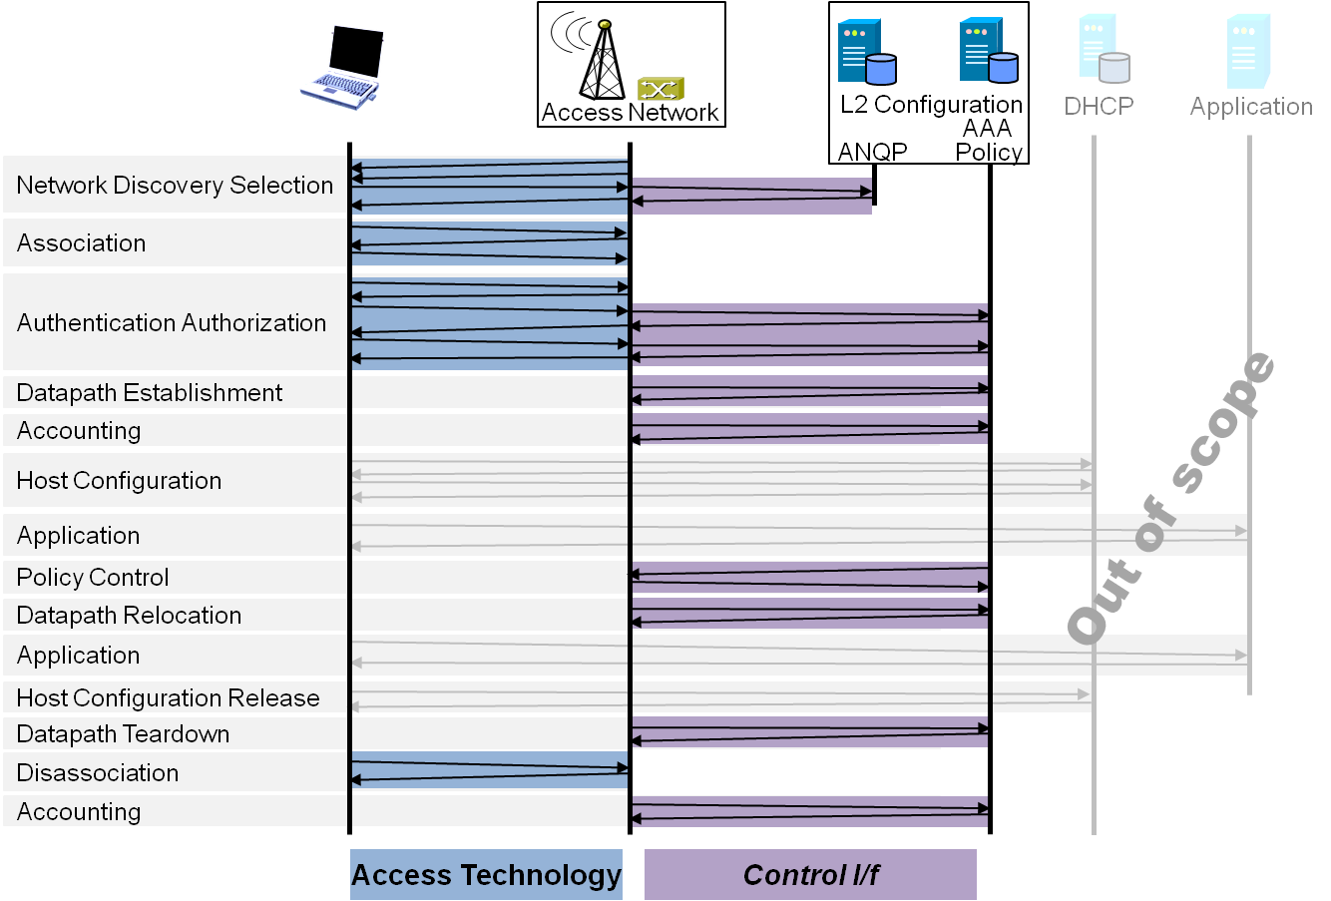
Necessary amendments to P802.1CF spec
Overview
References, definitions, acronyms and abbreviations
Conformance
Access network reference model
  Basic architectural concepts and terminology
  Overview of NRM
  Basic, enhanced and comprehensive NRM
  Operational roles
  Network virtualization
  Identifiers
  Deployment scenarios
Functional Design and Decomposition
  Access network setup
  Network discovery and selection
  Association and disassociation
  Authentication and trust establishment
  Data path establishment,
  relocation and teardown
  Authorization, QoS and policy control
  Accounting and monitoring
  Fault diagnostics and maintentance
  Information model
Network softwarization functions
  SDN functional decomposition
  Network Function Virtualization
  Virtualized network instantiation

Slide 26
Necessary amendments to
P802.1CF specification
Data path
  Extension to time-sensitive and real-time traffic classes
  Shaping, scheduling and forwarding functions in bridges for best effort, time-sensitive and real-time traffic
  Clock distribution
Authorization, QoS, and policy control
  Amend QoS model for time-sensitive and real-time traffic classes
  Description of fully centralized and centralized/distributed TSN configuration models

