Slide 1
Information Model Structure
Date: [2017-11-28]
Authors:
Name | Affiliation | Phone | Email
Hao Wang | Fujitsu R&D Center | +86-10-59691000 | wangh@cn.fujitsu.com
Xiaojing Fan | Fujitsu R&D Center | +86-10-59691000 | fanxiaojing@cn.fujitsu.com
Ryuichi Matsukura | Fujitsu/Fujitsu Laboratory | +81-44-754-2667 | r.matsukura@jp.fujitsu.com
Notice: This document does not represent the agreed view of the IEEE 802.1 OmniRAN TG. It represents only the views of the participants listed in the ‘Authors:’ field above. It is offered as a basis for discussion. It is not binding on the contributor, who reserve the right to add, amend or withdraw material contained herein.
Copyright policy: The contributor is familiar with the IEEE-SA Copyright Policy <http://standards.ieee.org/IPR/copyrightpolicy.html>.
Patent policy: The contributor is familiar with the IEEE-SA Patent Policy and Procedures: <http://standards.ieee.org/guides/bylaws/sect6-7.html#6> and <http://standards.ieee.org/guides/opman/sect6.html#6.3>.
Abstract
This presentation provides further thoughts on the 802.1CF information model structure.
Complete network model is proposed based on consensus reached in previous meetings.

Slide 2
Information Model Structure
2017-11-28
Hao Wang
Fujitsu R&D Center

Slide 3
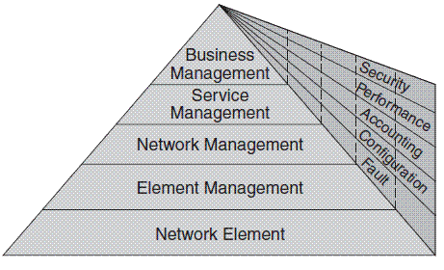
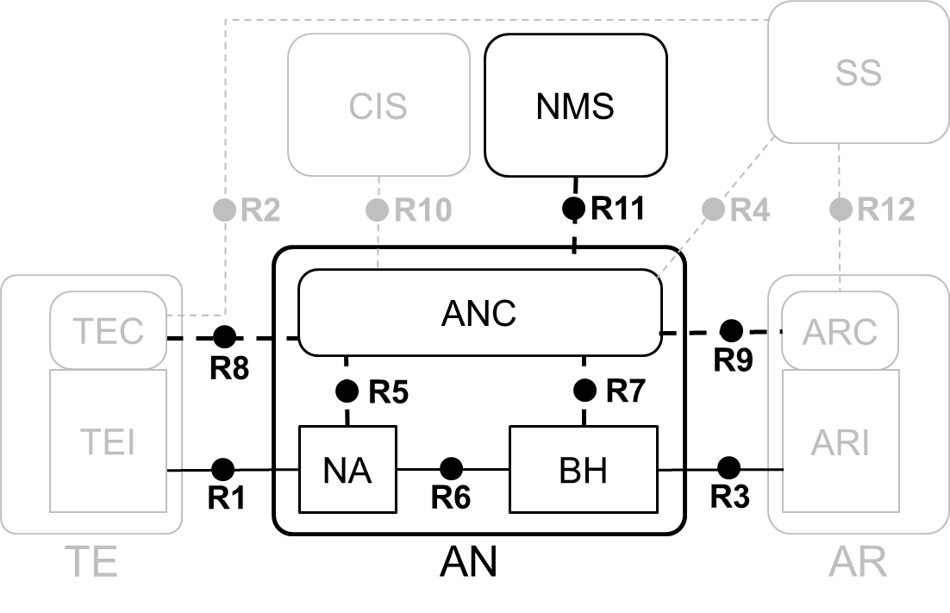
TMN 5-Layer Management Architecture
Every layer suggests certain management functionalities
EML provides management functions for network elements on an individual or group basis. It also supports an abstraction of the functions provided by the network element layer.
NML offers a holistic view of the network, independent of device types and vendors. It manages a network as supported by the element management layer.
FCAPS have different tasks at each layer.
EML-NML interface is the point

Slide 4
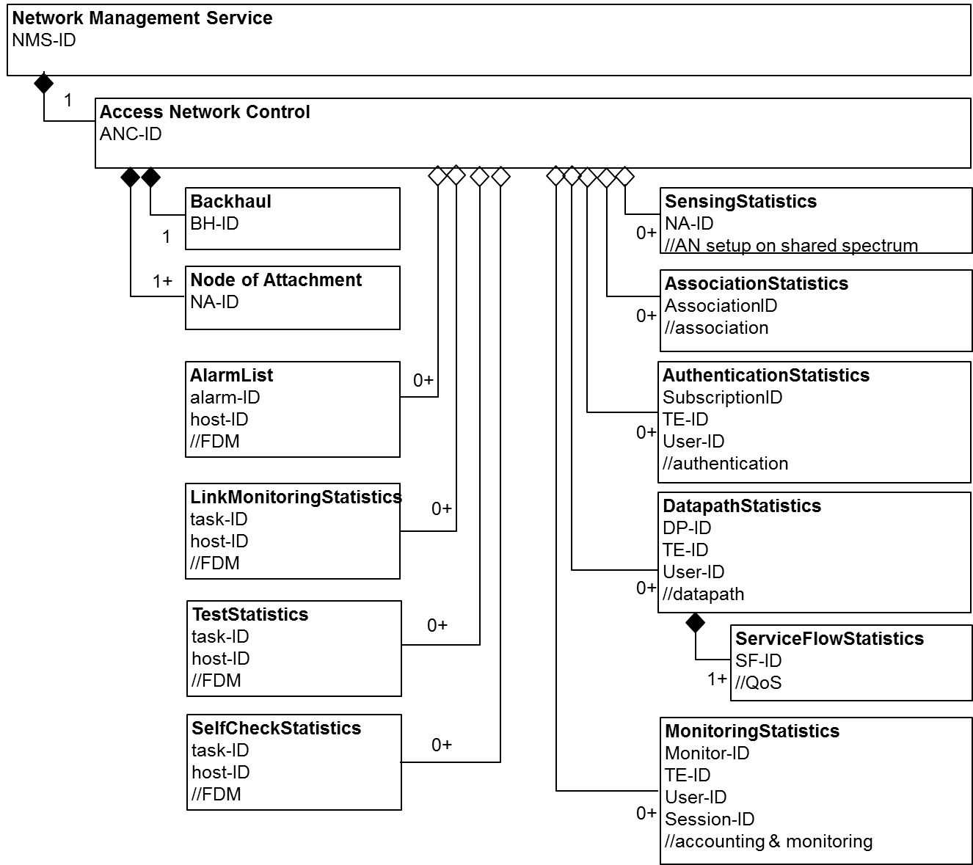
Network Infrastructure Model

Slide 5
Practice with 7.1 AN Setup
NMS
ANC_activated
AN_configuration
AN_operation_status
enable
(power-up)
ANC
Status, set and/or cleared by source
AN operator
Procedures initiated by source and consumed by destination
(no need to specify details, maybe out of scope of 802)
NA_activated
NA_operation_status
enable
(power-up)
NA_configuration
…
AN operator
NA
BH

Slide 6
IM for 7.1 AN Setup
Network Management Service
NMS-ID
1
Access Network Control
ANC-ID
bool activated
enum operationStatus;
// for setup on authorized spectrum
Timeout spectrumsensingPeriod
preferredChannelList
backupChannelList
Backhaul
BH-ID
bool activated
enum operationStatus
SensingStatistics
NA-ID
spectrumAvailability
channelClassification
1
0+
Node of Attachment
NA-ID
bool activated
enum operationStatus
// for setup on authorized spectrum
Geolocation
bool enableSensing
Timeout quietPeriod
1+

Slide 7
Practice with 7.2 NDS
Status, set and/or cleared by source
Procedures initiated by source and consumed by destination
(no need to specify details, maybe out of scope of 802)
Open questions
Should ‘AN’ changed to ‘ANC’ ?
Is a role for SS & AR ?
NA has a role but doesn’t hold any attributes?
Scanning, a 802 procedure, is for NA discovery only. What key information should delivered?
AN, SS, AR detection relies on non-802 proc?
How ANC send ‘attribute’ to TE?
It’s necessary for TE to retrieve something directly from AR and SS?
ANC
Sup. SS
Remote database
Sup. AR
Certificate
AN capability
Not specified
Passive scan
TE
NA
Subscription
Active scan
Retrieve specific info.

Slide 8
IM for 7.2 NDS
Network Management Service
1
Access Network Control
supportedSS
supportedAR
Certificate
AN capabilities
Backhaul
1
Node of Attachment
Timeout beaconPeriod
1+

Slide 9
Practice with 7.3 Association
Functions of ANC
Asso. decision point: approve / reject
Agent control for accounting: terminate accounting (SS) after disassociation
Session transfer: support fast handover
Attributes of NA
NA capability: denote the negotiable options of the association
Preferred connection parameters
Attributes of TE
TE capability (link, security, & QoS capabilities)
Status, set and/or cleared by source
Procedures initiated by source and consumed by destination
(no need to specify details, maybe out of scope of 802)
ANC
Terminate accounting
Decision point
SS
Agent ctrl account.
Session transfer
Listed Attributes (7.3.5) | Presumed Owner
Protocol configuration | ANC
Link capability information | TE
Preferred and requested link capabilities | NA
Security and QoS capabilities | TE
Support of particular services | ANC
Result codes | ANC
Not specified
Asso.
NA
TE
capability
NA capability
disAsso.
Pref. conn. Para.
ReAsso.

Slide 10
IM for 7.3 Association
Network Management Service
1
Access Network Control
protocolConfiguration
SpecialServicesSupport
Backhaul
AssociationStatistics
Association ID
TE ID
NA ID
LinkProfile
SecurityProfile
QoSProfile
ResultCodes
1
0+
Node of Attachment
{1} NA capability
{1+} PreferredLinkProfile
{1+} PreferredSecurityProfile
{1+} PreferredQosProfile
1+
‘LinkConfig’ in both ‘Access link’ and ‘ANC’, may need differentiation

Slide 11
Practice with 7.4 Authentication
Status, set and/or cleared by source
Functions of ANC
Forwarding point: forward subscription to SS
Attributes of ANC
Supported authentication method
supported encryption method
credential
Attributes of TE
Supported authentication method
supported encryption method
credential
Procedures initiated by source and consumed by destination
(no need to specify details, maybe out of scope of 802)
Access request
Access response
ANC
Forward point
SS
Supp. auth method
Decision point
Supp. encr. method
credential
Not specified
ID requst
TE
NA
supp. auth
supp. encry
EAP
credential
Result

Slide 12
IM for 7.4 Authentication
Network Management Service
1
Access Network Control
ANCredential
SupportedEncryptionModes
PreferredEncryptionMode
Backhaul
AuthenticationStatistics
SubscriptionID
TE ID
User ID
SessionKey
EncryptionMode
ResultCodes
1
0+
Node of Attachment
1+

Slide 13
Practice with 7.5 Datapath
Status, set and/or cleared by source
Procedures initiated by source and consumed by destination
(no need to specify details, maybe out of scope of 802)
Open questions
‘Subscriber’ vs. ‘User’?
‘user-specific’ vs. ‘subscriber-specific’ vs. ‘session-specific’ vs. ‘service-specific’?
Datapath can be shared by terminals?
L2236: The datapath is either pre-established during access network setup and/or dynamically configured when terminal connects to access network.
L2185: The datapath is usually preconfigured during access network setup when being shared for multiple user sessions, and may be dynamically established just for the lifetime of a user session
Detach vs. Disassociation?
Datapath relocation vs. session relocation with fast transition?
Auth. accept w/
authorization
SS
ANC
AR config
NA & BH config
Authorization
R3 negotiation
AR config
R1 negotiation
AR
R3 negotiation
NA config
BH config
Datapath ind.
TE
NA
BH
R1 negotiation

Slide 14
IM for 7.5 Datapath
Network Management Service
1
Access Network Control
Backhaul
R3Config
R6Config
DatapathStatistics
User-ID
TE-ID
Datapath-ID
DatapathConfig
ResultCodes
1
0+
Node of Attachment
R1Config
R6Config
1+

Slide 15
Practice with 7.6 QoS
Status, set and/or cleared by source
Procedures initiated by source and consumed by destination
(no need to specify details, maybe out of scope of 802)
Service flow attached to DP
Service flow negotiation happens both inside and outside AN
Either TE, AR, or SS can initialize, change and delete the SF?
part of the cases are covered
SF (admission) control is based on QoS policy provided and changed by SS
SF has operational states: provisioned, permitted, and active
Authorization w/
QoS policy
SS
ANC
QoS repository
SF config
pre-prov. SF
QoS decision
Authorization change
request
Policy decision ctrl
Admission ctrl
DP reg. req & res
SF add. req & res.
TE
NA
BH
preferred QoS
SF para.
SF para.
SF change. req & res.
filter
filter
SF delete. req & res.

Slide 16
IM for 7.6 QoS
Network Management Service
1
Access Network Control
qosConfig
Backhaul
SFParameters
FilterRules
DatapathStatistics
User-ID
TE-ID
Datapath-ID
DatapathConfig
ResultCodes
1
0+
Node of Attachment
SFParameters
FilterRules
1+
ServiceFlowStatistics
SF-ID
SFParameter
State
1+

Slide 17
Practice with 7.7 Accounting
Status, set and/or cleared by source
Procedures initiated by source and consumed by destination
(no need to specify details, maybe out of scope of 802)
SS provides the mon. config as
user specific
session specific
ANC controls mon. on sub NEs
NEs perform the mon. tasks and report the records
Mon. records are processed and forwarded to SS for accounting
session-specific
config
SS
ANC
session mon. config
mon. ctrl pt
collection
account req & rsp
mediation
Monitoring req & rsp
user session
TE
NA
BH
mon. pt
mon. pt

Slide 18
IM for 7.7 Accounting
Network Management Service
1
Access Network Control
monConfig
collectionConfig
mediationConfig
Backhaul
MonitoringStatistics
Monitor-ID
User-ID
TE-ID
Session-ID
timestamp
type
ResultCodes
MonitorRecords
1
0+
Node of Attachment
1+

Slide 19
Practice with 7.8 FDM
Summary of detail procedures
NMS
FDM_capability_ANC
FDM_config
FDM_aggregation_statistics
ANC
Status, set and/or cleared by source
Procedures initiated by source and consumed by destination
(no need to specify details, maybe out of scope of 802)
FDM_capability_NA
Alarm
Test
…
Link monitoring
FDM_config
FDM_capability_TE
TE
FDM_config
NA
BH
Alarm/Event

Slide 20
IM for 7.8 Accounting
Network Management Service
NMS-ID
1
Access Network Control
fdmCapability
fdmConfig
fdmRulesRepository
fdmAggregationConfig
Backhaul
fdmCapability
fdmConfig
fdmLinkMonConfig
fdmTestConfig
fdmSelfCheckConfig
AlarmList
alarm-ID
host-ID
raiseTime
prob.cause
1
1
type
severity
faultyparts
eventsList
LinkMonitoringStatistics
task-ID
host-ID
statuscode
1+
1+
neighborInfor
environmentInfor
eventsList
Node of Attachment
fdmCapability
fdmConfig
fdmLinkMonConfig
fdmTestConfig
fdmSelfCheckConfig
TestStatistics
task-ID
type
1+
results
SelfCheckStatistics
task-ID
host-ID
CPU
memory
swVersion
1+
localMIB
sysLog
commstat
rrmstat

Slide 21
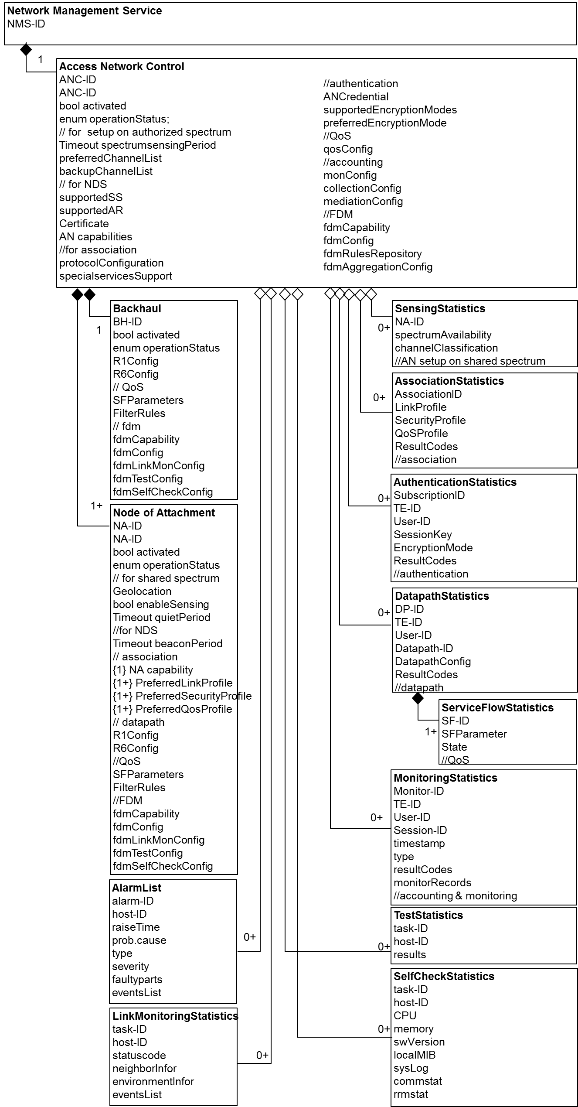
Network Infrastructure Model (complete)

Slide 22
For reference

Slide 23
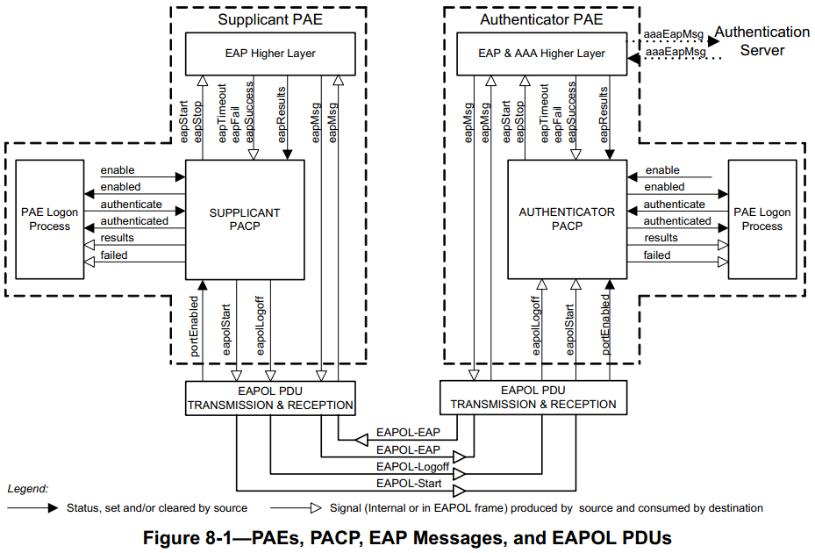
802.1X Model (1) – Symmetric Function
Symmetric structure & functions
EAP higher layer
EAP parser
PAE logon process
manage credential, initiate the use of supp and authen
‘X’ PACP
802.1X control
PDU tx & rx
process EAPOL messages
‘X’ PAE can be implemented on single physical port
802.1X model describes ‘entities’ inside the dotted box
essential attributes that need to be ‘set’ (enable) or ‘get’ (state)
EAPOL Statistics survey the results of EAPOL request-response

Slide 24
802.1X Model (2) – Symmetric Function
Part of Figure 12-3 PAE management information
PAE System
PAE
supplicant
LogonProcess
authenticator
SessionStatistics
EAPOLStatistics
…

Slide 25
802.1X Model (3) – Asymmetric Function
An EAPOL Announcement protocol that allows a PAE to indicate the availability of network services, helping other PAEs to choose appropriate credentials and parameters for authentication and network access (Clause 10).
Pair relationship: announcer & listener
Associated to PAE, but roles are bounded to Authenticator and Supplicant separately
Implementation flexibility
PAE System
Part of Figure 12-3 PAE management information
PAE
supplicant
Announcer
authenticator
Listener
*Announcement statistics
Announce
Announcement*

Slide 26
Two Options for Creating Network Operation Model
AN only focus on the core of the NRM
The whole NRM make use of the symmetric structure
NMS
Service
1
ANC
CIS
Interface
Control
SS
Interface
TE
AR
NA
Core of the NRM
BH

Slide 27
Consensus have been Reached
It was agreed to keep the attributes as generic as possible, examples are shown in the following contribution,
https://mentor.ieee.org/omniran/dcn/17/omniran-17-0081-01-CF00-user-service-information-model.pptx
It was agreed not to integrate the FDM functionalities at this moment, but to create a separate FDM model when the main model got shaped.
Some of the attributes related with FDM functionalities may appear in the main model.
Since there are two separate models under discussion, same attributes may appear in both the user service model and network operation model, but consisted by different classes.

Slide 28
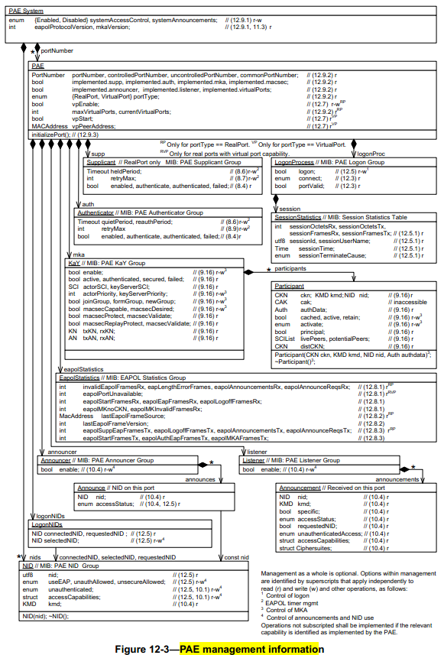
Reference: 802.1X model

Slide 29
Questions, Comments Thank YOU!

