Slide 1
Information Model Structure
Date: [2017-11-07]
Authors:
Name | Affiliation | Phone | Email
Hao Wang | Fujitsu R&D Center | +86-10-59691000 | wangh@cn.fujitsu.com
Xiaojing Fan | Fujitsu R&D Center | +86-10-59691000 | fanxiaojing@cn.fujitsu.com
Ryuichi Matsukura | Fujitsu/Fujitsu Laboratory | +81-44-754-2667 | r.matsukura@jp.fujitsu.com
Notice: This document does not represent the agreed view of the IEEE 802.1 OmniRAN TG. It represents only the views of the participants listed in the ‘Authors:’ field above. It is offered as a basis for discussion. It is not binding on the contributor, who reserve the right to add, amend or withdraw material contained herein.
Copyright policy: The contributor is familiar with the IEEE-SA Copyright Policy <http://standards.ieee.org/IPR/copyrightpolicy.html>.
Patent policy: The contributor is familiar with the IEEE-SA Patent Policy and Procedures: <http://standards.ieee.org/guides/bylaws/sect6-7.html#6> and <http://standards.ieee.org/guides/opman/sect6.html#6.3>.
Abstract
This presentation provides further thoughts on the 802.1CF information model structure.

Slide 2
Information Model Structure
2017-11-07
Hao Wang
Fujitsu R&D Center

Slide 3
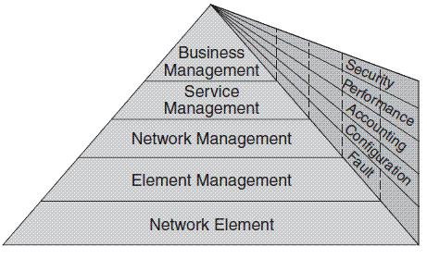
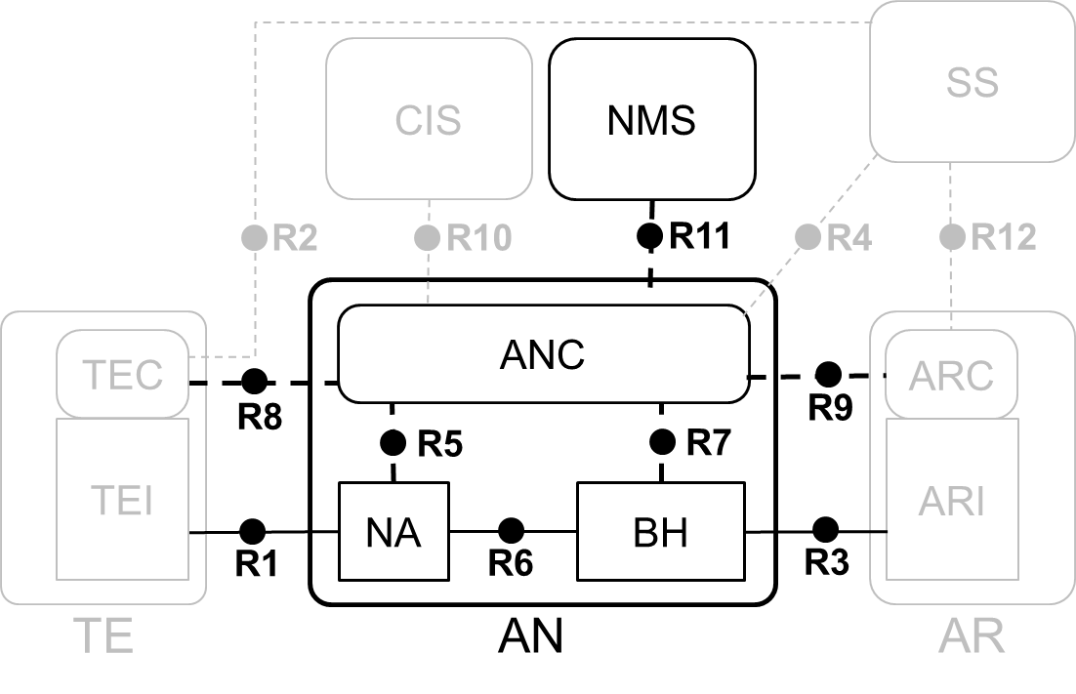
TMN 5-Layer Management Architecture
Every layer suggests certain management functionalities
EML provides management functions for network elements on an individual or group basis. It also supports an abstraction of the functions provided by the network element layer.
NML offers a holistic view of the network, independent of device types and vendors. It manages a network as supported by the element management layer.
FCAPS have different tasks at each layer.
EML-NML interface is the point

Slide 4
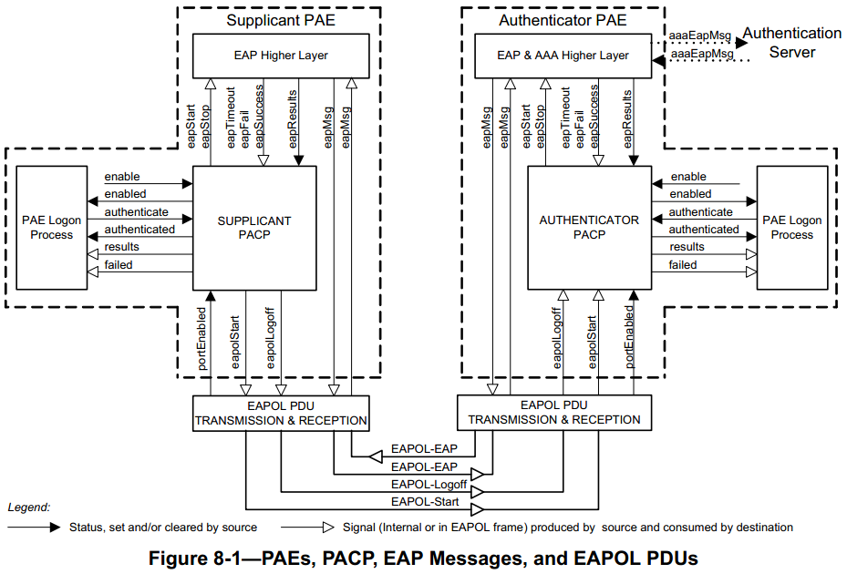
802.1X Model (1) – Symmetric Function
Symmetric structure & functions
EAP higher layer
EAP parser
PAE logon process
manage credential, initiate the use of supp and authen
‘X’ PACP
802.1X control
PDU tx & rx
process EAPOL messages
‘X’ PAE can be implemented on single physical port
802.1X model describes ‘entities’ inside the dotted box
essential attributes that need to be ‘set’ (enable) or ‘get’ (state)
EAPOL Statistics survey the results of EAPOL request-response

Slide 5
802.1X Model (2) – Symmetric Function
Part of Figure 12-3 PAE management information
PAE System
PAE
supplicant
LogonProcess
authenticator
SessionStatistics
EAPOLStatistics
…

Slide 6
802.1X Model (3) – Asymmetric Function
An EAPOL Announcement protocol that allows a PAE to indicate the availability of network services, helping other PAEs to choose appropriate credentials and parameters for authentication and network access (Clause 10).
Pair relationship: announcer & listener
Associated to PAE, but roles are bounded to Authenticator and Supplicant separately
Implementation flexibility
PAE System
Part of Figure 12-3 PAE management information
PAE
supplicant
Announcer
authenticator
Listener
*Announcement statistics
Announce
Announcement*

Slide 7
Two Options for Creating Network Operation Model
AN only focus on the core of the NRM
The whole NRM make use of the symmetric structure
NMS
Service
1
ANC
CIS
Interface
Control
SS
Interface
TE
AR
NA
Core of the NRM
BH

Slide 8
Practice with 7.1 AN Setup
Take AN setup for unlicensed spectrum (7.1) as an example
NMS
ANC_activated
AN_configuration
AN_operation_status
enable
(power-up)
ANC
Status, set and/or cleared by source
AN operator
Procedures initiated by source and consumed by destination
(no need to specify details, maybe out of scope of 802)
NA_activated
NA_operation_status
enable
(power-up)
NA_configuration
…
AN operator
NA
BH

Slide 9
Option 1
Network Management Service
NMS-ID
1
Access Network Control
ANC-ID
bool activated
enum operationStatus;
// for setup on authorized spectrum
Timeout heldPeriod
Backhaul
BH-ID
bool activated
enum operationStatus
SpectrumDatabase
CIS-ID
preferredChannelList
backupChannelList
1
1
Node of Attachment
NA-ID
bool activated
enum operationStatus
// for setup on authorized spectrum
Geolocation
bool enableSensing
Timeout quietPeriod
1+
SensingStatistics
spectrumAvailability
channelClassification
1

Slide 10
Option 2
Network Management Service
NMS-ID
1
Access Network Control
ANC-ID
bool activated
enum operationStatus;
// for setup on authorized spectrum
Timeout heldPeriod
Interface
SpectrumDatabase
CIS-ID
preferredChannelList
backupChannelList
1
Backhaul
BH-ID
bool activated
enum operationStatus
1
Node of Attachment
NA-ID
bool activated
enum operationStatus
// for setup on authorized spectrum
Geolocation
bool enableSensing
SensingStatistics
spectrumAvailability
channelClassification
Timeout quietPeriod
1
1+
TE
TE-ID
Geolocation
bool enableSensing
1

Slide 11
Consensus have been Reached
It was agreed to keep the attributes as generic as possible, examples are shown in the following contribution,
https://mentor.ieee.org/omniran/dcn/17/omniran-17-0081-01-CF00-user-service-information-model.pptx
It was agreed not to integrate the FDM functionalities at this moment, but to create a separate FDM model when the main model got shaped.
Some of the attributes related with FDM functionalities may appear in the main model.
Since there are two separate models under discussion, same attributes may appear in both the user service model and network operation model, but consisted by different classes.

Slide 12
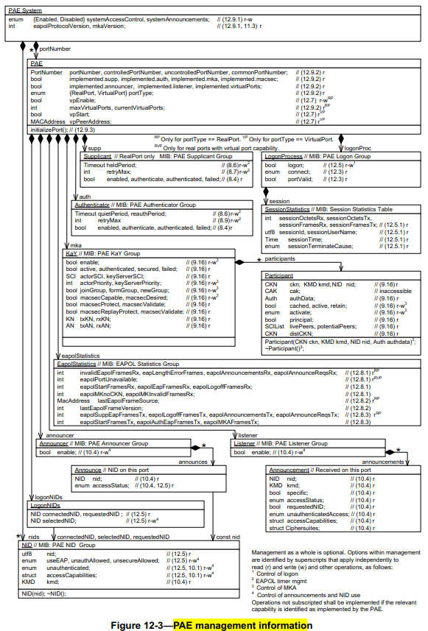
Reference: 802.1X model

Slide 13
Questions, Comments Thank YOU!

