Slide 1
P802.1CF User Service Information Model
Date: 2017-11-07
Authors:
Name | Affiliation | Phone | Email
Max Riegel | Nokia |  | maximilian.riegel@nokia.com
Notice: This document does not represent the agreed view of the IEEE 802.1 OmniRAN TG. It represents only the views of the participants listed in the ‘Authors:’ field above. It is offered as a basis for discussion. It is not binding on the contributor, who reserve the right to add, amend or withdraw material contained herein.
Copyright policy: The contributor is familiar with the IEEE-SA Copyright Policy <http://standards.ieee.org/IPR/copyrightpolicy.html>.
Patent policy: The contributor is familiar with the IEEE-SA Patent Policy and Procedures: <http://standards.ieee.org/guides/bylaws/sect6-7.html#6> and <http://standards.ieee.org/guides/opman/sect6.html#6.3>.
Abstract
The presentation contains the graphical representation of the user service information model. It builds on the concepts outlined in omniran-17-0064-004-CF00 and details the overarching user service model as well as its components.
First edition provides some examples of the information model for review.
Revision #1 provides initial proposal of user service information model
Revision #2 covers more complete and aligned models for user service and derives models for each network element.
Revision #3 mainly added editorial clean-up for better representation of the approach.

Slide 2
P802.1CF User Service Information Model
Max Riegel
(Nokia)
2017-11-05

Slide 3
Information Model
An information model* in software engineering is a representation of concepts and the relationships, constraints, rules, and operations to specify data semantics for a chosen domain of discourse.
Typically it specifies relations between kinds of things, but may also include relations with individual things.
It can provide sharable, stable, and organized structure of information requirements or knowledge for the domain context.
Y. Tina Lee (1999). "Information modeling from design to implementation"
National Institute of Standards and Technology.
* On difference between Information Model and Data Model: RFC 3444; A. Pras , J. Schoenwaelder; IETF, 2003

Slide 4
Information model notation
Information element with specification of attributes as well as functions, which could be invoked by other elements over reference points. Functions return an result value.
Class name
Attribute#1: abstract type
Attribute#2: abstract type
…
Response Function#1(parameter)
Response Function#2(parameter)
...
Instance
Function (parameter)
Response
Reference point
Aggregation
Aggregation is a special type of association used to model a "whole to its parts" relationship.
In basic aggregation relationships (framed diamond), the lifecycle of a part class is independent from the whole class's lifecycle.
- Associations are always assumed to be bi-directional; this means that both classes are aware of each other and their relationship
- In a uni-directional association (arrow), two classes are related, but only one class knows that the relationship exists.
The composition aggregation relationship (filled diamond) is just another form of the aggregation relationship, but the child class's instance lifecycle is dependent on the parent class's instance lifecycle.
- Associations are always assumed to be bi-directional; this means that both classes are aware of each other and their relationship
- In a uni-directional association (arrow), two classes are related, but only one class knows that the relationship exists.
Whole
0+
Part
Whole
1+
Part
Whole
0-1
Part
Whole
1
Part

Slide 5
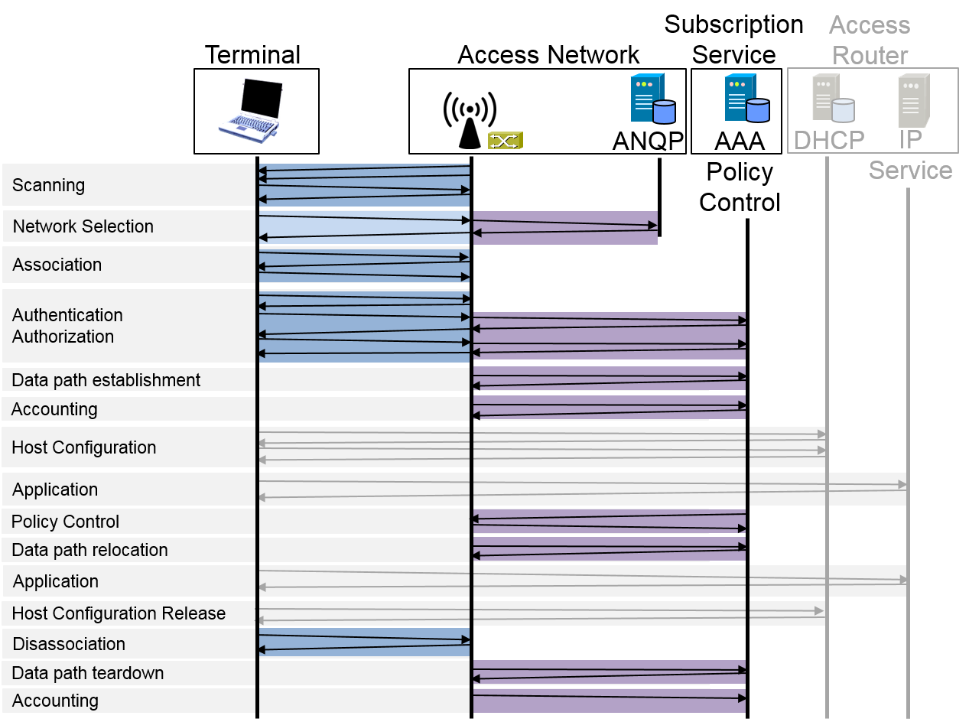
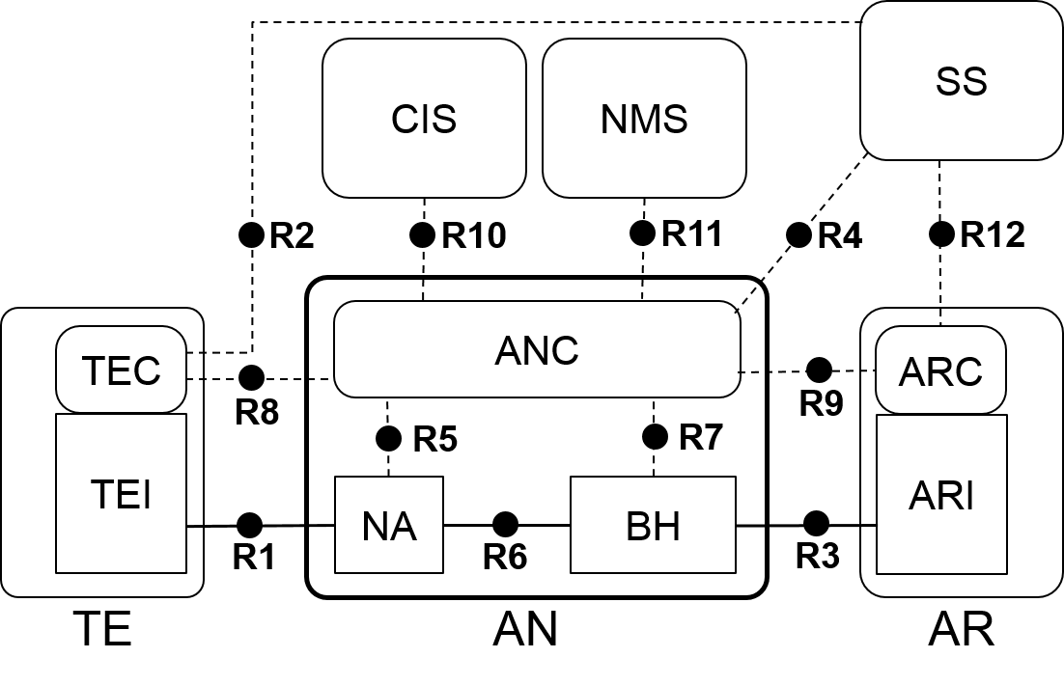
Two perspectives of information model
Infrastructure
Structural perspective
  Information derived according to functional entities
Service
Operational perspective
  Information derived according to functional phases

Slide 6
Creating the service information model
Service is defined through user session
User session is defined in section 7
  Model is strictly aligned to the sections
    7.2 Access network discovery and selection
    7.3 Association and disassociation
    7.4 Authentication and trust establishment
    7.5 Datapath establishment, relocation and teardown
    7.6 Authorization, QoS, and policy control
    7.7 Accounting and monitoring
User session model consists of the 6 components
Model is further detailed on following slides

Slide 7
Service Information Model
User session
Session-ID
1
Provider selection
ServiceProvider-ID: FQDN
IPProvider-ID: FQDN
NA-ID: Node of attachment identifier
AN-ID: Access network identifier
SS-ID: Subscription service identifier
AR-ID: Access router identifier
1+
Access link
Link-ID
1
Security association
Session-Key
0+
1
Datapath
Datapath-ID
1+
Service-Flow
ServiceFlow-ID
1+
Session statistics
StatsRecord-ID

Slide 8
Service Information Model
(alternative representation)
User session
Session-ID
1
Provider selection
IPProvider-ID: FQDN
NA-ID: Node of attachment identifier
AN-ID: Access network identifier
SS-ID: Subscription service identifier
AR-ID: Access router identifier
1
Subscription
{1} Subscription-ID: NAI
{1} ServiceProvider-ID: FQDN
{1} SubscriptionCredential: Subscription credential
{1} User-ID: Username
{1} ServiceProfile: Definition of provided services.
{1+} IPProvider-ID:FQDN
{0+} AccessPolicy: Weigthed list of AN-IDs
1+
Access link
Link-ID
1
Security association
Session-Key
0+
1
Datapath
Datapath-ID
1+
Service-Flow
ServiceFlow-ID
1+
Session statistics
StatsRecord-ID

Slide 9
Network selection
Provider selection
{1} ServiceProvider-ID: FQDN
{1} IPProvider-ID: FQDN
{1} NA-ID: Node of attachment identifier
{1} AN-ID: Access network identifier
{1} SS-ID: Subscription service identifier
{1} AR-ID: Access router identifier
1+
Subscription
{1} Subscription-ID: NAI
{1} ServiceProvider-ID: FQDN
{1+} IPProvider-ID:FQDN
{0+} AccessPolicy: Weigthed list of AN-IDs
1
TE
{1} TE-ID: Terminal identifier
{1+} TECapabilities: Terminal capabilities
void ANINDICATION (NA-ID, AN-ID, SS-ID,
ServiceProvider-ID, IPProvider-ID, AR-ID)
1+
NA
{1} NA-ID: Unique node of attachment identifier
{1} AN-ID: Access network identifier to which NA belongs to
{1+} ServiceProvider-ID: List of supported service providers
{1+} SS-ID: List of subscription services
{1+} IPProvider-ID: List of connected IP providers
{1+} AR-ID: List of connected access routers
ANInfo ANQUERY {TECapabilities}

Slide 10
Access Link
Access link
{1} Link-ID: Unique link identifier
{1} TE-ID: Terminal identifier
{1} NA-ID: NA identifier
{1} LinkConfig: configuration values of the link
1
TE
{1} TE-ID: Unique terminal identifier
{1+} SupportedLinkCapabilities: possible link configuration
{1+} SupportedSecurityCapabilities: possible security modes
{1+} SupportedQosCapabilities: possible QoS configuration
void DISASSOCIATE ()
1
NA
{1} NA-ID: Unique node of attachment identifier
{1+} AllowedLinkCapabilities: allowed link configuration
{1+} AllowedSecurityCapabilities: allowed security modes
{1+} AllowedQosCapabilities: allowed QoS configurations
{1} PreferredLinkProfile: desired link configuration attributes
{1} PreferredSecurityProfile: desired security mode
{1} PreferredQosProfile: desired QoS mode
LinkConfig ASSOCIATE (SupportedLinkCapabilities,
SupportedSecurityCapabilities,
SupportedQosCapabilities)
LinkConfig REASSOCIATE (Link-ID, S_NA-ID)
LinkConfig CONTEXTRESPONSE (Link-ID, TE-ID)
void DISASSOCIATE ()
1
ANC
{1} ANC-ID: Unique ANC identifier
LinkConfig CONTEXTQUERY (Link-ID, S_NA-ID, TE-ID)

Slide 11
Security
Association
Security association
{1} SessionKey: Unique session credential
{1} EncryptionMode: Encryption configuration
{1} Subscription-ID: NAI
{1} TE-ID: Terminal identifier used for supplicant
{1} AN-ID: Access network identifier used for authenticator
{1} SS-ID: Subscription service identifier
1
Subscription
{1} Subscription-ID: NAI
{1} SubscriptionCredential: Subscription credential
{1} User-ID: Username
{1} ServiceProvider-ID: FQDN
{1} ServiceProfile: Definition of provided services.
1
TE
{1} TE-ID: Unique terminal identifier
{1+} SupportedAuthMethods: possible authentication modes
{1+} SupportedEncryptionModes: possible encryption modes
{1} PreferredAuthMethod: preferred authentication methods
{1} PreferredEncryptionMode: preferred encryption mode
Subscription-ID IDENTIFY (SupportedEncryptionMode
PreferredEncryptionMode, ANCredential)
SubsCredential AUTHENTICATE (SupportedAuthMethods,
PreferredAuthMethod, SSCredential)
1
ANC
{1} ANC-ID: Unique ANC identifier
{1} ANCredential: Authenticator credential
{1+} SupportedEncryptionModes: possible encryption modes
{1} PreferredEncryptionMode: preferred encryption mode
resultMsg TEAUTHENTICATE (TE-ID, queryMsg)
1
SS
{1} SS-ID: Unique SS identifier
{1} SSCredential: Subscription service credential
{1+} SupportedAuthMethods: possible authentication modes
{1} PreferredAuthMethod: preferred authentication methods
AuthResult ACCESSREQ (TE-ID, Subscription-ID)
SessionKey AUTHENTICATE (SupportedAuthMethods,
PreferredAuthMethod, SubsCredential)

Slide 12
Data path
Data path
{1} DP-ID: Unique identifier
{1} DPConfig: Configuration parameters of data path
{1} SessionKey: Unique session credential
{1} TE-ID: Terminal identifier
1
ANC
{1} ANC-ID: Unique ANC identifier
NAConfig DPESTABLISH (SessionKey, TE-ID, NA-ID)
NAConfig DPRELOCATE (SessionKey, TE-ID, +NA-ID)
resultMsg DPRELEASE (SessionKey, TE-ID, NA-ID)
1+
NA
{1} NA-ID: Unique NA identifier
{1} R1Config: R1 Session configuration parameters
{1} R6Config: R6 Session configuration parameters
{1} BRcfg: Bridging service definition
resultMsg NACONFIG (DP-ID, R1Config, R6Config, BRCfg)
resultMsg NARELEASE (DP-ID)
1
BH
{1} BH-ID: Unique BH identifier
{1+} R6Config: R6 Session configuration parameters
{1+} R3Config: R3 Session configuration parameters
{1+} BRCfg: Bridging service definition
resultMsg BHCONFIG (DP-ID, R6Config, R3Config, BRCfg)
resultMsg BHRELEASE (DP-ID)
1+
AR
{1} AR-ID: Unique identifier
{1} IPProvider-ID: FQDN
{1+} ARI-ID: Interface identifier
{1+} R3Config: Interface configuration parameters
resultMsg ARICONFIG (DP-ID, R3Config)
resultMsg ARIRELEASE (DP-ID)
1
SS
{1} SS-ID: Unique SS identifier
{1} ServiceProvider-ID: FQDN
{1} DPSrvSpec: DataPath service definition
DPSrvSpec DPREQUEST (DP-ID, SessionKey, TE-ID)
void DPTERMINATE (DP-ID)

Slide 13
Service flow
Service flow
{1} ServiceFlow-ID: Unique identifier
{1} SFConfig: Configuration parameters of service flow
{1} SessionKey: Unique session credential
{1} DP-ID: Related DataPath-ID
1
ANC
{1} ANC-ID: Unique ANC identifier
resultMsg SFPREPROV (SessionKey, SFSpec, PolicyRules)
resultMsg SFCHGAUTH (SessionKey, SFSpec, PolicyRules)
ServiceFlow-ID SFADDITION (DataPath-ID, SFSpec)
resultMsg SFMODIFY (ServiceFlow-ID, SFSpec)
resultMsg SFDELETE (ServiceFlow-ID)
1
NA
{1} NA-ID: Unique NA identifier
{0+} SFParams: Service flow configuration parameters
resultMsg SFCONFIG (ServiceFlow-ID, SFParams, DP-ID)
resultMsg SFRELEASE (ServiceFlow-ID)
1
BH
{1} BH-ID: Unique BH identifier
{0+} SFParams: Service flow configuration parameters
resultMsg SFCONFIG (ServiceFlow-ID, SFParams, DP-ID)
resultMsg SFRELEASE (ServiceFlow-ID)
1
AR
{1} AR-ID: Unique identifier
resultMsg SFCFGCONFIRM (ServiceFlow-ID, DP-ID)
1
TE
{1} TE-ID: Unique identifier
resultMsg SFCFGCONFIRM (ServiceFlow-ID, DP-ID)
1
SS
{1} SS-ID: Unique SS identifier
{1} ServiceProvider-ID: FQDN
{1} SFSpec: Service flow parameters
{1} PolicyRules: Policing rules

Slide 14
Accounting and monitoring
Session statistics
{1} StatsRecord-ID: Unique identifier of accounting record
{1} SessionKey: Unique session credential
{1} DP-ID: Related data path identifier
{1} AccountingStart: TimeStamp
{1} AccountingStop: TimeStamp
{1+} StatsParams: Session statistics parameters
1
ANC
{1} ANC-ID: Unique ANC identifier
resultMsg SSCONFIG (Session-ID, DP-ID)
StatsParms SSREQUEST (Session-ID, DP-ID)
resultMsg SSINDICATION (Session-ID, StatsParams)
1+
NA
{1} NA-ID: Unique NA identifier
resultMsg SSCONFIG (Session-ID, DP-ID)
resultMsg SSMONITORSTART (Session-ID, DP-ID)
StatsParams SSMONITORSTOP (Session-ID)
1
BH
{1} BH-ID: Unique BH identifier
resultMsg SSCONFIG (Session-ID, DP-ID)
resultMsg SSMONITORSTART (Session-ID, DP-ID)
StatsParams SSMONITORSTOP (Session-ID)
1
SS
{1} SS-ID: Unique SS identifier
{1} ServiceProvider-ID: FQDN
{1} AccountingConfig: Accounting configuration specification

Slide 15
Service Information Model
User service (session)
Session-ID
1
Provider selection
{1} ServiceProvider-ID: FQDN
{1} IPProvider-ID: FQDN
{1} NA-ID: Node of attachment identifier
{1} AN-ID: Access network identifier
{1} SS-ID: Subscription service identifier
{1} AR-ID: Access router identifier
1+
Access link
{1} Link-ID: Unique link identifier
{1} TE-ID: Terminal identifier
{1} NA-ID: NA identifier
{1} LinkConfiguration: configuration values of the link
1
Security association
{1} SessionKey: Unique session credential
{1} EncryptionMode: Encryption configuration
{1} Subscription-ID: NAI
{1} TE-ID: Terminal identifier used for supplicant
{1} AN-ID: Access network identifier used for authenticator
{1} SS-ID: Subscription service identifier
1
Data path
{1} DataPath-ID: Unique identifier
{1} DPConfig: Configuration parameters of data path
{1} SessionKey: Unique session credential
{1} TE-ID: Terminal identifier
1+
Service flow
{1} ServiceFlow-ID: Unique identifier
{1} SFConfig: Configuration parameters of service flow
{1} SessionKey: Unique session credential
{1} DataPath-ID: Related DataPath-ID
1+
Session statistics
{1} StatsRecord-ID: Unique identifier of accounting record
{1} SessionKey: Unique session credential
{1} DataPath-ID: Related data path identifier
{1} AccountingStart: TimeStamp
{1} AccountingStop: TimeStamp
{1+} StatsParams: Session statistics parameters

Slide 16
Subscription Information Model
Subscription
{1} Subscription-ID: NAI
{1} ServiceProvider-ID: FQDN
{1} SubscriptionCredential: Subscription credential
{1} User-ID: Username
{1} ServiceProfile: Definition of provided services.
{1+} IPProvider-ID:FQDN
{0+} AccessPolicy: Weigthed list of AN-IDs

Slide 17
TE Information Model
TE
{1} TE-ID: Unique terminal identifier
{1+} TECapabilities: Terminal capabilities
{1+} SupportedLinkCapabilities: possible link configuration
{1+} SupportedSecurityCapabilities: possible security modes
{1+} SupportedQosCapabilities: possible QoS configuration
{1+} SupportedAuthMethods: possible authentication modes
{1+} SupportedEncryptionModes: possible encryption modes
{1} PreferredAuthMethod: preferred authentication methods
{1} PreferredEncryptionMode: preferred encryption mode
void ANINDICATION (NA-ID, AN-ID, SS-ID,
ServiceProvider-ID, IPProvider-ID, AR-ID)
void DISASSOCIATE ()
Subscription-ID IDENTIFY (SupportedEncryptionMode
PreferredEncryptionMode, ANCredential)
SubsCredential AUTHENTICATE (SupportedAuthMethods,
PreferredAuthMethod, SSCredential)
resultMsg SFCFGCONFIRM (ServiceFlow-ID, DP-ID)

Slide 18
NA Information Model
NA
{1} NA-ID: Unique node of attachment identifier
{1} AN-ID: Access network identifier to which NA belongs to
{1+} ServiceProvider-ID: List of supported service providers
{1+} SS-ID: List of subscription services
{1+} IPProvider-ID: List of connected IP providers
{1+} AR-ID: List of connected access routers
{1+} AllowedLinkCapabilities: allowed link configuration
{1+} AllowedSecurityCapabilities: allowed security modes
{1+} AllowedQosCapabilities: allowed QoS configurations
{1} PreferredLinkProfile: desired link configuration attributes
{1} PreferredSecurityProfile: desired security mode
{1} PreferredQosProfile: desired QoS mode
{1} R1Config: R1 Session configuration parameters
{1} R6Config: R6 Session configuration parameters
{1} BRcfg: Bridging service definition
{0+} SFParams: Service flow configuration parameters
ANInfo ANQUERY {TECapabilities}
LinkConfig ASSOCIATE (SupportedLinkCapabilities,
SupportedSecurityCapabilities,
SupportedQosCapabilities)
LinkConfig REASSOCIATE (Link-ID, S_NA-ID)
LinkConfig CONTEXTRESPONSE (Link-ID, TE-ID)
void DISASSOCIATE ()
resultMsg NACONFIG (DP-ID, R1Config, R6Config, BRCfg)
resultMsg NARELEASE (DP-ID)
resultMsg SFCONFIG (ServiceFlow-ID, SFParams, DP-ID)
resultMsg SFRELEASE (ServiceFlow-ID)
resultMsg SSCONFIG (Session-ID, DP-ID)
resultMsg SSMONITORSTART (Session-ID, DP-ID)
StatsParams SSMONITORSTOP (Session-ID)

Slide 19
BH Information Model
BH
{1} BH-ID: Unique BH identifier
{1+} R6Config: R6 Session configuration parameters
{1+} R3Config: R3 Session configuration parameters
{1+} BRCfg: Bridging service definition
{0+} SFParams: Service flow configuration parameters
resultMsg BHCONFIG (DP-ID, R6Config, R3Config, BRCfg)
resultMsg BHRELEASE (DP-ID)
resultMsg SFCONFIG (ServiceFlow-ID, SFParams, DP-ID)
resultMsg SFRELEASE (ServiceFlow-ID)
resultMsg SSCONFIG (Session-ID, DP-ID)
resultMsg SSMONITORSTART (Session-ID, DP-ID)
StatsParams SSMONITORSTOP (Session-ID)

Slide 20
ANC Information Model
ANC
{1} ANC-ID: Unique ANC identifier
{1} ANCredential: Authenticator credential
{1+} SupportedEncryptionModes: possible encryption modes
{1} PreferredEncryptionMode: preferred encryption mode
LinkConfig CONTEXTQUERY (Link-ID, S_NA-ID, TE-ID)
resultMsg TEAUTHENTICATE (TE-ID, queryMsg)
NAConfig DPESTABLISH (SessionKey, TE-ID, NA-ID)
NAConfig DPRELOCATE (SessionKey, TE-ID, +NA-ID)
resultMsg DPRELEASE (SessionKey, TE-ID, NA-ID)
resultMsg SFPREPROV (SessionKey, SFSpec, PolicyRules)
resultMsg SFCHGAUTH (SessionKey, SFSpec, PolicyRules)
ServiceFlow-ID SFADDITION (DataPath-ID, SFSpec)
resultMsg SFMODIFY (ServiceFlow-ID, SFSpec)
resultMsg SFDELETE (ServiceFlow-ID)
resultMsg SSCONFIG (Session-ID, DP-ID)
StatsParms SSREQUEST (Session-ID, DP-ID)
resultMsg SSINDICATION (Session-ID, SSParams)

Slide 21
SS Information Model
SS
{1} SS-ID: Unique SS identifier
{1} SSCredential: Subscription service credential
{1+} SupportedAuthMethods: possible authentication modes
{1} PreferredAuthMethod: preferred authentication methods
{1} ServiceProvider-ID: FQDN
{1} DPSrvSpec: DataPath service definition
{1} SFSpec: Service flow parameters
{1} PolicyRules: Policing rules
{1} AccountingConfig: Accounting configuration specification
AuthResult ACCESSREQ (TE-ID, Subscription-ID)
SessionKey AUTHENTICATE (SupportedAuthMethods,
PreferredAuthMethod, SubsCredential)
DPSrvSpec DPREQUEST (DP-ID, SessionKey, TE-ID)
void DPTERMINATE (DP-ID)

Slide 22
AR Information Model
AR
{1} AR-ID: Unique identifier
{1} IPProvider-ID: FQDN
{1+} ARI-ID: Interface identifier
{1+} R3Config: Interface configuration parameters
resultMsg ARICONFIG (DP-ID, R3Config)
resultMsg ARIRELEASE (DP-ID)
resultMsg SFCFGCONFIRM (ServiceFlow-ID, DP-ID)

Slide 23
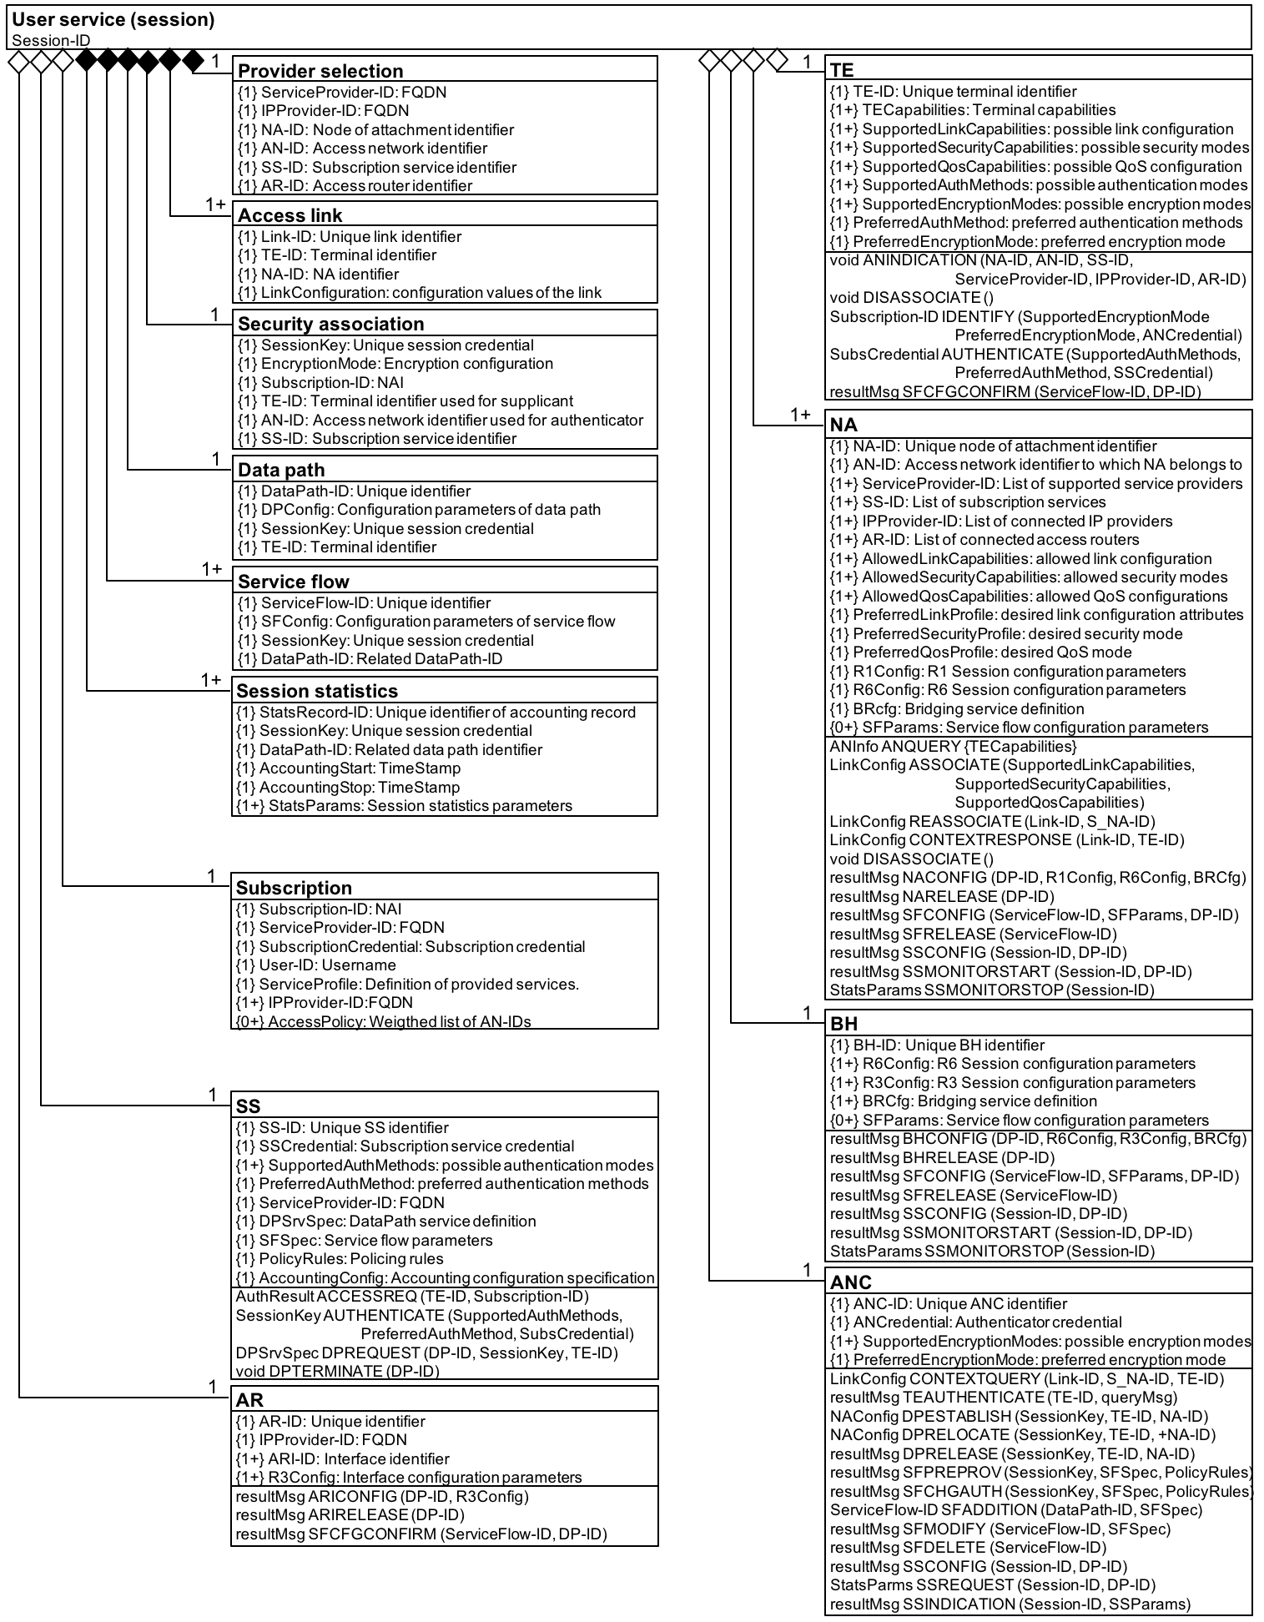
Complete
Service
Info Model

Slide 24
Going forward
User session information model has some opens
  Treatment of Subscription
  Linking between user session and network elements
Information model requires further review on particular aspects:
  Determination of IPProvider-ID and AR-ID
    User selection or provisioning through SS?
Is there a combined information model (infrastructure and user session) by pulling together the user session model with the combined descriptions of the functional entities?
Initial draft text for chapter 8.1 under preparation.

