Slide 1
P802.1CF User Service Information Model
Date: 2017-10-30
Authors:
Name | Affiliation | Phone | Email
Max Riegel | Nokia |  | maximilian.riegel@nokia.com
Notice: This document does not represent the agreed view of the IEEE 802.1 OmniRAN TG. It represents only the views of the participants listed in the ‘Authors:’ field above. It is offered as a basis for discussion. It is not binding on the contributor, who reserve the right to add, amend or withdraw material contained herein.
Copyright policy: The contributor is familiar with the IEEE-SA Copyright Policy <http://standards.ieee.org/IPR/copyrightpolicy.html>.
Patent policy: The contributor is familiar with the IEEE-SA Patent Policy and Procedures: <http://standards.ieee.org/guides/bylaws/sect6-7.html#6> and <http://standards.ieee.org/guides/opman/sect6.html#6.3>.
Abstract
The presentation contains the graphical representation of the user service information model. It builds on the concepts outlined in omniran-17-0064-004-CF00 and details the overarching user service model as well as its components.
First edition provides some examples of the information model for review.
Revision #1 provides initial proposal of user service information model

Slide 2
P802.1CF User Service Information Model
Max Riegel
(Nokia)
2017-10-30

Slide 3
Information Model
An information model* in software engineering is a representation of concepts and the relationships, constraints, rules, and operations to specify data semantics for a chosen domain of discourse.
Typically it specifies relations between kinds of things, but may also include relations with individual things.
It can provide sharable, stable, and organized structure of information requirements or knowledge for the domain context.
Y. Tina Lee (1999). "Information modeling from design to implementation" National Institute of Standards and Technology.
* On difference between Information Model and Data Model: RFC 3444; A. Pras , J. Schoenwaelder; IETF, 2003

Slide 4
Information model notation
Class name
Attribute#1: abstract type
Attribute#2: abstract type
…
Response Function#1(parameter)
Response Function#2(parameter)
...
Information element with specification of attributes as well as functions, which could be invoked by other elements over reference points. Functions return an result value.
Aggregation
Aggregation is a special type of association used to model a "whole to its parts" relationship.
In basic aggregation relationships (framed diamond), the lifecycle of a part class is independent from the whole class's lifecycle.
- Associations are always assumed to be bi-directional; this means that both classes are aware of each other and their relationship
- In a uni-directional association (arrow), two classes are related, but only one class knows that the relationship exists.
The composition aggregation relationship (filled diamond) is just another form of the aggregation relationship, but the child class's instance lifecycle is dependent on the parent class's instance lifecycle.
- Associations are always assumed to be bi-directional; this means that both classes are aware of each other and their relationship
- In a uni-directional association (arrow), two classes are related, but only one class knows that the relationship exists.
Whole
0+
Part
Whole
1+
Part
Whole
0-1
Part
Whole
1
Part

Slide 5
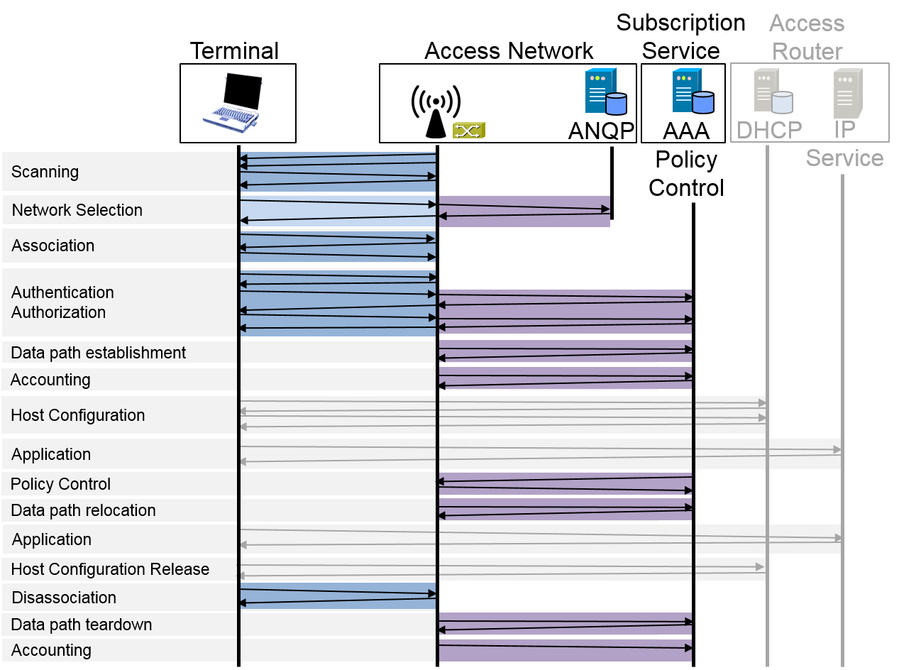
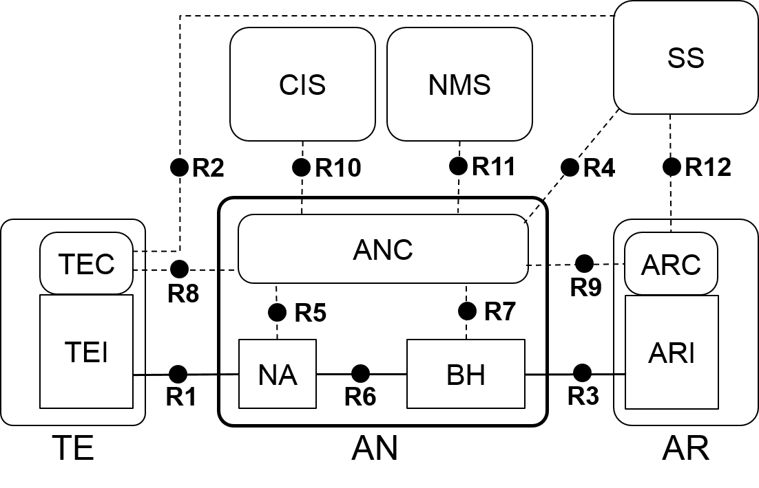
Two perspectives of information model
Infrastructure
Information model is structured according to functional entities
User Service
Information model is structured according to functional phases

Slide 6
User Service Information Model
User service (session)
Session-ID
1
Subscription
NAI
1
Unmodified from omniran-17-0064-04
Requires revision!
Service provider
SP-ID:FQDN
1
User
User-ID
1+
Network access policies
NDS-policy-ID
1+
Access link
Link-ID
1
Security association
Session-Key
0+
1
Subscription service
SS-ID
1
Datapath
Datapath-ID
1
IP Provider
AR-ID
1+
Service-Flow
ServiceFlow-ID
1+
Accounting record
AccountingRecord-ID

Slide 7
Creating the user session information model
Model is strictly aligned to the sections
7.2 Access network discovery and selection
7.3 Association and deassociation
7.4 Authentication and trust establishment
7.5 Datapath establishment, relocation and teardown
7.6 Authorization, QoS, and policy control
7.7 Accounting and monitoring
Top level model consists of the 6 components
Each of the components is further detailed on following slides

Slide 8
User Service Information Model
User session
Session-ID
1
Provider selection
ServiceProvider-ID: FQDN
IPProvider-ID: FQDN
NA-ID: Node of attachment identifier
AN-ID: Access network identifier
SS-ID: Subscription service identifier
AR-ID: Access router identifier
1+
Access link
Link-ID
1
Security association
Session-Key
0+
1
Datapath
Datapath-ID
1+
Service-Flow
ServiceFlow-ID
1+
Session statistics
SSRecord-ID

Slide 9
Network selection
Provider selection
{1} ServiceProvider-ID: FQDN
{1} IPProvider-ID: FQDN
{1} NA-ID: Node of attachment identifier
{1} AN-ID: Access network identifier
{1} SS-ID: Subscription service identifier
{1} AR-ID: Access router identifier
1+
Subscription
{1} Subscription-ID: NAI
{1} ServiceProvider-ID: FQDN
{1+} IPProvider-ID:FQDN
{0+} AccessPolicy: Weigthed list of AN-IDs
1
TE
{1} TE-ID: Terminal identifier
{1+} TECapabilities: Terminal capabilities
NAList NADISCOVERY (TECapabilities, Subscription)
ANList ANDETECTION (NAList)
SSList SSDETECTION (ANList)
ARList ARDETECTION (ANList)
1+
NA
{1} NA-ID: Unique node of attachment identifier
{1} AN-ID: Access network identifier to which NA belongs to
NACapabilities NAQUERY (TECapabilities)
1+
AN
{1} AN-ID: Unique access network identifier
{1+} ServiceProvider-ID: List of supported service providers
{1+} SS-ID: List of subscription services
{1+} IPProvider-ID: List of connected IP providers
{1+} AR-ID: List of connected access routers
ANCapabilities ANQUERY {AN-ID}

Slide 10
Access Link
Access link
{1} Link-ID: Unique link identifier
{1} TE-ID: Terminal identifier
{1} NA-ID: NA identifier
{1} LinkConfiguration: configuration values of the link
1
TE
{1} TE-ID: Unique terminal identifier
{1+} SupportedLinkCapabilities: possible configuration attributes
{1+} SupportedSecurityCapabilities: possible security modes
{1+} SupportedQosCapabilities: possible QoS configurations
{1} PreferredLinkProfile: desired link configuration attributes
{1} PreferredSecurityProfile: desired security mode
{1} PreferredQosProfile: desired QoS mode
LinkConfiguration ASSOCIATE (SupportedLinkCapabilities, PreferredLinkProfile, SupportedSecurityCapabilities,
PreferredSecurityProfile, SupportedQosCapabilities,
PreferredQosProfile)
void DISASSOCIATE ()
1
NA
{1} NA-ID: Unique node of attachment identifier
{1+} SupportedLinkCapabilities: possible configuration attributes
{1+} SupportedSecurityCapabilities: possible security modes
{1+} SupportedQosCapabilities: possible QoS configurations
{1} PreferredLinkProfile: desired link configuration attributes
{1} PreferredSecurityProfile: desired security mode
{1} PreferredQosProfile: desired QoS mode
LinkConfiguration ASSOCIATE (SupportedLinkCapabilities, PreferredLinkProfile, SupportedSecurityCapabilities,
PreferredSecurityProfile, SupportedQosCapabilities,
PreferredQosProfile)
LinkConfiguration REASSOCIATE (Link-ID)
void DISASSOCIATE ()

Slide 11
Security Association
Security association
{1} SessionKey: Unique session credential
{1} EncryptionMode: Encryption configuration
{1} Subscription-ID: NAI
{1} TE-ID: Terminal identifier used for supplicant identifier
{1} AN-ID: Access network identifier used for authenticator identifier
{1} SS-ID: Subscription service identifier
1
Subscription
{1} Subscription-ID: NAI
{1} SubscriptionCredential: Subscription credential
{1} User-ID: Username
{1} ServiceProvider-ID: FQDN
{1} ServiceProfile: Definition of provided services.
1
TE
{1} TE-ID: Unique terminal identifier
{1+} SupportedAuthMethods: possible authentication methods
{1+} SupportedEncryptionModes: possible encryption methods
{1} PreferredAuthMethod: preferred authentication methods
{1} PreferredEncryptionMode: preferred encryption mode
Subscription-ID IDENTIFY (ANCredential, SupportedEncryptionMode , PreferredEncryptionMode)
SubscriptionCredential AUTHENTICATE (SupportedAuthMethods,
PreferredAuthMethod, SSCredential)
1
AN
{1} AN-ID: Unique AN identifier
{1} ANCredential: Authenticator credential
{1+} SupportedEncryptionModes: possible encryption methods
{1} PreferredEncryptionMode: preferred encryption mode
resultMsg TEAUTHENTICATE (TE-ID, queryMsg)
1
SS
{1} SS-ID: Unique SS identifier
{1} SSCredential: Subscription service credential
{1+} SupportedAuthMethods: possible authentication methods
{1} PreferredAuthMethod: preferred authentication methods
AuthResult ACCESSREQ (TE-ID, Subscription-ID)
SessionKey AUTHENTICATE (SupportedAuthMethods,
PreferredAuthMethod, SubscriptionCredential)

Slide 12
Data path
Data path
{1} DataPath-ID: Unique identifier
{1} DataPathConfiguration: Configuration parameters of data path
{1} SessionKey: Unique session credential
{1} TE-ID: Terminal identifier
1
ANC
{1} ANC-ID: Unique ANC identifier
NAConfig DPESTABLISH (SessionKey, TE-ID, NA-ID)
NAConfig DPRELOCATE (SessionKey, TE-ID, NA1-ID, NA2-ID)
resultMsg DPRELEASE (SessionKey, TE-ID, NA-ID)
1+
NA
{1} NA-ID: Unique NA identifier
{1} R1Config: R1 Session configuration parameters
{1} R6Config: R6 Session configuration parameters
{1} BRconfig: Bridging service definition
resultMsg NACONFIG (DataPath-ID, R1Config, R6Config, BRConfig)
resultMsg NARELEASE (DataPath-ID)
1
BH
{1} BH-ID: Unique BH identifier
{1+} R6Config: R6 Session configuration parameters
{1+} R3Config: R3 Session configuration parameters
{1+} BRConfig: Bridging service definition
resultMsg BHCONFIG (DataPath-ID, R6Config, R3Config, BRConfig)
resultMsg BHRELEASE (DataPath-ID)
1+
AR
{1} AR-ID: Unique identifier
{1} IPProvider-ID: FQDN
{1+} ARI-ID: Interface identifier
{1+} R3Config: Interface configuration parameters
resultMsg ARICONFIG (DataPath-ID, R3Config)
resultMsg ARIRELEASE (DataPath-ID)
1
SS
{1} SS-ID: Unique SS identifier
{1} ServiceProvider-ID: FQDN
{1} DPSrvSpec: DataPath service definition
DPSrvSpec DPREQUEST (DataPath-ID, SessionKey, TE-ID)
void DPTERMINATE (DataPath-ID)

Slide 13
Service flow
Service flow
{1} ServiceFlow-ID: Unique identifier
{1} ServiceFlowConfig: Configuration parameters of service flow
{1} SessionKey: Unique session credential
{1} DataPath-ID: Related DataPath-ID
1
ANC
{1} ANC-ID: Unique ANC identifier
resultMsg SFPROVISION (SessionKey, ServiceFlowSpec, PolicyRules)
resultMsg SFREAUTHORIZE (SessionKey, ServiceFlowSpec, PolicyRules)
ServiceFlow-ID SFADDITION (DataPath-ID, ServiceFlowSpec)
resultMsg SFMODIFY (ServiceFlow-ID, ServiceFlowSpec)
resultMsg SFDELETE (ServiceFlow-ID)
1
NA
{1} NA-ID: Unique NA identifier
{0+} SFParams: Service flow configuration parameters
resultMsg SFCONFIG (ServiceFlow-ID, SFParams, DataPath-ID)
resultMsg SFRELEASE (ServiceFlow-ID)
1
BH
{1} BH-ID: Unique BH identifier
{0+} SFParams: Service flow configuration parameters
resultMsg SFCONFIG (ServiceFlow-ID, SFParams, DataPath-ID)
resultMsg SFRELEASE (ServiceFlow-ID)
1
AR
{1} AR-ID: Unique identifier
resultMsg SFCFGCONFIRM (ServiceFlow-ID, DataPath-ID)
1
TE
{1} TE-ID: Unique identifier
resultMsg SFCFGCONFIRM (ServiceFlow-ID, DataPath-ID)
1
SS
{1} SS-ID: Unique SS identifier
{1} ServiceProvider-ID: FQDN
{1} ServiceFlowSpec: service flow parameters
{1} PolicyRules: Policing rules

Slide 14
Accounting and monitoring
Session statistics
{1} SSRecord-ID: Unique identifier of accounting record
{1} SessionKey: Unique session credential
{1} DataPath-ID: Related data path identifier
{1} AccountingStart: TimeStamp
{1} AccountingStop: TimeStamp
{1+} SSParams: Session statistics parameters
1
ANC
{1} ANC-ID: NAI
resultMsg SSCONFIG (Session-ID, DataPath-ID)
SSParms SSREQUEST (Session-ID, DataPath-ID)
resultMsg SSINDICATION (Session-ID, SSParams)
1+
NA
{1} NA-ID: Unique NA identifier
resultMsg SSCONFIG (Session-ID, DataPath-ID)
resultMsg SSMONITORSTART (Session-ID, DataPath-ID)
SSParams SSMONITORSTOP (Session-ID)
1
BH
{1} BH-ID: Unique BH identifier
resultMsg SSCONFIG (Session-ID, DataPath-ID)
resultMsg SSMONITORSTART (Session-ID, DataPath-ID)
SSParams SSMONITORSTOP (Session-ID)
1
SS
{1} SS-ID: Unique SS identifier
{1} ServiceProvider-ID: FQDN
{1} AccountingConfig: Accounting configuration specification

Slide 15
User Service Information Model
User service (session)
Session-ID
1
Provider selection
{1} ServiceProvider-ID: FQDN
{1} IPProvider-ID: FQDN
{1} NA-ID: Node of attachment identifier
{1} AN-ID: Access network identifier
{1} SS-ID: Subscription service identifier
{1} AR-ID: Access router identifier
1+
Access link
{1} Link-ID: Unique link identifier
{1} TE-ID: Terminal identifier
{1} NA-ID: NA identifier
{1} LinkConfiguration: configuration values of the link
1
Security association
{1} SessionKey: Unique session credential
{1} EncryptionMode: Encryption configuration
{1} Subscription-ID: NAI
{1} TE-ID: Terminal identifier used for supplicant identifier
{1} AN-ID: Access network identifier used for authenticator identifier
{1} SS-ID: Subscription service identifier
1
Data path
{1} DataPath-ID: Unique identifier
{1} DataPathConfiguration: Configuration parameters of data path
{1} SessionKey: Unique session credential
{1} TE-ID: Terminal identifier
1+
Service flow
{1} ServiceFlow-ID: Unique identifier
{1} ServiceFlowConfig: Configuration parameters of service flow
{1} SessionKey: Unique session credential
{1} DataPath-ID: Related DataPath-ID
1+
Session statistics
{1} SSRecord-ID: Unique identifier of accounting record
{1} SessionKey: Unique session credential
{1} DataPath-ID: Related data path identifier
{1} AccountingStart: TimeStamp
{1} AccountingStop: TimeStamp
{1+} SSParams: Session statistics parameters

Slide 16
Going forward
User session information model is completely specified
Requires adjustments to the function specific attributes in some of the 7.x sections
Information model has to be carefully reviewed regarding the completeness and origin of information elements
Information description should be kept as generic as possible.
Some of the descriptions may be too condensed.
The information model would allow to establish as well a infrastructure information model by pulling together the descriptions of the functional entities
Draft text for chapter 8.1 describing the user session model will be delivered for Orlando meeting.

