Slide 1
P802.1CF User Service Information Model
Date: 2017-10-10
Authors:
Name | Affiliation | Phone | Email
Max Riegel | Nokia |  | maximilian.riegel@nokia.com
Notice: This document does not represent the agreed view of the IEEE 802.1 OmniRAN TG. It represents only the views of the participants listed in the ‘Authors:’ field above. It is offered as a basis for discussion. It is not binding on the contributor, who reserve the right to add, amend or withdraw material contained herein.
Copyright policy: The contributor is familiar with the IEEE-SA Copyright Policy <http://standards.ieee.org/IPR/copyrightpolicy.html>.
Patent policy: The contributor is familiar with the IEEE-SA Patent Policy and Procedures: <http://standards.ieee.org/guides/bylaws/sect6-7.html#6> and <http://standards.ieee.org/guides/opman/sect6.html#6.3>.
Abstract
The presentation contains the graphical representation of the user service information model. It builds on the concepts outlined in omniran-17-0064-004-CF00 and details the overarching user service model as well as its components.
First edition provides some examples of the information model for review.

Slide 2
P802.1CF User Service Information Model
Max Riegel
(Nokia)
2017-10-10

Slide 3
Information Model
An information model* in software engineering is a representation of concepts and the relationships, constraints, rules, and operations to specify data semantics for a chosen domain of discourse.
Typically it specifies relations between kinds of things, but may also include relations with individual things.
It can provide sharable, stable, and organized structure of information requirements or knowledge for the domain context.
Y. Tina Lee (1999). "Information modeling from design to implementation" National Institute of Standards and Technology.
* On difference between Information Model and Data Model: RFC 3444; A. Pras , J. Schoenwaelder; IETF, 2003

Slide 4
Information model notation
Class name
Attribute#1: abstract type
Attribute#2: abstract type
…
Response Function#1(parameter)
Response Function#2(parameter)
...
Information element with specification of attributes as well as functions, which could be invoked by other elements over reference points. Functions return an result value.
Aggregation
Aggregation is a special type of association used to model a "whole to its parts" relationship.
In basic aggregation relationships (framed diamond), the lifecycle of a part class is independent from the whole class's lifecycle.
- Associations are always assumed to be bi-directional; this means that both classes are aware of each other and their relationship
- In a uni-directional association (arrow), two classes are related, but only one class knows that the relationship exists.
The composition aggregation relationship (filled diamond) is just another form of the aggregation relationship, but the child class's instance lifecycle is dependent on the parent class's instance lifecycle.
- Associations are always assumed to be bi-directional; this means that both classes are aware of each other and their relationship
- In a uni-directional association (arrow), two classes are related, but only one class knows that the relationship exists.
Whole
0+
Part
Whole
1+
Part
Whole
0-1
Part
Whole
1
Part

Slide 5
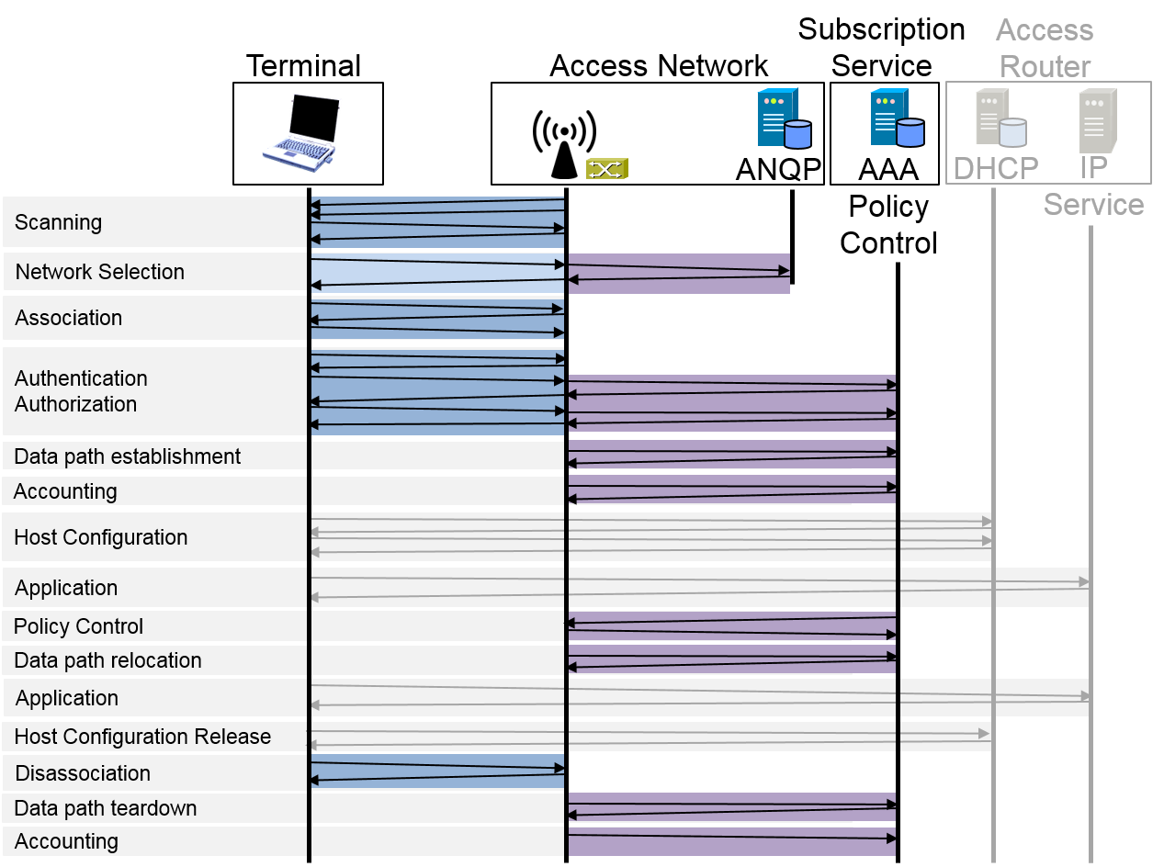
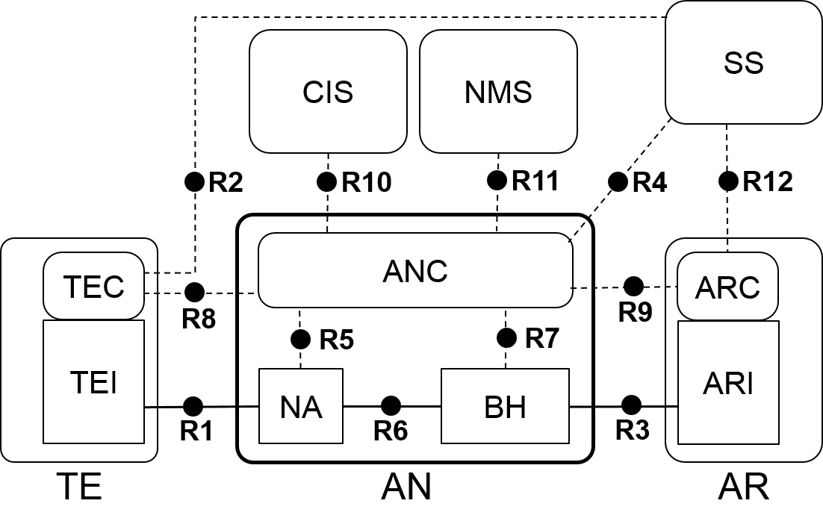
Two perspectives of information model
Infrastructure
Information model is structured according to functional entities
User Service
Information model is structured according to functional phases

Slide 6
User Service Information Model
User service (session)
Session-ID
1
Subscription
NAI
1
Unmodified from omniran-17-0064-04
Requires revision!
Service provider
SP-ID:FQDN
1
User
User-ID
1+
Network access policies
NDS-policy-ID
1+
Access link
Link-ID
1
Security association
Session-Key
0+
1
Subscription service
SS-ID
1
Datapath
Datapath-ID
1
IP Provider
AR-ID
1+
Service-Flow
ServiceFlow-ID
1+
Accounting record
AccountingRecord-ID

Slide 7
Should FDM appear in the User Service Information Model?
FDM describes the kind of information and the procedures for detecting and mitigating faulty behavior of the network.
The section does not expose any relationship to individual user sessions.
It seems, the FDM functions are better addressed in the Infrastructure Information model.

Slide 8
Access Link – Option 1
Access Link
Link-ID: Unique link identifier
LinkConfiguration: configuration values of the link
SupportedLinkCapabilities: possible configuration attributes
SupportedSecurityCapabilities: possible security modes
SupportedQosCapabilities: possible QoS configurations
SupportedApplications: possible applications
PreferredLinkProfile: desired link configuration attributes
PreferredSecurityProfile: desired security mode
PreferredQosProfile: desired QoS mode
LinkConfiguration ASSOCIATE (SupportedLinkCapabilities, PreferredLinkProfile, SupportedSecurityCapabilities,
PreferredSecurityProfile, SupportedQosCapabilities,
PreferredQosProfile)
LinkConfiguration REASSOCIATE (Link-ID)
void DISASSOCIATE ()

Slide 9
Access Link – Option 2
Access Link
Link-ID: Unique link identifier
TE-ID: Terminal identifier
NA-ID: NA identifier
LinkConfiguration: configuration values of the link
1
TE
TE-ID: Unique terminal identifier
SupportedLinkCapabilities: possible configuration attributes
SupportedSecurityCapabilities: possible security modes
SupportedQosCapabilities: possible QoS configurations
PreferredLinkProfile: desired link configuration attributes
PreferredSecurityProfile: desired security mode
PreferredQosProfile: desired QoS mode
LinkConfiguration ASSOCIATE (SupportedLinkCapabilities, PreferredLinkProfile, SupportedSecurityCapabilities,
PreferredSecurityProfile, SupportedQosCapabilities,
PreferredQosProfile)
void DISASSOCIATE ()
1
NA
NA-ID: Unique node of attachment identifier
SupportedLinkCapabilities: possible configuration attributes
SupportedSecurityCapabilities: possible security modes
SupportedQosCapabilities: possible QoS configurations
PreferredLinkProfile: desired link configuration attributes
PreferredSecurityProfile: desired security mode
PreferredQosProfile: desired QoS mode
LinkConfiguration ASSOCIATE (SupportedLinkCapabilities, PreferredLinkProfile, SupportedSecurityCapabilities,
PreferredSecurityProfile, SupportedQosCapabilities,
PreferredQosProfile)
LinkConfiguration REASSOCIATE (Link-ID)
void DISASSOCIATE ()

Slide 10
Security Association
Security Association
SessionKey: Unique session credential
EncryptionMode: Encryption configuration
Subscription-ID: NAI
TE-ID: Terminal identifier used for supplicant identifier
AN-ID: Access network identifier used for authenticator identifier
SS-ID: Subscription service identifier
1
Subscription
Subscription-ID: NAI
SubscriptionCredential: Subscription credential
User-ID: Username
ServiceProvider-ID: FQDN
ServiceProfile: Definition of provided services.
1
TE
TE-ID: Unique terminal identifier
SupportedAuthMethods: possible authentication methods
SupportedEncryptionModes: possible encryption methods
PreferredAuthMethod: preferred authentication methods
PreferredEncryptionMode: preferred encryption mode
Subscription-ID IDENTIFY (ANCredential, SupportedEncryptionMode , PreferredEncryptionMode)
SubscriptionCredential AUTHENTICATE (SupportedAuthMethods,
PreferredAuthMethod, SSCredential)
1
AN
AN-ID: Unique AN identifier
ANCredential: Authenticator credential
SupportedEncryptionModes: possible encryption methods
PreferredEncryptionMode: preferred encryption mode
resultMsg TEAUTHENTICATE (TE-ID, queryMsg)
1
SS
SS-ID: Unique SS identifier
SSCredential: Subscription service credential
SupportedAuthMethods: possible authentication methods
PreferredAuthMethod: preferred authentication methods
AuthResult ACCESSREQ (TE-ID, Subscription-ID)
SessionKey AUTHENTICATE (SupportedAuthMethods,
PreferredAuthMethod, SubscriptionCredential)

Slide 11
Outlook
The examples provide first impressions how the user service information model may look like.
Model structure, attributes and functions reflect the textual descriptions of chapter 7
Attribute descriptions might be revised according to the insights from information modeling
Complete model could be established along the same lines for the next conference call.
Does the approach make sense?

