Slide 1
Relation between information modeling and network operation
Date: 2017-10-09
Authors:
Name | Affiliation | Phone | Email
Max Riegel | Nokia |  | maximilian.riegel@nokia.com
Notice: This document does not represent the agreed view of the IEEE 802.1 OmniRAN TG. It represents only the views of the participants listed in the ‘Authors:’ field above. It is offered as a basis for discussion. It is not binding on the contributor, who reserve the right to add, amend or withdraw material contained herein.
Copyright policy: The contributor is familiar with the IEEE-SA Copyright Policy <http://standards.ieee.org/IPR/copyrightpolicy.html>.
Patent policy: The contributor is familiar with the IEEE-SA Patent Policy and Procedures: <http://standards.ieee.org/guides/bylaws/sect6-7.html#6> and <http://standards.ieee.org/guides/opman/sect6.html#6.3>.
Abstract
The presentation investigates the relation of the 802.1CF information models to network management and operation.

Slide 2
Relation between information modeling and network operation
Max Riegel
(Nokia)
2017-10-09

Slide 3
Network operation models
FCAPS
Fault management
Detection, correction and logging of faults that occur in the network
Configuration management
Monitoring of system configuration information, and any changes of it
Accounting management
Collection and tracking of network utilization information
Performance management
Ensuring that network performance remains at acceptable levels
Security management
Controlling access to assets in the network
OAMPT
Operation
Procedures used to control normal network operation
Administration
Support procedures accompanying normal network operation
Maintenance
Re-adjustments of system operation due to failures and regular needs
Provisioning
Installation and activation of new network resources.
Troubleshooting
Procedures due to fault or failure to compensate the misbehavior

Slide 4
Definitions (Wikipedia) https://en.wikipedia.org/wiki/Operations,_administration_and_management
Operations
Basically, these are the procedures you use during normal network operations.
They are day to day organizational procedures: handover, escalation, major issue management, call out, support procedures, regular updates including emails and meetings. In this section group you will find things like: Daily Checklists, On-call and Shift rotas, Call response and ticket opening procedures, Manufacturer documentation like technical specifications and operator handbooks, OOB Procedures
Administration
These are support procedures that are necessary for day-to-day operations - things like common passwords, equipment and tools access, organizational forms and timesheets, meetings minutes and agendas, and customer Service Reports.
This is not necessarily 'network admin', but also 'network operations admin'.
Maintenance
Tasks that if not done will affect service or system operation, but are not necessarily as a result of a failure. Configuration and hardware changes that are a response of system deterioration. These involve scheduling provider maintenance, standard network equipment configuration changes as a result of policy or design, routine equipment checks, hardware changes and software/firmware upgrades. Maintenance tasks can also involve the removal of administrative privileges as a security policy.
Provisioning
Introducing a new service, creating new circuits and setting up new equipment, installing new hardware. Provisioning processes will normally include 'how to' guides and checklists that need to be strictly adhered to and signed off. They can also involve integration and commissioning process which will involve sign-off to other parts of the business life cycle.
Troubleshooting
Troubleshooting is carried out as a result of a fault or failure, may result in maintenance procedures, or emergency workarounds until such time as a maintenance procedure can be carried out. Troubleshooting procedures will involve knowledge databases, guides and process to cover the role of network operations engineers from initial diagnostics to advanced troubleshooting. This stage often involves problem simulation, and is the traditional interface to design.

Slide 5
802.1CF and network operations
802.1CF covers various aspects of network operation
There are two major structural approaches of network operation
FCAPS (Fault, Configuration, Accounting, Performance, Security)
OAMPT (Operation, Administration, Maintenance, Provisioning, Troubleshooting)
The OAMPT model seems to be better aligned with 802.1CF
Chapters of 802.1CF can be well mapped to particular OAMPT aspects of network operation

Slide 6
Mapping of 802.1CF to OAMPT
Operations
Procedures used to control normal network operation
Sections 7.2 – 7.7 of Functional decomposition and design
Administration
Support procedures accompanying normal network operation
Section 6.6 Operational roles, and Section 7.1 Access network setup
Maintenance
Re-adjustments of system operation due to failures and regular needs
Section 6.3 – 6.5 NRM, Section 7.1 Access network setup, and Section 7.8 Fault diagnostics and maintenance
Provisioning
Installation and activation of new network resources.
Section 6.8 Network virtualization, and Section 8.2 Virtualized network instantiation
Troubleshooting
Procedures due to fault or failure to compensate the misbehavior
Section 7.8 Fault diagnostics and maintenance

Slide 7
Network entities providing OAMPT functions
Operations
Procedures used to control normal network operation
Usually performed through the network infrastructure
Sections 7.2 – 7.7 of Functional decomposition and design
Administration
Support procedures accompanying normal network operation
Usually performed through the Business Supporting System (BSS)
Section 6.6 Operational roles, and Section 7.1 Access network setup
Maintenance
Re-adjustments of system operation due to failures and regular needs
Usually performed through the Operation Supporting System (OSS)
Section 6.3 – 6.5 NRM, Section 7.1 Access network setup, and Section 7.8 Fault diagnostics and maintenance
Provisioning
Installation and activation of new network resources.
Usually performed through the network orchestration system (??)
Section 6.8 Network virtualization, and Section 8.2 Virtualized network instantiation
Troubleshooting
Procedures due to fault or failure to compensate the misbehavior
Usually performed through Network Operations Center (NOC)
Section 7.8 Fault diagnostics and maintenance
Troubleshooting seems to be a meta category of activities closely related to Maintenance.
Should we subsume ‘Troubleshooting’ into ‘Maintenance’ (i.e. OAMPT => OAMP) ??

Slide 8
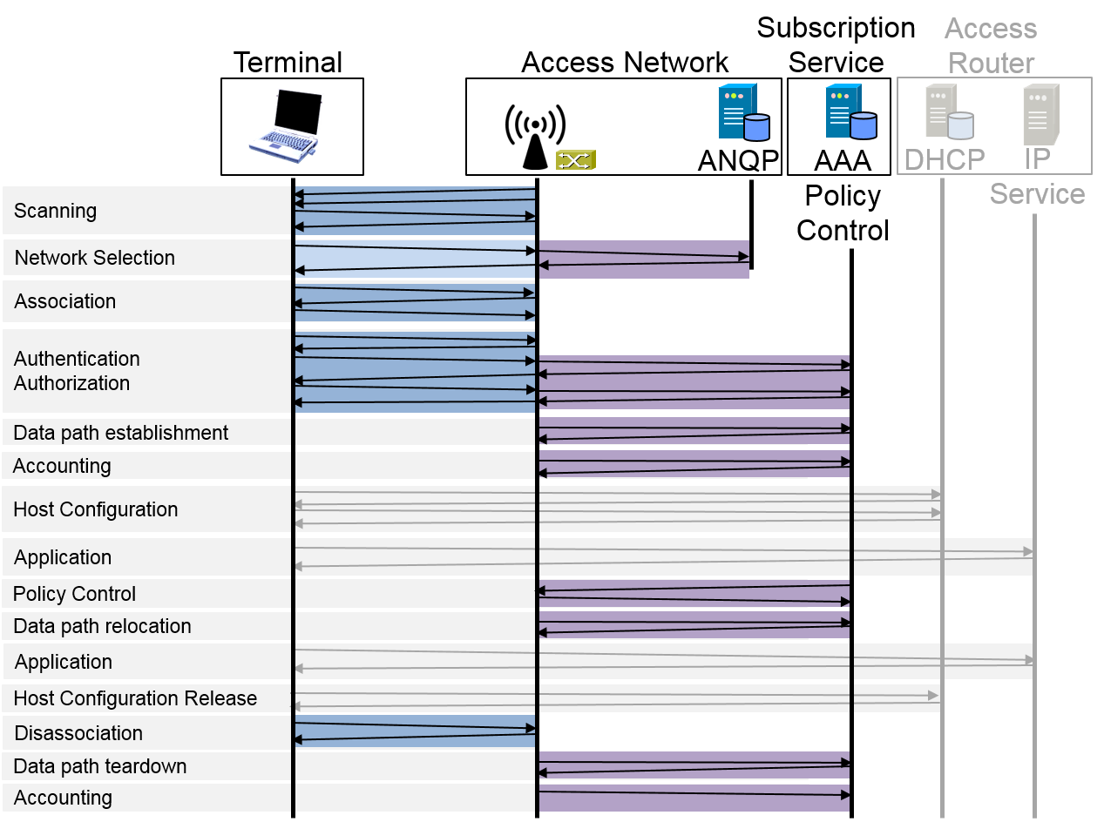
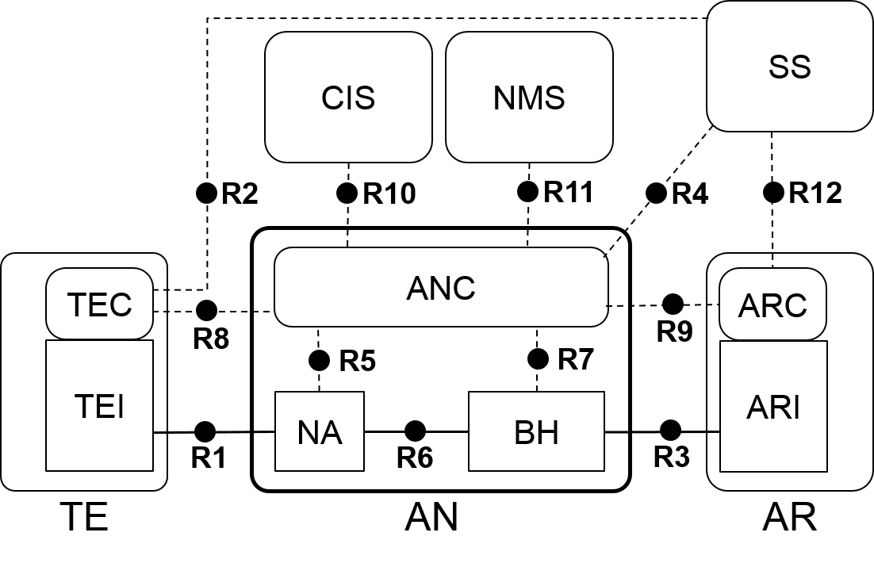
Could we proceed with the two models agreed?
Infrastructure
Information model is structured according to functional entities
User Service
Information model is structured according to functional phases

Slide 9
Conclusion
The two agreed model describe the Operations aspect, as well as the Maintenance aspect of a network.
Additional information models may address Administration, and Provisioning.
For the time being, the two agreed information model may be sufficient.
Information models may be amended during the WG ballot phase.

