Slide 1
Time Sensitive Networking within the scope of P802.1CF
Max Riegel
OmniRAN TG chair
(Nokia)

Slide 2
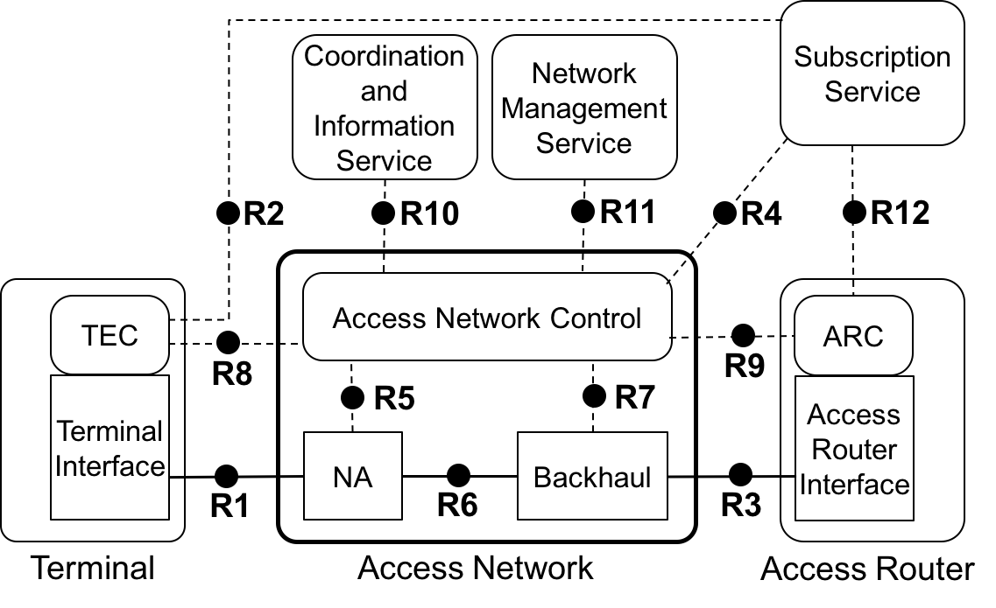
TSN and OmniRAN architectural models
OmniRAN will adopt TSN functionality to its P802.1CF specification.
Amending the P802.1CF functional description chapters on ‘Data path’ and ‘QoS, authorization, and policy control’
How does it fit together?

Slide 3
P802.1CF architectural model
TSN within the scope of P802.1CF

Slide 4
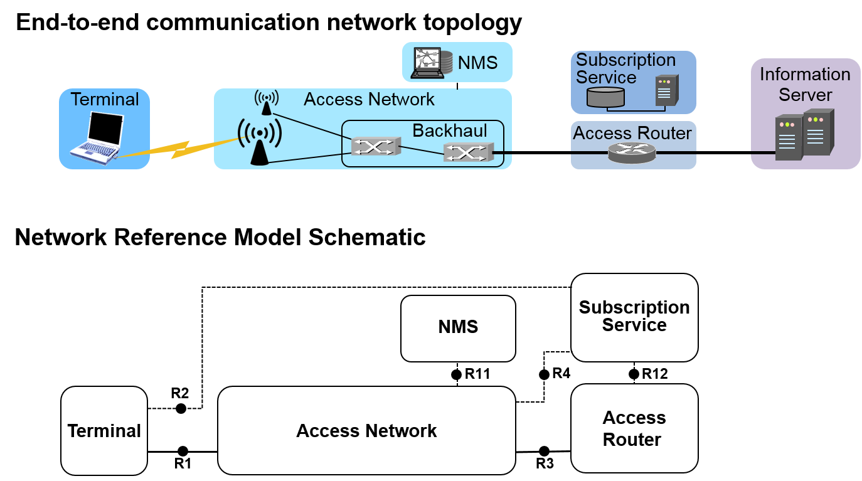
P802.1CF Access network reference model
P802.1CF provides reference architecture and functional description of IEEE 802 LANs supporting managed attachments of terminals
  Such networks are commonly called ‘access networks’
Fits to nearly all kind of managed LANs w/ access control

Slide 5
P802.1CF Network Reference Model
NRM represents a logical view on an access network architecture
Functional entities represented by rounded rectangles
Relations are shown by reference points indicating interfaces
  Forwarding path of Ethernet frames represented by solid lines
  Control interfaces represented by dotted lines

Slide 6
Representation of TSN configuration models in P802.1CF NRM
SS
CIS
NMS
Centralized
User
Configuration
R2
R10
R11
R4
R12
User/Network
Configuration
info
User/Network
Configuration
info
ANC
TEC
Centralized
Network
Configuration
ARC
R8
R9
TEI
R5
R7
ARI
NA
BH
Listener/Talker
R1
Bridge
R6
Bridges
R3
Listener/Talker
TE
AN
AR

Slide 7
Adoption of TSN Functionality to P802.1CF
TSN within the scope of P802.1CF

Slide 8
P802.1CF supports TSN
P802.1CF access network represents the bridged connectivity between end stations
  Supports as well multicast behavior for single Talker forwarding streams to multiple Listener
P802.1CF datapath (solid line) can provide support for time-sensitive streams and real-time data
  Implementation of TSN queuing and forwarding in the Bridges in NA and Backhaul required
The TSN configuration models w/ centralized network configuration can be easily represented in the P802.1CF Network Reference Model

Slide 9
Centralized network / distributed user configuration in P802.1CF NRM
Access Network Control (ANC) provides centralized network configuration for user sessions
  Basic network configuration delivered by Network Management Service (NMS)
  User session configuration info provided through
  R8 and R9 from/to end stations
CNC is contained in ANC
  ANC is control entity to align user demand with available network resources
R8, R9, and ANC provide means to process
User/ Network
Configuration Info
SS
CIS
NMS
R2
R10
R11
R4
R12
User/Network
Configuration
info
User/Network
Configuration
info
ANC
TEC
Centralized
Network
Configuration
ARC
R8
R9
TEI
R5
R7
ARI
NA
BH
Listener/Talker
R1
Bridge
R6
Bridges
R3
Listener/Talker
TE
AN
AR

Slide 10
Fully centralized TSN configuration in P802.1CF NRM
Access Network Control (ANC) provides centralized network configuration for user sessions
  Basic network
  configuration delivered by Network Management
  Service (NMS)
  User session configuration delivered by Subscription Service (SS)
CUC maps to SS
CNC maps to ANC
  ANC is control entity
  to align user demand
  with available network
  resources
No use of R8, R9
SS
CIS
NMS
Centralized
User
Configuration
User/Network
Configuration
info
R2
R10
R11
R4
R12
ANC
TEC
Centralized
Network
Configuration
ARC
R8
R9
TEI
R5
R7
ARI
NA
BH
Listener/Talker
R1
Bridge
R6
Bridges
R3
Listener/Talker
TE
AN
AR

Slide 11
Distributed TSN configuration model doesn’t work well in P802.1CF NRM
Access Network Control (ANC) doesn’t have any control role in TSN configuration
  User session configuration info provided through
  R8 and R9 from/to end stations
  ANC purely forwards configuration information to the bridges in NA and BH
No central knowledge about resource usage throughout the network.
Not really the scenario P802.1CF is designed for!
SS
CIS
NMS
R2
R10
R11
R4
R12
User/Network
Configuration
info
User/Network
Configuration
info
TEC
ANC
ARC
R8
R9
TEI
R5
R7
ARI
NA
BH
Listener/Talker
R1
Bridge
R6
Bridges
R3
Listener/Talker
TE
AN
AR

Slide 12
Amendments to P802.1CF Specification
TSN within the scope of P802.1CF

Slide 13
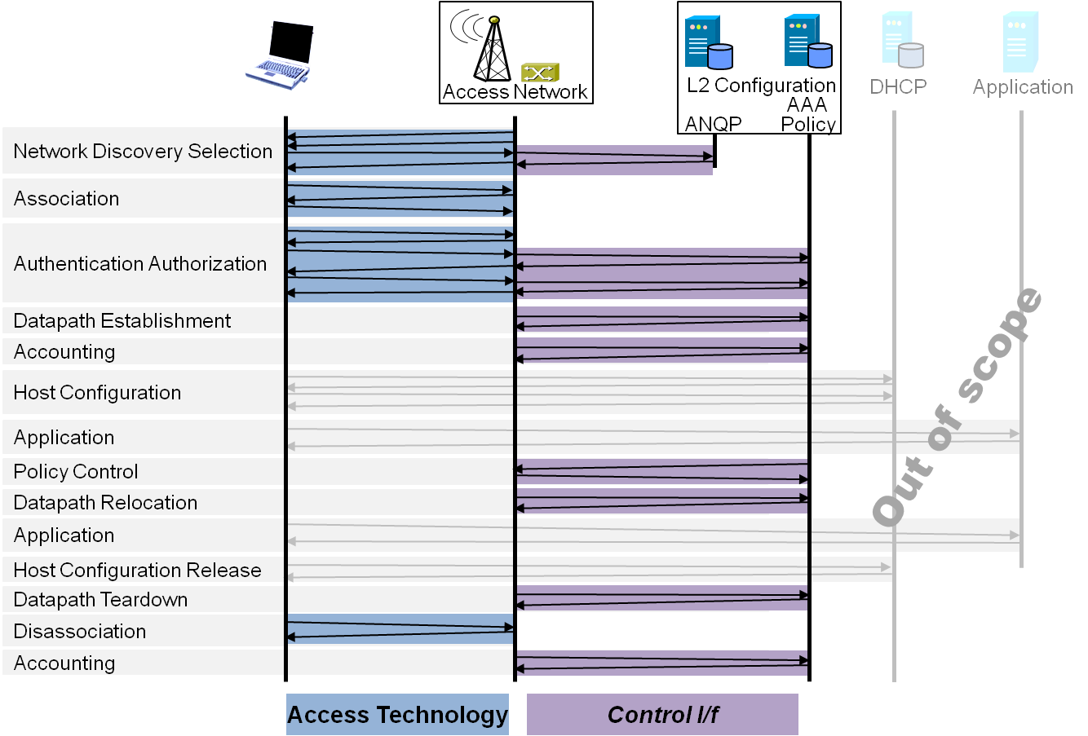
Necessary amendments to P802.1CF spec
Overview
References, definitions, acronyms and abbreviations
Conformance
Access network reference model
  Basic architectural concepts and terminology
  Overview of NRM
  Basic, enhanced and comprehensive NRM
  Operational roles
  Network virtualization
  Identifiers
  Deployment scenarios
Functional Design and Decomposition
  Access network setup
  Network discovery and selection
  Association and disassociation
  Authentication and trust establishment
  Data path establishment,
  relocation and teardown
  Authorization, QoS and policy control
  Accounting and monitoring
  Fault diagnostics and maintentance
  Information model
Network softwarization functions
  SDN functional decomposition
  Network Function Virtualization
  Virtualized network instantiation

Slide 14
Necessary amendments to
P802.1CF specification
Data path
  Extension to time-sensitive and real-time traffic classes
  Shaping, scheduling and forwarding functions in bridges for best effort, time-sensitive and real-time traffic
  Clock distribution
Authorization, QoS, and policy control
  Amend QoS model for time-sensitive and real-time traffic classes
  Description of fully centralized and centralized/distributed TSN configuration models
Open: Coexistence with P802.1CF policy control model

Slide 15
P802.1CF QoS architecture
Repository of QoS control/policy information is part of Subscription Service
  Policy parameters belong to subscription
  Subscription service provides QoS parameters as part of authorization
    … and might have possibilities to change parameters during ongoing session
Generic policy control architecture
Policy decision point
Policy data base
Resource
Request
Policy enforcement
point
Policy enforcement point
Policy enforcement point

Slide 16
Policy control in P802.1CF NRM
SS
CIS
NMS
Policy Data Base
R2
R10
R11
R4
R12
ANC
TEC
Policy Decision Point
ARC
R8
R9
TEI
R5
R7
ARI
NA
BH
PEP
PEP
R1
R6
R3
TE
AN
AR

Slide 17
Conclusion
TSN within the scope of P802.1CF

Slide 18
Conclusion
It seems that TSN can be well covered in P802.1CF
  At least configuration models with centralized network configuration
  Distributed network configuration is not inline with centralized control structures of P802.1CF
P802.1CF could provide additional capabilities to TSN through its authorization and policy control features
  User initiated stream reservation can be checked against policies

