Slide 1
P802.1CF Information Model Structure
Date: 2017-09-06
Authors:
Name | Affiliation | Phone | Email
Max Riegel | Nokia |  | maximilian.riegel@nokia.com
Notice: This document does not represent the agreed view of the IEEE 802.1 OmniRAN TG. It represents only the views of the participants listed in the ‘Authors:’ field above. It is offered as a basis for discussion. It is not binding on the contributor, who reserve the right to add, amend or withdraw material contained herein.
Copyright policy: The contributor is familiar with the IEEE-SA Copyright Policy <http://standards.ieee.org/IPR/copyrightpolicy.html>.
Patent policy: The contributor is familiar with the IEEE-SA Patent Policy and Procedures: <http://standards.ieee.org/guides/bylaws/sect6-7.html#6> and <http://standards.ieee.org/guides/opman/sect6.html#6.3>.
Abstract
The revision of the presentation provides an initial example of the basic structure of the P802.1CF information model.
Revision 2 adds the core model for service as well as a short explanation of the notation
Revision 3 contains editorial corrections introduced during discussions at St. John’s meeting
Revision 4 adds a more comprehensive model for user service.

Slide 2
P802.1CF Information Model Structure
Max Riegel
(Nokia)
2017-09-26

Slide 3
Information Model
An information model* in software engineering is a representation of concepts and the relationships, constraints, rules, and operations to specify data semantics for a chosen domain of discourse.
Typically it specifies relations between kinds of things, but may also include relations with individual things.
It can provide sharable, stable, and organized structure of information requirements or knowledge for the domain context.
Y. Tina Lee (1999). "Information modeling from design to implementation" National Institute of Standards and Technology.
* On difference between Information Model and Data Model: RFC 3444; A. Pras , J. Schoenwaelder; IETF, 2003

Slide 4
Purpose of P802.1CF Information Model
Graphical representation of the configuration information and statistics of the IEEE 802 access network infrastructure and communication service.
Distinction and relationship between ‘infrastructure’ information and ‘service’ information
Structural description of network architecture.
Describe what the thing is
Description of parameters of user service
Describe what the thing provides
Information model should be aligned to the structure of the specification.

Slide 5
Thoughts on information model structure
Essentially two information models needed:
Infrastructure model of IEEE 802 access network
Service model an IEEE 802 session
Network information model
Description of network infrastructure
Structured according to the functional entities of NRM
Differentiating configuration (‘wr’) and statistics (‘ro’)
User service information model
Description of user session
Structured according to functional description
Differentiating configuration (‘wr’) and statistics (‘ro’)

Slide 6
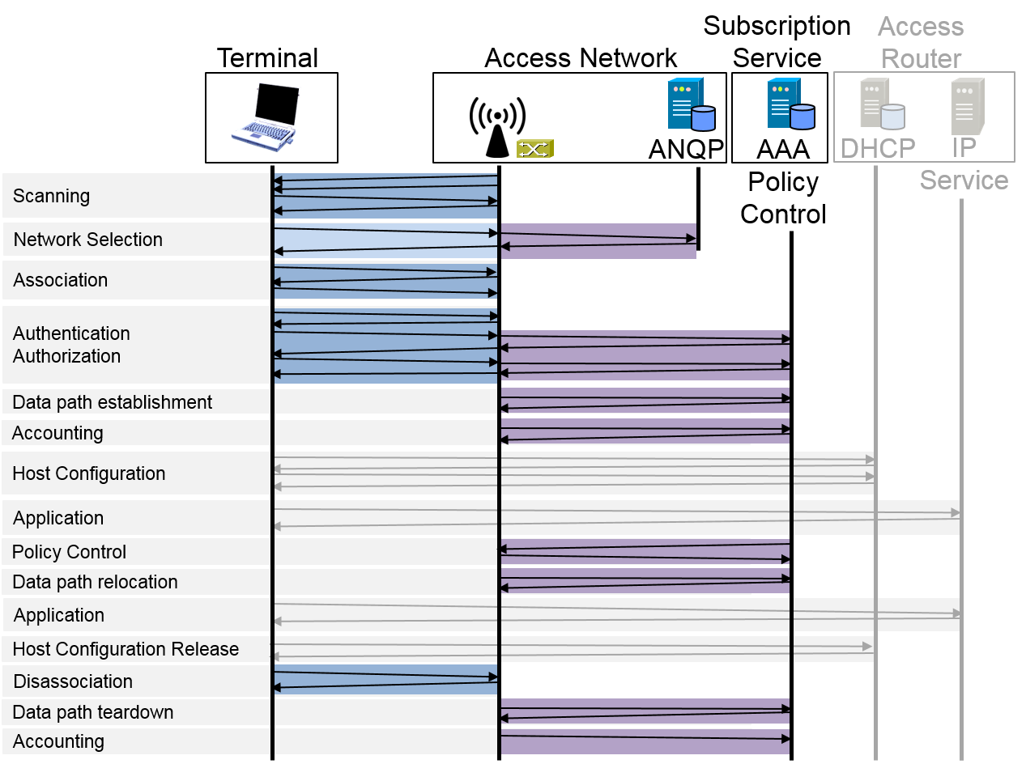
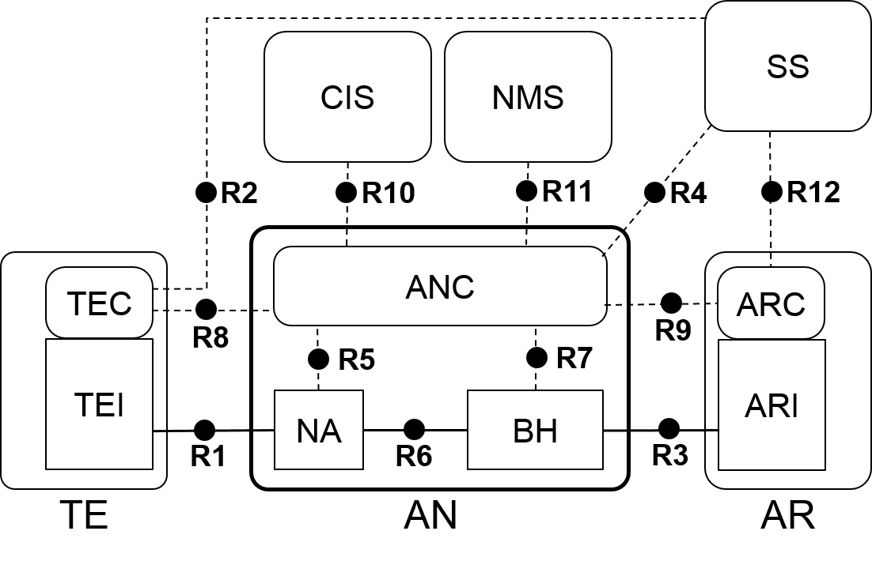
Two perspectives of information model
Infrastructure
Information model is structured according to functional entities
Service
Information model is structured according to functional phases

Slide 7
Infrastructure Information Model
Access Network
AN-ID
1
Backhaul
BH-ID
1+
Node of Attachment
NA-ID
1
Access Network Control
ANC-ID
1
Network Management Service
NMS-ID
0+
Coordination and Information Service
CIS-ID
1+
Subscription Service
SS-ID
Service Provider: FQDN
0+
Access Router
AR-ID
1
Access Router Control
ARC-ID
1+
Access Router Interface
ARI-ID
0+
Terminal
TE-ID
1
Terminal Control
TEC-ID
1+
Terminal Interface
TEI-ID

Slide 8
User Service Information Model
User service (session)
Session-ID
1
Subscription
NAI
1
Service provider
SP-ID:FQDN
1
User
User-ID
1+
Network access policies
NDS-policy-ID
1+
Access link
Link-ID
1
Security association
Session-Key
0+
1
Subscription service
SS-ID
1
Datapath
Datapath-ID
1
IP Provider
AR-ID
1+
Service-Flow
ServiceFlow-ID
1+
Accounting record
AccountingRecord-ID

Slide 9
Network management approaches
FCAPS
Fault management
Detection, correction and logging of faults that occur in the network
Configuration management
Monitoring of system configuration information, and any changes of it
Accounting management
Collection and tracking of network utilization information
Performance management
Ensuring that network performance remains at acceptable levels
Security management
Controlling access to assets in the network
OAMPT
Operation
Procedures used to control normal network operation
Administration
Support procedures accompanying normal network operation
Maintenance
Re-adjustments of system operation due to failures and regular needs
Provisioning
Installation and activation of new network resources.
Troubleshooting
Procedures due to fault or failure to compensate the misbehavior
Neither approach directly maps to the information model. However, classes may be structured according to management approaches.
OAMPT looks to be the more suited model.

Slide 10
Conclusion
The presentation presents the top level structures
Not yet fully complete
Requires further details and hierarchical extensions
Slideset can be converted into introductory text for information model section 8.1
How to proceed:
Create detailed representation of classes
Differentiate between configuration: ‘wr’ and statistics: ‘ro’
Adding of operations (methods) to classes
Methods denote functional procedures described in chapter 7
Align to/with function specific attributes in chapter 7

Slide 11
Graphical Notation
Information Model Structure

Slide 12
Information model notation
Class name
Attribute#1: abstract type
Attribute#2: abstract type
…
Response Function#1(parameter)
Response Function#2(parameter)
...
Information element with specification of attributes as well as functions, which could be invoked by other elements over reference points. Functions return an result value.
Aggregation
Aggregation is a special type of association used to model a "whole to its parts" relationship.
In basic aggregation relationships (framed diamond), the lifecycle of a part class is independent from the whole class's lifecycle.
- Associations are always assumed to be bi-directional; this means that both classes are aware of each other and their relationship
- In a uni-directional association (arrow), two classes are related, but only one class knows that the relationship exists.
The composition aggregation relationship (filled diamond) is just another form of the aggregation relationship, but the child class's instance lifecycle is dependent on the parent class's instance lifecycle.
- Associations are always assumed to be bi-directional; this means that both classes are aware of each other and their relationship
- In a uni-directional association (arrow), two classes are related, but only one class knows that the relationship exists.
Whole
0+
Part
Whole
1+
Part
Whole
0-1
Part
Whole
1
Part

