Slide 1
Model for Accounting and Monitoring
Date: [2017-05-15]
Authors:
Name | Affiliation | Phone | Email
Hao Wang | Fujitsu R&D Center | +86-10-59691000 | wangh@cn.fujitsu.com
Xiaojing Fan | Fujitsu R&D Center | +86-10-59691000 | fanxiaojing@cn.fujitsu.com
Su Yi | Fujitsu R&D Center | +86-10-59691000 | yisu@cn.fujitsu.com
Ryuichi Matsukura | Fujitsu/Fujitsu Laboratory | +81-44-754-2667 | r.matsukura@jp.fujitsu.com
Notice: This document does not represent the agreed view of the IEEE 802.1 OmniRAN TG. It represents only the views of the participants listed in the ‘Authors:’ field above. It is offered as a basis for discussion. It is not binding on the contributor, who reserve the right to add, amend or withdraw material contained herein.
Copyright policy: The contributor is familiar with the IEEE-SA Copyright Policy <http://standards.ieee.org/IPR/copyrightpolicy.html>.
Patent policy: The contributor is familiar with the IEEE-SA Patent Policy and Procedures: <http://standards.ieee.org/guides/bylaws/sect6-7.html#6> and <http://standards.ieee.org/guides/opman/sect6.html#6.3>.
Abstract
This presentation proposes the initial thoughts on modeling the accounting and monitoring attributes and functions.

Slide 2
Model for Accounting and Monitoring
2017-05-17
Hao Wang
Fujitsu R&D Center

Slide 3
Introduction
Accounting is about gathering usage data records for network devices, exporting those records to a collection server, processing the records for user or another application.
Usage data records could be generated based on
User session statistics
Port performance statistics
Monitoring on the port provides real-time and accurate observation of the performance of network resource.

Slide 4
Accounting and Authentication
User session started when user has been authenticated by 802.1X.
802.1X PAE maintains session statistics for accounting purposes.
PAE resides in both TEC and ANC, and may reside in ARC in some scenarios.
Accounting can be augmented to ‘control’ as a function, avoid to import the full model of 802.1X.
Accounting policy refers to the set of parameters for configuration in order to provide the appropriate accounting records.
Accounting records can be leveraged in multiple use cases, such as billing, security management, etc.

Slide 5
Accounting and Authorization
QoS is authorized to the terminal and required by new services when user session established.
The ANC processes the network resource requests and determines the policy for QoS control.
Accounting gathers the utilization information of network resources and maintain the statistics for QoS.
Accounting records can be provided to external management entities such as NMS for auditing the operation of services in a user session.

Slide 6
Monitoring
Monitoring the performance of a physical port can be implemented on the interface entities, or as a separate entity.
Monitoring the user specific traffic requires filtering rules provided by the control entities.
Monitoring jobs and reports are scheduled and configured by the control entities.
Monitoring records based on the performance statistics can be pushed to or pulled from the control entities for accounting or other management purposes.

Slide 7
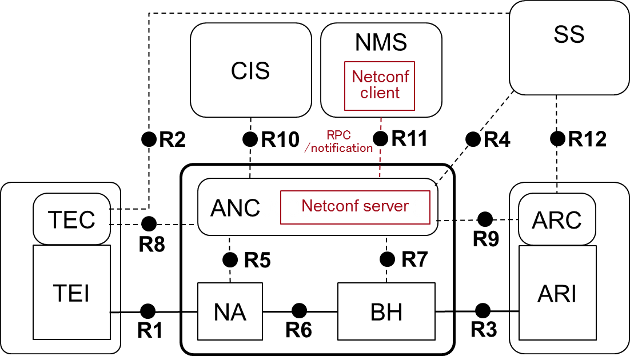
Generic OmniRAN Model
For network management purposes, the underlay network infrastructure needs to be modeled.
Control and service entities form a common client-server pair support the network management protocol such as NETCONF.
Interface entities should be separated for outstanding IEEE 802 attributes and functionality.
Refer to the UML model in 802.1X
OmniRAN Network
Ctrl_ID
*
Control
Intf_ID
*
ANC
AN
Interface
ARC
AR
Service
Port_ID
*
TEC
TE
Port
NA
NA
Control
802.11
BH
802.11
BH
802.16
TEI
TE
Interface
802.16
ARI
802.22
AR
802.22
Port
802.3
802.3

Slide 8
Model for OmniRAN Control Functions
OmniRAN Network
Ctrl_ID
*
Control
AuthenProc
Intf_ID
*
ANC
Authentication
AN
session
Interface
ARC
AR
SessionStatistics
Port_ID
*
TEC
AuthorProc
TE
Port
NA
Authorization
IEEE 802.1X model
NA
Serviceflow
BH
QoS
PAE System
BH
TEI
AccountProc
TE
PAE
ARI
Accounting
AR
mediation
MonitorProc
AccountingRecords
supplicant
LogonProcess
Monitoring
measurement
MonitoringRecords
AccountingPolicy
authenticator
…
SessionStatistics
MonitoringPolicy

Slide 9
Element: Accounting
Control
AccountProc
Accounting
+accounting-id
+ss-id
+state
+accounting-type
+user-id
1
*
mediation
AccountingPolicy
AccountingRecords
+accounting-condition
+accounting-action
+application-ready-data

Slide 10
Element: Monitoring
Port
MonitorProc
Monitoring
+monitoring-id
+state
+monitor-type
1
*
measurement
MonitoringPolicy
MonitoringRecords
+start-time
+duration
+interval
+storage-time
+accuracy
+monitor-source
+trigger-condition
+Tx-volume
+Rx-volume
+Throughput
+QoS-monitoring

Slide 11
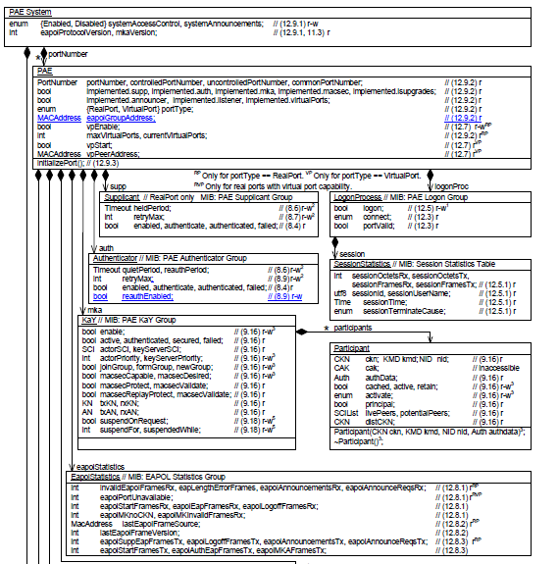
Snapshot of 802.1X UML Model

Slide 12
Reference
802.1X-2010
802.1Xck-d1-0
omniran-17-0028-00-CF00-data-model-for-fdm.pptx
omniran-16-0039-00-CF00-key-concepts-of-accounting-and-monitoring.pptx
802-1cf-d0-4

Slide 13
Questions, Comments Thank YOU!

