Slide 1
Introduction into the Industry Connections Activity Initiation Document (ICAID) addressing the IEEE 802 5G SC Action A
2017-03-12
Max Riegel, Nokia
(OmniRAN TG Chair)

Slide 2
Motion at 802.1 Nov ’16 closing plenary
Authorize OmniRAN TG to create an ICAID proposal addressing the 5G SC Action A and authorize the 802.1 chair to pre-circulate the ICAID proposal to the EC for consideration.
  Moved: Max Riegel
  Second: John Messenger
  Vote: 22, 0, 1

Slide 3
IEEE 802 5G SC
Introduction to the IEEE 802.1 ICAID

Slide 4
IEEE 5G SC/IMT-2020 Standing Committee
Chartered by EC ballot
  Active Feb - July 2016
  Chaired by Glenn Parsons
Authorized Scope
  To provide a report on the following items to the EC:
    Costs and benefits of creating an IEEE 5G specification
    Costs and benefits of providing a proposal for IMT-2020, considering possible models of a proposal:
      as a single technology,
      as a set of technologies,
      or as one or more technologies within a proposal from external bodies (e.g., 3GPP)
  During its lifetime, to act as the communication point with other IEEE organizations on this topic.

Slide 5
5G SC Conclusion
Action A: Establish a kind of IEEE “5G” for the non-mobile environment
  Organized by 802.1 WG (Industry Connections project)
Action B3: Ensure IEEE 802.11 is becoming well integrated in the incumbent mobile operator 5G universe
  Organized by 802.11 WG (Liaison with 3GPP)
Spectrum issues handled by 802.18
Joint 802.1/802.11 meetings as necessary for coordination of actions A & B3

Slide 6
Mentor DCN: EC-16-0119-01-5GSG
6
Action A: IEEE “5G” specification
Candidate Approach
• specify an 802 access network
  could be based on P802.1CF
    “network reference model defines a generic foundation for the description of IEEE 802 access networks, which may include multiple network interfaces, multiple network access technologies, and multiple network subscriptions, aimed at unifying the support of different interface technologies, enabling shared network control and use of software-defined networking (SDN) principles”
  provides an external view into general 802 access network
  could support many 802 MACs and PHYs
  could plug into incumbent mobile operator networks
    for example, expand the notion of LWA so that the cellular network supports 802 rather than 802.11
    gives 802 a strong supporting role in cellular 5G networks
  could support integration into other operator networks
    e.g. cable TV or fixed telecom
    gives 802 a central role in non-cellular 5G networks
  feasible for 802 access network to support both
  need not promote it as an “IEEE 5G” network

Slide 7
Scope and title of the Industry Connections activity
“IEEE next generation communication infrastructure specifications that support enhanced broadband, massive machine type communication and ultra-reliable and low latency communications not belonging to mobile networks”
Working title (Some better marketing slang would be desirable;-).
  IEEE 802 network enhancements for the next decade

Slide 8



IEEE 802 networking is predominantly happen in non-IMT networks
IMT
‘Verticals’
Hotspot
Smart Grid
Cloud Computing
…
eHealth
Internet of Things
Smart Cities
2G
3G
IMT2000
4G
IMT2010
5G
IMT2020
xDSL
FTTH
Cable
Enterprise
LAN
Mobile Core
CSP Backbone
CSP Backbone
WAN
Internet

Slide 9
Network deployments aside of mobile networks
Other operators of public communication networks than mobile network operators
  MSO
  FNO
  Hotspot operators
‘Verticals’ represented in IEEE standards like
  Smart Grid
    http://standards.ieee.org/develop/msp/smartgrid.pdf
  Cloud Computing
    http://standards.ieee.org/develop/msp/cloudcomputing.pdf
  Internet of Things (including Green Community Networks)
    http://standards.ieee.org/develop/msp/iot.pdf
  Intelligent Transportation Systems
    http://standards.ieee.org/develop/msp/its.pdf
  eHealth
    http://standards.ieee.org/develop/msp/ehealth.pdf
  Smart Cities
    http://standards.ieee.org/develop/msp/smartcities.pdf

Slide 10
Aims of ‘5G SC Action A’
New deployments of IEEE 802 by better addressing deployment needs
  Unifying technical approaches among various deployment domains by better communications
  Development of further amendments to fulfill particular requirements.
Faster adoption of emerging trends to IEEE 802 standards by better understanding of market evolution.
  More direct involvement of “customers” in the evolution of IEEE 802 technologies

Slide 11
INDustry Connections
Introduction to the IEEE 802.1 ICAID

Slide 12
Industry Connections (IC) Program
An efficient, economical, neutral environment for building consensus
  Supports incubation of new technologies, standards and services
  Help groups to solve shared problems and produce shared results
  Minimal effort, time and expense to begin collaborative work
  Respected, neutral, third-party home for activities and results
  Efficient path toward prestigious IEEE publication/standardization
  Flexible options for evolution, transition and conclusion of activities
Possible Outputs of IC Activities
  Proposals for standards
  White papers
  Peer-reviewed guides and position papers
  Workshops and other events
  Databases and registration services
  Software, tools and web services
  Other jointly developed results
Complements IEEE-SA “formal” standards activities

Slide 13
Study Groups vs.
Industry Connection Activity
Study Group (per IEEE 802 LMSC P&P)
  When a Sponsor is presented with a proposal concerning a standards development project, the Sponsor may form a Standards Study Group to examine the proposal to determine if there is a need for a standard to be developed.
  If the proposal merits formation of a project, the Study Group will draft a PAR for consideration by the Sponsor.
Industry Connections Activity
  An Industry Connections activity is initiated when a group of companies or individuals recognizes a need for collaboration and consensus within a technical area, and often before they fully understand what form that collaboration should take.
  Does not replace standards process, but may precede.

Slide 14
IEEE 802 network enhancements for the next decade
Introduction to the IEEE 802.1 ICAID

Slide 15
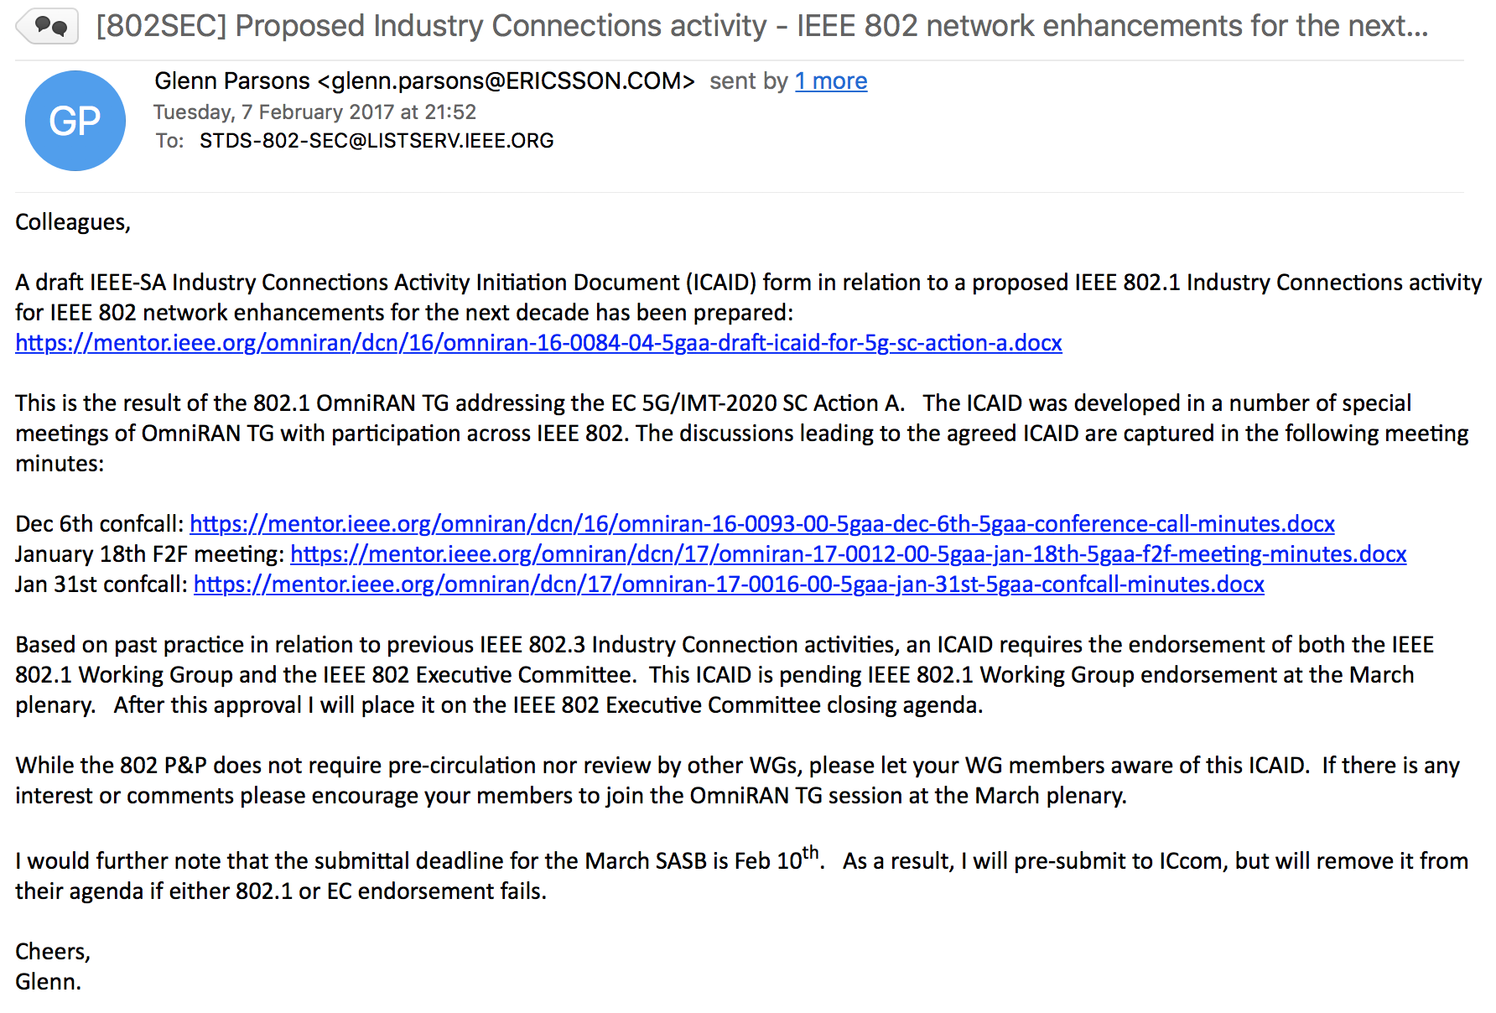

Slide 16
Motivation
The mobile industry is currently pursuing the development of the next generation mobile communication networks fulfilling the requirements for extreme mobile broadband, massive machine-type communication, and ultra-reliable and low latency communications as specified in ITU-R M.2083 for IMT-2020.
Many of the observed trends and use cases described in ITU-R M.2083 apply as well to communication infrastructures which do not belong to the IMT domain because they do not rely on high-velocity scenarios or on licensed radio spectrum. IEEE 802 technologies are mainly deployed in communication infrastructures outside of the IMT domain, and may require enhancements to address the emerging requirements of future communications.

Slide 17
Goal
The goal of this activity is to assess emerging requirements for IEEE 802-based communication infrastructures outside of the IMT domain, identify commonalities, gaps, and trends not currently addressed by IEEE 802 standards and projects, and facilitate building industry consensus towards proposals to initiate new standards development efforts. Topics concerning enhanced cooperative functionality among existing IEEE standards in support of network integration will be encouraged.
Findings related to existing IEEE 802 standards and projects are forwarded to the responsible working groups for further considerations.

Slide 18
Potential markets served
IEEE 802 technologies are deployed in a huge number of market applications, which are exhibiting a growing diversity in terms of the features needed. Solutions spanning these different application spaces and feature requirements will be best addressed by leveraging common technology approaches. This activity will enable industry consensus building on the market/application requirements and identify gaps and trends not currently addressed by IEEE 802 standardization of new solutions, which will help to foster industry engagements in new study groups and standardization topics.

Slide 19
Proposed deliverables
There will be two deliverables:
Records of the meetings, including minutes and supporting presentations.
A report documenting the findings of the IC activity, with recommendations regarding new standardization topics, documentation of use cases and user needs for those topics, and proposed organizational approaches to ensure effective participation from user communities. It is expected that the first draft of the report documenting the findings of the IC will be available in March 2018.

Slide 20
GOING FORWARD
Introduction to the IEEE 802.1 ICAID

Slide 21
Steps during this week for final approval
Since February 7th, a few comments have been received on the ICAID proposal.
OmniRAN TG will address comments and create final proposal in its Wednesday PM2 special session.
Proposed ICAID will be brought up for approval in the 802.1 closing plenary on Thursday.
  50% majority vote required
Proposed ICAID has to be confirmed by the closing EC plenary on Friday.
  50% majority vote required

Slide 22
After approval ...
Glenn has to decide how to operate the Industry Connection activity
  OmniRAN has prepared the ICAID proposal, however the topic is related to whole IEEE 802.1 and the other 802 WGs as well.
Involvement of all 802.1 TGs required, as well as close cooperation with stakeholders in the other IEEE 802 WGs
  BTW: OmniRAN could act as host for the special meetings of the IC activity.

Slide 23
Thinking further…
Getting in touch with the verticals?
Can IEEE SA headquarter help to establish communications to the verticals?
  Who are the staff liaisons for the verticals?
Can we do a kind of structured assessment to determine where IEEE 802 matters most?
  Are IEEE 802 networks already deployed?
How would we initiate discussions?
  Presentations at standardization meetings?
  Workshops on IEEE conferences?

Slide 24
Questions, Comments?
Introduction to the IEEE 802.1 ICAID

