Slide 1
YANG Data Model for FDM
Date: [2017-03-13]
Authors:
Name | Affiliation | Phone | Email
Hao Wang | Fujitsu R&D Center | +86-10-59691000 | wangh@cn.fujitsu.com
Su Yi | Fujitsu R&D Center | +86-10-59691000 | yisu@cn.fujitsu.com
Xiaojing Fan | Fujitsu R&D Center | +86-10-59691000 | fanxiaojing@cn.fujitsu.com
Ryuichi Matsukura | Fujitsu/Fujitsu Laboratory | +81-44-754-2667 | r.matsukura@jp.fujitsu.com
Notice: This document does not represent the agreed view of the IEEE 802.1 OmniRAN TG. It represents only the views of the participants listed in the ‘Authors:’ field above. It is offered as a basis for discussion. It is not binding on the contributor, who reserve the right to add, amend or withdraw material contained herein.
Copyright policy: The contributor is familiar with the IEEE-SA Copyright Policy <http://standards.ieee.org/IPR/copyrightpolicy.html>.
Patent policy: The contributor is familiar with the IEEE-SA Patent Policy and Procedures: <http://standards.ieee.org/guides/bylaws/sect6-7.html#6> and <http://standards.ieee.org/guides/opman/sect6.html#6.3>.
Abstract
This presentation proposes initial YANG data model structure design for FDM related attributes.

Slide 2
YANG Data Model for FDM
2017-03-13
Hao Wang
Fujitsu R&D Center

Slide 3
Introduction
UML is a common tool used in IEEE 802.1 specifications, and assists to generate YANG data model.
  E.g. IEEE 802.1Xck, 802.1Qcp YANG model
802.1CF specification will benefit from UML as well for preparation of YANG model.
Based on Clause 7.8 Fault Diagnostics and Maintenance (FDM) in 802.1CF draft (D0.4) and attributes mapping to IEEE 802 technologies, an initial YANG model structure for FDM is proposed.
The model is incomplete at this point, and more detailed attributes need to be considered in the future.

Slide 4
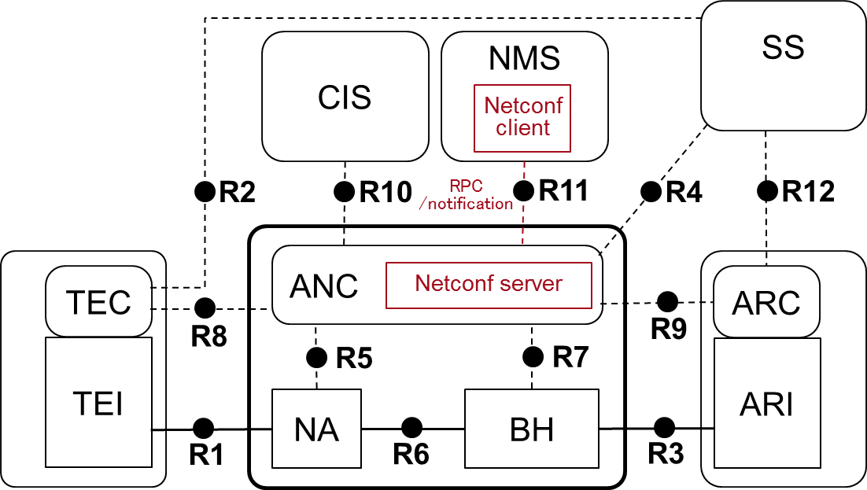
Basic Assumptions for FDM Functionality
Management client, i.e NETCONF client, resides in NMS by default, and forming a client-server pair as NMS-ANC.
FDM control functionality is available for all control entities in the NRM, allowing the possibility of the second client-server form as e.g ANC-TEC.
FDM functionality for interface is separated to distinguish those attributes mapping to IEEE 802 technologies.
The relevant model of the managed objects defined by other SDO is referred.
FDM Control Functionality
FDM Functionality for interface
Port

Slide 5
Basic Assumptions of UML Class Diagram
YANG does not have a concept of ‘public’, ‘private’, ‘protected’ etc. All attributes and operations in UML format are defined as ‘public’ to serve the purpose of YANG/NETCONF operations.
Most operations in class are left vacant temporarily.
The syntax defined for each attribute needs to be consist with other control functions.
This UML example shows a composite aggregation relationship indicating ownership or containment of the source class by the target class. Class 2 values will be contained in Class 1.
Visibility of the element:
+ public
- private
# protected
~ packet visibility
Composite aggregation -
represented by different levels of containers in YANG.
Equivalent in YANG
Container
Leaf
RPC, notification
Multiplicity. 1 = [1,1]
Multiplicity. * = 0..∞
Equivalent to “list” in YANG

Slide 6
FDM Module
“fdm” is a YANG module that is part of the OmniRAN data model. It can be imported to YANG data model on any OminRAN entities.
Reference: ITU-T X.733, BBF TR-181

Slide 7
Element: interface

Slide 8
Element: port
Defined thresholds for reporting link related threshold crossing event.
Defined in 802.3
Defined in 802.1Q, a.k.a. Ethernet ping.
RRM results as defined in 802.11k
WNM results as defined in 802.11v
Topology, configuration info provided by LLDP (802.1ab)
Reference: MEF-38 (mef-cfm YANG module)

Slide 9
Element: continuity-check
Continuity Check (CC): The multicast unidirectional heartbeat message is used to detect connectivity. Defined in 802.3.
Reference: MEF-38 (mef-cfm YANG module)

Slide 10
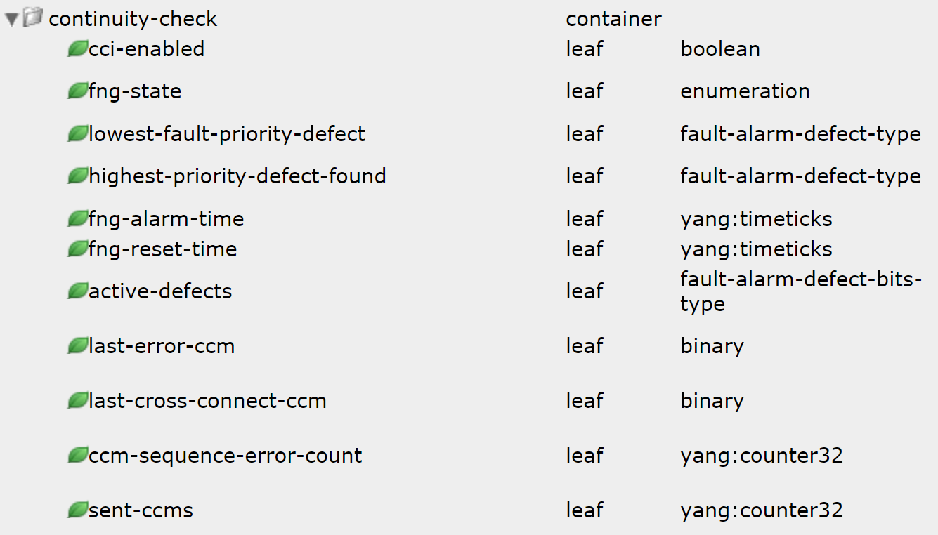
Reference: MEF-38
Example: a container in mef-cfm YANG module

Slide 11
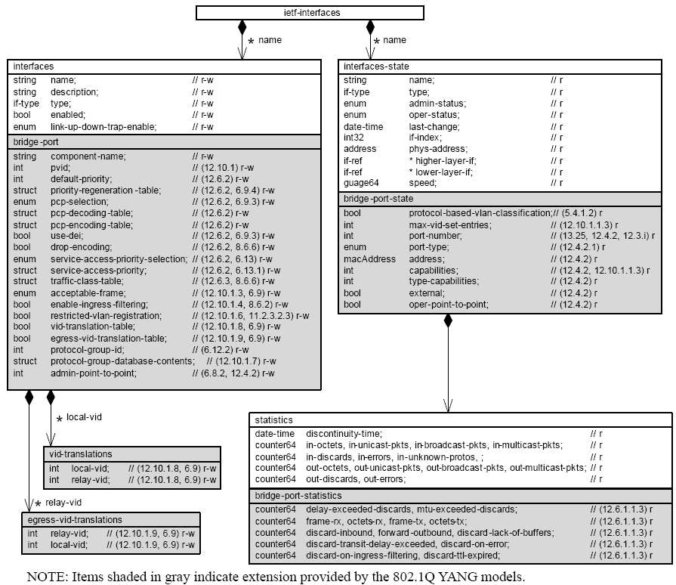
Reference: IEEE 802.1Q

Slide 12
Reference
IETF RFC 6020, YANG - A Data Modeling Language for the Network Configuration Protocol (NETCONF)
OMG Unified Modeling Language (OMG UML), Version 2.5, 2015
http://www.uml.org
IEEE 802.1Qcp, IEEE Standard for Local and Metropolitan Area Networks: Bridges and Bridged Networks—Amendment: YANG Data Model, d0.7, 2016
IEEE 802.1Xck, IEEE Standard for Local and Metropolitan Area Networks: Port-Based Network Access Control Amendment 2: YANG Data Model, d1.0, 2016
MEF 38, Service OAM Fault Management YANG Modules, 2012

Slide 13
Questions, Comments
Thank YOU!

