Slide 1
IEEE 802.1 OmniRAN TG Special session on 5G SC Action A (Industry Connections activity)
2017-01-18
Max Riegel, Nokia Bell Labs
(TG Chair)

Slide 2
Guidelines for IEEE-SA Meetings
All IEEE-SA standards meetings shall be conducted in compliance with all applicable laws, including antitrust and competition laws.
Don’t discuss the interpretation, validity, or essentiality of patents/patent claims.
Don’t discuss specific license rates, terms, or conditions.
Relative costs, including licensing costs of essential patent claims, of different technical approaches may be discussed in standards development meetings.
Technical considerations remain primary focus
Don’t discuss or engage in the fixing of product prices, allocation of customers, or division of sales markets.
Don’t discuss the status or substance of ongoing or threatened litigation.
Don’t be silent if inappropriate topics are discussed… do formally object.
---------------------------------------------------------------
If you have questions, contact the IEEE-SA Standards Board Patent Committee Administrator at patcom@ieee.org or visit http://standards.ieee.org/about/sasb/patcom/index.html
See IEEE-SA Standards Board Operations Manual, clause 5.3.10 and “Promoting Competition and Innovation: What You Need to Know about the IEEE Standards Association's Antitrust and Competition Policy” for more details.
This slide set is available at https://development.standards.ieee.org/myproject/Public/mytools/mob/preparslides.ppt

Slide 3
Agenda proposal
Introduction
Approval of minutes
Update on IEEE 5G initiative
Industry Connections Activity Initiation Document (ICAID)
Going forward
AoB

Slide 4
Introduction
802.1 OmniRAN TG is tasked to hold sessions in preparation of an Industry Connections activity resulting out of 5G SC Action A.
Goals for this meeting:
Work and conclude on the wording of the ICAID
Plan for submission and approval of ICAID

Slide 5
Motion at 802.1 Nov ’16 closing plenary
Authorize OmniRAN TG to create an ICAID proposal addressing the 5G SC Action A and authorize the 802.1 chair to pre-circulate the ICAID proposal to the EC for consideration.
Moved: Max Riegel
Second: John Messenger
Vote: 22, 0, 1

Slide 6
5G SC Action A

Slide 7
Mentor DCN: EC-16-0119-01-5GSG
7
Action A: IEEE “5G” specification
Candidate Approach
• specify an 802 access network
could be based on P802.1CF
“network reference model defines a generic foundation for the description of IEEE 802 access networks, which may include multiple network interfaces, multiple network access technologies, and multiple network subscriptions, aimed at unifying the support of different interface technologies, enabling shared network control and use of software-defined networking (SDN) principles”
provides an external view into general 802 access network
could support many 802 MACs and PHYs
could plug into incumbent mobile operator networks
for example, expand the notion of LWA so that the cellular network supports 802 rather than 802.11
gives 802 a strong supporting role in cellular 5G networks
could support integration into other operator networks
e.g. cable TV or fixed telecom
gives 802 a central role in non-cellular 5G networks
feasible for 802 access network to support both
need not promote it as an “IEEE 5G” network

Slide 8
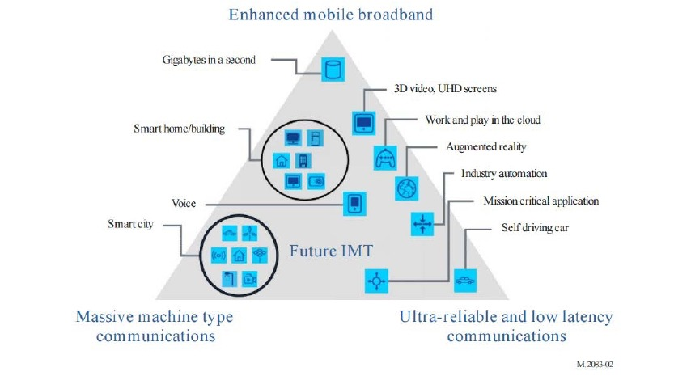
IMT-2020 (per ITU-R M.2083)
8

Slide 9
Scope of Action A
“IEEE next generation communication infrastructure specifications that support enhanced broadband, massive machine type communication and ultra-reliable and low latency communications not belonging to mobile networks”
Well sounding brand name missing.
For further study

Slide 10
What are the deployments aside of mobile networks?
Other operators of public communication networks than mobile network operators
MSO
FNO
Hotspot operators
‘Verticals’ represented in IEEE standards like
Smart Grid
http://standards.ieee.org/develop/msp/smartgrid.pdf
Cloud Computing
http://standards.ieee.org/develop/msp/cloudcomputing.pdf
Internet of Things (including Green Community Networks)
http://standards.ieee.org/develop/msp/iot.pdf
Intelligent Transportation Systems
http://standards.ieee.org/develop/msp/its.pdf
eHealth
http://standards.ieee.org/develop/msp/ehealth.pdf
Smart Cities
http://standards.ieee.org/develop/msp/smartcities.pdf

Slide 11
Getting in touch with the verticals?
Can IEEE SA headquarter help to establish communications to the verticals?
Who are the staff liaisons for the verticals?
Can we do a kind of structured assessment to determine where IEEE 802 matters most?
Are IEEE 802 networks already deployed?
How would we initiate discussions?
Presentations at standardization meetings?
Workshops on IEEE conferences?

Slide 12
Our goals?
Make new deployments of IEEE 802 happen by better serving deployment needs
Unifying technical approaches among various deployment domains by better communications
Development of further amendments to fulfill particular requirements.
Faster adoption of emerging trends to IEEE 802 standards by better understanding of market evolution.
More direct involvement of “customers” in the evolution of IEEE 802 technologies

Slide 13
DRAFt ICAID

Slide 14
Draft ICAID
Initial draft text based on input from John and edited by Max available by
https://mentor.ieee.org/omniran/dcn/16/omniran-16-0084-00-5gaa-draft-icaid-for-5g-sc-action-a.doc
Revision with comments from John:
https://mentor.ieee.org/omniran/dcn/16/omniran-16-0084-01-5gaa-draft-icaid-for-5g-sc-action-a.doc

Slide 15
Way forward

Slide 16
Next steps
Chair invites for comments on draft ICAID for the upcoming meeting at the IEEE 802 interim. Text of ICAID will be revised at the meeting based on submitted comments.
Next F2F meeting: Atlanta, Jan 2017
Session on Wed, January 18th, PM2
Next conference call:
Tues, January 31st, 2017, 09:30-11:00AM ET
BTW: Submission deadline of ICAID for consideration in the March EC closing:
February 10th
DONE

Slide 17
AoB
??

