Slide 1
Investigation Report on 802.22-2011
Date: [2016-11-09]
Authors:
Name | Affiliation | Phone | Email
Hao Wang | Fujitsu R&D Center | +86-10-59691000 | wangh@cn.fujitsu.com
Su Yi | Fujitsu R&D Center | +86-10-59691000 | yisu@cn.fujitsu.com
Xiaojing Fan | Fujitsu R&D Center | +86-10-59691000 | fanxiaojing@cn.fujitsu.com
Ryuichi Matsukura | Fujitsu/Fujitsu Laboratory | +81-44-754-2667 | r.matsukura@jp.fujitsu.com
Notice: This document does not represent the agreed view of the OmniRAN EC SG. It represents only the views of the participants listed in the ‘Authors:’ field above. It is offered as a basis for discussion. It is not binding on the contributor, who reserve the right to add, amend or withdraw material contained herein.
Copyright policy: The contributor is familiar with the IEEE-SA Copyright Policy <http://standards.ieee.org/IPR/copyrightpolicy.html>.
Patent policy: The contributor is familiar with the IEEE-SA Patent Policy and Procedures: <http://standards.ieee.org/guides/bylaws/sect6-7.html#6> and <http://standards.ieee.org/guides/opman/sect6.html#6.3>.
Abstract
This presentation investigates and summarizes the functions and procedures defined in 802.22-2011, providing references for revision the AN setup procedures on shared spectrum.

Slide 2
Investigation Report on 802.22-2011 for Revision of AN Setup in ASA Bands
2016-11-09
Hao Wang
Fujitsu R&D Center

Slide 3
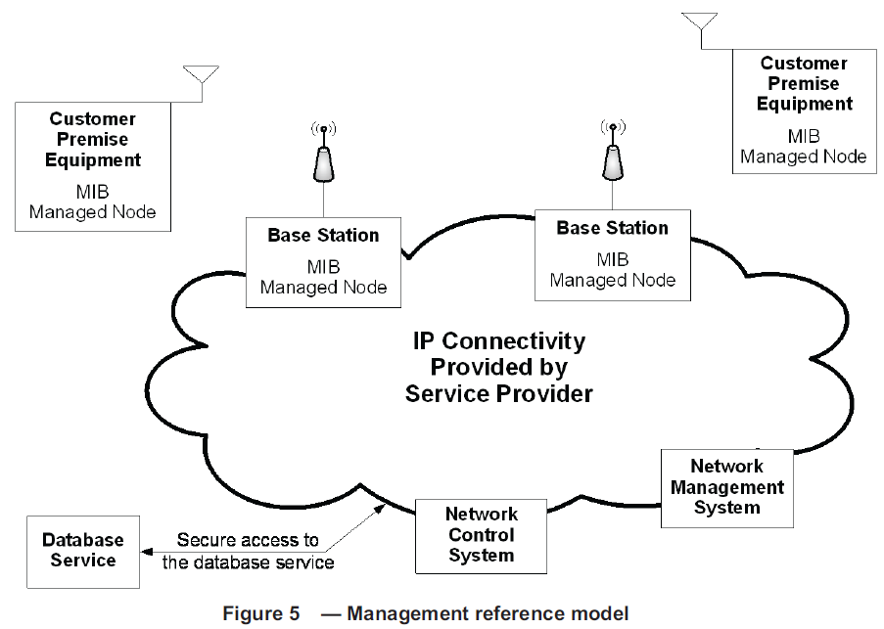
Management Reference Model
The BS and CPEs shall collect and store the managed objects in the format as defined in the WRAN Management Information Base (MIB).
Examples of services that may be provided by the NCMS include: Authentication, Authorization, and Accounting (AAA) services, Radio Resources Management (RRM) services, security services, Service Flow Management services, Location-Based services (LBS) management, and Network Management services.
Database service: Service officially operated under the rules of the local regulatory authority that provides a list of available channels and possibly the maximum EIRP allowable on these channels based on queries containing the geolocation of the Wireless Regional Area Network (WRAN) devices.

Slide 4
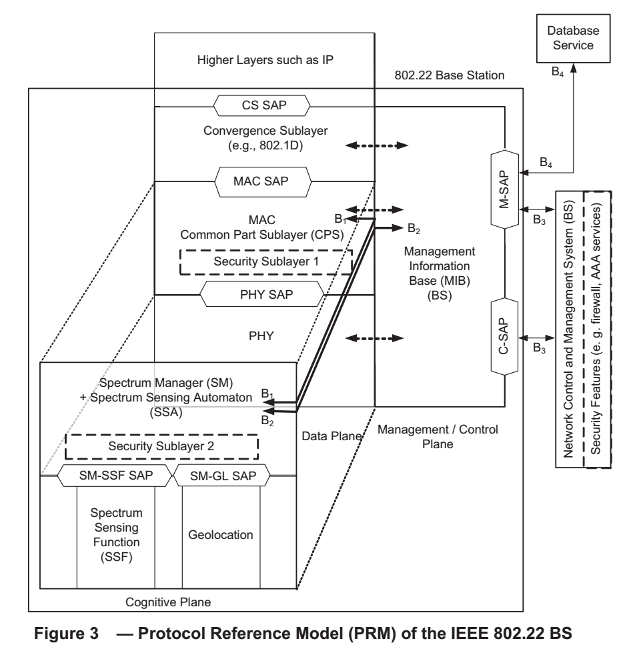
Architecture of a 802.22 BS

Slide 5
Related 802.22 Functionality to AN Setup
MAC common part sublayer
BS initialization
Incumbent protection
Quiet periods and sensing
Channel management
Cognitive radio capability
Spectrum Manager operation
Database service
Primitives and messages exchange between BS and Database
Security for the messages

Slide 6
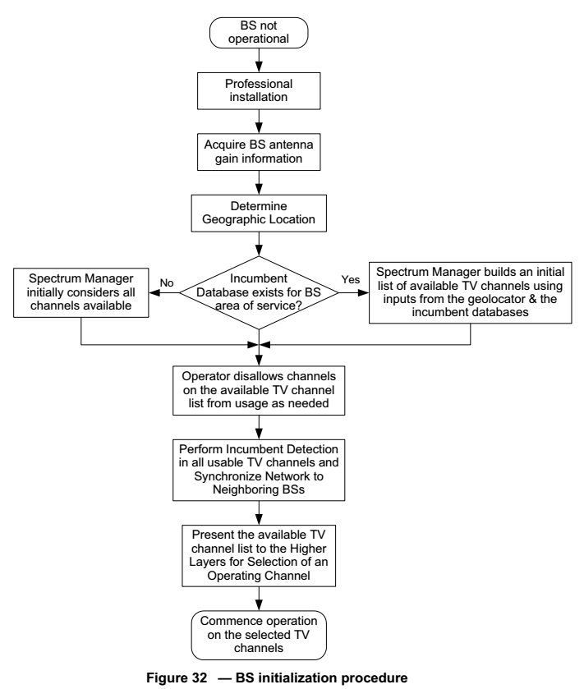
BS Initialization
BS is professionally installed.
BS acquires the antenna gain information
Determine the BS geographic location
If a database service exists, the SM at the BS receives an initial list of available channels from the database service. If not exists, the SM initially considers all channels available.
Operator disallows channels on the available channel list as needed.
Perform incumbent detection in all usable channels and synchronize network to neighboring BSs.
Presentation of the available channel list to the higher layers for selection of an operating channel.
Commence operation on the selected operating channel(s).

Slide 7
Classification of Channels
Available
Potential used for WRAN operation at a given location
Stored at database
Available channels are further classified based on sensing
Channel set: “Disallowed,” “Operating,” “Backup,” “Candidate,” “Protected,” and “Unclassified,”
Maintained by BS and CPE

Slide 8
Layered Sensing
Spectrum Manager (SM): always at BS
Maintain spectrum availability Information
Channel classification and selection
Association control
Channel set management
Accessing the database service
Scheduling quiet periods for spectrum sensing
Enforcing IEEE 802.22 and regulatory domain policies
Making channel move decisions for one or more CPEs or the entire cell
Self-coexistence with other WRANs, etc.
Spectrum Sensing Automation (SSA): at both BS and CPEs
interface to the Spectrum Sensing Function (SSF) and execute the commands from the SM to enable spectrum sensing

Slide 9
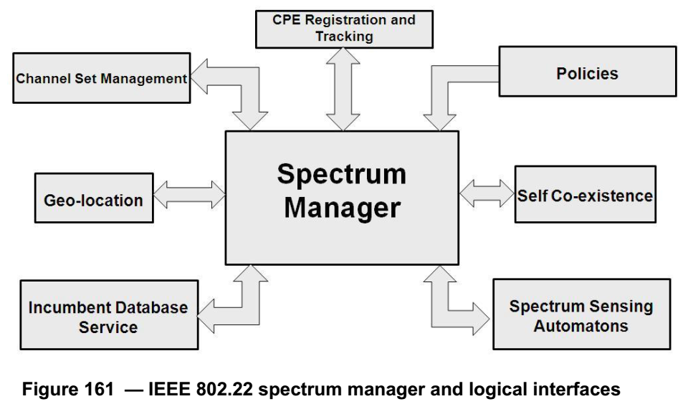
Sensing Manager (SM)
“SM has a key role in the overall architecture as it is the central point at the BS where all the information on the spectrum availability resulting from the database service and the spectrum sensing function is gathered.”
“SM is responsible for the most important tasks, such as maintaining spectrum availability information, channel selection, channel management, scheduling spectrum sensing operation, access to the database, enforcing IEEE 802.22 and regulatory domain policies, and enabling self-coexistence, etc. “

Slide 10
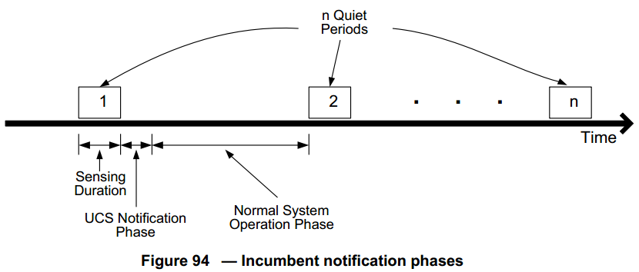
Incumbent Protection Mechanisms
Automatic Sensing in quiet periods
UCS notification to notify BS about the detected presence of incumbent
In notification phase or upstream transmission periods
SSA measurement
BS collects detail incumbent transmission measurements from CPEs
Triggered by UCS notification or upper layer requirement
Incumbent detection recovery (IDRP)
Quiet specific CPEs
Switch whole cell to backup channel (may cause termination of service)

Slide 11
An Example Procedure of Incumbent Protection
Automatic sensing and UCS notification
Measurement request and report
measurement
Detection and recovery
If channel switch fails
BS terminates operation if no backup channel available
CPE re-initializes if fails on all backup channels

Slide 12
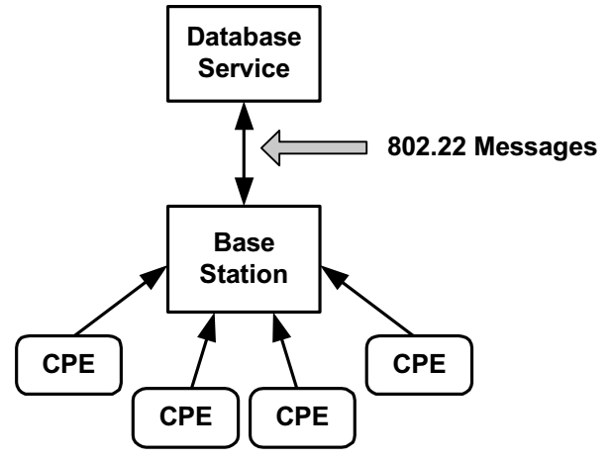
Database Service Access
Primitives and messages
M-DB-AVAILABLE-REQUEST: to verify the availability of database service
M-DB-AVAILABLE-CONFIRM: to confirm the availability
M-DEVICE-ENLISTMENT-REQUEST: to enlist a new device
M-DEVICE-ENLISTMENT-CONFIRM: to confirm the register
M-DB-AVAILABLE-CHANNEL-REQUEST: to request a list of available channels and maximum allowed EIRP per channel
M-DB-AVAILABLE-CHANNEL-INDICATION: to return parameters
M-DB-DELIST-REQUEST: to remove enlistment
M-DB-DELIST-CONFIRM: to confirm the removal
Security for the messages is necessary
allow authentication between database service and BS
avoid the message exchange being altered on the backhaul connection.
support SSL for transport layer security

Slide 13
Questions, Comments

