Slide 1
IEEE 802.1 OmniRAN TG
Special session on WP-5A/ RLAN approach for 5G SC
2016-07-26
Max Riegel, Nokia
(TG Chair)

Slide 2
July 2016 Special session on WP-5A/ RLAN approach for 5G SC
Venue:
  Manchester Grand Hyatt
    1 Market Place
    San Diego, CA USA
    Information Tel: +1 619-232-1234
Meeting room:
  Mon, Tue, Wed, Thu: Hillcrest C
Sessions:
  Mon, Mar 25th, 16:00-18:00
  Tue, July 26th, 13:30-15:30 special session on 5G
  Tue, Mar 26th, 16:00-18:00
  Wed, Mar 27th, 16:00-18:00
  Thu, Mar 28th, 10:30-12:30

Slide 3
Guidelines for IEEE-SA Meetings
All IEEE-SA standards meetings shall be conducted in compliance with all applicable laws, including antitrust and competition laws.
Don’t discuss the interpretation, validity, or essentiality of patents/patent claims.
Don’t discuss specific license rates, terms, or conditions.
  Relative costs, including licensing costs of essential patent claims, of different technical approaches may be discussed in standards development meetings.
    Technical considerations remain primary focus
Don’t discuss or engage in the fixing of product prices, allocation of customers, or division of sales markets.
Don’t discuss the status or substance of ongoing or threatened litigation.
Don’t be silent if inappropriate topics are discussed… do formally object.
---------------------------------------------------------------
If you have questions, contact the IEEE-SA Standards Board Patent Committee Administrator at patcom@ieee.org or visit http://standards.ieee.org/about/sasb/patcom/index.html
See IEEE-SA Standards Board Operations Manual, clause 5.3.10 and “Promoting Competition and Innovation: What You Need to Know about the IEEE Standards Association's Antitrust and Competition Policy” for more details.
This slide set is available
at https://development.standards.ieee.org/myproject/Public/mytools/mob/preparslides.ppt

Slide 4
Agenda proposal for special session on WP-5A/ RLAN approach for 5G SC
Introduction (Max)
IEEE 802 as a component of 5G (Yonggang)
  https://mentor.ieee.org/802-ec/dcn/16/ec-16-0078-01-5GSG-ieee-802-as-a-component-of-5g.pptx
Introduction and thoughts on Action A: IEEE “5G” specification (Roger)
  https://mentor.ieee.org/802-ec/dcn/16/ec-16-0094-07-5GSG-proposed-draft-report-ieee-802-ec-5g-imt-2020-sc.pptx
Views on related regulatory activities (Rich)
Discussion on potential (standardization) activities in IEEE 802 (all)
Conclusion
AoB

Slide 5
Introduction
Question came up during Budapest 5G SC meeting:
  “What kind of (network standardization) efforts would be needed to follow alternative path for 5G with focus on WP5A/RLAN approach?”
    Not striving for IMT-2020 application but positioning IEEE 802 as a complementary solution
There was no answer as all considerations so far were made on efforts for IMT-2020 application.
Question became even more important due to Action A in 5G SC report.
  Potential efforts for Action A have been raised several times during 5G SC discussions on Monday EVE meeting.
Let’s find a way forward to create an idea about the standardization efforts in IEEE 802!

Slide 6
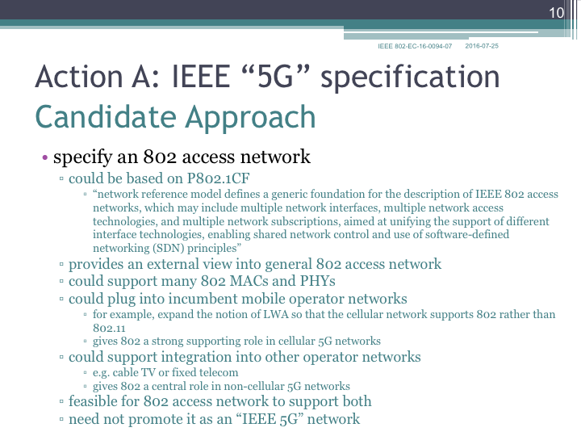

Slide 7
Summary
About 20 participants in the discussion
Rich input and lively discussions
Presentation of positioning IEEE 802 as alternative/complementary 5G solution in ITU-R WP5A
Discussion of meaning of “5G” for ITU-R
Presentation of current representation of IEEE 802 technologies in ITU-R M.1450
Discussion of potential ways to more prominently present IEEE 802 in M.1450
Presentation of various possibilities to establish IEEE 802 “5G” specification as proposed by Action A
Discussion on how to find the customer for the IEEE 802 “5G” specification

Slide 8
Conclusions
There are limited possibilities to establish IEEE 802 as complementary 5G technology in ITU WP-5A
  ”5G” is a marketing term not used by ITU-R
IEEE 802 is already prominently represented in M.1450 maintained by WP-5A
  Could potentially be even more enhanced
  IEEE 802.18 is already active, but might require more input
There are plenty of options to establish an IEEE 802 “5G” specification
  But we are currently missing the objectives for such an effort
We need a customer for the IEEE 802 “5G” specification
  Like 3GPP has strong relationship with mobile operators on 5G/IMT-2020
We have to work on industry relations for IEEE 802 “5G”
  Ideas and proposals wanted!
BTW: Standardization effort for Action A is not the issue.

