Slide 1
Key Concepts of Accounting and Monitoring
Date: 2016-06-21
Authors:
Name | Affiliation | Phone | Email
Hao Wang | Fujitsu R&D Center | +86-10-59691000 | wangh@cn.fujitsu.com
Su Yi | Fujitsu R&D Center | +86-10-59691000 | yisu@cn.fujitsu.com
Xiaojing Fan | Fujitsu R&D Center | +86-10-59691000 | fanxiaojing@cn.fujitsu.com
Lefei Wang | Fujitsu R&D Center | +86-10-59691000 | wanglefei@cn.fujitsu.com
Ryuichi Matsukura | Fujitsu/Fujitsu Laboratory | +81-44-754-2667 | r.matsukura@jp.fujitsu.com
Notice: This document does not represent the agreed view of the IEEE 802.1 OmniRAN TG. It represents only the views of the participants listed in the ‘Authors:’ field above. It is offered as a basis for discussion. It is not binding on the contributor, who reserve the right to add, amend or withdraw material contained herein.
Copyright policy: The contributor is familiar with the IEEE-SA Copyright Policy <http://standards.ieee.org/IPR/copyrightpolicy.html>.
Patent policy: The contributor is familiar with the IEEE-SA Patent Policy and Procedures: <http://standards.ieee.org/guides/bylaws/sect6-7.html#6> and <http://standards.ieee.org/guides/opman/sect6.html#6.3>.
Abstract
The presentation provides a summary of the key concepts and facts for the function of accounting and monitoring. This update is aimed for introduction of a text contribution to chapter 7.7 of P802.1CF specification.

Slide 2
Key Concepts of Accounting and Monitoring
Wang Hao
(Fujitsu)

Slide 3
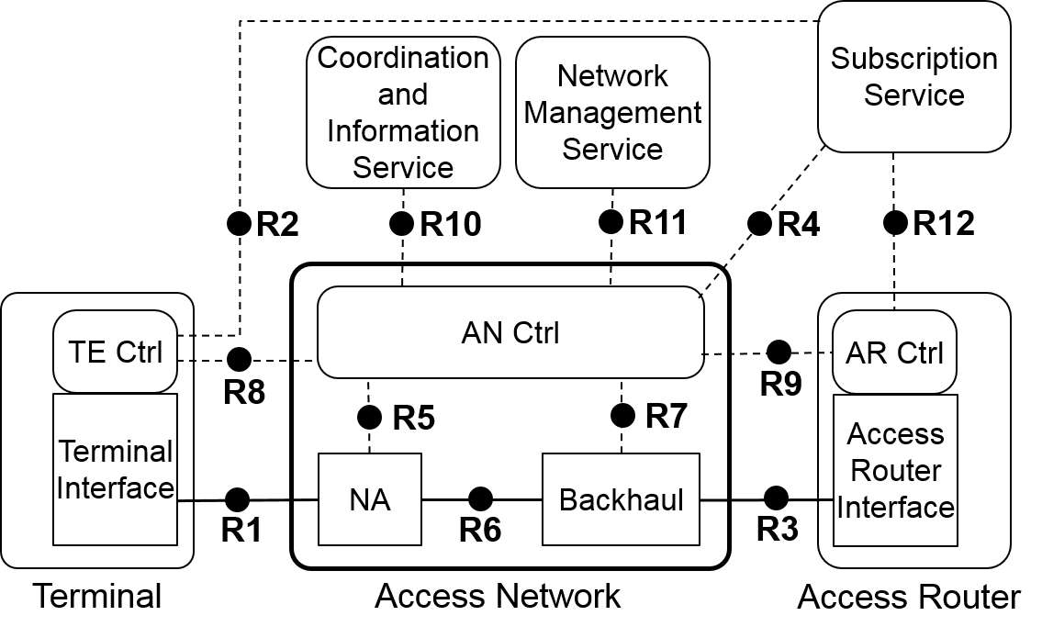
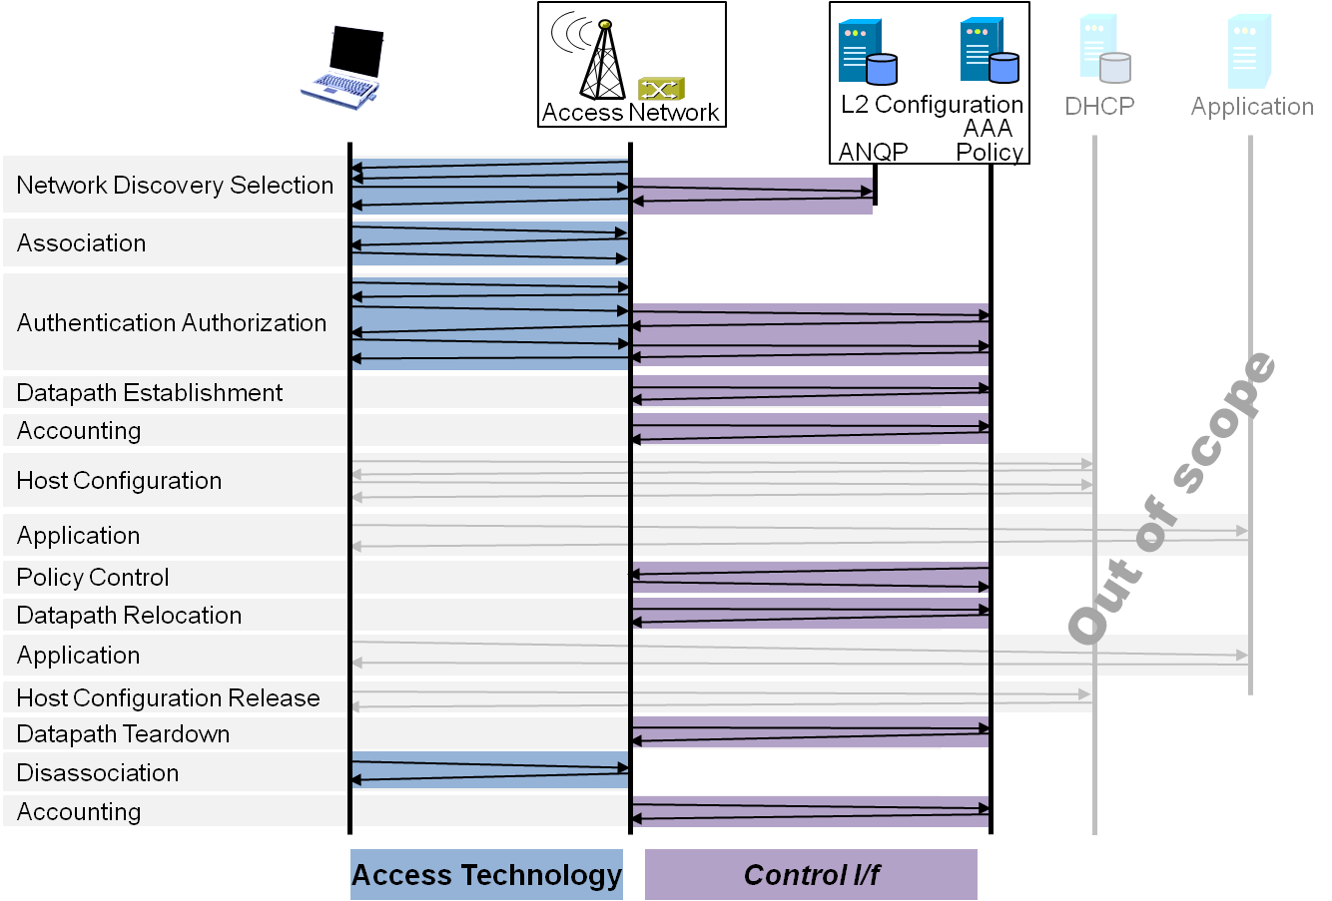
P802.1CF Draft ToC
Overview
References, definitions, acronyms and abbreviations
Conformance
Network Reference Model
Basic concepts and terminology
Overview of NRM
Basic, enhanced and comprehensive NRM
Deployment scenarios
Functional Design and Decomposition
Access Network Setup
Network Discovery and Selection
Association and Disassociation
Authentication and Trust Establishment
Data path establishment, relocation and teardown
Authorization, QoS and policy control
Accounting and Monitoring
Fault diagnostics and maintenance
SDN Abstraction
Annex:
Privacy Engineering
Applicability to non-IEEE 802 PHY layer technologies
Bibliography

Slide 4
Functional design and decomposition Chapter ToC
Introduction
Roles and identifiers
Use cases
Functional requirements
Specific attributes
Basic functions
Detailed procedures
Mapping to IEEE 802 technologies

Slide 5
1. Introduction
Accounting describes the process of gathering usage data records at network devices and exporting those records to an accounting server, where processing takes place. Then the records are presented to the user or provided to another application, such as performance management, security management, or billing.
Applications (performance management, security, billing)
Accounting data
Accounting and monitoring
Mediation
Collected data
Collection
Monitoring/meter data
Monitoring (performance and usage data generation, storage)

Slide 6
2. Roles and identifiers
NMS
Making use of the functionality provided by ANC, and providing additional functions for management purpose
Representing a human interface to access network operators and providing policies for configuring the accounting functions
ANC
Collecting data gathered by monitoring
Providing mediation functionality for the collected data
NA and BH
Setting up the observation point and capturing data about resource consumption
Data storage
SS
Providing user-specific information for accounting service

Slide 7
3. Use cases (1) Performance Analysis
Accounting collection process gathers usage records of network resources, such as interface utilization, traffic per server or per user, and network management traffic. They may include details such as the originator and recipient of a communication.
Granularity
E.g. individual user details for premium customers (service provider’s interest)
E.g. a summary per department (enterprise’s interest)
Type
Device and link performance
Path connectivity and performance
…

Slide 8
3. Use cases (2) Security Analysis
Monitoring provided by accounting and performance management is a relevant building block for security solutions, because security management and incident mitigation depend entirely on information about the network’s state.
An application of security analysis can import the accounting records and analyze the different types of protocols, traffic patterns between source and destination.
When attacks are taking place, the records can be used to detect unusual situations or suspicious flows and alarm the network operator, and further to reduce the risk of future attacks.

Slide 9
3. Use cases (3) Billing
Accounting describes the process of measuring and collecting network usage parameters from network devices or application servers, and billing is an application that makes use of these well-formatted usage records.
For a billing solution, the following steps are necessary:
Data mediation: After measuring the usage data at the device level, combining multiple records into a single one. Converting proprietary records into a well-known or standard format.
Assigning usernames to IP addresses: Performing a DNS and DHCP lookup and getting additional accounting records from AAA servers.
Calculating call duration: Combining the data records from the devices with RADIUS session information and converting sysUpTime entries to time of day and date of month, related to the user's time zone.
Charging: Assigning nonmonetary cost metrics to the accounting data based on call duration, transmitted data volume, traffic per class of service, and so on. Charging policies define tariffs and parameters to be applied.
Invoicing: Translating charging information into monetary units and printing a final invoice for the customer. In addition, billing policies are applied, such as invoicing or charging a credit card.

Slide 10
4. Functional requirements
Monitoring device-/link-/service- related performance should be supported
Monitoring data classes
performance
usage records
Generating performance records and usage data records should be supported
Monitoring data storage and data collection should be supported
Data filtering, sampling, aggregation, correlation, de-duplication and mediation should be supported

Slide 11
5. Specific attributes
NA
Device level monitoring data
E.g. device interface counter, CPU utilization, memory consumption, etc.
R1/R3 monitoring data (link performance monitoring)
E.g. link availability, transmitted volume, throughput, RTT, jitter, path utilization, QoS parameters, etc.
BH
Device monitoring data
E.g. device interface counter, CPU utilization, memory consumption, etc.
R3/R6 monitoring data
E.g. link availability, transmitted volume, throughput, RTT, jitter, path utilization, QoS parameters, etc.
ANC
R5/R7 collected data
E.g. network usage per user/group/department, traffic per server/service, etc.
R11 accounting policies, monitoring configurations
E.g. rules for generation, transport, and storage of accounting data, collection model (push or pull), filtering criteria, sampling method (deterministic or random), monitoring method (passive or active), monitoring scope, type, schedule, granularity, etc.
Accounting data
R4 user-specific information

Slide 12
6. Basic functions (1) Monitoring
Monitoring is the process of collecting and optionally preprocessing usage data records at devices in the network. These devices can be either network elements with integrated monitoring functionality or a dedicated measurement device ("black box") that is specifically designed as a monitor.
The monitoring process can be configured by applying monitoring policies.
Two major monitoring concepts:
Passive monitoring— Also referred to as "collecting observed traffic," this form of monitoring does not affect the user traffic, because it listens to only the packets that pass the meter.
Active monitoring— Introduces the concept of generating synthetic traffic, which is performed into two instances. The first part creates monitoring traffic, and the second part collects these packets on arrival and measures them.

Slide 13
6. Basic functions (2) Collection
The data gathered by the monitoring has to be collected at the collection server for further processing.
Collection server in ANC applies collection rules provided by the NMS and configures the collection process to, e.g.
guarantee the delivery of critical accounting
avoid the accounting reports to congest the network and affect the user traffic
balance the accounting accuracy and network load
monitor the retrieved records and identify lost accounting records
Collection mode
Push mode, accounting and performance monitoring data are not stored are the devices or kept there for a short time until being pushed toward a collection server, the exporting is event triggered.
Pull mode, the monitoring data are stored in device (like counters in MIB), the device constantly updates the counters while the NMS is responsible for regular collection, the exporting frequency can be configured at the NMS.

Slide 14
6. Basic functions (3) Mediation
Processing accounting records, including the following sub-functions:
Filtering: reduce the volume of data, or for application indicating purpose from NMS
Estimation from sampling
Threshold monitoring
Data aggregation
Aggregation of key fields: specifically for different accounting records with the same key field, merges such two data sets into one
Aggregation over time: applied to both accounting and performance records within specific period
Data record correlation (from different sources) and enrichment data record formatting and storage
Data record de-duplication
Data formatting and storage

Slide 15
7. Detailed procedures Accounting

Slide 16
8. Mapping to IEEE 802 technologies

