Slide 1
Investigation on Accounting and Monitoring
Date: [2016-05-26]
Authors:
Name | Affiliation | Phone | Email
Hao Wang | Fujitsu R&D Center | +86-10-59691000 | wangh@cn.fujitsu.com
Lefei Wang | Fujitsu R&D Center | +86-10-59691000 | wanglefei@cn.fujitsu.com
Ryuichi Matsukura | Fujitsu/Fujitsu Laboratory | +81-44-754-2667 | r.matsukura@jp.fujitsu.com
Notice: This document does not represent the agreed view of the OmniRAN EC SG. It represents only the views of the participants listed in the ‘Authors:’ field above. It is offered as a basis for discussion. It is not binding on the contributor, who reserve the right to add, amend or withdraw material contained herein.
Copyright policy: The contributor is familiar with the IEEE-SA Copyright Policy <http://standards.ieee.org/IPR/copyrightpolicy.html>.
Patent policy: The contributor is familiar with the IEEE-SA Patent Policy and Procedures: <http://standards.ieee.org/guides/bylaws/sect6-7.html#6> and <http://standards.ieee.org/guides/opman/sect6.html#6.3>.
Abstract
The presentation provides preliminary investigation results on account and monitoring. The contents include terms, architectures, and process defined by other SDOs. It is aimed to get the agreement of the group on what concept is currently in scope of P802.1CF.

Slide 2
Investigation on Accounting and Monitoring
2016-05-26
Hao Wang
Fujitsu R&D Center

Slide 3
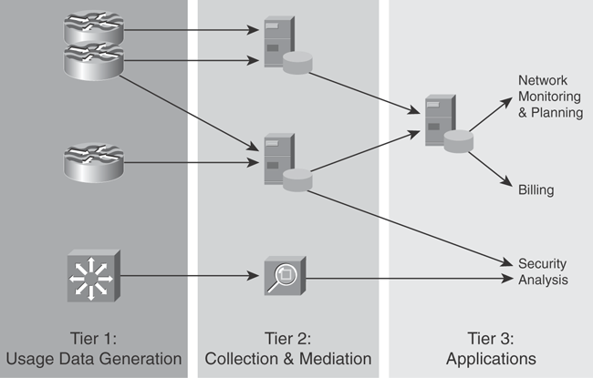
What is Accounting
Accounting describes the process of gathering usage data records at network devices and exporting those records to a collection server, where processing takes place. Then the records are presented to the user or provided to another application, such as performance management, security management, or billing.
Historically close linkage between accounting and billing, but accounting is different from billing, because billing is just one of the applications that leverage accounting.
3-Tier Accounting
Infrastructure

Slide 4
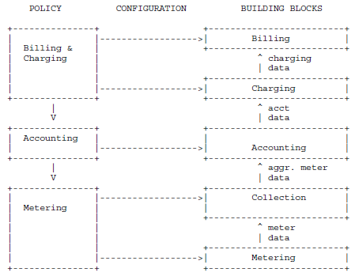
Accounting Architecture in IETF
IETF RFC 3334
Billing translates costs calculated by the Charging into monetary units and generates a final bill for the customer.
Charging derives non-monetary costs for accounting data sets based on service and customer specific tariff parameters.
Charging policies define the tariffs and parameters which are applied.
Control of data gathering (via metering)
Transport and storage of accounting data.
Associate the metered data with a user Associate the metered data with a customer (service subscriber) that is responsible for payment.
Collection of meter data can be initiated by the meter itself (push model) or by a collector entity (pull model).
Metering policies define how collection and aggregation is done.
Data about resource consumption (e.g. transmitted volume)
Meters is probably placed at the edge of the network
Static meters and configurable meters

Slide 5
Accounting Management
Accounting now becomes a major building block for network and application design and deployment.
collected accounting data records are not limited to billing applications, in addition, can be used for other applications such as performance monitoring, checking that a configuration change fixed a problem, or even security analysis.
For example, if the administrator has configured the network so that business-critical data should go via one path and best-effort traffic should take another path, accounting can verify if this policy is applied and otherwise notify the fault and configuration tools.
Management Functional Area (MFA) | Management Function Set Groups
Fault | Alarm surveillance, fault localization and correlation, testing, trouble administration, network recovery
Configuration | Network planning, engineering, and installation; service planning and negotiation; discovery; provisioning; status and control
Accounting | Usage measurement, collection, aggregation, and mediation; tariffing and pricing
Performance | Performance monitoring and control, performance analysis and trending, quality assurance
Security | Access control and policy; customer profiling; attack detection, prevention, containment, and recovery; security administration

Slide 6
Monitoring for Accounting and Performance
Similarities | Differences
Both parts collect usage information, which can be applied to similar applications afterward | performance addresses details such as network load, device load, throughput, link capacity, different traffic classes, dropped packets, congestion accounting addresses usage data collection, such as transmission volume, online time, etc
Same protocols are applicable for both, such as SNMP counters can be assigned to both performance and accounting | for performance, collection interval needs to be real time for accounting, it doesn’t have to be real time, except for prepaid billing
Both monitoring sources are important for security management - combination of the two areas can be a strong instrument to identify security attacks almost in real time | accounting don’t keep historical data sets, because the billing application does this. performance needs history data to analyze deviation from normal as well as trending functions
 | accounting monitoring is always passive, by meters performance monitoring can be passive or active

Slide 7
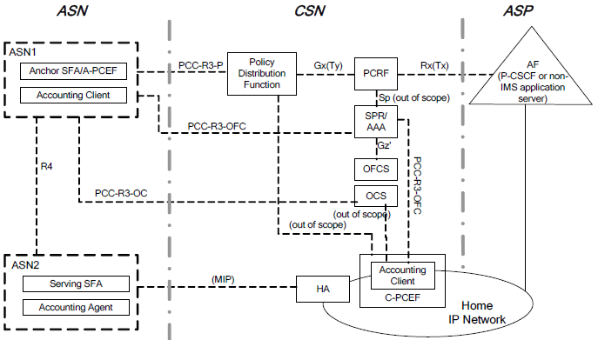
Accounting, Charging Deployment (WiMAX)
Accounting Client
Receiving the charging information in the PCC rule and forwarding it as accounting information to Accounting Agent;
Collecting the accounting information from Accounting Agent and relaying it to the OCS for online charging and offline charging.
Accounting Agent
Enforcement point of charging in the ASN.
Enforcing charging policy of PCC rule and generating offline accounting information;
Reporting accounting information to accounting client

Slide 8
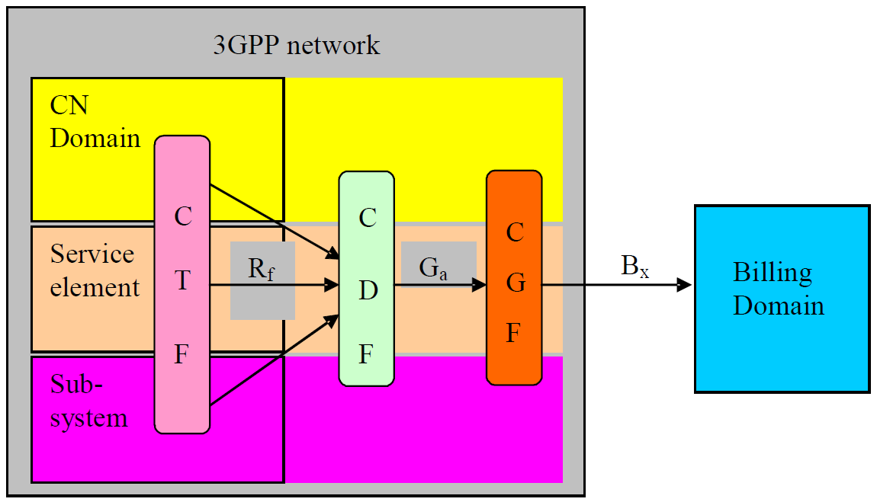
Accounting, Charging Deployment (3GPP)
Functional blocks for offline charging
Charging Trigger Function (CTF), mandatory
Transferring ‘chargeable events’ to ‘charging events’
Charging Data Function (CDF)
Generate CDR, well defined content and format
Charging Gateway Function (CGF)
Processing, routing, filtering, managing CDR
Chargeable events
CTF
Charging events
Accounting
Metrics Collection
Accounting
Data Forwarding
Rf
Collected accounting metrics
Chargeable event: A single call, service profile administration, or roaming.
Charging event : Set of charging information forwarded by the CTF.
Accounting Metrics Collection
Provide metrics that identify the user and the user’s consumption of network resources and/or services in real-time.
Accounting Data Forwarding
Assembles charging events
Forwards the charging events towards the CDF

Slide 9
Accounting and Monitoring Mapping to NRM
Access Network Operator
IP Service Provider
CIS
BSS
BSS
OSS
OSS
R10
NM
NM
NMfkts
SS
Billing
(Out of scope)
EM
Monitoring
Accounting
R2
R4
R11
ANC
EM
EM
EM
TEC
ARC
EM
R8
R9
TEI
R5
R7
ARI
NA
BH
R1
R6
R3
Terminal
Access Network
Access Router

Slide 10
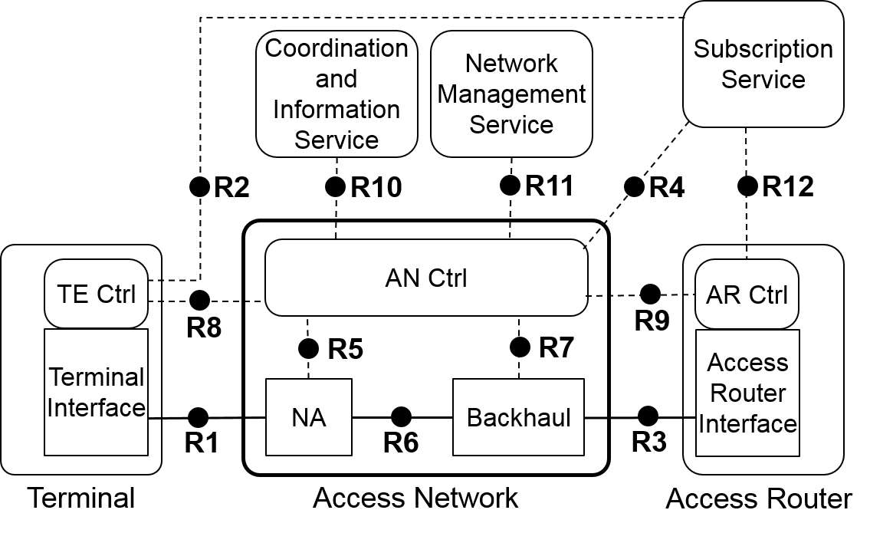
Accounting and Monitoring Mapping to NRM
Monitoring
Collection, mediation,
accounting,
Performance Monitoring for real time data
Metering for usage data

Slide 11
Questions, Comments

