Slide 1
P802.1CF operational models
Date: 2016-03-15
Authors:
Name | Affiliation | Phone | Email
Max Riegel | Nokia | +49 173 293 8240 | maximilian.riegel@nokis.com
Notice: This document does not represent the agreed view of the IEEE 802.1 OmniRAN TG. It represents only the views of the participants listed in the ‘Authors:’ field above. It is offered as a basis for discussion. It is not binding on the contributor, who reserve the right to add, amend or withdraw material contained herein.
Copyright policy: The contributor is familiar with the IEEE-SA Copyright Policy <http://standards.ieee.org/IPR/copyrightpolicy.html>.
Patent policy: The contributor is familiar with the IEEE-SA Patent Policy and Procedures: <http://standards.ieee.org/guides/bylaws/sect6-7.html#6> and <http://standards.ieee.org/guides/opman/sect6.html#6.3>.
Abstract
The presentation provides an overview about the operational arrangements under consideration within P802.1CF.

Slide 2
P802.1CF operational models
Max Riegel
(Nokia)

Slide 3
Problem description
802.1CF currently describes only functional partitioning without much declaration how the functional blocks represent different operator arrangements.
Authentication and trust establishment introduced the operational roles of ‘User’ and ‘Service Provider’
More comprehensive documentation of operational models is required.

Slide 4
NRM Overview
CIS Coordination and Information Service
SS Subscription Service
TEC Terminal Control
TEI Terminal Interface
ANC Access Network Control
NA Node of Attachment
BH Backhaul
ARC Access Router Control
ARI Access Router Interface
SS
CIS
R2
R10
R4
R11
TEC
ANC
ARC
R8
R9
TEI
R5
R7
ARI
NA
BH
R1
R6
R3
Terminal
Access Network
Access Router
The NRM provides the set of functions and their relationships of an IEEE 802 access network.
The NRM does not make any assumption about the entities operating the represented functions.

Slide 5


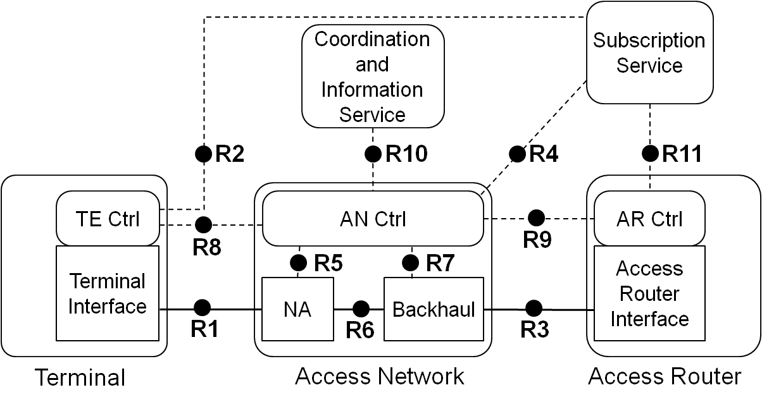
Operational assumption for authentication and trust establishment
User
Service Provider
Subscription

Slide 6
Operational assumption
Generic case
User
Service Provider
Subscription
Access Network Operator
IP Network
Operator

Slide 7
Special case of
Service Provider operating IP Network
User
Service Provider
Subscription
Access Network Operator

Slide 8
Unified case: Service Provider operates access network and IP network
User
Service Provider
Subscription

Slide 9
Conclusion
P802.1CF assumes in its generic case that access network, subscription service and access router are operated by different entities
  Reference points are especially designed for this arrangement
  Implying that each of the entity has own OSS as well as BSS (currently not depicted)
Network virtualization should take into account at least the generic case.
  Independent virtualization by each of the entities.

