Slide 1
Ethernet OAM Survey and Introducing Network Management Service
Date: [2016-02-23]
Authors:
Name | Affiliation | Phone | Email
Hao Wang | Fujitsu R&D Center | +86-10-59691000 | wangh@cn.fujitsu.com
Su Yi | Fujitsu R&D Center | +86-10-59691000 | yisu@cn.fujitsu.com
Xiaojing Fan | Fujitsu R&D Center | +86-10-59691000 | fanxiaojing@cn.fujitsu.com
Ryuichi Matsukura | Fujitsu/Fujitsu Laboratory | +81-44-754-2667 | r.matsukura@jp.fujitsu.com
Notice: This document does not represent the agreed view of the OmniRAN EC SG. It represents only the views of the participants listed in the ‘Authors:’ field above. It is offered as a basis for discussion. It is not binding on the contributor, who reserve the right to add, amend or withdraw material contained herein.
Copyright policy: The contributor is familiar with the IEEE-SA Copyright Policy <http://standards.ieee.org/IPR/copyrightpolicy.html>.
Patent policy: The contributor is familiar with the IEEE-SA Patent Policy and Procedures: <http://standards.ieee.org/guides/bylaws/sect6-7.html#6> and <http://standards.ieee.org/guides/opman/sect6.html#6.3>.
Abstract
This presentation surveys on IEEE 802.3ah and 802.1ag, and discusses about the need for introducing a network management service into OmniRAN.

Slide 2
Ethernet OAM Survey and Introducing Network Management Service
2016-02-23
Hao Wang
Fujitsu R&D Center

Slide 3
OAM Concept
Operation, Administration, Maintenance & Provision
Fault analysis, performance monitoring, security management, configuration & service provision
OAM covers both N-S and W-E interfaces
Management Plane (NM,EM)
N
OAM&P
Network Plane (Network Elements)
S
W
E

Slide 4
Specification Landscape
Standard Organization | Specification
 | IEEE 802.3ah ‘link OAM’ [E<>W] IEEE 802.1ag ‘CFM’ [E<>W]
 | WMF-T31-119-R016v01 ‘NMS to EMS Interface’ [N<>S]
 | Y.1731 ‘Ethernet OAM’ [E<>W]
 | 3GPP TS 32.111-1 ‘3G Fault Management Requirements’ [N<>S]
 | ‘Ethernet Local Management Interface (E-LMI) [E<>W]

Slide 5
Ethernet OAM Layering
OAM is layered
Service layer OAM, network layer OAM, transport layer OAM
Each layer supports its own OAM mechanisms
Protocol building blocks for Ethernet OAM
Service Layer
E-LMI
Network Layer
802.1ag/Y.1731
W
E
Transport Layer
802.3ah

Slide 6
Carrier Ethernet OAM
Carrier Ethernet Capabilities | Benefits
IEEE 802.1ag Fault management per services/VLAN | End-to-end service manageability
IEEE 802.3ah Link protection and monitoring | First mile physical connectivity verification
MEF 16 E-LMI for customer premise equipment | Pro-active service status and availability

Slide 7
Link OAM: 802.3ah Ethernet First Mile (EFM) OAM
Supports point-to-point (single) link OAM
Monitors and supports troubleshooting individual links
Standards-based for Ethernet networks
Interoperates in a multivendor environment
Uses standard Ethernet frames, called OAMPDUs
OAMPDU is sourced and terminated at both ends of a link, not relayed by bridges
Types:
Information OAMPDU
Event Notification OAMPDU
Variable Request OAMPDU
Variable Response OAMPDU
Loopback Control OAMPDU
Organization Specific OAMPDU
802.3ah
OAM
802.3ah
OAM

Slide 8
EFM OAM Functions
Discovery
The first phase of Ethernet OAM
Identify the devices in the network along with their OAM capabilities
Remote failure indication
A mechanism for and OAM entity to convey slow degradation of Ethernet link to its peer via specific flags in the OAMPDU
Link monitoring
Detect and indicate link faults under a variety of conditions
Remote loopback
Help the administrator ensure the quality of links during installation when troubleshooting
Polling of MIB variables
A read-only access to remote MIB variables limited to a specific MIB branch and leaf

Slide 9
Service OAM: 802.1ag Connectivity Fault Management (CFM)
Service Provider
Facilitates
Path discovery
Fault detection
Fault verification and isolation
Fault notification
Fault recovery
Supports
Continuity Check (CC) Message
LinkTrace (LT)
Loopback (LB) message
Customer Network
Operator A Network
Operator B Network
Customer Network
Customer location 1
Customer location 2
Customer MA
ME
MD level 5
(7, 6, or 5)
Service Provider MA
ME
MD level 3
(4 or 3)
MEP
Operator A MA
Operator B MA
MIP
ME
ME
MD level 1
(2, 1, or 0)
MD (Maintenance Domain)
The part of a network for which faults in Layer 2 connectivity can be managed
MEP (Maintenance End Point)
A Maintenance Point (MP) at the edge of a domain that actively sources CFM messages
MIP (Maintenance Intermediate Point)
A maintenance point internal to a domain that only responds when triggered by certain CFM messages
MA (Maintenance Association)
A set of MEPs established to verify the integrity of a single service instance (a VLAN or a VPLS)
ME (Maintenance Entity)
A point-to-point relationship between two MEPs within a single MA

Slide 10
CFM Functions
Continuity Check Message (CCM)
A periodic hello message multicast by an MEP within the maintenance domain
Periodic CCM (multicast)
MEP
Periodic CCM
MEP
LinkTrace Message (LTM)
A multicast message used by a source MEP to trace the path to other MEPs and MIPs in the same domain
All reachable MIPs and MEPs respond back with a Link Trace Unicast Reply (LTR)
The originating MEP can then determine the MAC addresses of all MIPs and MEPs belonging to the same Maintenance Domain
MEP
LTM (multicast)
LTR (Unicast)
MEP
MIP
LTR (Unicast)
Loopback Message (LBM)
Used to verify the connectivity between a MEP and a peer MEP or MIP
A loopback message is initiated by a MEP with a destination MAC address set to the desired destination MEP or MIP (Unicast)
The receiving MIP or MEP responds to the Loopback message with a Loopback Reply (LBR) (Unicast)
A loopback message helps a MEP identify the precise location of a fault along a given path
LBM (Unicast)
MEP
LBR
MEP

Slide 11
Comparing 802.3ah and 802.1ag
IEEE 802.3ah EFM Link OAM | IEEE 802.1ag CFM Service OAM
Operates on Physical Link Only, Cannot Pass through a Bridge | May Be Per-Service or Per-Wire; Passes End-to-End through Bridges
Discovery, Statistics Enquiry, Keep alive, Loopback (Mirror) Mode | Connectivity Verification, Traceroute, Ping, Alarm Indication/Suppression
Single Instantiation per physical link | Multiple instances operating at multiple levels simultaneously.
Created by One Committee (IEEE 802.3) | Joint Effort by IEEE 802.1, ITU-T
Standard Approved by IEEE 802 | IEEE P802.1ag (Published December 17, 2007), ITU SG 13/3

Slide 12
OAM Interworking Scenario: 802.3ah to 802.1ag
Link layer defects detected by 802.3ah (remote failure indication)
Defects relayed to 802.1ag on same device
802.1ag notifies remote devices of localized fault by transmitting CC
Customer
Service Provider
Customer
Eth Access
MPLS Core
MPLS Access
CC
MEP
Service OAM
MIP
802.3ah to 802.1ag interworking
Remote failure indication
Link OAM
802.3ah
802.3ah
802.3ah
802.3ah

Slide 13
Introducing Network Management Service

Slide 14
Network Management Service (NMS)
NMS performs management functions through the management interface to multiple Network Elements (NE)
It is a network management application, and can be as simple as a command generator
Focus on managing the functions related to the interaction between multiple network elements
Perform functions for distribution of network resources: configuration, control and supervision of the network
These functions can achieve fault diagnostics and maintenance (FDM), configuration management, performance management, security management, and so on

Slide 15
802.3ah OAM Client
OAM client responsibilities – integral role in establishing and managing OAM on a link
Enable and configure the OAM sublayer entity
Link events are signaled between peer OAM client entities
OAM client
MAC client
MAC client
OAM client
OAM sublayer
OAM sublayer
MAC control (optional)
MAC control (optional)
MAC
MAC
PHY
PHY

Slide 16
NMS Fits in a Common Structure
802.3ah
802.1ag
OmniRAN
NMS (SS)
NMS
NMS
Itf-N
Itf-N
Element Manager (EM)
EM
Controller
Ex. SNMP manager
Ex. SNMP interface
OAM client
OAM client
Ex. SNMP agent
Ex. SNMP agent
Interface
802.3 OAM service interface
Layer management interface (LMI)
MAC/PHY interface
MAC/PHY interface
MAC/PHY interface
MAC/PHY interface
OAMPDU
CFM message

Slide 17
Propose Change of NRM
Extend Subscription Service (SS) to a general management entity (NMS), which provides security management (AAA capability)
NMS includes more functions than SS
NMS requirements for FDM will be specified in FDM chapter
R2, R4, and R11 will carry more information as a result
NMS
(SS)
R2, R4, R11 for OAM [N<>S]
R1, R6, R3 for OAM [W<>E]
R5, R7 for EM-NE interface [N<>S]

Slide 18
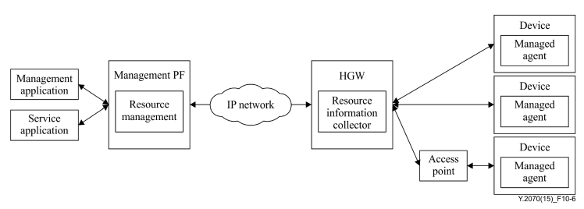
Annex: ITU-T Y.2070 Management Architecture of Home Network
Home network is complex: different types of technologies co-exist, complicated topology composed of various resources, difficult to maintain for end users
Resource management function in the management PF
Resource information collector function: gets status, performance and configuration data
Managed agent on the device executes configuring and gathering the home environment information by the instruction
Interfaces for remote administrators such as call centers and customer support centers

Slide 19
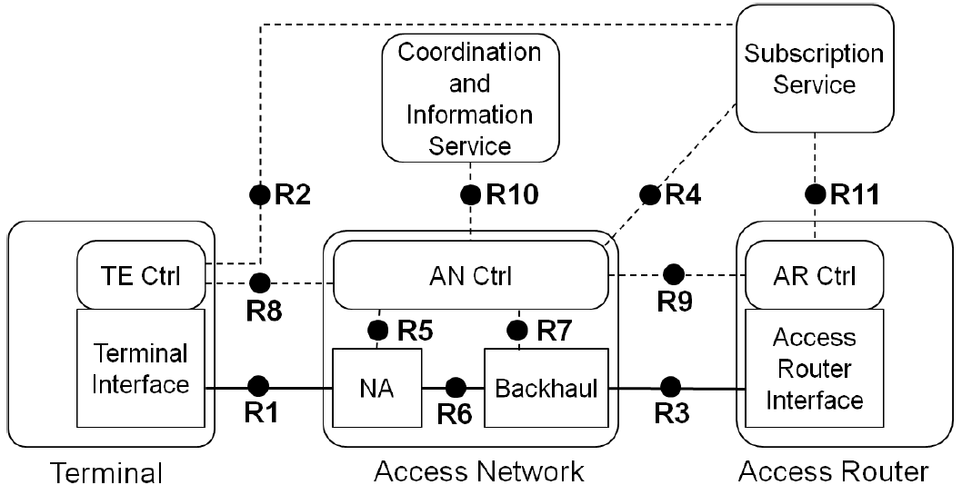
Annex: Mapping Y.2070 Architecture to NRM
Introducing NMS essentially extends the availability of network reference model of OmniRAN
Management PF
NMS (SS)
Resource management
Home gateway (HGW)
Resource information collector
IP Network
End device
AP

Slide 20
References
IEEE 802.1ag-2007 "Local and metropolitan area networks – Virtual Bridged Local Area Networks, Amendment 5: Connectivity Fault Management"
IEEE 802.3ah-2004 "Local and metropolitan area networks – Specific requirements, Part 3: Carrier Sense Multiple Access with Collision Detection (CSMA/CD) Access Method and Physical Layer Specifications, Amendment: Media Access Control Parameters, Physical Layers, and Management Parameters for Subscriber Access Networks"
3GPP TS 32.111-1 "Telecommunication management; Fault Management; Part 1: 3G Fault Management Requirements" (v12.2.0)
WMF-T31-119-R016v01 "WiMAX Forum Network Requirements; WiMAX Network Management: NMS to EMS Interface"
ITU-T Y.2070 "Next Generation Networks – Frameworks and functional architecture models, Requirements and architecture of the home energy management system and home network services" 01/2015
TR-1053 "Customer support functions for home network service platform" (Edition 1.0)
TR-1057 "Customer support guideline for home network service" (Edition 1.0)
Ethernet OAM Tutorial, APRICOT 2007
Carrier Ethernet Operations, Administration and Maintenance, APNIC 35 Conference 2013
http://www.ieee802.org/802_tutorials/04-July/802.1ag%20-%20CFM%20Tutorial%20-%20Part%201%20v2.ppt
Practical use of Ethernet OAM, SwiNOG 22, 2011

Slide 21
Questions, Comments
Fault Diagnosis and Maintenance

