Slide 1
Key Concepts of Authentication and Trust Establishment
Date: 2016-01-20
Authors:
Name | Affiliation | Phone | Email
Max Riegel | Nokia Networks | +49 173 293 8240 | maximilian.riegel@nokis.com
Notice: This document does not represent the agreed view of the IEEE 802.1 OmniRAN TG. It represents only the views of the participants listed in the ‘Authors:’ field above. It is offered as a basis for discussion. It is not binding on the contributor, who reserve the right to add, amend or withdraw material contained herein.
Copyright policy: The contributor is familiar with the IEEE-SA Copyright Policy <http://standards.ieee.org/IPR/copyrightpolicy.html>.
Patent policy: The contributor is familiar with the IEEE-SA Patent Policy and Procedures: <http://standards.ieee.org/guides/bylaws/sect6-7.html#6> and <http://standards.ieee.org/guides/opman/sect6.html#6.3>.
Abstract
The presentation provides initial thoughts for the chapter Authentication and Trust Establishment

Slide 2
Key Concepts of Authentication and Trust Establishment
Max Riegel
(Nokia Networks)

Slide 3
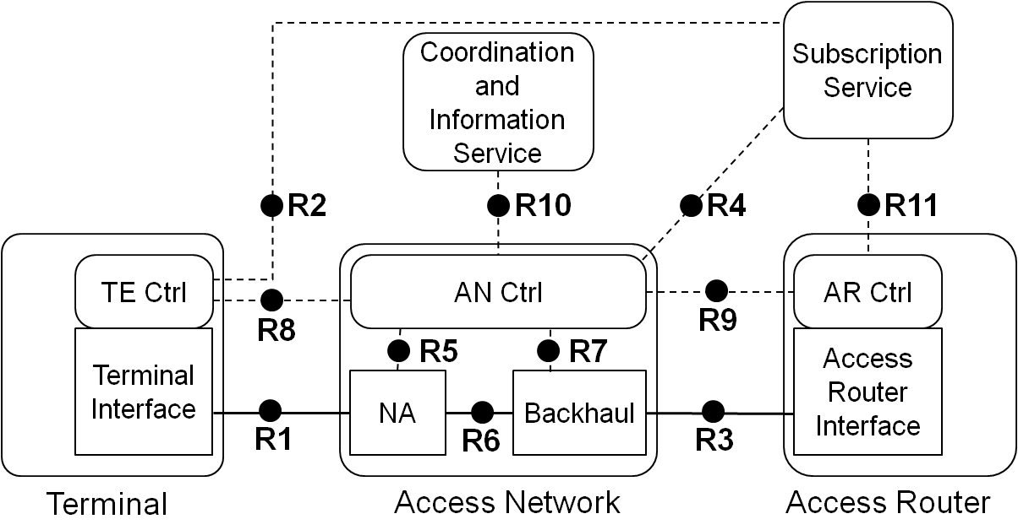
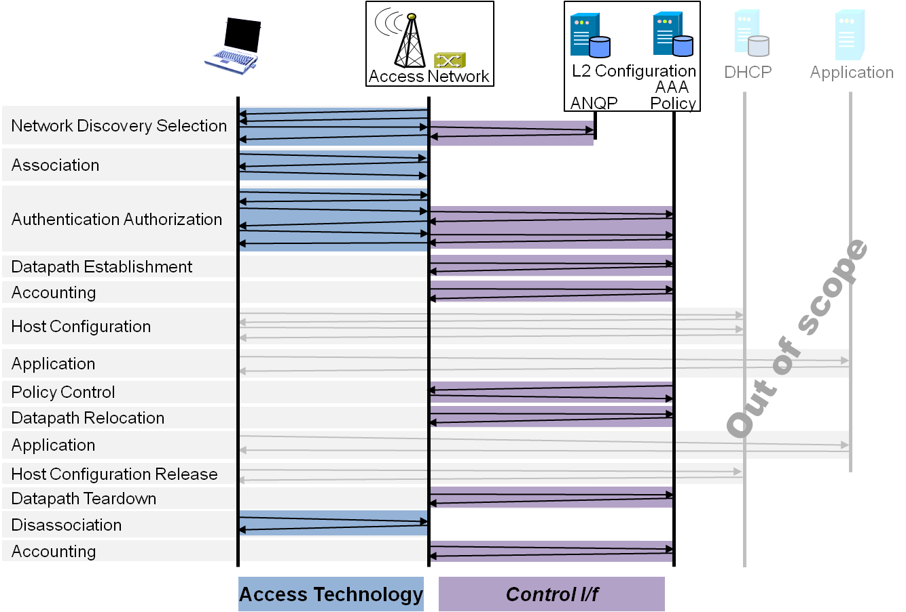
P802.1CF Draft ToC
Overview
References, definitions, acronyms and abbreviations
Conformance
Network Reference Model
Basic concepts and terminology
Overview of NRM
Basic, enhanced and comprehensive NRM
Deployment scenarios
Functional Design and Decomposition
Access Network Setup
Network Discovery and Selection
Association and Disassociation
Authentication and Trust Establishment
Data path establishment, relocation and teardown
Authorization, QoS and policy control
Monitoring and statistics
Fault diagnostics and maintentance
SDN Abstraction
Annex:
PICS proforma
Privacy Engineering
Applicability to non-IEEE 802 PHY layer technoogies
Bibliography

Slide 4
Functional design and decomposition Generic Chapter ToC
Introduction
Roles and identifiers
Use cases
Functional requirements
Specific attributes
Basic functions
Detailed procedures
Mapping to IEEE 802 technologies

Slide 5
Trust in IEEE 802 access networks
User
Service Provider
Subscription

Slide 6
1. Introduction
Authentication and trust establishment is about security in IEEE 802 access networks
Two aspects:
Securing the provision of services to users
Securing the infrastructure
Securing the infrastructure requires security means on each and every interface
Identity
Integrity
Non-repudiation
Encryption
Security is realized through digital signatures established between peers
Persistent passwords/certificates for verifying identities
Temporary keys for processing the transferred information to realize integrity, non-repudiation and encryption
Chapter mainly about securing the access and provisioning of services to users.

Slide 7
2. Roles and identifiers
User
Entity responsible for the terminal seeking access to service
User-ID
ServiceProvider
Organization responsible for provisioning of service
ServiceProvider-ID
Subscription
Contract between user and service provider
Subscription-ID
Terminal
Device bound to User, which receives information containing the service
Access network
Equipment controlling access to service and delivering service on behalf of service provider
Subscription Service
Service entity bound to the service provider which provides service authorization to access network and access router

Slide 8
3. Use cases
Service access to home network
User seeks and receives service through the the access network infrastructure completely owned by service provider
Service access to visited network
User seeks and receives service by the infrastructure completely owned by an organization having a relationship with the service provider
Service access to home access router by way of visited access network
User seeks and receives service from the service provider by the way of an access network owned by an organization having a relationship with the service provider
Service access to third-party access router by way of visited access network
User seeks and receives service from an third-party access router by the way of an access network, both owned by organizations having relationships with the service provider

Slide 9
4. Functional requirements
It should support various methods of authentication
It should support mutual authentication
It should support derivation of master keys from the authentication process
It should support various kinds of digital signatures for the identity verification of user and service provider
It should support hiding of the identity information between terminal and subscription service
It should support standardized forms of Network Access Identifiers (NAI)
It should support anonymous terminal identifiers for the authorization of services
It should support that the same subscription is used for multiple terminals
It should support multiple concurrent terminal sessions with a single subscription
It should support of access to services in the service providers network
It should support roaming scenarios with either the access network or the access router operated by third-party entities
It should support roaming scenarios with authentication information being relayed by a visited subscription service
It should avoid leaking the identity or the credentials of the user in any roaming scenario
It should allow for user initiated service selection when a choice of multiple services is available through an access network
It should derive all required session keys for all involved entities from a single authentication process

Slide 10
5. Specific attributes
User
Description
Credential (password, certificate)
Terminal-ID
ServiceProvider
Description
Credential (password, certificate)
Subscription
Description
User-ID
ServiceProvider-ID
Supported Service
Roaming Partner
Service:usage credit
Terminal
Supported authentication method
Supported encryption modes/key requirements
Credential
Access Network
Supported authentication method
Supported encryption modes/key requiremens
Credential
SubscriptionService
Supported authentication methods
Associated access network
Associated access router
Associated subscription service (roaming partner)

Slide 11
6. Basic functions
Identification request
Access network provides credential of subscription service, supported authentication methods and queries identity of user and terminal
Identification notify
Terminal provides its choice of subscription service, temporary user identity and requested authentication method. Chosen subscription service respond with its certificate.
Authentication process
Terminal and subscription service initiates and executes the chosen authentication method. Authentication method terminates association when authentication fails, otherwise it proceeds with trust establishment
Trust establishment
Subscription service generates all required session specific keys and distributes them to the involved entities.
Trust revocation
Subscription service forces termination of service provisioning for a particular terminal session.

Slide 12
7. Detailed procedures
Access to service delivered by service provider’s access network and access router
All network elements operated by the same service provider
Access to service provider’s access router through a visited access network.
Access network has connections to multiple subscription services
Access network relays authentication to selected subscription service and establish keying material dependent of home service provider
Access to third party access router through a visited access network
Access network has connections to multiple subscription services and multiple access router.
Service provider’s subscription service has direct relation with both the visited access network and the visited access router
Access to third party access router through a visited access network with authentication relayed by visited subscription service
Service provider’s subscription service is connected via another subscription service to the access network and access router.

Slide 13
8. Mapping to IEEE 802 technologies
IEEE 802.3
Deployment of IEEE 802.1X
IEEE 802.11
Authentication specifics aligned to 802.1X
IEEE 802.16
EAP over IEEE 802.16
IEEE 802.22
EAP over IEEE 802.22

Slide 14
Conclusion
Slides provide outline of initial content for authentication and trust establishment chapter.
Assumption that subscription server is present in all cases
No pre-shared key scenarios
Content requires additional refinements when initial text is available.
Slide set misses many details.
Any additional recommendations ?

