Slide 1
Content and outline considerations for Annex: Applicability to non-IEEE 802 PHY layer technologies
Date: 2015-11-08
Authors:
Name | Affiliation | Phone | Email
Max Riegel | Nokia Networks | +49 173 293 8240 | maximilian.riegel@nokis.com
Notice: This document does not represent the agreed view of the IEEE 802.1 OmniRAN TG. It represents only the views of the participants listed in the ‘Authors:’ field above. It is offered as a basis for discussion. It is not binding on the contributor, who reserve the right to add, amend or withdraw material contained herein.
Copyright policy: The contributor is familiar with the IEEE-SA Copyright Policy <http://standards.ieee.org/IPR/copyrightpolicy.html>.
Patent policy: The contributor is familiar with the IEEE-SA Patent Policy and Procedures: <http://standards.ieee.org/guides/bylaws/sect6-7.html#6> and <http://standards.ieee.org/guides/opman/sect6.html#6.3>.
Abstract
802.1CF can be well applied to access networks carrying Ethernet payload over non-IEEE 802 PHY layer technologies. OmniRAN TG decided to add an annex to describe such deployment cases.
The presentation provides thoughts on the structure of the information and the outline of the annex.

Slide 2
Content and outline considerations for Annex: Applicability to non-IEEE 802 PHY layer technologies
Max Riegel
(Nokia Networks)

Slide 3
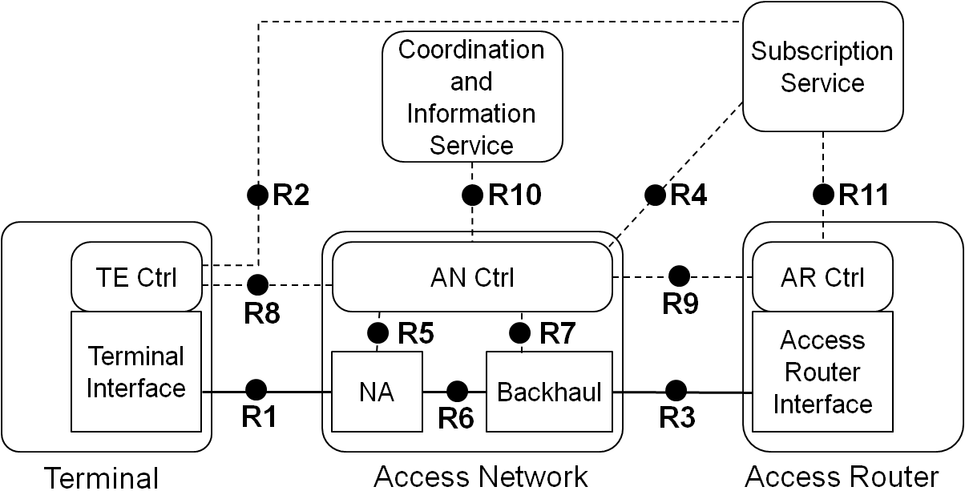
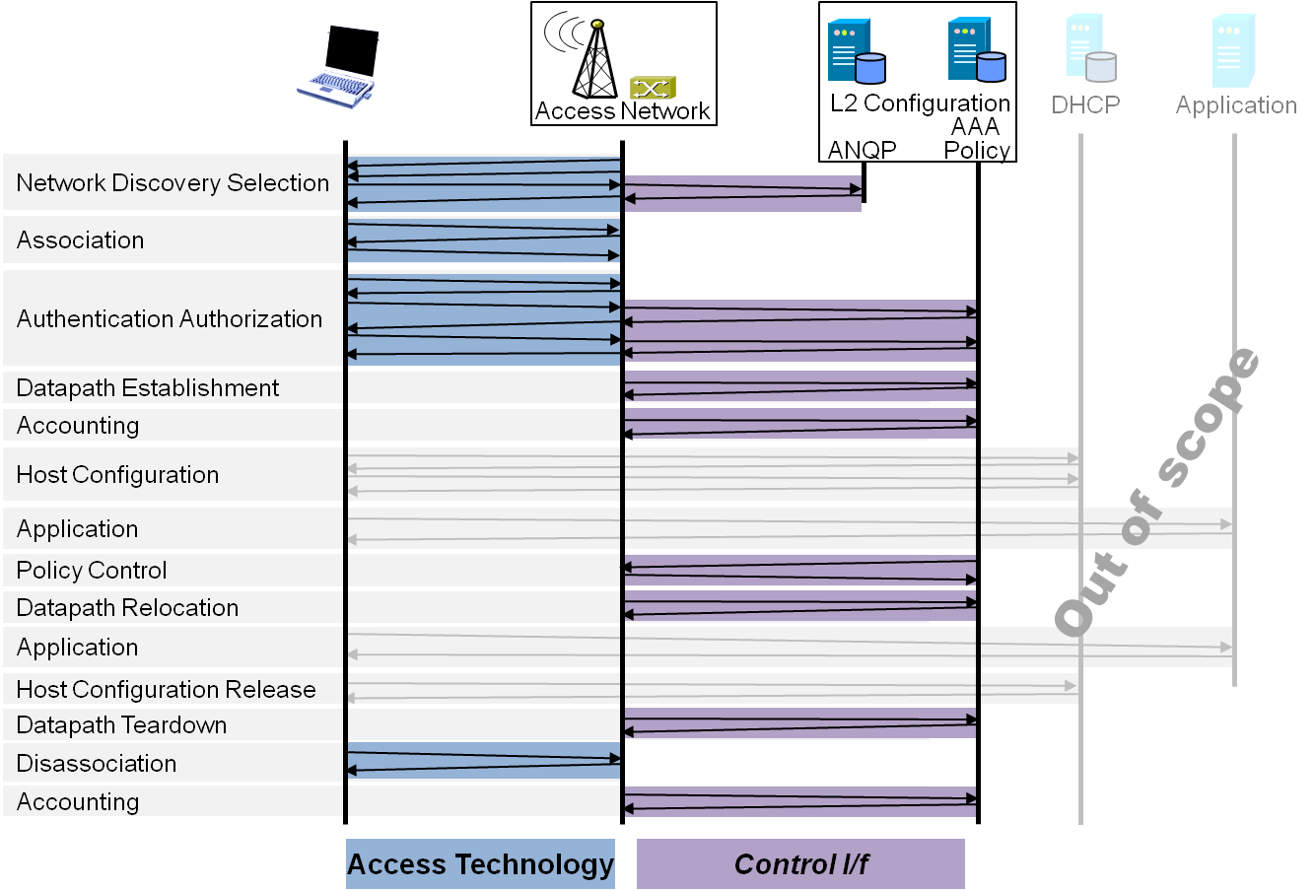
P802.1CF Draft ToC
Overview
References, definitions, acronyms and abbreviations
Conformance
Network Reference Model
Basic concepts and terminology
Overview of NRM
Basic, enhanced and comprehensive NRM
Deployment scenarios
Functional Design and Decomposition
Access Network Setup
Network Discovery and Selection
Association and Disassociation
Authentication and Trust Establishment
Data path establishment, relocation and teardown
Authorization, QoS and policy control
Monitoring and statistics
Fault diagnostics and maintentance
SDN Abstraction
Annex:
PICS proforma
Privacy Engineering
Applicability to non-IEEE 802 PHY layer technologies
Bibliography

Slide 4
Scope and purpose
802.1CF provides an architectural model and a functional description of IEEE 802 access network
Defined by the transport of Ethernet frames as payload
There are widely deployed access network infrastructures carrying Ethernet frames over non-IEEE 802 PHY technologies
E.g. Cable, DSL
It was observed that 802.1CF would also provide a model and functional description for the evolution of such non-IEEE 802 Ethernet access networks.
OmniRAN TG decided to document such deployments in the annex to 802.1CF.
This presentation would like to provide considerations and guidance for the creation of the annex. It proposes generic hints for the content and outline.

Slide 5
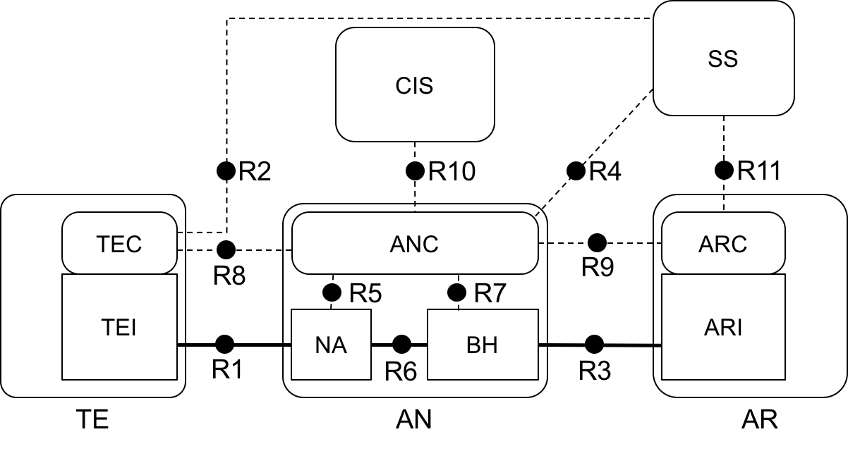
The issue
Large public access infrastructures are providing Ethernet payload connectivity over non-IEEE 802 technologies
To leverage non-IEEE 802 communication technologies for transport of Ethernet
Most likely deploying a non-IEEE 802 PHY technology for the reference point R6
Potentially also R1 may not be based on IEEE 802 PHY
R3 is likely based on IEEE 802 PHY
The network reference model as well as control signaling of 802.1CF is well applicable

Slide 6
The desired content of the annex
Architectural description of the particular access infrastructure in its basic form with native terms
Deployment variation and evolutionary enhancements
List of references
Mapping of functional entities to 802.1CF NRM
Identification of 802.1CF reference points in ‘foreign’ access infrastructure
Mapping of terminology
Mapping of functional behavior to 802.1CF functional description
Summary of differences and similarities to 802.1CF

Slide 7
Proposed outline of Annex: Applicability to non-IEEE 802 PHY layer technologies
Access infrastructure ‘A’
Introduction
Basic architecture and interfaces
Deployment variations and evolution
References
Architectural alignment to 802.1CF NRM
Related functional entities
Related reference points
Differences
Mapping of terminology
Functional alignment to 802.1CF
Mapping of functional behavior
Major functional differences
Summary and conclusion
Access infrastructure ’B’
…

Slide 8
Conclusion
A common outline for annex on applicability to non-IEEE 802 PHY technologies is desired.
Content should be structured similar for all different technologies.
The proposed outline is aligned to the outline of the normative part of 802.1CF
The contribution on distributed CCAP needs to be enhanced in particular to provide the linking to the 802.1CF
Any additional recommendations ?

