Slide 1
Key Concepts of Fault Diagnostics and Maintenance
Date: [2016-01-18]
Authors:
Name | Affiliation | Phone | Email
Hao Wang | Fujitsu R&D Center | +86-10-59691000 | wangh@cn.fujitsu.com
Su Yi | Fujitsu R&D Center | +86-10-59691000 | yisu@cn.fujitsu.com
Xiaojing Fan | Fujitsu R&D Center | +86-10-59691000 | fanxiaojing@cn.fujitsu.com
Ryuichi Matsukura | Fujitsu/Fujitsu Laboratory | +81-44-754-2667 | r.matsukura@jp.fujitsu.com
Notice: This document does not represent the agreed view of the OmniRAN EC SG. It represents only the views of the participants listed in the ‘Authors:’ field above. It is offered as a basis for discussion. It is not binding on the contributor, who reserve the right to add, amend or withdraw material contained herein.
Copyright policy: The contributor is familiar with the IEEE-SA Copyright Policy <http://standards.ieee.org/IPR/copyrightpolicy.html>.
Patent policy: The contributor is familiar with the IEEE-SA Patent Policy and Procedures: <http://standards.ieee.org/guides/bylaws/sect6-7.html#6> and <http://standards.ieee.org/guides/opman/sect6.html#6.3>.
Abstract
The presentation provides a summary of the key concepts and facts for the specification of fault diagnostics and maintenance. This update is aimed for introduction of a text contribution to P802.1CF on fault diagnostics and maintenance.

Slide 2
Key Concepts of Fault Diagnostics and Maintenance
2016-01-18
Hao Wang
Fujitsu R&D Center

Slide 3
P802.1CF Draft ToC
Introduction and Scope
Abbreviations, Acronyms, Definitions, and Conventions
References
Identifiers
Network Reference Model
  Overview
  Reference Points
  Access Network Control Architecture
    Multiple deployment scenarios including backhaul
Functional Design and Decomposition
  Access network setup
  Access network discovery and selection
  Association and Disassociaiton
  Authentication and Trust Establishment
  Datapath establishment, relocation and teardown
  Authorization, QoS and policy control
  Accounting and monitoring
  Fault diagnostics and maintenance (FDM)
SDN Abstraction
Annex:
  Privacy Engineering
  Tenets (Informative)

Slide 4
FDM Chapter ToC
Introduction
Roles and identifiers
Use cases
Functional requirements
Specific attributes
Specific basic functions
Detailed procedures
Mapping to IEEE 802 Technologies

Slide 5
Introduction
Fault diagnosis and maintenance (FDM) provides the capabilities useful for detecting, isolating, reporting and mitigation the failures during the life cycle of a terminal session.
These capabilities allow the network operators as well as the service providers to monitor the health of the network, quickly determine the location of failing links or fault conditions, and perform necessary functions to recover the faults.
TE
NA
BH
AR
IP
DLL
DLL
IP
DLL
DLL
PHY
DLL
DLL
PHY
DLL
DLL
PHY
PHY
PHY
PHY
PHY
PHY
LAN
Access Network
MAN
RAN

Slide 6
Fault
Fault denotes a deviation of a system from normal operation, which may result in the loss of operational capabilities of the element or the loss of redundancy in case of a redundant configuration.
  Fault may occur on a network element (NE) and cause the malfunction of the logical and physical resources and will, in severe cases, lead to the complete unavailability of the respective NE.
  Fault may occur on a link and cause communication performance deterioration thus affect quality of service.
  Fault may occur along a data path which is established to carry user payload between the terminal and access router, or between the terminal and another terminal, and affects the end-to-end connectivity.

Slide 7
Alarm
As a consequence of faults, appropriate alarms related to the physical or logical resources affected by the faults, shall be generated by a NE.
An alarm signifies an undesired condition of network resource that can be grouped into one of the following categories [8]:
  communications alarm type: An alarm of this type is principally associated with the procedures and/or processes required to convey information from one point to another;
  quality of service alarm type: An alarm of this type is principally associated with a degradation in the quality of a service;
  processing error alarm type: An alarm of this type is principally associated with a software or processing fault;
  equipment alarm type: An alarm of this type is principally associated with an equipment fault;
  environmental alarm type: An alarm of this type is principally associated with a condition relating to an enclosure in which the equipment resides.

Slide 8
Levels of FDM
FDM is the set of functions and process managing the complete life cycle of a fault, generally associated with detecting, indicating, verifying, isolating and restoring from abnormal operations.
Regarding the context where FDM is used, these concepts and functions are described on two levels
  Link FDM is conducted on a link, intends to detect faults as soon as they occur and to limit their effects on the network Quality of Service (QoS) as far as possible.
  Path FDM is conducted towards a data path, intends to discover and verify the path through bridges and LANs, to detect and isolate of a connectivity fault.

Slide 9
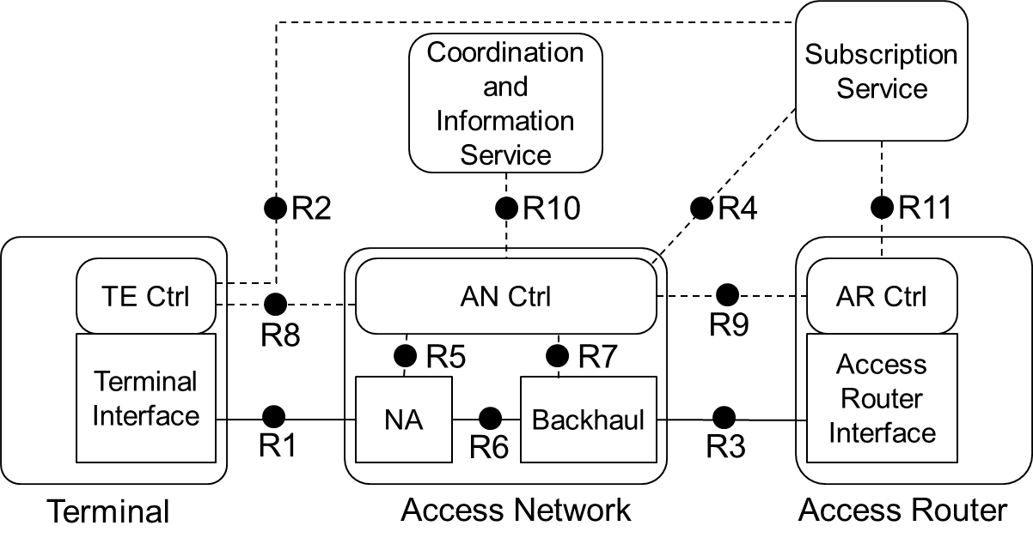
Roles and identifiers
The control entity contained by TE, AN and AR facilitates the FDM functions according to its configurations and capabilities.
In order to detect faults, the controllers may use autonomous self check circuits and measurement procedures to observe the performance of physical ports.
Interface between controllers, i.e R8, R9, are used to exchange necessary FDM information for basic functions, e.g. to configure the parameters and criteria of a remote entity.
For some faults, additional means, such as test and diagnosis features, may be executed on data interfaces, i.e R1, R6, and R3, to obtain the required level of detail.
In a comprehensive network reference model, AN Ctrl uses R5 and R7 for configuration and operation of NA and BH respectively.

Slide 10
Use Cases
Link FDM I
When a fault occurs on the link, e.g. between TE and AN and affects communication capability, each of the controllers may detect the fault and generate alarm from its own perspective.
In order to ease fault isolation and recovery, it is necessary to notify locally provided information to a remote entity for aggregation to the one with more resources.
In order to detect the faults, the controllers shall be able to monitor each of the physical ports as well as the medium. As the access network is decomposed into a NA and BH, ANC should accomplish such task via either one observing the links towards both TE and AR, as well as the one between NA and BH.
For some faults there is no need for any short term action, since the fault condition lasted for a short period of time only and then disappeared.

Slide 11
Use Cases
Link FDM II
A mobile TE may seek services from multiple NA controlled by the same controller.
As these NAs usually operating in overlapping area. It allows ANC to do enhanced features, such as interference coordination, load balancing, mobility support, etc.
Thus, it is necessary for ANC to monitor multiple communication interfaces simultaneously.
For some faults, additional means, such as test and diagnostic process may be necessary in order to obtain the required level of detail, e.g. an 802.11 AP requests specific station to perform scanning process, in either passive or active way, and convey the information.

Slide 12
Use Cases
Path FDM
In IEEE 802 access networks, an integrated model of BH may consist of multiple IEEE 802.1 bridges, each with restricted management access to other’s equipment. As increasing number of bridges are used as BH, to perform a full scale of link FDM functions will exhaust the resources in ANC.
The purpose of path FDM is to detect and isolate the connectivity fault with a domain which denotes a segment of path bounded by end points.
These configured end points issue trains of point-to-point messages and multicast messages to determine the availability of the path.

Slide 13
Functional Requirements
In order to minimize the effects of faults on the QoS as perceived by the network users it is necessary to support:
  Capability Discovery to discover the FDM capability of a remote entity
  Configuration to configure parameters, thresholds used for FDM functions, as well as process flows and restoration actions depending on the nature and severity of the faults
  Notification to notify FDM related information, e.g alarms, to a remote entity
  Detection to detect faults in the network affects HW, SW, communication and end-to-end connectivity, as soon as they occur
  Isolation to determine the cause of the failure using diagnosis
  Recovery to isolate the faults and limit the effect , and repair/eliminate failures in due time

Slide 14
Specific Attributes
Terminal
  Self-check parameters, e.g. communication interface status
  R1 MAC and PHY configuration parameters
  R1 link monitoring parameters, e.g. counters
  R8 alarm, e.g. communication alarm
Node of Attachment
  R1 MAC and PHY configuration parameters
  R1/R6 link monitoring parameters
  R6 configuration parameters
  R5 FDM configuration parameters, e.g. testing command
Access Network Controller
  Self-check parameters, e.g. communication interface status
  R8/R9 alarm, e.g. communication alarm
  R5/R7 FDM configurations, e.g. testing command
Backhaul
  R6/R3 link monitoring parameters, e.g. counters
  R6/R3 configuration parameters
  R7 FDM configuration parameters, e.g. threshold
Access Router
  Self-check parameters, e.g. communication interface status
  Alarm e.g. QoS alarm.
  R3 link monitoring parameters, e.g. counters
  R9 FDM configuration parameters, e.g. testing command

Slide 15
Specific basic functions
Capability Discovery
A mechanism is provided to detect the presence of FDM functionalities at a remote entity. The discovery procedure identifies the devices in the network along with their FDM capability.
It indicates the FDM functions that can be performed, thus determines the FDM process.
It typically involves the discovery of a TE by AN. It may also involve discovery of any connected entity, e.g. between NA and BH, inside BH, or between BH and AR.
The controller should be able to response with descriptions of own capability, when a discovery request is received from a remote controller. If necessary, it may actively announce own FDM capability to the network.

Slide 16
Specific basic functions
Remote Failure Indication
In order to detect faults, the controllers may use autonomous self check circuits and daemon programs to validate the availability and operation of HW/SW.
  For some faults there is no need for any short term action, since the fault condition lasted for a short period of time only and then disappeared.
For each detected fault, appropriate alarm should be generated by the faulty entity which contains all the information provided by the fault detection process.
The alarm may be forwarded to a remote entity, in the form of unsolicited notifications.
If forwarding is not possible at this time, e.g. due to communication breakdown, the notification shall be sent as soon as the communication capability has been restored.
All alarms generated may be filtered and input into a list within local entity, which could be provided to a remote entity when requested.
Specific procedures maybe different depending on specific 802 technologies
  Some physical layer devices have specific remote failure signaling mechanisms in the physical layer.

Slide 17
Specific basic functions
Link Monitoring
Link monitoring allows the entity to monitor the performance of the communication interface and the medium.
Measurement procedures are provided on the physical or logical resources to evaluate the quality of current services.
It is also necessary to exchange or notify information about the link with/to a remote entity.
Link monitoring may supply the following information for further FDM procedures:
  Communication statistic, e.g. error counters
  Resource measurement, e.g. signal-to-noise ratio (SINR)
  Variables in the local Management Information Base (MIB)
  Configurations of the physical port
Above information associated with threshold is commonly used for declaration of fault occurrence and clearing.

Slide 18
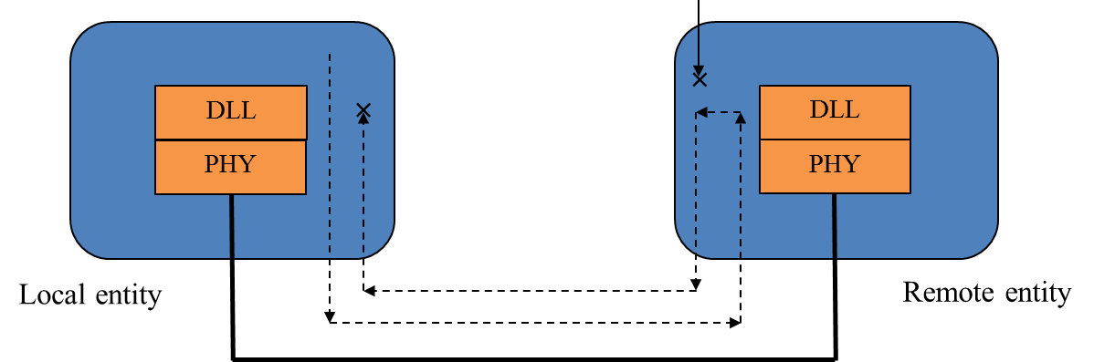
Specific basic functions
Remote Test (I)
The remote test is the mechanism provided to actively evaluate the performance of the links or the validity of the remote entities.
The testing procedures as such specified by IEEE std 802.3, IEEE std 802.11 and other IEEE standards are summarized as follows,
  Loopback test. As such test executed on link, the remote entity is controlled to enter a loopback mode in which frames are echoed back. Statistics from both local and remote entities can be queried and compared for fault localization and link performance testing.
  Such test executed towards a data path is referred to the Ethernet ping scheme. Through unicast and bi-directional ping message, it can detect and verify connectivity failures along the path and measure round-trip delay and one-way jitter by using embedded timestamps.
Loopback test on Ethernet link

Slide 19
Specific basic functions
Remote Test (II)
IEEE 802 specified test procedures also include:
  The remote functionality test is provided to verify the operation and configuration of the remote entity. For example, TE may be requested to perform authentication or association test with another specified AN and convey the information to the original AN.
  Continuity check (CC) and Ethernet traceroute are commonly used for connectivity verification towards the path (domain). In practice, CC may issues multicast, unidirectional heartbeat message (CCM) in the specific domain which can also be used to carry the information indicating defective bridge port.
  Ethernet traceroute provides the mechanism to discover all the enable entities in a domain.
Ethernet traceroute

Slide 20
Specific basic functions
Aggregation
In order to ease the fault isolation and recovery, it is necessary to configure the controller with sufficient resources to aggregate information which is separately provided by different entities or physical ports.
The information includes those associated with individual FDM function, such as remote failure indication, link monitoring and remote test, if necessary, also includes those provided by other functions which allows the aggregator have a comprehensive view of the overall heath status of the network.

Slide 21
Specific basic functions
Failure Isolation
Failure isolation is to pinpoint one or more root causes of the faults, intended to help take correct actions to recover from the failure condition.
The isolation algorithms and procedures can be tailored to the information provided according to the entity's capability and FDM configuration.
Details are implementation specific and therefore they are out of scope of IEEE 802.1CF.

Slide 22
Specific basic functions
Failure Recovery
After a fault has been detected and the root cause have been identified, some actions and procedures are necessary in order to perform system recovery and/or restoration.
The recovery actions that performed by the entities in case of faults depend on the nature and severity of the faults, on the hardware and software capabilities of the entity and on the current configuration of the entity.
As soon as the system is confirmed of recovery, the corresponding alarm shall be cleared.
The detailed implementation of recovery is also out of the scope of IEEE 802.1CF.

Slide 23
Detailed procedures
Remote Failure Indication

Slide 24
Detailed procedures
Link Monitoring

Slide 25
Detailed procedures
Remote Test

Slide 26
Detailed procedures
Aggregation

Slide 27
An Implementation of FDM Process Flow
(Informative)

Slide 28
Reference
IEEE
  [1] IEEE 802.1ag-2007 "Local and metropolitan area networks – Virtual Bridged Local Area Networks, Amendment 5: Connectivity Fault Management Virtual Bridged Local Area Networks, Amendment 5: Connectivity Fault Management"
  [2] IEEE 802.3ah-2004 "Local and metropolitan area networks – Specific requirements, Part 3: Carrier Sense Multiple Access with Collision Detection (CSMA/CD) Access Method and Physical Layer Specifications, Amendment: Media Access Control Parameters, Physical Layers, and Management Parameters for Subscriber Access Networks"
  [3] IEEE 802.11-2012 "Local and metropolitan area networks – Specific requirements, Part 11: Wireless LAN Medium Access Control (MAC) and Physical Layer (PHY) Specifications"
  [4] IEEE 802.11k-2008 "Local and metropolitan area networks – Specific requirements, Part 11: Wireless LAN Medium Access Control (MAC) and Physical Layer (PHY) Specifications Amendment 1: Radio Resource Measurement of Wireless LANs"
  [5] IEEE 802.11v-2011 "Local and metropolitan area networks – Specific requirements, Part 11: Wireless LAN Medium Access Control (MAC) and Physical Layer (PHY) specifications, Amendment 8: IEEE 802.11 Wireless Network Management"
  [6] IEEE 802.16-2012 "IEEE Standard for Air Interface for Broadband Wireless Access Systems”
  [7] IEEE 802.16g-2007 "Local and metropolitan area networks, Part 16: Air Interface for Fixed and Mobile Broadband Wireless Access Systems, Amendment 3: Management Plane Procedures and Services"
ITU
  [8] ITU-T X.733 "Information Technology – Open System Interconnection – System Management: Alarm Reporting Function"
  [9] ITU-T X.745 “Information Technology – Open System Interconnection – System Management: Test Management Function”
  [10] ITU-T M.3400 "Telecommunications management network, TMN management functions" 02/2000
  [11] ITU-T Y.2070 "Next Generation Networks – Frameworks and functional architecture models, Requirements and architecture of the home energy management system and home network services" 01/2015
3GPP
  [12] 3GPP TS 32.111-1 "Telecommunication management; Fault Management; Part 1: 3G Fault Management Requirements" (v12.2.0)
WiMAX Forum
  [13] WMF-T31-119-R016v01 "WiMAX Forum Network Requirements; WiMAX Network Management: NMS to EMS Interface"
TTC
  [14] TR-1053 "Customer support functions for home network service platform" (Edition 1.0)
  [15] TR-1057 "Customer support guideline for home network service" (Edition 1.0)

Slide 29
Questions, Comments
Fault Diagnosis and Maintenance

