Slide 1
Key Concepts of Fault Diagnostics and Maintenance
Date: [2015-12-10]
Authors:
Name | Affiliation | Phone | Email
Hao Wang | Fujitsu R&D Center | +86-10-59691000 | wangh@cn.fujitsu.com
Su Yi | Fujitsu R&D Center | +86-10-59691000 | yisu@cn.fujitsu.com
Xiaojing Fan | Fujitsu R&D Center | +86-10-59691000 | fanxiaojing@cn.fujitsu.com
Ryuichi Matsukura | Fujitsu/Fujitsu Laboratory | +81-44-754-2667 | r.matsukura@jp.fujitsu.com
Notice: This document does not represent the agreed view of the OmniRAN EC SG. It represents only the views of the participants listed in the ‘Authors:’ field above. It is offered as a basis for discussion. It is not binding on the contributor, who reserve the right to add, amend or withdraw material contained herein.
Copyright policy: The contributor is familiar with the IEEE-SA Copyright Policy <http://standards.ieee.org/IPR/copyrightpolicy.html>.
Patent policy: The contributor is familiar with the IEEE-SA Patent Policy and Procedures: <http://standards.ieee.org/guides/bylaws/sect6-7.html#6> and <http://standards.ieee.org/guides/opman/sect6.html#6.3>.
Abstract
The presentation provides a summary of the key concepts and facts for the specification of fault diagnostics and maintenance. This update is aimed for introduction of a text contribution to P802.1CF on fault diagnostics and maintenance.

Slide 2
Key Concepts of Fault Diagnostics and Maintenance
2015-12-10
Hao Wang
Fujitsu R&D Center

Slide 3
P802.1CF Draft ToC
Introduction and Scope
Abbreviations, Acronyms, Definitions, and Conventions
References
Identifiers
Network Reference Model
  Overview
  Reference Points
  Access Network Control Architecture
    Multiple deployment scenarios including backhaul
Functional Design and Decomposition
  Access network setup
  Access network discovery and selection
  Association and Disassociaiton
  Authentication and Trust Establishment
  Datapath establishment, relocation and teardown
  Authorization, QoS and policy control
  Accounting and monitoring
  Fault diagnostics and maintenance (FDM)
SDN Abstraction
Annex:
  Privacy Engineering
  Tenets (Informative)

Slide 4
FDM Chapter ToC
Introduction
Roles and identifiers
Use cases
Functional requirements
Specific attributes
Specific basic functions
Detailed procedures
Mapping to IEEE 802 Technologies

Slide 5
Introduction
Fault diagnosis and maintenance (FDM) provides the capabilities useful for detecting, isolating and reporting the failures during the life cycle of a terminal session.
These capabilities allow the network operators to monitor the health of the network and quickly determine the location of failing links or fault conditions.
TE
NA
BH
AR
IP
DLL
DLL
IP
DLL
DLL
PHY
DLL
DLL
PHY
DLL
DLL
PHY
PHY
PHY
PHY
PHY
PHY
LAN
Access Network
MAN

Slide 6
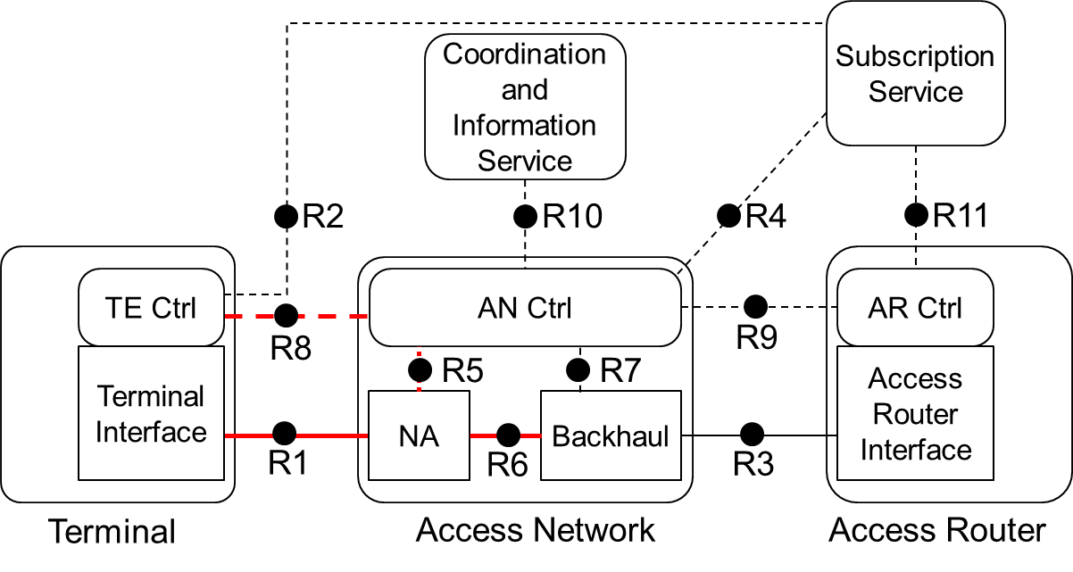
Roles and identifiers
Terminal (TE)
  TE Ctrl is used to process FDM request and report
  TEI is used to test and monitor the performance of a link
Access Network (AN)
  AN Ctrl
    R8 for communicating FDM messages with TE
    R5 to retrieve FDM related information from NA
  Node of Attachment (NA)
    R1 and R6 to test and monitor the performance of a link

Slide 7
Use Cases
FDM in local area network I
In a local area network, the NA can detect whether there is a link failure or a performance degradation happening for a specific terminal using FDM functions.
It may also be able to diagnose the cause of the problem depending on the relevant information NA has and the diagnosis capability.

Slide 8
Use Cases
FDM in local area network II
In a coordinated access network, AN controller can help multiple NAs do interference coordination, load balancing, and other performance enhancement.
One example in 802.11: After finishing some diagnostic process (e.g., a WiFi scan), an NA sends a diagnostic report to the AN controller indicating that a neighboring AP is using the same WiFi channel. The AN controller can then take some action, e.g., change channel command to the other NA, to do interference coordination.

Slide 9
Use Cases
FDM in access network
FDM can provide connectivity verification for links from NA to backhaul or within backhaul, in an access network.

Slide 10
Functional Requirements
Mechanism to discover the FDM capability of a remote entity should be supported
Detection of local critical events should be supported
Monitoring wired or wireless link status by local and remote entities should be supported
Testing data link performance should be performed on demand by control entity
Logging the miscellaneous events and status according to its FDM capability should be supported
Fault isolation should be supported
Mechanism to notify FDM related information to a remote entity should be supported

Slide 11
FDM specific attributes
Self-check parameters
  Communication interface status
  Device internal status
  Configuration parameters, etc
Link monitoring parameters
  Frame errors
  Retransmission count
  RSSI
  Scan report, etc
Failure events
  Problem of the radio channel
  Problem of radio propagation
  Problem of a setup mistake
  Problem of a unit failure, etc
FDM Log
  Association status
  Authentication status
  Transition status, etc

Slide 12
Specific basic functions
Capability discovery
FDM provides a mechanism to detect the presence of an FDM function at the remote entity. This mechanism is called capability discovery.
This discovery procedure identifies the devices in the network along with their FDM capabilities, such as configured functions and mode of the entity. It will decide whether the remote entity can support full FDM operations or not.

Slide 13
Specific basic functions
An example of capability discovery in 802.11
Peer-capability discovery: extended capabilities IE carried in
  Beacon
  Association/re-association request/reply frame
  Probe request/reply frame
TE
NA
  dot11MgmtOptionEventsActivated = TRUE
Association REQ (capability IE)
  Discover TE’s capability of supporting Event Req/Rep
Association RES

Slide 14
Specific basic functions
Remote Failure Indication
Remote failure indication is provided to notify a remote entity that the local entity is nonoperational.
The failures of the local entity can be detected by self-check function.
  Depending on the physical layer properties, some devices may support unidirectional operation that allows remote failure indication during fault conditions.
  Some physical layer devices have specific remote failure signaling mechanisms in the physical layer.
  The definition of specific remote failures depends on the different 802 technologies.

Slide 15
Specific basic functions
Link Monitoring
Link monitoring is a mechanism to support event notification that permits the inclusion of diagnostic information.
  statistics of a data link such as excessive frame errors, excessive duplicate frames, etc
  real time events such as transition, RSNA, peer-to-peer link establishment etc
  results of radio resource measurement
Link monitoring also supports polling of information from the remote entity. The polling information includes variables in the remote MIB.

Slide 16
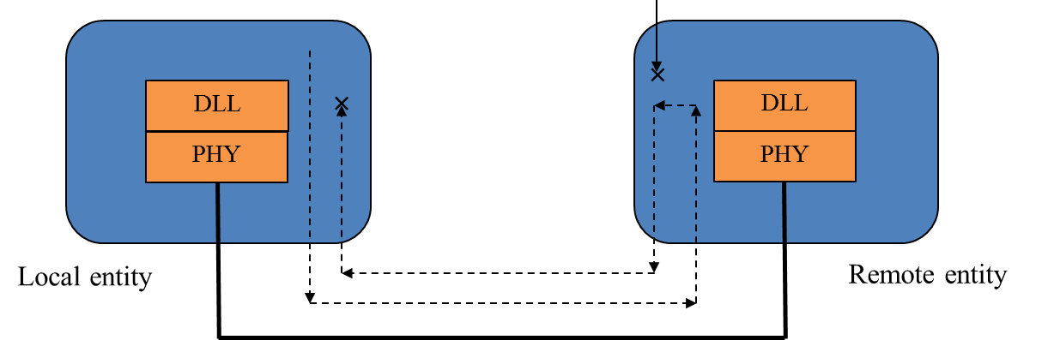
Specific basic functions
Remote Test
A loopback mode can be supported on control demand by a remote entity.
  When in loopback mode, all data received should be echoed back to the transmitter.
The mechanism to retrieve specific condition from a remote entity, such as the result of association/ authentication test, is supported.

Slide 17
Specific basic functions
FDM Log
The FDM Log is a general reporting mechanism that can apply to configuration or monitoring behavior for PHY and MAC.
The FDM Log is particularly useful for logging success or failure events across the life cycle of a session such as IEEE 802.11 or IEEE 802.1X authentication, authorization, status changes while associated or unassociated.
FDM Log function also supports the mechanism to retrieve Log information from a remote entity.
Scanning
FDM
Log
Network Selection
Association
Authentication
Authorization
Accounting Start
Host Configuration
Application
QoS Control
Application
Host Cfg Release
Disassociation
Accounting

Slide 18
Specific basic functions
Aggregation of Failure Information
For some fault diagnosis process, the information acquired by multiple TEs or/and NAs is aggregated in the AN Ctrl.
  Self-check parameters
  Link monitoring parameters
  Failure events
  FDM Log

Slide 19
Specific basic functions
Failure isolation
Failure isolation is to pinpoint one or more root causes of the faults, to help take correct actions to recover from the failure condition.
A mechanism to indicate failure isolation results to a remote entity is provided.

Slide 20
Detailed procedures
Link Monitoring
TE
NA
Monitoring Req
Monitoring process
Monitoring Report

Slide 21
Questions, Comments
Fault Diagnosis and Maintenance

