Slide 1
WLAN as a Component (WaaC)
Date: 2019-09-14
Authors:
Name | Affiliation | Phone | Email
Yonggang Fang | ZTETX
Bo Sun | ZTE
He Huang | ZTE
Notice: This document represents only the views of the participants listed in the ‘Authors:’ field above. It is offered as a basis for discussion. It is not binding on contributors, who reserve the right to add, amend or withdraw material contained herein.
Copyright policy: The contributor is familiar with the IEEE-SA Copyright Policy <http://standards.ieee.org/IPR/copyrightpolicy.html>.
Patent policy: The contributor is familiar with the IEEE-SA Patent Policy and Procedures: <http://standards.ieee.org/guides/bylaws/sect6-7.html#6> and <http://standards.ieee.org/guides/opman/sect6.html#6.3>.
Abstract
This contribution is intended to discuss WLAN as a Component (WaaC) to support incorporation with other technologies.

Slide 2
Background
Issues [2]
  No single external interface for 3GPP to interwork with and control the standardized 802.11 WLANs.
  Need a cloud based standardized network management system to manage the carrier-grade WLAN.
  The future 5G technologies require multi-technologies coexistence over the same medium, which requires to avoid any impediment for the use of appropriate 802.11 technology in a future 5G network.

Slide 3
Background
What is a Component?
  A component has
    defined functions and
    defined external interfaces to communicate with others.
  Interoperable
    It should be possible to swap implementations of the component from different sources if those implementations are compliant to the defined functions and external interfaces.

Slide 4
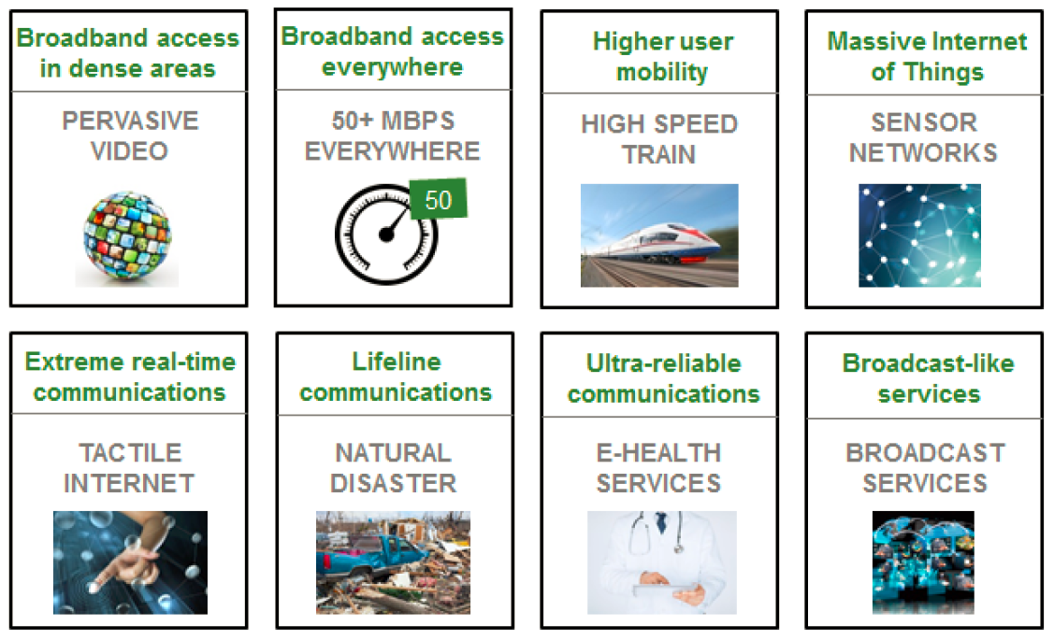
NGMN 5G Use Cases

Slide 5
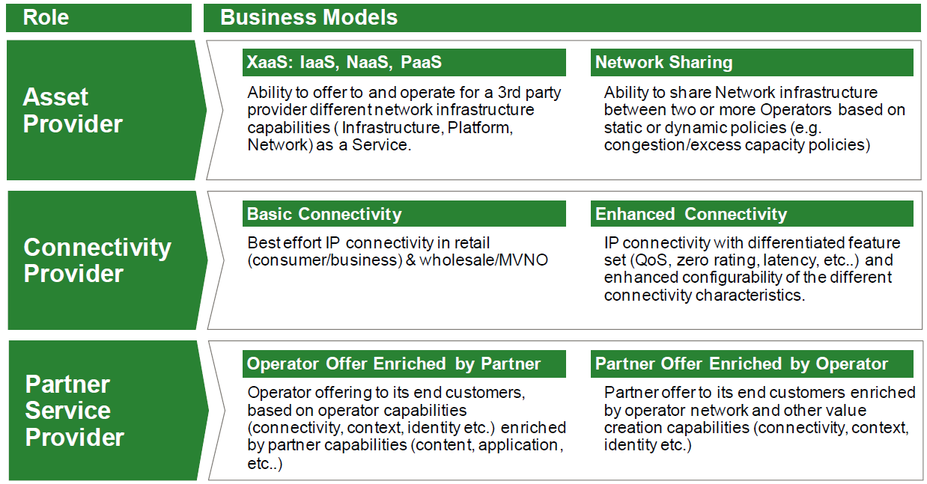
NGMN 5G Business Models [1]

Slide 6
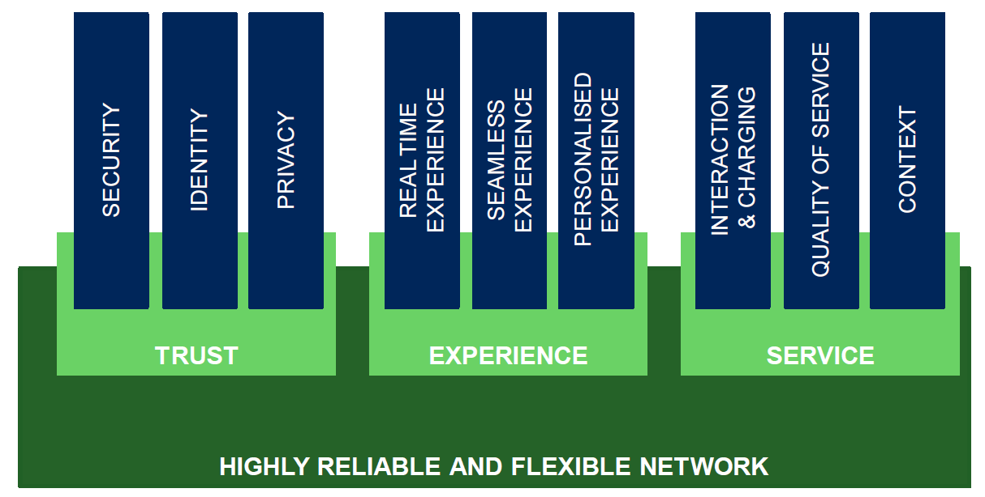
NGMN 5G Value Creation Capabilities

Slide 7
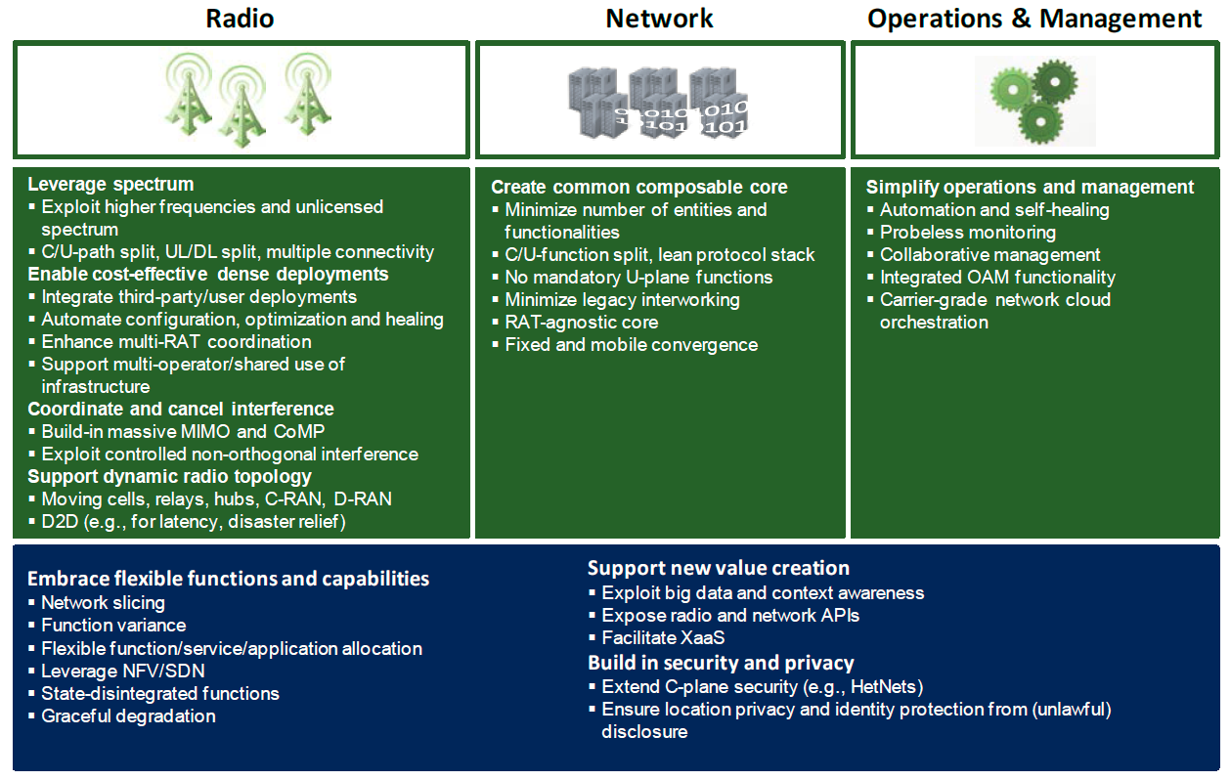
NGMN 5G Design Principle

Slide 8



WLAN as a Component
Basic WaaC
BSS1
External Management/Control Plane Interface
ANC
BH
NA1
External Data Plane Interface
NA2
BSS2

Slide 9
WLAN as a Component
WaaC in omniRAN NRM
Subscription
Service
Coordination and Information
Service
R2
R10
R4
R11
TE Ctrl
AN Ctrl
AR Ctrl
R8
R9
Terminal
Interface
R5
R7
Access Router
Interface
NA
Backhaul
R1
R6
R3
Terminal
Access Network
Access Router
WaaC

Slide 10
WLAN as a Component
Functional Entities
  Node of Attachment (NA):
    IEEE 802.11 based radio access stations operating in license-exempt frequency bands or shared authorized license frequency band(s).
  Backhaul (BH):
    Manage the backhaul network setup and configuration
    Control the user data plane traffic forwarding
  Access Network Controller:
    Manage radio access network setup and configuration.

Slide 11
WLAN as a Component
Separated Planes
  Data Plane Functionalities:
    carrying, sequencing, tunneling, forwarding the user data traffic between the Core network, AN
  Control Plane Functionalities:
    service management, user traffic connection setup, mobility management, accounting management, etc.
  Management Plane Functionalities
    carrying messages for authenticating, controlling and managing IEEE 802.11 AN
    Support different WaaC use cases.

Slide 12
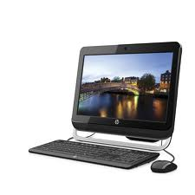


Use Case of WaaC
Cloud Management
  manage and control carrier-grade WLAN through management/control interface
Cloud Management System
BSS1
ANC
BH
Internet
NA1
NA2
BSS2

Slide 13
Use Case of WaaC
Why needs Cloud Management
  Support of 5G broadband access in dense area and everywhere such as public venues, especially for massive Internet of Things, requires to manage a large number of APs efficiently and effectively.
  Support a central controlled management system to consolidate management of multiple local WiFi networks offered by single service provider
  Support the carrier-grade WLAN integrated with other wireless infrastructure managed through a unified management system.

Slide 14
Use Case of WaaC
Sharing by Multi-Cores
  Provide sharing to multi-Core to reduce the cost of Service Providers
BSS1
Core 1
ANC
VLAN1
BH
NA1
VLAN2
NA2
Core 2
BSS2

Slide 15
Use Case of WaaC
Why needs Sharing with Multi Cores
  Required by 5G, not only reduce the cost of service providers, but also improve medium usage efficiency in the limited spectrum.
  Maximize utilization of available resources to meet 5G requirements.
  Support 5G business model of XaaS, IaaS, NasS, PaaS.
  Support enriched and value creation capabilities.
  Some incumbent deployment has to share RAN with other existing service providers and operators.

Slide 16
Use Case of WaaC
Interworking
  Control plane is connected through ANC/TWAP to AAA server in 3GPP Core.
  User data plane is connected to PDN GW over BH/TWAG.
HSS
ANC (TWAP)
STa
BSS1
AAA Server
BH (TWAG)
3GPP CORE
NA1
S2a
PDN GW
NA2
BSS2
Trusted Non-3GPP WLAN

Slide 17
Use Case of WaaC
Why needs Interworking
  Support 3GPP interworking with WiFi for data offloading.
  Support future LTE LAA coexisting with WiFi over unlicensed band.
  Standardize the external interface of WaaC for interworking with the future 5G multi-technologies.

Slide 18
Summary
WaaC is proposed to address future 5G requirements.
OmniRAN should take the network reference model into account for support WaaC.

Slide 19
References
NGMN_5G_White_Paper_V1_0
11-15-0757-01-0000-802-11-as-a-component-tutorial

