Slide 1
IEEE 802.1 OmniRAN TG
September 2015 F2F Meeting
Bangkok, Thailand
2015-09-14
Max Riegel, Nokia Networks
(TG Chair)

Slide 2
September 2015 F2F Meeting
Venue
  Centara Grand & Bangkok Convention Centre
  999/99 Rama1 Road, Pathumwan
  Bangkok 10330, Thailand
    www.centarahotelsresorts.com
Sessions, location
  Mon, Sep 14th,16:00-18:00 Lotus Suite 8
  Tue, Sep 15th, 16:00-18:00 Lotus Suite 12
  Wed, Sep 16th, 13:30-15:30 Lotus Suite 12
  Thu, Sep 17th, 16:00-18:00 Lotus Suite 4

Slide 3
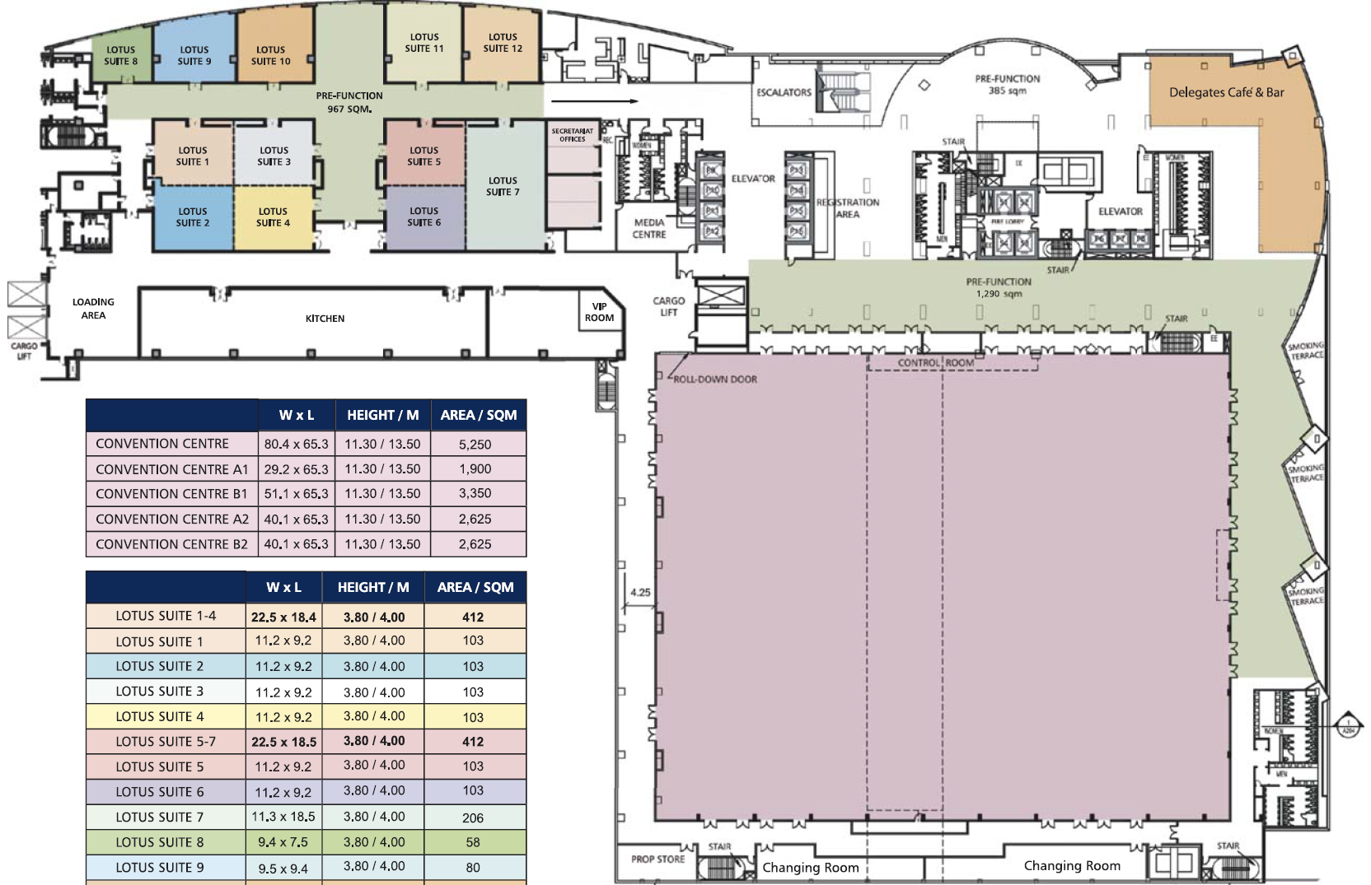
22nd Level Floor Plan

Slide 4
September 2015 Agenda Graphics
 | Mon 9/14 | Tue 9/15 | Wed 9/16 | Thu 9/17 | Fri 9/18
08:00 10:00 | Opening Sessions | 802.11 WNG | 802.11 ARC |  | 802.11 Closing
10:30 12:30 |  | 802.11 ARC | 802.11/802.15 Mid-week Plenaries
13:30 15:30 |  |  | 802.11 as a component
16:00 18:00 | OmniRAN Opening New contributions | CF text review |  | OmniRAN Closing
 |  |  |  | 802.15 Closing

Slide 5
Participants, Patents, and Duty to Inform
All participants in this meeting have certain obligations under the IEEE-SA Patent Policy.
  Participants [Note: Quoted text excerpted from IEEE-SA Standards Board Bylaws subclause 6.2]:
    “Shall inform the IEEE (or cause the IEEE to be informed)” of the identity of each “holder of any potential Essential Patent Claims of which they are personally aware” if the claims are owned or controlled by the participant or the entity the participant is from, employed by, or otherwise represents
    “Should inform the IEEE (or cause the IEEE to be informed)” of the identity of “any other holders of potential Essential Patent Claims” (that is, third parties that are not affiliated with the participant, with the participant’s employer, or with anyone else that the participant is from or otherwise represents)
  The above does not apply if the patent claim is already the subject of an Accepted Letter of Assurance that applies to the proposed standard(s) under consideration by this group
  Early identification of holders of potential Essential Patent Claims is strongly encouraged
  No duty to perform a patent search

Slide 6
Patent Related Links
All participants should be familiar with their obligations under the IEEE-SA Policies & Procedures for standards development.
Patent Policy is stated in these sources:
  IEEE-SA Standards Boards Bylaws
  http://standards.ieee.org/develop/policies/bylaws/sect6-7.html#6
  IEEE-SA Standards Board Operations Manual
  http://standards.ieee.org/develop/policies/opman/sect6.html#6.3
  Material about the patent policy is available at
  http://standards.ieee.org/about/sasb/patcom/materials.html
If you have questions, contact the IEEE-SA Standards Board Patent Committee Administrator at patcom@ieee.org or visit http://standards.ieee.org/about/sasb/patcom/index.html
This slide set is available at
https://development.standards.ieee.org/myproject/Public/mytools/mob/slideset.ppt

Slide 7
Call for Potentially Essential Patents
If anyone in this meeting is personally aware of the holder of any patent claims that are potentially essential to implementation of the proposed standard(s) under consideration by this group and that are not already the subject of an Accepted Letter of Assurance:
  Either speak up now or
  Provide the chair of this group with the identity of the holder(s) of any and all such claims as soon as possible or
  Cause an LOA to be submitted

Slide 8
Other Guidelines for IEEE WG Meetings
All IEEE-SA standards meetings shall be conducted in compliance with all applicable laws, including antitrust and competition laws.
  Don’t discuss the interpretation, validity, or essentiality of patents/patent claims.
  Don’t discuss specific license rates, terms, or conditions.
    Relative costs, including licensing costs of essential patent claims, of different technical approaches may be discussed in standards development meetings.
      Technical considerations remain primary focus
  Don’t discuss or engage in the fixing of product prices, allocation of customers, or division of sales markets.
  Don’t discuss the status or substance of ongoing or threatened litigation.
  Don’t be silent if inappropriate topics are discussed … do formally object.
See IEEE-SA Standards Board Operations Manual, clause 5.3.10 and “Promoting Competition and Innovation: What You Need to Know about the IEEE Standards Association's Antitrust and Competition Policy” for more details.

Slide 9
Resources – URLs
Link to IEEE Disclosure of Affiliation
  http://standards.ieee.org/faqs/affiliationFAQ.html
Links to IEEE Antitrust Guidelines
  http://standards.ieee.org/resources/antitrust-guidelines.pdf
Link to IEEE Code of Ethics
  http://www.ieee.org/web/membership/ethics/code_ethics.html
Link to IEEE Patent Policy
  http://standards.ieee.org/board/pat/pat-slideset.ppt

Slide 10
Agenda proposal for September 2015 F2F
Review of minutes
Reports
P802.1CF contributions
  Functional decomposition and design
  SDN abstraction
P802.1CF editor’s draft
  Review and comments resolution
Component model within scope of 802.1CF
Status report to IEEE 802 WGs
AOB

Slide 11
Agenda items #1
Call Meeting to Order
  Chair called meeting to order at 16:08
Minutes taker:
  Walter is taking notes.
Roll Call
Name | Affiliation |  | Name | Affiliation
Max Riegel | Nokia Networks |  | Jeorge S. Hurtarte | Teradyne
Walter Pienciak | IEEE SA |  | Katsuo Yunoki | KDDI R&D Labs
Juan Carlos Zuniga | Interdigital |  | Stephen Pain | BRCM
Yonggang Fang | ZTETX |  | Bill Carney | Sony
Hyeong Ho Lee | ETRI |  | Praveen Due | Qualcomm
Chenchen Liu | Huawei |  | Mark Hamilton | Ruckus Wireless
James Lepp | Blackberry |  | Wang Hao | Fujitsu

Slide 12
Call for Potentially Essential Patents
If anyone in this meeting is personally aware of the holder of any patent claims that are potentially essential to implementation of the proposed standard(s) under consideration by this group and that are not already the subject of an Accepted Letter of Assurance:
  Either speak up now or
  Provide the chair of this group with the identity of the holder(s) of any and all such claims as soon as possible or
  Cause an LOA to be submitted
Nobody spoke up.

Slide 13
September 2015 F2F Agenda
Review of minutes
  https://mentor.ieee.org/omniran/dcn/15/omniran-15-0039-00-00TG-july-2015-f2f-meeting-minutes.docx
Reports
  Discussions on ‘802.11 as a component’
  Status of Privacy ECSG
  Creation of new revision of cf text
P802.1CF contributions
  Functional decomposition and design
    https://mentor.ieee.org/omniran/dcn/15/omniran-15-0042-00-CF00-an-setup-over-unlicensed-band.docx
  SDN abstraction
P802.1CF editor’s draft
  https://mentor.ieee.org/omniran/dcn/15/omniran-15-0035-01-CF00-cf-text-review.pdf
  Review and comments resolution
Component model within scope of 802.1CF
  https://mentor.ieee.org/omniran/dcn/15/omniran-15-0043-00-CF00-wlan-as-a-component.pptx
  https://mentor.ieee.org/omniran/dcn/15/omniran-15-0044-00-CF00-radio-interface-component.pptx
Status report to IEEE 802 WGs
AOB
  Agenda approved without comments.
  Group agreed to hold session on component model on Wed, PM1

Slide 14
Agenda items #2
Review of minutes
  https://mentor.ieee.org/omniran/dcn/15/omniran-15-0039-00-00TG-july-2015-f2f-meeting-minutes.docx
    No comments received.
Reports
  Discussions on ‘802.11 as a component’
    Max reporting about activities afterJuly F2F going into Sept F2F
    Multiple presentations prepared for this meeting.
  Status of Privacy ECSG
    Juan Carlos reported about successful completion and plans into Nov F2F
  Creation of new revision of cf text
    New revision was created after Jul F2F and made publically available on mentor by removing official elements and adding submission cover page.
P802.1CF contributions
  Functional decomposition and design
    https://mentor.ieee.org/omniran/dcn/15/omniran-15-0042-00-CF00-an-setup-over-unlicensed-band.docx
    Yonggang introduced new contribution
    Revision invited addressing the issues mentioned during discussion.
  SDN abstraction
    No contribution available
Recess at 18:10

Slide 15
Agenda items #3
Reconvene: 16:05
P802.1CF editor’s draft
  https://mentor.ieee.org/omniran/dcn/15/omniran-15-0035-01-CF00-cf-text-review.pdf
  Review and comments resolution
    https://mentor.ieee.org/omniran/dcn/15/omniran-15-0045-00-CF00-review-comments-on-doc-0035-01.xlsx
  Results captured in revision of Excel sheet
    https://mentor.ieee.org/omniran/dcn/15/omniran-15-0045-01-CF00-review-comments-on-doc-0035-01.xlsx
    Max will deliver a proposal for the table at the end of the NRM listing the identifiers for the entities defined within the NRM. The table will also contain references to related IEEE 802 specifications.
    Max will deliver proposal for restructuring of section 7.2.5 showing the differentiation between mandatory and optional elements. Informative notes are provided for the optional elements to explain the usage of the information.
    When input is available for review in next teleconference on Sept 29th, a new text revision will be created after the teleconference for contributions to the November F2F meeting.
Recess: 17:40

Slide 16
Agenda items #4
Reconvene: 13:30
Component model within scope of 802.1CF
  https://mentor.ieee.org/omniran/dcn/15/omniran-15-0043-01-CF00-wlan-as-a-component.pptx
    Introduces a new perspective on discussion that essentially a WLAN RAN may be required to successfully introduce 802.11 to 5G
    Request to amend slide 11 that access router/core network is required for Internet connectivity.
    Adding a slide would be appreciated to show how OmniRAN NRM fits to presented network figures.
  https://mentor.ieee.org/omniran/dcn/15/omniran-15-0044-01-CF00-radio-interface-component.pptx
    Showed that OmniRAN approach provides both, a model for a 802.11 radio component as well as a 802.11 Radio Access Network.
    No consensus on how to treat terminals in the component discussions. The presentation introduced the radio interface in the terminal as a second kind of radio component. However when considering complete access networks, terminals may not considered as independent components. It was mentioned, that Wi-Fi terminals may never only used within operator networks.
    Various discussions on reference points and network reference model; missing perspective on IP layer was brought up, but presenter explained that IP layer is out of scope for P802.1CF but model may be easily extended by IP layer signaling.
    Strong opposition on statement on slide 23 that only LMI would have to be refined by 802.11. Other interfaces may need refinements as well.
Recess: 15:30

Slide 17
Agenda items #5
Reconvene: 16:05
Status report to IEEE 802 WGs
  https://mentor.ieee.org/omniran/dcn/15/omniran-15-0046-00-00TG-sept-2015-status-report-to-802wgs.pptx
  Content agreed by group
  Also contains plans for next confcall and next F2F meeting
AOB
  Walter asking for review by technical contributors for editorial changes to the text.
Meeting adjourned at 17:39

