Slide 1
IEEE 802.1 OmniRAN TG September 2015 F2F Meeting Bangkok, Thailand
2015-09-14 Max Riegel, Nokia Networks
(TG Chair)

Slide 2
September 2015 F2F Meeting
Venue
Centara Grand & Bangkok Convention Centre 999/99 Rama1 Road, Pathumwan Bangkok 10330, Thailand
www.centarahotelsresorts.com
Sessions, location
Mon, Sep 14th,16:00-18:00 Lotus Suite 8
Tue, Sep 15th, 16:00-18:00 Lotus Suite 12
Wed, Sep 16th, 13:30-15:30 Lotus Suite 12
Thu, Sep 17th, 16:00-18:00 Lotus Suite 4

Slide 3
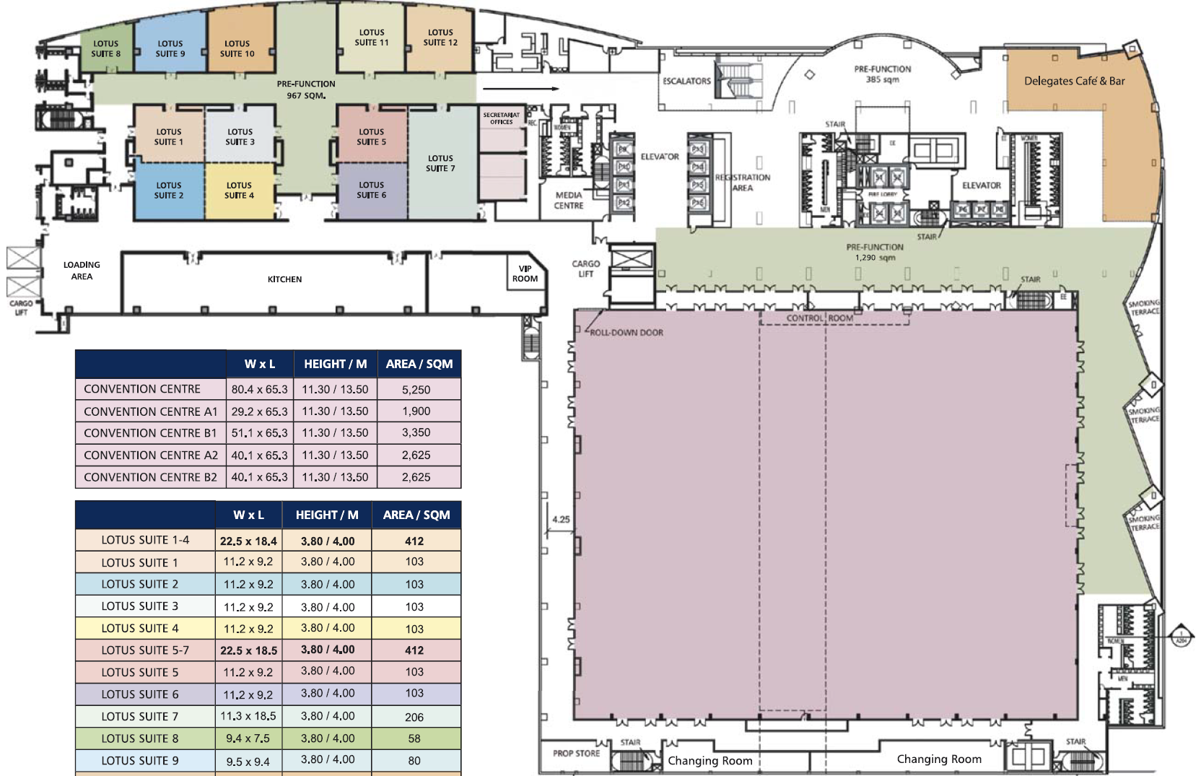
22nd Level Floor Plan

Slide 4
September 2015 Agenda Graphics
 | Mon 9/14 | Tue 9/15 | Wed 9/16 | Thu 9/17 | Fri 9/18
08:00 10:00 | Opening Sessions | 802.11 WNG | 802.11 ARC |  | 802.11 Closing
10:30 12:30 |  | 802.11 ARC | 802.11/802.15 Mid-week Plenaries
13:30 15:30 |  |  | 802.11 as a component
16:00 18:00 | OmniRAN Opening New contributions | CF text review |  | OmniRAN Closing
 |  |  |  | 802.15 Closing

Slide 5
Participants, Patents, and Duty to Inform
All participants in this meeting have certain obligations under the IEEE-SA Patent Policy.
Participants [Note: Quoted text excerpted from IEEE-SA Standards Board Bylaws subclause 6.2]:
“Shall inform the IEEE (or cause the IEEE to be informed)” of the identity of each “holder of any potential Essential Patent Claims of which they are personally aware” if the claims are owned or controlled by the participant or the entity the participant is from, employed by, or otherwise represents
“Should inform the IEEE (or cause the IEEE to be informed)” of the identity of “any other holders of potential Essential Patent Claims” (that is, third parties that are not affiliated with the participant, with the participant’s employer, or with anyone else that the participant is from or otherwise represents)
The above does not apply if the patent claim is already the subject of an Accepted Letter of Assurance that applies to the proposed standard(s) under consideration by this group
Early identification of holders of potential Essential Patent Claims is strongly encouraged
No duty to perform a patent search

Slide 6
Patent Related Links
All participants should be familiar with their obligations under the IEEE-SA Policies & Procedures for standards development.
Patent Policy is stated in these sources:
IEEE-SA Standards Boards Bylaws http://standards.ieee.org/develop/policies/bylaws/sect6-7.html#6
IEEE-SA Standards Board Operations Manual http://standards.ieee.org/develop/policies/opman/sect6.html#6.3
Material about the patent policy is available at http://standards.ieee.org/about/sasb/patcom/materials.html
If you have questions, contact the IEEE-SA Standards Board Patent Committee Administrator at patcom@ieee.org or visit http://standards.ieee.org/about/sasb/patcom/index.html
This slide set is available at https://development.standards.ieee.org/myproject/Public/mytools/mob/slideset.ppt

Slide 7
Call for Potentially Essential Patents
If anyone in this meeting is personally aware of the holder of any patent claims that are potentially essential to implementation of the proposed standard(s) under consideration by this group and that are not already the subject of an Accepted Letter of Assurance:
Either speak up now or
Provide the chair of this group with the identity of the holder(s) of any and all such claims as soon as possible or
Cause an LOA to be submitted

Slide 8
Other Guidelines for IEEE WG Meetings
All IEEE-SA standards meetings shall be conducted in compliance with all applicable laws, including antitrust and competition laws.
Don’t discuss the interpretation, validity, or essentiality of patents/patent claims.
Don’t discuss specific license rates, terms, or conditions.
Relative costs, including licensing costs of essential patent claims, of different technical approaches may be discussed in standards development meetings.
Technical considerations remain primary focus
Don’t discuss or engage in the fixing of product prices, allocation of customers, or division of sales markets.
Don’t discuss the status or substance of ongoing or threatened litigation.
Don’t be silent if inappropriate topics are discussed … do formally object.
See IEEE-SA Standards Board Operations Manual, clause 5.3.10 and “Promoting Competition and Innovation: What You Need to Know about the IEEE Standards Association's Antitrust and Competition Policy” for more details.

Slide 9
Resources – URLs
Link to IEEE Disclosure of Affiliation
http://standards.ieee.org/faqs/affiliationFAQ.html
Links to IEEE Antitrust Guidelines
http://standards.ieee.org/resources/antitrust-guidelines.pdf
Link to IEEE Code of Ethics
http://www.ieee.org/web/membership/ethics/code_ethics.html
Link to IEEE Patent Policy
http://standards.ieee.org/board/pat/pat-slideset.ppt

Slide 10
Agenda proposal for September 2015 F2F
Review of minutes
Reports
P802.1CF contributions
Functional decomposition and design
SDN abstraction
P802.1CF editor’s draft
Review and comments resolution
Component model within scope of 802.1CF
Status report to IEEE 802 WGs
AOB

Slide 11
Agenda items #1
Call Meeting to Order
Chair called meeting to order at 16:08
Minutes taker:
Walter is taking notes.
Roll Call
Name | Affiliation |  | Name | Affiliation
Max Riegel | Nokia Networks
Walter Pienciak | IEEE SA
Juan Carlos Zuniga | Interdigital
Yonggang Fang | ZTETX
Hyeong Ho Lee | ETRI
Chenchen Liu | Huawei
James Lepp | Blackberry

Slide 12
Call for Potentially Essential Patents
If anyone in this meeting is personally aware of the holder of any patent claims that are potentially essential to implementation of the proposed standard(s) under consideration by this group and that are not already the subject of an Accepted Letter of Assurance:
Either speak up now or
Provide the chair of this group with the identity of the holder(s) of any and all such claims as soon as possible or
Cause an LOA to be submitted
Nobody spoke up.

Slide 13
September 2015 F2F Agenda
Review of minutes
https://mentor.ieee.org/omniran/dcn/15/omniran-15-0039-00-00TG-july-2015-f2f-meeting-minutes.docx
Reports
Discussions on ‘802.11 as a component’
Status of Privacy ECSG
Creation of new revision of cf text
P802.1CF contributions
Functional decomposition and design
https://mentor.ieee.org/omniran/dcn/15/omniran-15-0042-00-CF00-an-setup-over-unlicensed-band.docx
SDN abstraction
P802.1CF editor’s draft
https://mentor.ieee.org/omniran/dcn/15/omniran-15-0035-01-CF00-cf-text-review.pdf
Review and comments resolution
Component model within scope of 802.1CF
https://mentor.ieee.org/omniran/dcn/15/omniran-15-0043-00-CF00-wlan-as-a-component.pptx
https://mentor.ieee.org/omniran/dcn/15/omniran-15-0044-00-CF00-radio-interface-component.pptx
Status report to IEEE 802 WGs
AOB
Agenda approved without comments.
Group agreed to hold session on component model on Wed, PM1

Slide 14
Agenda items #2
Review of minutes
https://mentor.ieee.org/omniran/dcn/15/omniran-15-0039-00-00TG-july-2015-f2f-meeting-minutes.docx
No comments received.
Reports
Discussions on ‘802.11 as a component’
Max reporting about activities afterJuly F2F going into Sept F2F
Multiple presentations prepared for this meeting.
Status of Privacy ECSG
Juan Carlos reported about successful completion and plans into Nov F2F
Creation of new revision of cf text
New revision was created after Jul F2F and made publically available on mentor by removing official elements and adding submission cover page.
P802.1CF contributions
Functional decomposition and design
https://mentor.ieee.org/omniran/dcn/15/omniran-15-0042-00-CF00-an-setup-over-unlicensed-band.docx
Yonggang introduced new contribution
Revision invited addressing the issues mentioned during discussion.
SDN abstraction
No contribution available
Recess at 18:10

Slide 15
Agenda items #3
P802.1CF editor’s draft
https://mentor.ieee.org/omniran/dcn/15/omniran-15-0035-01-CF00-cf-text-review.pdf
Review and comments resolution
https://mentor.ieee.org/omniran/dcn/15/omniran-15-0045-00-CF00-review-comments-on-doc-0035-01.xlsx
Component model within scope of 802.1CF
https://mentor.ieee.org/omniran/dcn/15/omniran-15-0043-00-CF00-wlan-as-a-component.pptx
https://mentor.ieee.org/omniran/dcn/15/omniran-15-0044-00-CF00-radio-interface-component.pptx
Status report to IEEE 802 WGs
AOB

