Slide 1
802.1CF Network Reference Model Introduction
Date: 2015-07-13
Authors:
Name | Affiliation | Phone | Email
Max Riegel | Nokia Networks | +49 173 293 8240 | maximilian.riegel@nokia.com
Notice: This document does not represent the agreed view of the IEEE 802.1 OmniRAN TG. It represents only the views of the participants listed in the ‘Authors:’ field above. It is offered as a basis for discussion. It is not binding on the contributor, who reserve the right to add, amend or withdraw material contained herein.
Copyright policy: The contributor is familiar with the IEEE-SA Copyright Policy <http://standards.ieee.org/IPR/copyrightpolicy.html>.
Patent policy: The contributor is familiar with the IEEE-SA Patent Policy and Procedures: <http://standards.ieee.org/guides/bylaws/sect6-7.html#6> and <http://standards.ieee.org/guides/opman/sect6.html#6.3>.
Abstract
The presentation contains an introduction into the basic concepts, design choices and the various stages of the 802.1CF Network Reference Model

Slide 2
802.1CF NRM Introduction
2015-07-13
Max Riegel
(Nokia Networks)

Slide 3
Unresolved issues at the end of the March 2015 F2F
Nature of the reference points
  Separation of data and control on R1, R3, R6
Notation of reference points
  R1 to R9, usage of –c, -d suffix
Term for the entity right to R3
  ‘Core’ / ‘Network service’
Interfaces of Coordination and Information Service

Slide 4
NRM as of March 2015
Subscription
Service
Coordination and Information
Service
R2c
R9c
R4c
R5c
TE Ctrl
AN Ctrl
CN Ctrl
R8c/1c
R3c
Terminal
Interface
R6c
R7c
Core
Network
Interface
NA
Backhaul
R1d
R6d
R3d
Terminal
Access Network
Core Network/
Network Service

Slide 5
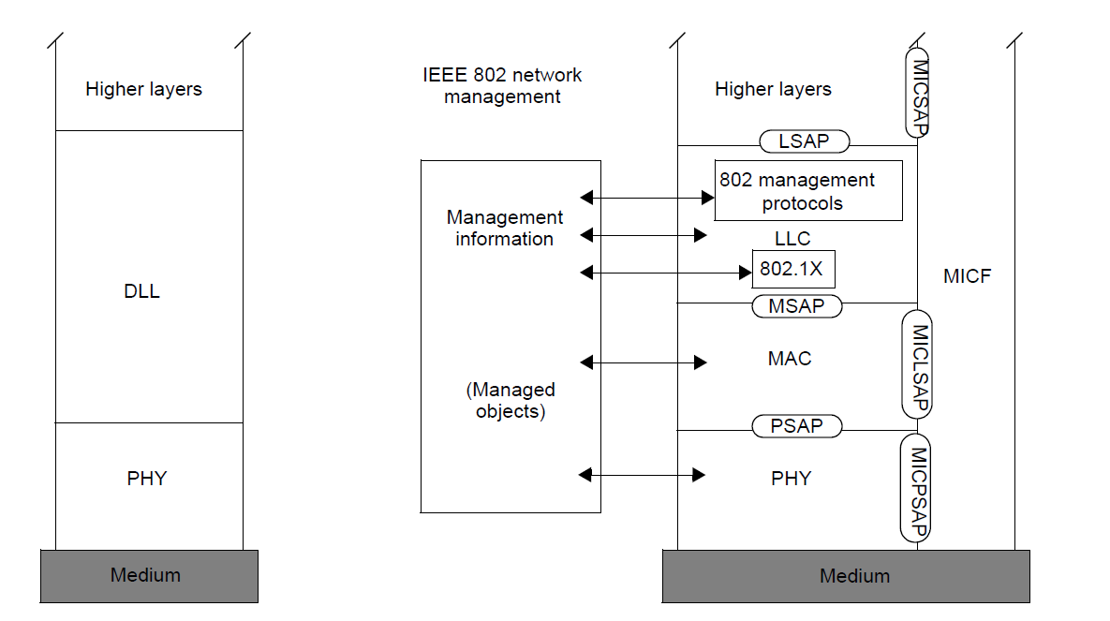
Reference Points
IEEE 802 knows about 2 kind of interfaces:
User data as well as peer-to-peer control is conveyed via ports
Control and management is represented by Layer Management Information as currently specified by the MIB
Control
Port

Slide 6


NRM mappings
Network Reference Model Schematic
Subscription
Service
Terminal
R2
R4
Access Network
Access Router
R1
R3
End-to-end communication network topology
Subscription
Service
Information
Server
Terminal
Access Network
Backhaul
Access Router
Scope of Network Reference Model in the protocol layer architecture
Application
Application
Transport
Transport
Network
Network
Network
Network
Data Link
DL
DL
DL
DL
DL
DL
Data Link
Data Link
Data Link
Physical
Phy
Phy
Phy
Phy
Phy
Phy
Physical
Physical
Physical
Medium
Medium
Medium
Medium
Medium
Terminal
Interface
Node of
Attachment
Backhaul
Access Router
Interface
Scope of P802.1CF

Slide 7
802.1CF NRM
Subscription
Service
Coordination and Information
Service
R2
R10
R4
R11
TE Ctrl
AN Ctrl
AR Ctrl
R8
R9
Terminal
Interface
R5
R7
Access Router
Interface
NA
Backhaul
R1
R6
R3
Terminal
Access Network
Access Router

Slide 8
Resolution of issues
The link from the terminal across the access network is terminated by the ‘access router’
  Terminology adjustment for ‘core network/network service’
R1, R3, R6 represent Ports according to IEEE 802 understanding
R5, R7 represent control and management of IEEE 802 (LMI, data format t.b.d.)
R8, R9 represent control information exchanges between terminal, access network and access router
  Further details to be provided
R2, R4, R10, R11 represent communication with external management entities for
  User sessions
  Common network resources e.g. spectrum

Slide 9
Examples for control information
R2: Credentials carried in EAP-methods
R4: Public user identity, authentication, authorization, accounting information, policy control
R8: User identity, ANQP information
R9: ??
R10: Network resource management, (e.g. interface into TVWS-DB)
R11: Session specific interface configuration for access router (e.g. VLAN-ID)

Slide 10
Basic NRM
Do we need such ‘simplified’ version?
Subscription
Service
R2
R4
R11
TE Ctrl
AN Ctrl
AR Ctrl
R8
R9
Terminal
Interface
Access Router
Interface
R1
R3
Terminal
Access Network
Access Router

Slide 11
Basic NRM w/ CIS
Do we need such ‘simplified’ version?
Subscription
Service
Coordination and Information
Service
R2
R10
R4
R11
TE Ctrl
AN Ctrl
AR Ctrl
R8
R9
Terminal
Interface
Access Router
Interface
R1
R3
Terminal
Access Network
Access Router

Slide 12
Opens?
We are missing definitions for TE Ctrl, Terminal Interface, AN Ctrl, AR Ctrl, and Access Router Interface.
Is there need for inter-access network communication?
  How coordinate multiple access networks among each other?
How to treat multiple NAs within an access network?
How large can a layer-2 domain become?

