Slide 1
P802.1CF NRM Mapping to real networks
Date: 2015-04-16
Authors:
Name | Affiliation | Phone | Email
Max Riegel | Nokia Networks | +49 173 293 8240 | maximilian.riegel@nokia.com
Notice: This document does not represent the agreed view of the IEEE 802.1 OmniRAN TG. It represents only the views of the participants listed in the ‘Authors:’ field above. It is offered as a basis for discussion. It is not binding on the contributor, who reserve the right to add, amend or withdraw material contained herein.
Copyright policy: The contributor is familiar with the IEEE-SA Copyright Policy <http://standards.ieee.org/IPR/copyrightpolicy.html>.
Patent policy: The contributor is familiar with the IEEE-SA Patent Policy and Procedures: <http://standards.ieee.org/guides/bylaws/sect6-7.html#6> and <http://standards.ieee.org/guides/opman/sect6.html#6.3>.
Abstract
Contributions and discussions in the March 2015 meeting covered the mapping of P802.1CF NRM to real access networks, both IEEE 802 access networks as well as non-IEEE 802 access networks carrying Ethernet frames.
The presentation introduces early considerations on mapping of Wi-Fi access network, China Mobile iPCN and Cable Networks to the P802.1CF NRM.

Slide 2
P802.1CF NRM mapping to real networks
2015-04-16
Max Riegel
(Nokia Networks)

Slide 3
Terminology
SS: Subscription Service
CIS: Coordination and Information Service
AN: Access Network
ANC: Access Network Controller
NA: Node of Attachment
CN: Core Network
CNI: Core Network Interface
CNC: Core Network Controller
TE: Terminal
TEI: Terminal Interface
TEC: Terminal Controller
BH: Backhaul

Slide 4
Draft P802.1CF NRM
Subscription
Service
Coordination and Information
Service
R2c
R9c
R4c
R5c
TE Ctrl
AN Ctrl
CN Ctrl
R8c/1c
R3c
Terminal
Interface
R6c
R7c
Core
Network
Interface
NA
Backhaul
R1d
R6d
R3d
Terminal
Access Network
Core Network

Slide 5
Wi-Fi Access Network
NRM mapping to real networks

Slide 6


End-to-end network topology
Subscription
Service
Information
Service
Terminal
Access Network
Backhaul
Core Network
TE
NA
Scope of P802.1CF in the protocol layer architecture
Application
Application
Transport
Transport
Network
Network
Network
Network
Data Link
DL
DL
DL
DL
DL
DL
Data Link
Data Link
Data Link
Physical
Phy
Phy
Phy
Phy
Phy
Phy
Physical
Physical
Physical
Medium
Medium
Medium
Medium
Medium
Terminal
Interface
Node of
Attachment
Backhaul
Core Network
Interface
Scope of P802.1CF
Schematic NRM for the IEEE 802 access network
Subscription
Service
Terminal
R2
R4
Access Network
Core Network
R1
R3

Slide 7
Wi-Fi access network further considerations
Where is an appropriate public reference for Wi-Fi network architecture?

Slide 8
China Mobile iPCN
NRM mapping to real networks

Slide 9
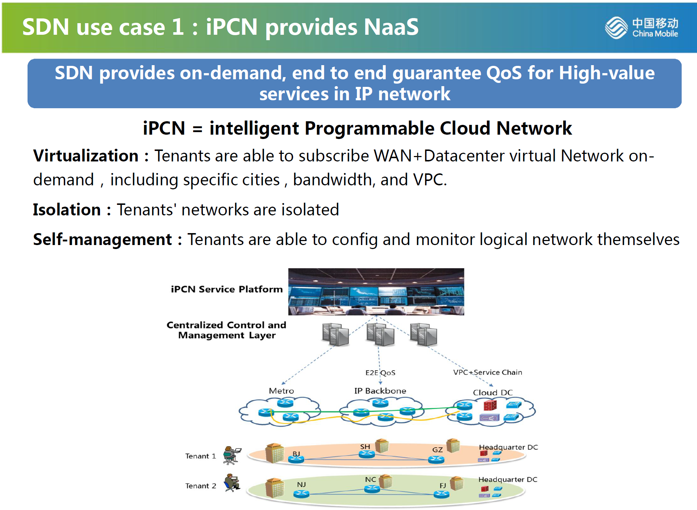
China Mobile iPCN omniran-15-0016-00-wsdn-sdn-practice-of-china-mobile.pdf

Slide 10
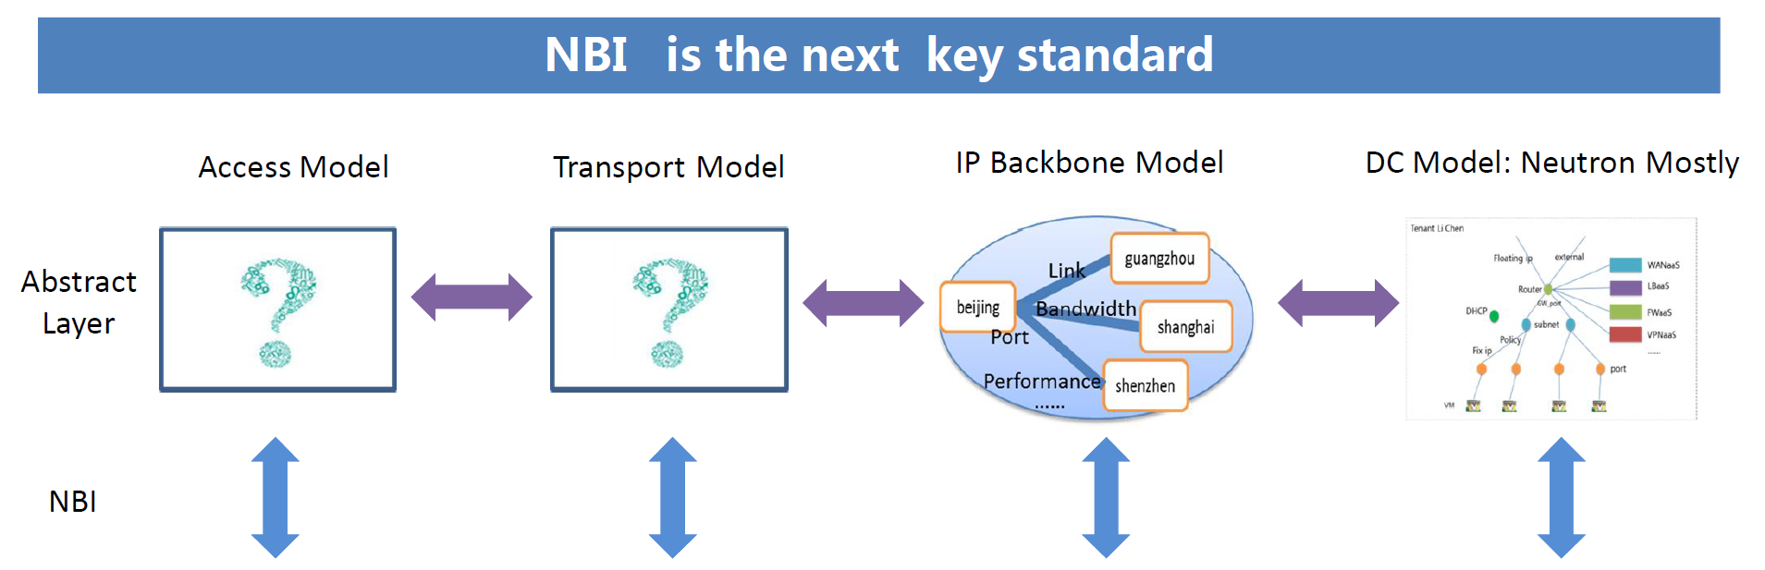
P802.1CF model for iPCN
P802.1CF
It seems, P802.1CF can provide the access model and partly(?) the transport model
  Does iPCN comply with carrying Ethernet frames end-to-end?
Further input from China Mobile needed to fully understand the required functionality for both, access and transport.
  What kind of access technologies are supported by iPCN?
  What is the demarcation between Transport Model and IP Backbone Model?
  How is access control for terminals realized?

Slide 11
CABLE Network
NRM mapping to real networks

Slide 12




Mapping of cable networks
CM
CM
AAA
SNMP
CMTS
CM
Cable
Network

Slide 13
Mapping of cable networks
Basic case: cable network represents R1
CM
CM
AAA
SNMP
CMTS
CM
Cable
Network
TE
R1
NA
R3

Slide 14


Second flavor of cable networks
Community Wi-Fi (e.g. Comcast xfinity)
CM
CM
AAA
SNMP
CMTS
AAA
CM
Cable
Network

Slide 15
Second flavor of cable networks
Community Wi-Fi (e.g. Comcast xfinity)
Cable Network represents Backhaul
CM
CM
AAA
SNMP
CMTS
AAA
CM
Cable
Network
TE
R1
NA
Backhaul
R3

Slide 16
R-MACPHY Architecture
from Hesham
R-MACPHY Controller manages the configuration of the of the R-MACPHY device.
The Controller can be either a separate device or a component embedded in an aggregation and switching device, such as a router, a switch, or an OLT

Slide 17
R-PHY L2TPv3 Topology
from Hesham

Slide 18
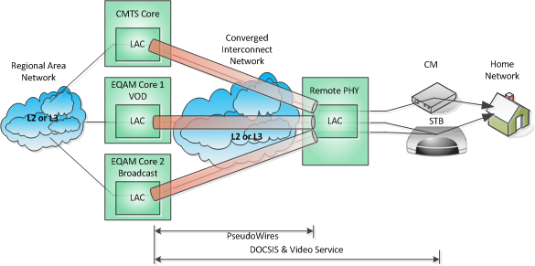
R-PHY L2TPv3 Topology – Multiple Tunnels
from Hesham

Slide 19
Conclusion
P802.1CF NRM can be easily mapped to real Ethernet access networks
Details have to be worked out as multiple configurations may exist.
It is important to have a public reference for the particular network architecture.
Who would be willing to work on text on particular mappings?

