Slide 1
Distributed Access Architectures
Authors: Hesham ElBakoury
Version: 1.0

Slide 2
Objectives
Present current Cablelabs Distributed Access Architectures.
Discuss if/how IEEE 1904.2 should support these architectures.

Slide 3
Agenda
Cablelabs Distributed Access Architectures
Remote MAC & PHY (R-MACPHY)
Functional Modules of Distributed CMTS Architecture
R-MACPHY System Architecture
R-MACPHY Management Architecture
Remote PHY (R-PHY)
L2TPv3 Pseudo-wires
R-PHY System Architecture
Example of R-PHY L2TPv3 Topologies
R-PHY Tunneling Protocols (use L2TPv3 – RFC3931).
DEPI (Downstream External PHY Interface)
UPEI (Upstream External PHY Interface)

Slide 4
Distributed Access Architectures

Slide 5
1
R-MACPHY

Slide 6
Functional Modules of the Distributed CMTS Architecture
System control module: This logical module is responsible for Configuration and management of the RFI module and the classification and forwarding module. For example, during CM registration, the system control module parses service flows and classification information reported by the CM and configures the classification and forwarding module accordingly. In addition, the system control module works with the NMS and the configuration system for service configuration and management.

Slide 7
R-MACPHY Architecture
R-MACPHY Controller manages the configuration of the of the R-MACPHY device.
The Controller can be either a separate device or a component embedded in an aggregation and switching device, such as a router, a switch, or an OLT

Slide 8
R-MACPHY Management Using the Controller
OLT/Router is managed using existing management systems.
CM is Managed using existing DOICSIS provisioning and NMS systems.
R-MACPHY devices and their CM interfaces are managed like slots in CMTS Chassis.
No interest within China MSO for interoperability between Controller and R-MACPHY (CMC). Therefore, there is no interest to update CDMM to reflect new requirements. As a result vendors such as Huawei implement their own L2 protocol.
Huawei proposes Netconf/SNMP as the management protocol between the controller and R-MACPHY node.
PNM is used for MER Reporting, Symbol Capture, FEC Error Reporting PHY Stats Reporting

Slide 9
2
R-PHY

Slide 10
L2TPv3 Tunnels and Pseudo-wires
The base protocol that is used for the DEPI is the Layer 2 Tunneling Protocol Version 3, or L2TPv3 for short [RFC3931].
L2TPv3 is an IETF protocol that is a generic protocol for creating a pseudowire (PW)
PW is defined in RFC 3955 (Pseudo-wire Emulation Edge to Edge Architecture – PWE3) as an Emulation of Point to point connection over a packet switching network (PSN).
L2TPv3 tunnel can carry more than one session (PW).
There is an optional L2-Specific Sublayer is an intermediary layer between the L2TP session header and the start of the tunneled frame.

Slide 11
R-PHY System Architecture

Slide 12
R-PHY L2TPv3 Topology

Slide 13
R-PHY L2TPv3 Topology – Multiple Tunnels

Slide 14
Remote PHY Pseudo-wires

Slide 15
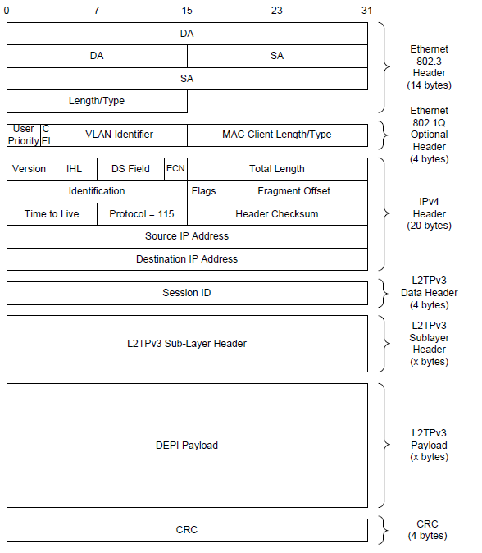
Downstream External PHY Interface (DEPI)
Data plane protocol for DS direction
Based on L2TPv3
Support IP encapsulation

Slide 16
Downstream External PHY Interface (DEPI)
Based on L2TPv3 with IP Encapsulation
Only Session ID as L2TPv3 Data Header. Cookies are not used.
Supports both DOCSIS Packet Streaming Protocols (PSP) and DOCSIS MPEG Transport (D-MPT)

Slide 17
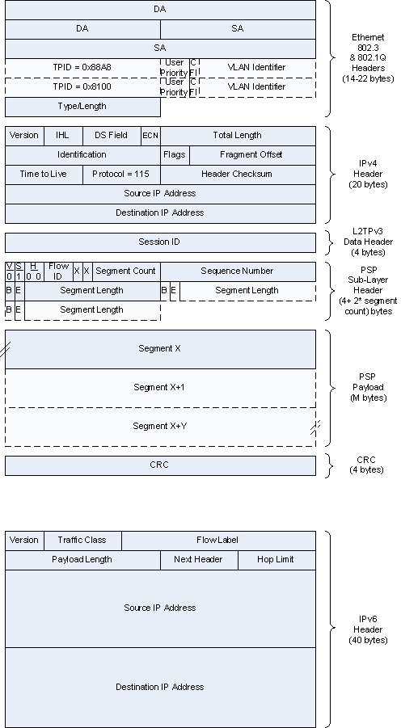
Upstream External PHY Interface (UEPI)
Only session ID is used. No Cookies
Based on L2TPv3 with IP encapsulation
Supports PSP.

Slide 18
THANK YOU

Slide 19
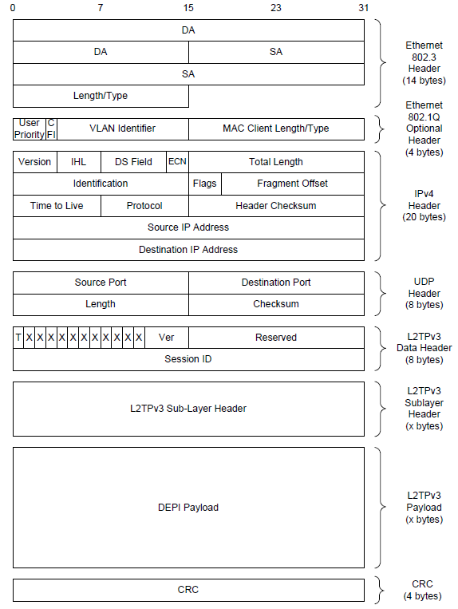
L2TPv3 UDP encapsulation (Not Used in R-PHY)
Protocol ID is 17 (UDP)
Use 8 bytes L2TPv3 Data Header
4B Version Header
4B Session ID

Slide 20
UMT Discovery Protocol – EPoC Use Case

