Slide 1
IEEE 802.1 OmniRAN TG February 10th, 2015 Conference Call
2015-02-10 Max Riegel, Nokia Networks
(OmniRAN TG Chair)

Slide 2
Conference Call
Tuesday, February 10th, 2015 at 10:00-11:00am ET
WebEX
Meeting Number: 705 116 269
Meeting Password: OmniRAN
To join this meeting
1. Go to https://nsn.webex.com/nsn/j.php?J=705116269&PW=67935ad6df24070150362776
2. Enter the meeting password: OmniRAN
3. Click "Join Now".
4. Follow the instructions that appear on your screen.
Teleconference information
Call-in number: 1-(972) 445 9673 (US)
Show global numbers: http://www.nsn.com/nvc
Conference Code: 433 819 2102

Slide 3
Participants, Patents, and Duty to Inform
All participants in this meeting have certain obligations under the IEEE-SA Patent Policy.
Participants [Note: Quoted text excerpted from IEEE-SA Standards Board Bylaws subclause 6.2]:
“Shall inform the IEEE (or cause the IEEE to be informed)” of the identity of each “holder of any potential Essential Patent Claims of which they are personally aware” if the claims are owned or controlled by the participant or the entity the participant is from, employed by, or otherwise represents
“Personal awareness” means that the participant “is personally aware that the holder may have a potential Essential Patent Claim,” even if the participant is not personally aware of the specific patents or patent claims
“Should inform the IEEE (or cause the IEEE to be informed)” of the identity of “any other holders of such potential Essential Patent Claims” (that is, third parties that are not affiliated with the participant, with the participant’s employer, or with anyone else that the participant is from or otherwise represents)
The above does not apply if the patent claim is already the subject of an Accepted Letter of Assurance that applies to the proposed standard(s) under consideration by this group
Early identification of holders of potential Essential Patent Claims is strongly encouraged
No duty to perform a patent search

Slide 4
Patent Related Links
All participants should be familiar with their obligations under the IEEE-SA Policies & Procedures for standards development.
Patent Policy is stated in these sources:
IEEE-SA Standards Boards Bylaws http://standards.ieee.org/develop/policies/bylaws/sect6-7.html#6
IEEE-SA Standards Board Operations Manual http://standards.ieee.org/develop/policies/opman/sect6.html#6.3
Material about the patent policy is available at
http://standards.ieee.org/about/sasb/patcom/materials.html
If you have questions, contact the IEEE-SA Standards Board Patent Committee Administrator at patcom@ieee.org or visit http://standards.ieee.org/about/sasb/patcom/index.html
This slide set is available at https://development.standards.ieee.org/myproject/Public/mytools/mob/slideset.ppt

Slide 5
Call for Potentially Essential Patents
If anyone in this meeting is personally aware of the holder of any patent claims that are potentially essential to implementation of the proposed standard(s) under consideration by this group and that are not already the subject of an Accepted Letter of Assurance:
Either speak up now or
Provide the chair of this group with the identity of the holder(s) of any and all such claims as soon as possible or
Cause an LOA to be submitted

Slide 6
Other Guidelines for IEEE WG Meetings
All IEEE-SA standards meetings shall be conducted in compliance with all applicable laws, including antitrust and competition laws.
Don’t discuss the interpretation, validity, or essentiality of patents/patent claims.
Don’t discuss specific license rates, terms, or conditions.
Relative costs, including licensing costs of essential patent claims, of different technical approaches may be discussed in standards development meetings.
Technical considerations remain primary focus
Don’t discuss or engage in the fixing of product prices, allocation of customers, or division of sales markets.
Don’t discuss the status or substance of ongoing or threatened litigation.
Don’t be silent if inappropriate topics are discussed … do formally object.
---------------------------------------------------------------
See IEEE-SA Standards Board Operations Manual, clause 5.3.10 and “Promoting Competition and Innovation: What You Need to Know about the IEEE Standards Association's Antitrust and Competition Policy” for more details.

Slide 7
Resources – URLs
Link to IEEE Disclosure of Affiliation
http://standards.ieee.org/faqs/affiliationFAQ.html
Links to IEEE Antitrust Guidelines
http://standards.ieee.org/resources/antitrust-guidelines.pdf
Link to IEEE Code of Ethics
http://www.ieee.org/web/membership/ethics/code_ethics.html
Link to IEEE Patent Policy
http://standards.ieee.org/board/pat/pat-slideset.ppt

Slide 8
Agenda
Agenda bashing
Review of minutes
Reports
Contributions to P802.1CF
Preparation of Mar 2015 F2F meeting
AOB

Slide 9
Business#1
Call Meeting to Order
Meeting called to order by chair at 10:05 ET
Minutes taker:
Antonio volunteered to take notes
Roll Call
Name | Affiliation |  | Name | Affiliation
Max Riegel | Nokia Networks
Juan Carlos Zuniga | Interdigital
Antonio de la Oliva | UC3M

Slide 10
Business #2
Review of minutes
Minutes of January 2015 F2F meeting
https://mentor.ieee.org/omniran/dcn/15/omniran-15-0007-00-00TG-january-2015-f2f-meeting-minutes.docx
Will be reviewed in upcoming F2F meeting
Reports
Introduction of OmniRAN to IEEE 1904.2 (http://www.ieee1904.org/index.shtml)
http://www.ieee1904.org/2/meeting_archive/2015/02/tf2_1502_elbakoury_3.pdf
Presenter not available in the call
Will be brought up again in next F2F meeting to learn about responses from 1904.2
Introduction of OmniRAN to WBA whitepaper on SDN &NFV
Contribution on next slide
Chair will create more comprehensive description based on results of today’s conference call
Updates on related SDN standardization activities
https://mentor.ieee.org/omniran/bp/SDN_Wiki
Desire to have more detailed updates in upcoming F2F meeting
Chair should ask experts for availability to provide reports
Other report
No other reports provided

Slide 11
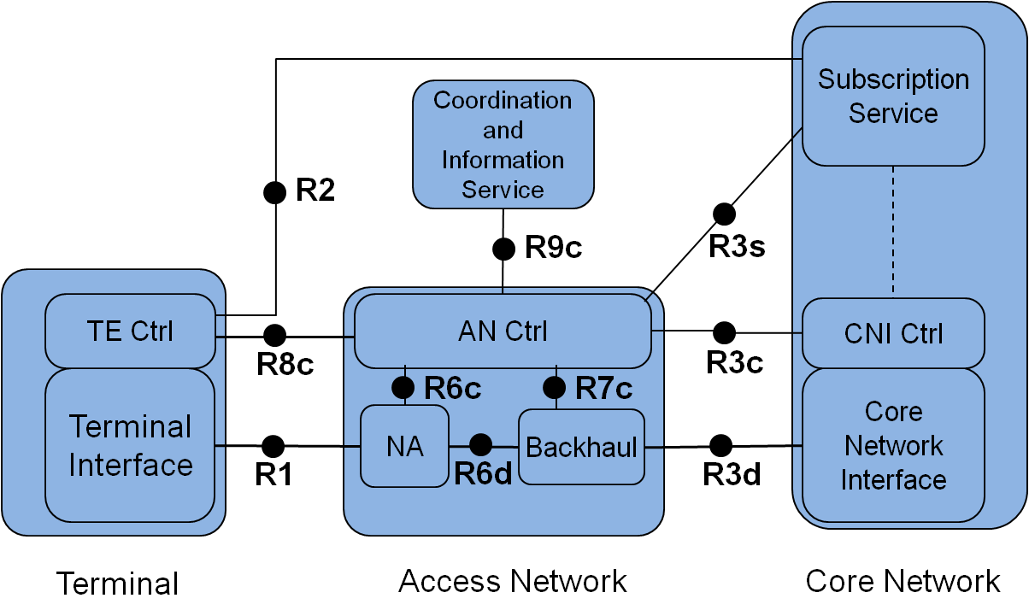
Contribution to WBA SDN&NFV White Paper
The IEEE 802.1 OmniRAN TG was established and authorized in March 2014 to create a recommended practice on Network Reference Model and Functional Description of IEEE 802 Access Network. Its project P802.1CF specifies an access network reference model, including entities and reference points along with behavioral and functional descriptions of communications among those entities to provide a generic model of IEEE 802 access network for connecting terminals to their access routers. An IEEE 802 access network is defined by the usage of Ethernet frames for the transport on the link between the terminal interface to the core network interface, where the access router resides.
Figure 5‑3: IEEE 802 Network Reference Model
To provide an abstraction of an access network well aligned to the principles of Software Defined Networks the network reference model introduces a clear separation of control and configuration information from the Ethernet datapath.
The P802.1CF specification describes the use of IEEE 802 technologies to build heterogeneous access networks, which may include multiple network interfaces, multiple network access technologies, and multiple network subscriptions, aimed to unify the support of different interface technologies, enabling shared network control and use of software defined network (SDN) principles.
To align the specification work with SDN related activities in other standardization organizations and to determine emerging approaches for modeling and description of software defined networks the OmniRAN TG helds SDN related BoF sessions at IEEE 802 plenary meetings and maintains a wiki page listing standardization efforts in other SDOs with close relation to the technologies developed by IEEE 802
Related Links:
P802.1CF project status: http://www.ieee802.org/1/pages/802.1cf.html
OmniRAN TG status: https://mentor.ieee.org/omniran/bp/StartPage
OmniRAN SDN Wiki: https://mentor.ieee.org/omniran/bp/SDN_Wiki

Slide 12
Business #3
Contributions to P802.1CF
NRM Refinements
https://mentor.ieee.org/omniran/dcn/15/omniran-15-0008-00-CF00-nrm-refinements.pptx
Refinements to terminology introduced
No agreement yet on treatment of R1 & R8c
Agreement to separate Subscription Service in separate entity and introduce interface between subscription service and core network
Informative text on applicability and example deployments looks fien
Update of slides created and uploaded.
https://mentor.ieee.org/omniran/dcn/15/omniran-15-0008-01-CF00-nrm-refinements.pptx

Slide 13
Business#4
Preparation of Mar 2015 F2F meeting
Schedules, see next slide
No overlap with privacy on Thursday morning
Agenda proposal, see slide after
Added item on representation of radio over Ethernet
AOB
May 2015 interim meeting in Pittsburgh, PA
OmniRAN meets on May 20th/21st (Wed&Thu)
Start on Wed likely in the morning; depends on DCB
Adjourned at 11:16 AM ET

Slide 14
Mar 2015 Agenda Graphics
 | Mon 3/9 | Tue 3/10 | Wed 3/11 | Thu 3/12 | Fri 3/13
08:00 10:00 | 802 EC Opening | 802.11 WNG | 802.11 ARC/802.1 IWK | Privacy EC SG | 802.11 Closing
10:30 12:30 |  | 802.11 ARC | 802.11/802.15 Mid-week Plenaries
 | 802.1 Opening Plenary
 |  |  |  |  | 802 EC Closing
13:30 14:00 15:30 |  |  |  | 802.1 Closing Plenary
16:00 18:00
 | Tutorials | Privacy EC SG

Slide 15
Agenda proposal for January 2015 F2F
Review of minutes
Reports
SDN & NFV status update
P802.1CF contributions
Network reference model
Backhaul representation
Radio over Ethernet representation
SDN Abstraction
Functional design and decomposition
Project planning
Publicity activities
Status report to IEEE 802 WGs
AOB

