Slide 1
Short introduction into
OmniRAN P802.1CF
Max Riegel, Nokia Networks
(Chair IEEE 802.1 OmniRAN TG)

Slide 2
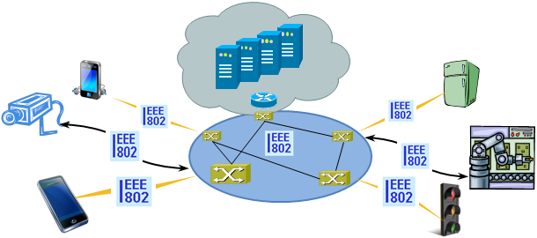
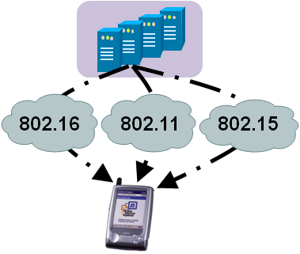



There is evidence to consider commonalities of IEEE 802 Access Networks
More (huge) networks are coming
up by everything gets connected
  e.g. SmartGrid, ITS, IoT, …
New markets for
IEEE 802 access technologies
  e.g. factory automation, in-car communication, home automation, …
IEEE 802 access is becoming more heterogeneous
  multiple network interfaces
    e.g. IEEE 802.3, IEEE 802.11, IEEE 802.15…
  multiple access network topologies
    e.g. IEEE802.11 in residential, corporate and public
  multiple network subscriptions
    e.g. multiple subscriptions for same interface
New emerging techniques, like SDN and virtualization

Slide 3
OmniRAN P802.1CF provides a kind of ‘Stage 2’ Specification for IEEE 802
The ITU-T defined in its Rec. I.130 a sequential 3 stage process, which is nowadays commonly used in most telecommunication network standardization activities.
A ‘Stage 2’ specification provides a mapping of the existing IEEE 802 protocols to a functional network model, which facilitates easier evaluation and better understanding of end-to-end behavior.
‘External’ requirements from the
service/deployment perspective
Develop a logical/functional model
for evaluation of those requirements
Available IEEE 802 specifications
of protocols and attributes.
?

Slide 4
P802.1CF in the big picture of the Internet
Internet
Peer
(Client)
Peer
(Server)
Internet/Web Applications
WWW
WWW
HTTP
HTTP
TCP
TCP
IP
IP
IP
IP
IP
IP
IP
IP
LINK
LINK
LINK
LINK
LINK
LINK
LINK
LINK
LINK
LINK
LINK
LINK
PHY
PHY
PHY
PHY
PHY
PHY
PHY
PHY
PHY
PHY
PHY
PHY
P802.1CF Domain
Access
Router
UE

Slide 5
Key constraints for P802.1CF
Reverse engineering of a ‘Stage 2’ document based on the existing IEEE 802 protocols
  Show, how the IEEE 802 protocols fit together
  Show, that required functionality is available
  Gaps in existing IEEE 802 protocols may appear, but its up to the responsible 802 WGs to fill them
Recommended Practice
  It provides common understanding however does not exclude other solutions
  It may lead to better alignment of capabilities of IEEE 802 access technologies (wired as well as wireless)
Aim is to sharpen the understanding of IEEE 802 for the deployment in access networks
  Provide a kind of cookbook to network engineers
  Provide a reference specification to other organizations and operators

Slide 6
P802.1CF Project Authorization Request
Project Title:
Network Reference Model and Functional Description of IEEE 802 Access Network
Scope:
This Recommended Practice specifies an access network, which connects terminals to their access routers, utilizing technologies based on the family of IEEE 802 Standards by providing an access network reference model, including entities and reference points along with behavioral and functional descriptions of communications among those entities.
Purpose:
Heterogeneous networks may include multiple network interfaces, multiple network access technologies, and multiple network subscriptions. In some cases such heterogeneous functionality must be supported in a single user terminal.
This Recommended Practice supports the design and deployment of access networks based on IEEE 802 technologies, guides the developers of extensions to the existing standards in support of a heterogeneous access network, and enables the use of IEEE 802 standards in new network deployments by specifying the functions of the IEEE 802 technologies when deployed in access networks.

Slide 7
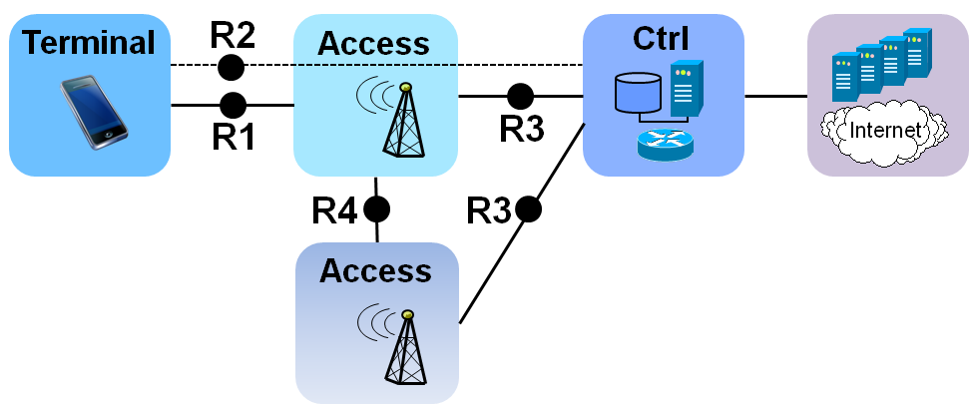
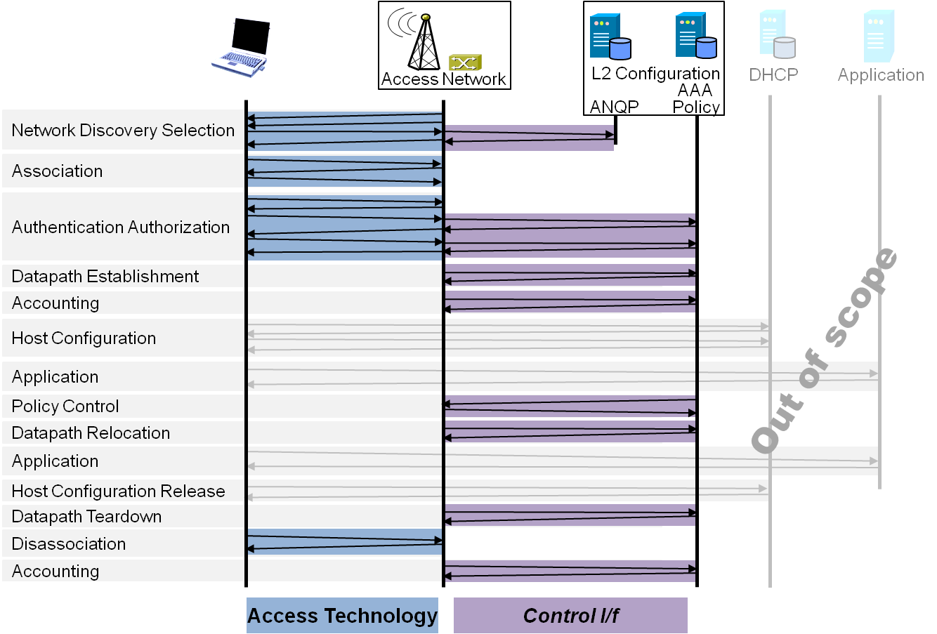
P802.1CF Draft ToC
Introduction and Scope
Abbreviations, Acronyms, Definitions, and Conventions
References
Identifiers
Network Reference Model
  Overview
  Reference Points
  Access Network Control Architecture
    Multiple deployment scenarios including backhaul
Functional Design and Decomposition
  Dynamic Spectrum Access
  Network Discovery and Selection
  Association and Disassociaiton
  Authentication and Trust Establishment
  Datapath establishment,
  relocation and teardown
  Authorization, QoS and policy control
  Accounting and monitoring
SDN Abstraction
  Terminal
  Access Network
Annex:
  Tenets (Informative)

Slide 8
SDN is part of OmniRAN P802.1CF
Control Entity
CORE
Higher Layers Control I/f
Data Link
Data Link
Physical
Physical
Medium
Medium
Openflow Switch Specification v1.3.2
Common understanding of SDN is aligned to the same architectural model as used by OmniRAN.
Access networks have always been a kind of ‘software defined’ network.

Slide 9
Example Chapter Structure
Functional Design and Decomposition
  Dynamic Spectrum Access
  Network Discovery and Selection
    Generic functional requirements and information flows
    Ethernet functional design <- 802.3
    WPAN functional design <- 802.15
    WLAN functional design <- 802.11
    WMAN functional design <- 802.16
    WRAN functional design <- 802.22
  Association and Disassociaiton
  Authentication and Trust Establishment
  Datapath establishment,
  relocation and teardown
  Authorization, QoS and policy control
  Accounting and monitoring

Slide 10




NDS Functional Requirements
IEEE 802 network discovery and selection should support more complex scenarios:
  Multiple access technologies
  Multiple different access networks
  Multiple subscriptions
  Specific service requirements
  No a-priori knowledge about offered services
Access Network
>1<
CORE
A
CORE
C
Access Network
>2<
CORE
B
Access
Network
>3<

Slide 11
Network Discovery and Selection
Functions
A process which allows a station to retrieve the list of all access network interfaces in reach by
  Passive scanning
  Active scanning
  Data base query
Retrieving supplementory information for each of the access network interfaces to learn about
  Identity of the access network
  Supported Subscriptions
  Supported Services
Some algorithm in the station, which processes all the retrieved information, for determination of the ‘best’ access network interface to connect to.

Slide 12
NDS Roles and Identifiers
User
  One or more Subscriptions
    Subscription Identifier {NAI} + Subscription Name {String}
Terminal
  Station
    STA {EUI-48}
Access Network
  One or more Access Network Interfaces
    ANI {EUI-48}
  Access Network
    AN Identifier {EUI-48} + AN Name {String}
  Supported Subscription Services
  Supported User Services
  Access Network Capabilities
    Record of capabilities {t.b.d. (ANQP???}
CORE
  Subscription Service – ‘Termination point of AAA’
    SSP Identifier {FQDN} + SSP Name {String}
  User Service – ‘Termination point of IEEE 802 user plane’
    USP Identifier {???} + USP Name {String}

Slide 13
NDS Technology Specific Design
 |  | 802.3 | 802.11 | 802.15 | 802.16 | 802.22
Identifiers | STA | EUI-48 | EUI-48 | EUI-64 | EUI-48 | EUI-48
 | ANI | EUI-48 | EUI-48 | EUI-64 | EUI-48 | EUI-48
 | AN-id | ??? | EUI-48 | ??? | EUI-48 | EUI-48
 | AN-name | 256 Char | 30 Char | ???
Subscriptions |  | NAI | NAI/PSK | ???/PSK | NAI | NAI
Multiple COREs |  | Info | ANQP | - | ? | -
Discovery process |  | manual | passive, active | passive, active | passive | passive
A specific section for each of the IEEE 802 access technologies should explain, how the generic requirements are supported and realized.
  It would be great, if references into the specifications would be provided.

Slide 14
Conclusion
The P802.1CF specification provides a kind of functional framework across all IEEE 802 access technologies.
OmniRAN would like to engage subject matter experts of the 802 WGs for contributions on the particular access technologies.
  We will provide a kind of template to keep your efforts low
A thorough review should be performed by the WGs to ensure that the access technology specific content of P802.1CF is correct.

Slide 15
Looking forward to next session in
Athens, September 15-18
Envisioned topics:
  Refinement of Network Reference Model
  Review revision of text on dynamic spectrum access
  Network Detection and Selection /w review by other WGs
  Multiple IEEE 802 interfaces on the same link – what are the issues?
  Which of the IEEE 802.15 interfaces can apply to 802.1CF?
  Revision of SDN contribution text
  Project development schedule
Conference calls on September 4th and October 21st, 10:00AM ET
Announcements and dial-in details on OmniRAN TG Wiki page on mentor https://mentor.ieee.org/omniran/bp/StartPage

