Slide 1
802.1CF ToC Refinements
Date: 2014-06-20
Authors:
Name | Affiliation | Phone | Email
Behcet Sarikaya | Huawei |  | behcet.sarikaya@huaweicom
Notice: This document does not represent the agreed view of the OmniRAN EC SG. It represents only the views of the participants listed in the ‘Authors:’ field above. It is offered as a basis for discussion. It is not binding on the contributor, who reserve the right to add, amend or withdraw material contained herein.
Copyright policy: The contributor is familiar with the IEEE-SA Copyright Policy <http://standards.ieee.org/IPR/copyrightpolicy.html>.
Patent policy: The contributor is familiar with the IEEE-SA Patent Policy and Procedures: <http://standards.ieee.org/guides/bylaws/sect6-7.html#6> and <http://standards.ieee.org/guides/opman/sect6.html#6.3>.
Abstract
The presentation suggests some refinements on the ToC of 802.1CF.

Slide 2
OmniRAN P802.1CF ToC Refinements
Behcet Sarikaya
(Huawei)

Slide 3
Example ToC of the P802.1CF specification (Nov 2013)
Introduction and Scope
Abbreviations, Acronyms, Definitions, and Conventions
References
Network Reference Model
Overview
Reference Points
Access Network Control Architecture
Multiple deployment scenarios
Functional Design and Decomposition
Network Discovery and Selection
Association
Authentication and Authorization
Point-to-Point link establishment
Datapath establishment, relocation and teardown
QoS and policy control
Datapath relocation
Datapath teardown
Disassociation
Accounting
Annex:
Tenets (Informative)
Network Reference Model
Functional Description

Slide 4
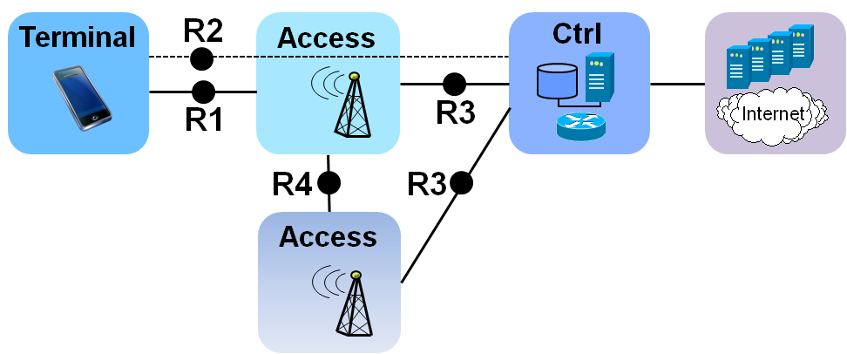
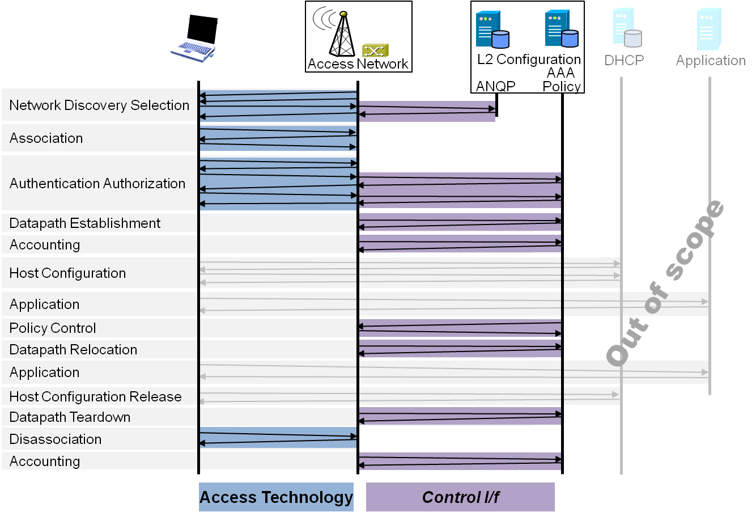
P802.1CF Draft ToC
Introduction and Scope
Abbreviations, Acronyms, Definitions, and Conventions
References
Identifiers
Network Reference Model
Overview
Reference Points
Access Network Control Architecture
Multiple deployment scenarios
Functional Design and Decomposition
Network Discovery and Selection
Association
Authentication and Authorization
Datapath establishment
QoS and policy control
Datapath relocation
Datapath teardown
Disassociation
Accounting
SDN Abstraction Layer
Terminal
Access
Backhaulbone
Annex:
Tenets (Informative)

Slide 5
Further thoughts
Suggesting a new section on Point-to-Point link establishment
Supporting the grouping of individual sections may make sense, e.g.
Datapath establishment, relocation and teardown
QoS and policy control with Authorization
Association and Disassociation
What else?
How to structure SDN Abstraction section
Proposing to move SDN section somewhere above
Following sections may need to present SDN solutions

