Slide 1
[ONF Wireless & Mobile WG Status Update]
Date: [2014-01-22]
Authors:
Name | Affiliation | Phone | Email
Paul Congdon | Tallac Networks | +1 916 765 4056 | paul.congdon@tallac.com
Notice: This document does not represent the agreed view of the OmniRAN EC SG. It represents only the views of the participants listed in the ‘Authors:’ field above. It is offered as a basis for discussion. It is not binding on the contributor, who reserve the right to add, amend or withdraw material contained herein.
Copyright policy: The contributor is familiar with the IEEE-SA Copyright Policy <http://standards.ieee.org/IPR/copyrightpolicy.html>.
Patent policy: The contributor is familiar with the IEEE-SA Patent Policy and Procedures: <http://standards.ieee.org/guides/bylaws/sect6-7.html#6> and <http://standards.ieee.org/guides/opman/sect6.html#6.3>.
Abstract
This presentation provides an update on the status and activities of the Open Networking Foundation’s Wireless and Mobile Working Group.

Slide 2
ONF Wireless & Mobile Working Group Status Update
Paul Congdon
January 22, 2014

Slide 3
Motivation
At the Tutorial for IEEE 802 Plenary in Dallas, Serge Manning, Chair of ONF WMWG, introduced the new ONF effort
This presentation provides updated status and more detail into the activities of the ONF WMWG.

Slide 4
Wireless & Mobile WG (WMWG)
Goals and Deliverables
Mission and Goals
  Examine the unique requirements of SDN in wireless and mobile networks
  Simplify the interaction between wireless physical networks and packet networks with centralized control and management.
  Develop reference architectural descriptions that encompass different elements of ONF based technologies in wireless and mobile network domains
  Identify enhancements to ONF technologies to improve operation of mobile and wireless networks.
    ONF technologies include OpenFlow Switch and OpenFlow-Config Protocols, Northbound interfaces and associated architectures.

Slide 5
WMWG Leadership
Serge Manning – Chair
Paul Congdon – Vice Chair
Charlie Perkins – Secretary
Project Teams
  Ariel Adam – Wireless Transport PT Lead
  Amy Ye – Wireless Transport PT Editor
  John Kaippallimalil – Mobile Packet Core PT Lead
  Xiaobo Long – Unified Access PT Lead

Slide 6
History and Timeline
Working Code
Protocol Extensions
Reference Architectures
Use Case Selection
Use Case Collection
Working Group and Project Teams
Formed
ONF Member
Workday
ONF Member
Workday
ONF Member
Workday
Study Group
Formed
3/13
6/13
9/13
12/13
3/14
6/14
9/14
12/14
3/15
6/15
You are here!

Slide 7
From use cases to project teams
Contributed Use Cases (To be published soon)
Flexibile scalable packet core
Dynamic resource management for wireless backhaul
Mobile Traffic Management
Connection-Oriented SDN for Wireless SCB
Management of secured flows in LTE
Media-Independent Handover
SDN Enhanced Distributed P/S-GW
Network-Aware UE Multiple Radio Interface Management
S-GW virtualization
Service Chaining in Mobile Service Domain
Energy Efficiency in Mobile Backhaul Network
Security and Backhaul Optimization
Unified Equipment Management and Control
Network Based Mobility Management
SDN-Based Mobility Management in LTE
IEEE OmniRAN
Unified Access Network for Enterprise and Large Campus
Use Case Project Teams
Mobile Packet Core
Wireless Transport
Unified Access
NOTE: Other PTs may be added later

Slide 8
WMWG Projects
Work is divided into technical areas as Projects
Additional Projects may be created in the future
Mobile Packet Core
Unified Access
Wireless
Backhaul
    Apply OpenFlow to 3GPP Evolved Packet Core (EPC)
    Many uses such as user/data plane separation in GW, mobility management and mobile flow steering for offload.
    Develop a unified access network that uses a common controller to manage both wireless access points (AP) and wired switches
    Backhaul links are wireless
    Central SDN controller optimizes radio parameters in data plane using OpenFlow

Slide 9
Mobile Packet Core Project Team
    Address Three Use Cases
    SDN based Evolved Packet Core
    SDN based Mobility Management
    Service Chaining in Mobile Service Domain
  EPC control plane and SDN controller separated
  from data plane implemented by OpenFlow switches
  Place and move the routing of GTP and non-GTP tunnel flows through EPC data plane using OpenFlow while supporting the needs of the wireless network
  OpenFlow extensions may be required to support:
  GTP/non-GTP tunneling, Policy Control, Online/Offline charging, and Lawful Interception

Slide 10
Service Chaining in Mobile Service Domain
Use OpenFlow/SDN to selectively steer traffic to the desired service enablers in a specific order.
Consider the use of a common service chain label or ID between Traffic Classifier in the Mobile Connection Zone and Mobile Service Zone.

Slide 11
Wireless Backhaul Project
Application
Application plane
Client
SDN Controller
    Combining 4 Use Cases
    Backhaul resource management
    Energy Efficiency
    Unified Equipment Management
    Common Public Radio Interface (CPRI) and Ethernet support
Virtual Control
Virtual Control
Microwave Backhaul SDN Controller
Optical Backhaul SDN Controller
Control plane
Direct Control
Direct Control
Direct Control
Data plane
MW Backhaul Network
ETH Backhaul Network
Optical Backhaul Network
Backhaul where the transport links themselves are wireless
As demand for backhaul resources change, the SDN controller calculates the path and assigns the backhaul resources taking into account
  SLA parameters (e.g., guaranteed vs. non-guaranteed)
  Link availability, capacity, e.g., adjusting modulation.
  Collection of traffic statistics to estimate the actual throughput
  Can also accomplish other things such as Energy Efficiency
  Alignment with Optical Transport Working Group
  Define new OpenFlow port types for wireless backhaul links (e.g. microwave)

Slide 12



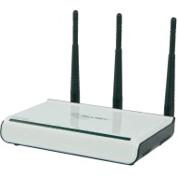

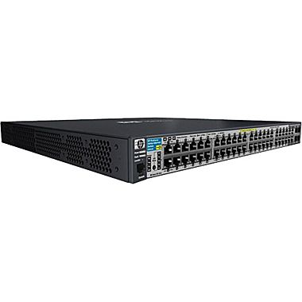
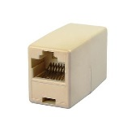


Unified Wired/Wireless Access Project
AAA Server
802.1X authenticator
Access Device Mgmt
CAPWAP
Device/users information collector
Policy rules
Fast Secure Handoff
802.11r
Rogue detection, etc…
Wireless User
SDN Applications
Unified Access NBI Convergence and Services
Wired User
SDN
Controller
VPN
Remote User
Requirements:
Ability to enforce consistent network access policy based on user/device authentication.
Ability to maintain network policy and meet application requirements in the present of user/device roaming.
Address needs for resilient network access in the presence of network infrastructure failure.
Provide fine grain monitoring for troubleshooting and rogue access device detection.

Slide 13
Application Priority Focus
Unified Access Control
  Enable IEEE 802.1X authenticator with OpenFlow policy enforcement
  Understand OpenFlow policy enforcement in IETF NEA and Trusted Computing TNC architectures
Large Scale Access Management
  OpenFlow enabled data path in CAPWAP environments
  OpenFlow agent and CAPWAP AP resident real-time function interaction
  CAPWAP device configuration and user session management operations
Other applications…

Slide 14
Example OpenFlow Implications
Unified IEEE 802.1X Authenticator
Scenario:
OpenFlow is used to capture/inject 802.1X/EAPOL messages
Application on controller performs 802.1X Authenticator/Radius Client functions
Resulting authorization causes controller to deploy user specific rules
Encryption key material must be installed in the access device (802.11i, MACSec)
Potential ONF Standardization Needs:
OpenFlow message extensions for key material distribution.
NOTE: ONF Security WG has similar need for IPSec key distribution.
Radius
Server
Unified Network Access Control
RADIUS
(UDP 1812/1813)
EAPOL
(802.1X)
Wireless User
OpenFlow Applications
OpenFlow
(TCP 6633/6634)
OpenFlow
Controller
=
OpenFlow Agent
EAPOL
(802.1X)
New Key Material Distribution
Wired User
=
802.1X Authenticator
Radius Client

Slide 15
Example OpenFlow Implications
Large Scale Access Management
Scenario:
Access device supports real-time functions locally
OpenFlow agent rules enable distributed device data path
Access device management provisions and monitors resources (RF channel assignment)
Potential ONF Standardization Needs:
OpenFlow action support for real-time functions (rate adaption, beam forming, learning)
Define WiFi port properties and unique 802.11 frame match fields for OpenFlow
OF-Config support for deploying WiFi configuration
Real-time
functions
Data path
management
Unified Access Device Mgmt
Unified Network Access Control
Wireless User
OF-Config
OpenFlow
Controller
Real-time
functions
Wired User
=
OpenFlow Agent
Real-time
functions
Wireless User

Slide 16
2014 Goals for WMWG
1Q 2014 Goals
  For each Project Team, initial draft of Ref Architecture and OpenFlow Study. Focus on Architecture - Extend General ONF Architecture as needed.
  Goal is to present draft ideas at Spring Member Workday
  These documents will contain illustrative architectures, determination of any architectural or OpenFlow family protocol specific issues and suggestions for OpenFlow family extensions or enhancements.
2Q-4Q 2014 Goals
  Focus on protocol issues. Circulate Ref Architecture and OpenFlow Study documents and incorporate feedback from other ONF WGs.
  Expect interactions with other ONF Working Groups (ARCH, EXT, and NBI)
  Finalize Reference Architecture and OpenFlow Study documents.
  Make recommendations for OpenFlow family extensions or enhancements to ONF.

Slide 17
General ONF Architecture
Architecture document nearing completion, but not yet published
Specifies the architecture of SDN and identifies further work
Intended to guide working groups and as a tool for external communication
Key Sections of the document
  3. SDN overview
  4. Principles and structure
    4.1 Data plane
    4.2 Control plane
    4.3 Application plane
    4.4 Management
    4.5 Information model
  5. Control functions and interactions
  6. Implementation considerations
  Appendix A. Example applications of the architecture
    A.1. Use case 1 – Multi-tenant virtual machine orchestration
    A.2. Use case 2 – Elephant flow traffic optimization

Slide 18
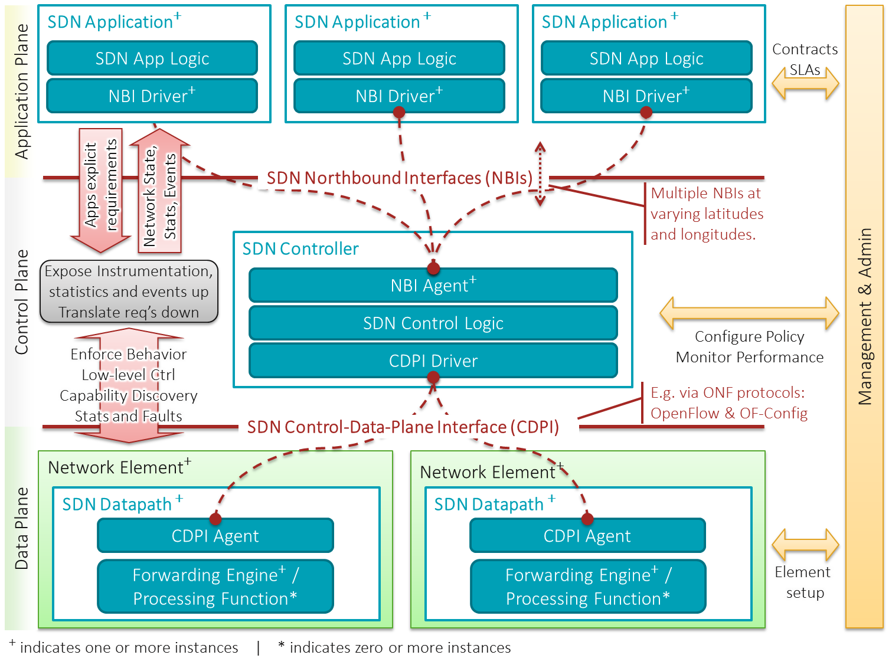
SDN Architecture Overview

Slide 19
WMWG Architecture Document Outline
1 Scope
2 References
3 Definitions
  3.1 Abbreviations and acronyms
4 Architectural/Functional Requirements (from Use Cases)
5 Architecture (Diagrams)
6 Information Models
  6.1 Southbound Interface Information Models
  6.2 Northbound Interface Information Models
7 OpenFlow Protocol Requirements
8 OpenFlow Extension Descriptions
  8.1 OF-Switch Extensions
  8.2 OF-Config Extensions

Slide 20
Key Take Aways
ONF WMWG is working quickly towards improvements to SDN for wireless environments
Current focus is on a reference architecture for each use case project
New project teams can be considered as long as there are warm bodies to work on them.

