Slide 1
OmniRAN SDN Use Case ToC
Date: 2014-01-22
Authors:
Name | Affiliation | Phone | Email
Juan Carlos Zúñiga | InterDigital | +1514 904 6300 | j.c.zuniga@ieee.org
Antonio de la Oliva | UC3M | +34 91 624 8803 | aoliva@it.uc3m.es
Notice: This document does not represent the agreed view of the OmniRAN EC SG. It represents only the views of the participants listed in the ‘Authors:’ field above. It is offered as a basis for discussion. It is not binding on the contributor, who reserve the right to add, amend or withdraw material contained herein.
Copyright policy: The contributor is familiar with the IEEE-SA Copyright Policy <http://standards.ieee.org/IPR/copyrightpolicy.html>.
Patent policy: The contributor is familiar with the IEEE-SA Patent Policy and Procedures: <http://standards.ieee.org/guides/bylaws/sect6-7.html#6> and <http://standards.ieee.org/guides/opman/sect6.html#6.3>.
Abstract
This document presents some considerations for addressing the SDN use case in the proposed Reference Model Table of Contents (ToC).

Slide 2
What do we want to achieve?
Control plane
Control of interface/radio parameters
Control of MAC-specific features
Data path establishment
User authentication and authorization
Data plane
Arbitrary matching of (wireless) frame parameters
Frame forwarding

Slide 3
Solution Matrix
Yellow: Changes required
Green: Supported
Red: Not supported

Slide 4
SDN modifications to the ToC
Include one section to the proposed ToC
Abstraction Layers at the Access, Backhaul and Terminal
Access: 802.11ac, 802.11af, 802.3, etc.
Backhaul: 802.16r, 802.3, 802.11ad+, 802.22, etc.
Terminal: 802.11ac, 802.11af, 802.3, etc.

Slide 5
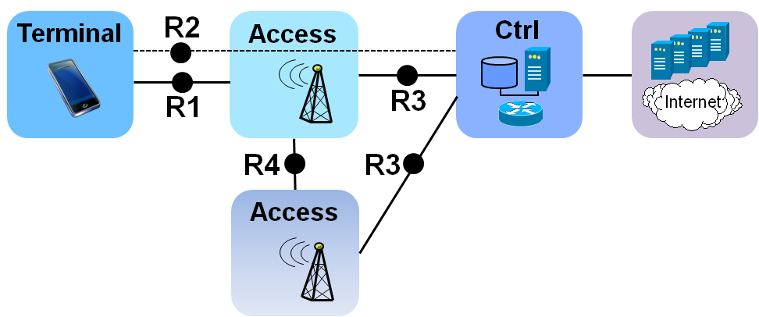
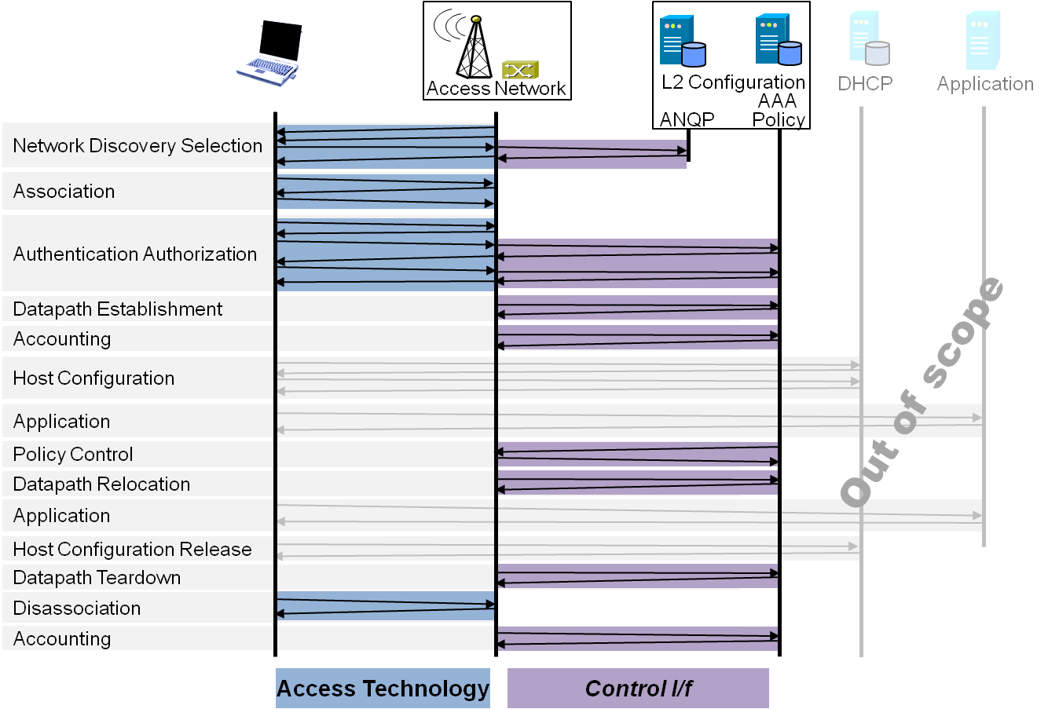
Draft ToC of the proposed specification
Introduction and Scope
Abbreviations, Acronyms, Definitions, and Conventions
References
Identifiers
Tenets for IEEE 802 Access Network Systems
Network Reference Model
Overview
Reference Points
Abstraction Layers
Access
Backhaul
Terminal
Access Network Control Architecture
Multiple deployment scenarios
Functional Design and Decomposition
Network Discovery and Selection
Association
Authentication and Authorization
Datapath establishment
QoS and policy control
Datapath relocation
Datapath teardown
Disassociation
Accounting

