Slide 1
IEEE 802 OmniRAN ECSG
Results and Proposals
Scope of IEEE 802, gaps and proposed ways forward
2014-01-21

Slide 2
ToC
Motivation
OmniRAN within the scope of IEEE 802
  Definition of IEEE 802 specific control attributes
Common Network Reference Model
Potential gaps to existing IEEE 802 standards
  Investigated use cases
    3GPP Trusted WLAN Access to EPC (3GPP SaMOG Rel 11)
    ZigBee Smart Energy Profile 2 (ZigBee SEP2)
    Software Defined Networking (SDN)
    Wi-Fi roaming
Necessary specification work within IEEE 802
Conclusion

Slide 3
Motivation
IEEE 802 OmniRAN Results and Proposals

Slide 4



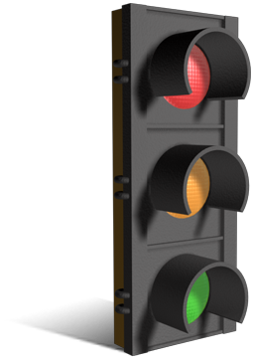
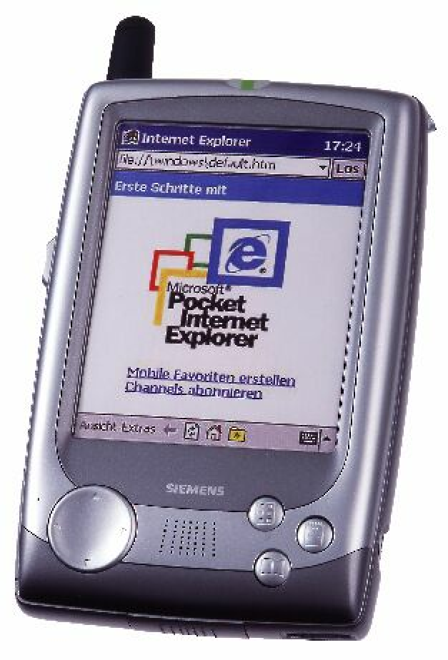
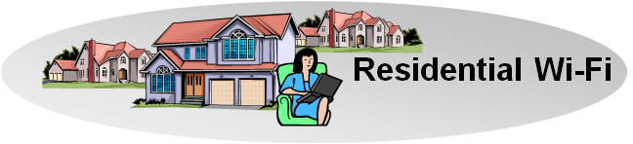
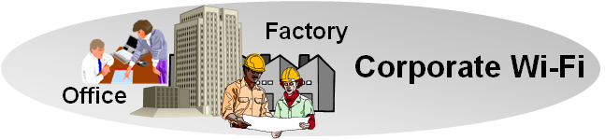
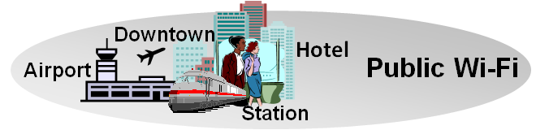
There is Evidence to consider Commonalities of IEEE 802 Access Networks
More (huge) networks are coming
up by everything gets connected
  e.g. SmartGrid, ITS, IoT, …
New markets for
IEEE 802 access technologies
  e.g. factory automation, in-car communication, home automation, …
IEEE 802 access is becoming more heterogeneous
  multiple network interfaces
    e.g. IEEE 802.3, IEEE 802.11, IEEE 802.15…
  multiple access network topologies
    e.g. IEEE802.11 in residential, corporate and public
  multiple network subscriptions
    e.g. multiple subscriptions for same interface
New emerging techniques, like SDN and virtualization
802.16
802.11
802.15

Slide 5
OmniRAN WITHIN
The SCOPE of IEEE 802
IEEE 802 OmniRAN Results and Proposals

Slide 6

Access Network Abstraction by OmniRAN
Terminal
Access Network
Ctrl
Service
OmniRAN Network Reference Model
R2
Terminal
Access Network
Ctrl
R1
R3
OmniRAN provides a generic model of an access network based on IEEE 802 technologies
Application
Application
Transport
Transport
Network
Network
Network
Network
Data Link
Data Link
Data Link
Data Link
Scope of IEEE 802
Data Link
Data Link
Data Link
Data Link
Physical
Physical
Physical
Physical
Physical
Physical
Physical
Physical
Medium
Medium
Medium
Medium

Slide 7
Access networks are for dynamic attachment of terminals to networks
Terminal
Access Network
Control
Services
Internet
Communication networks supporting dynamic attachment of terminals are usually structured into
  Access Network
    Distributed infrastructure for aggregation of multiple network access interfaces into a common interface
  Control (Core)
    Infrastructure for control and management of network access and end-to-end IP connectivity
  Services
    Infrastructure for providing services over IP connectivity

Slide 8
Functional decomposition of dynamic network access
Access Network
Control (Core)
Network advertisement
Pre-association signaling
Authentication, authorization and accounting client
L2 session establishment
  w/ QoS and Policy Enforcement
L2 mobility management inside access networks
Traffic forwarding to core based on L2 addresses
Subscription management
Terminal provisioning
Authentication, authorization and accounting server
IP address management
IP connectivity establishment to Internet and services
Policy & QoS management server (policy decision)
Mobility Anchor
Roaming support to other cores

Slide 9
Access Network Control Plane Functions
Access Network
ANQP
AAA
Policy
Configuration
DHCP
Application
Scanning
Network Selection
Association
Authentication
Authorization
Accounting
Host Configuration
Application
Policy Control
Application
Host Config Release
Disassociation
Accounting
Legend:
L2 Protocol
L2 Attributes
L2 Protocol
L3+ Attributes
L3+ Protocol
L2 Attributes
L3+ Protocol
L3+ Attributes

Slide 10

IEEE 802 Access Network Functions
Access Network
L2 Configuration
AAA
Policy
DHCP
Application
ANQP
Network Discovery Selection
Association
Authentication Authorization
Datapath Establishment
Accounting
Host Configuration
Out of scope
Application
Policy Control
Datapath Relocation
Application
Host Configuration Release
Datapath Teardown
Disassociation
Accounting
Access Technology
Control I/f

Slide 11
Mapping of OmniRAN Reference Points to IEEE 802 Reference Model
Higher Layers
Higher Layers
Higher Layers Control
Higher Layers Control
R2 R3
R3
Current scope of IEEE 802
Data Link
Data Link
Data Link
Data Link
Data Link
Data Link
Physical
R1
Physical
Physical
Physical
Physical
Physical
Medium
Medium
Medium
Reference Points can be mapped onto the IEEE 802 Reference Model
  R1 represents the PHY and MAC layer functions between terminal and base station
    Completely covered by IEEE 802 specifications
  R2 represents the L2 control protocol functions between terminal and central entities for control and AAA.
  R3 represents the L1 & L2 control interface from a central control entity into the network elements
‘R2’ and ‘R3’ cover IEEE 802 specific attributes
  However IP based protocols are used to carry control information between network elements and access network control
  Effectively each of IEEE 802 network elements contains an IP communication stack on top of the IEEE 802 data path for the exchange of the control information.

Slide 12
Handling IEEE 802 Attributes in IP Protocols
Current handling of IEEE 802 specific attributes for IP protocols:
  IEEE 802 has an established procedure for defining the MIBs of the own technologies
    Now completely in scope for IEEE 802
  Currently IEEE 802 does not deal with other IEEE 802 attribute definitions for IP protocols
    e.g. IEEE 802 specific AAA (RADIUS, DIAMETER) attributes are done by IETF with only some informal review by IEEE 802 WGs
Specification of IEEE 802 related attributes for IP protocols by IETF has cumbersome issues, e.g.:
  delayed availability (completion of RFC may last 2 years after completion of IEEE standard)
  RFC’s can’t cope with revisions and life cycle of IEEE standards
    new RFC required for each amendment and revision of IEEE 802 standard
    new RFC’s have different numbers
    RFCs stay forever, while IEEE 802 standards have limited lifecycle
IEEE 802 should take full responsibility for all its IEEE 802 specific attributes for IP protocols
  like done today for managed objects (MIBs)

Slide 13
Common Network Reference Model
IEEE 802 OmniRAN Results and Proposals

Slide 14
Make IEEE 802 technologies properly supporting important deployments
IEEE 802 technologies should fulfill the requirements of important deployments, e.g.:
  Telecommunication, Smart Grid, ITS, SDN, …
Two main questions have to addressed:
  Which IEEE 802 standards do contribute to the particular deployments?
  Do the IEEE 802 standards provide all required functions?
A common model is necessary to make IEEE 802 technologies assessable and comparable, e.g.
  a reference model to compare functionalities
  a reference architecture to show how the IEEE 802 standards are fitting together for particular deployments
OmniRAN defines a Network Reference Model which
  maps IEEE 802 technologies into a generic network architecture,
  allows functional evaluation of IEEE 802 access technologies.

Slide 15
Reference Model for IEEE 802 Network with Reference Points
Terminal
R2
Access
Ctrl
R1
R3
Internet
R4
R3
Access
Core
R3
Access
Authentication
Authentication
Authorization
Authorization
R5
Accounting
Accounting
Location
Location
CoA
CoA
Mobility
Datapath
Mobility
Access
R3
Ctrl
Encapsulation
Encapsulation
Transport
Internet
Reference Points represent a bundle of functions between peer entities
  Similar to real network interfaces
Functions are extensible but based on IEEE 802 specific attributes

Slide 16
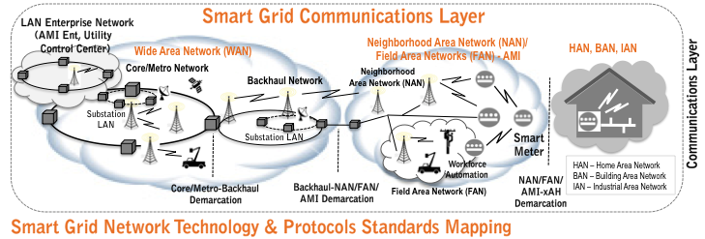

OmniRAN explains IEEE 802 Standards for Smart Grid Communications
Service
Ctrl
R5
Ctrl
R5
Ctrl
R3
R3
R3
R3
R3
R3
R3
Access
R4
Access
Access
Access
Access
Access
Access

Slide 17
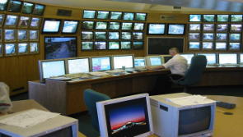
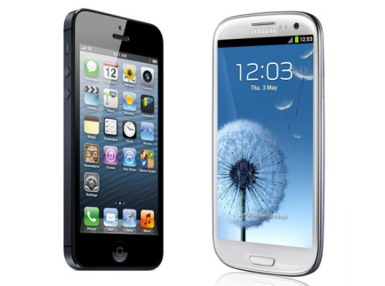
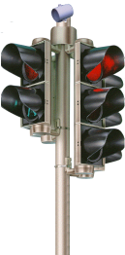


OmniRAN for upcoming topics: IEEE 802 Deployment for ITS Communications
ITS: Intelligent Transportation System Reference: ISO 21217(2013)
Vehicle ITS Station | Roadside ITS Station | Central ITS Station | Personal ITS Station
Roadside
Gateway
Access
Router
Roadside
Host
Border
Router
t
Facilities
t
Applications
n
n
Facilities
e
y
e
y
m
t
m
t
i
i
e
r
t
e
r
t
g
u
n
g
u
a
N
etworking
c
e
N
etworking
y
a
c
n
n
e
m
t
n
N
etworking
&
e
e
N
etworking
y
i
S
m
t
&
Transport
...
S
e
...
r
a
...
a
g
&
Transport
u
Transport
e
&
Transport
...
i
M
c
M
r
a
e
g
u
n
S
a
c
a
n
e
Access
M
Access
Access
a
Access
S
Technologies
5
.
9
Technologies
Technologies
M
Technologies
Ethernet
CAN bus
GHz
Ethernet
Ethernet
Ethernet
IPv
6
Mobile
Router
Vehicle
Host
Vehicle
Gateway
5.9
Traffic Centre/Service Centre
t
Applications
Applications
Central
Gateway
Central
Host
Border
Router
n
Facilities
e
y
t
Facilities
t
Facilities
m
t
n
n
i
e
y
e
y
e
r
m
t
m
t
u
i
i
e
r
e
r
g
t
u
u
c
n
N
networking
g
c
g
N
networking
c
e
y
a
N
etworking
&
e
a
e
a
e
m
...
t
n
...
S
n
...
S
&
Transport
i
a
Transport
a
&
Transport
n
N
etworking
e
r
M
M
S
g
u
a
c
a
n
e
...
a
Access
S
Access
Access
M
&
Transport
M
Technologies
Technologies
Technologies
ECU
ECU
Applications
Access
t
t
Technologies
n
Facilities
n
Facilities
e
y
e
y
m
t
m
t
i
i
e
r
e
r
g
u
g
u
t
a
c
a
c
n
n
N
etworking
e
n
N
etworking
&
e
e
N
networking
y
a
S
a
S
m
t
&
Transport
...
Transport
...
&
Transport
...
i
M
M
e
r
g
u
a
c
n
e
Access
a
S
Technologies
Technologies
Access
M
Access
Technologies
Ctrl
SENS
Ethernet
CAN bus
Ethernet
Ethernet
IPv
6
Loop Detector
Communication Network
ITS Network Technology & Protocols Standards Mapping
Terminal
R1
Access
R3
Ctrl
Service
Terminal
Terminal
R1
R1
Access
R3
R3
Access
Terminal
R2
Access
R3
Ctrl
R1

Slide 18
Potential gaps to existing IEEE 802 standards
IEEE 802 OmniRAN Results and Proposals

Slide 19
Example use cases investigated for gap analysis
3GPP Trusted WLAN Access to EPC
  TS 23.402 V11.6.0 (2013-03)
ZigBee SEP2 Smart Grid Use Case
  ZigBee docs-09-5449-33-0zse
SDN-based OmniRAN Use Case
Wi-Fi Hotspot Roaming Use Case

Slide 20
3GPP Trusted WLAN Access to EPC
TS 23.402 V11.6.0 (2013-03)
Support for non-seamless WLAN offload (NSWO) or single PDN connection selected by the network without IP address preservation
S2a bearer creation and deletion based on EAP and AAA signaling
  Emulating link state signaling of WLAN Access Network
Definition of a WLAN Access Network, a Trusted WLAN AAA Proxy (TWAP) and a Trusted WLAN Access Gateway (TWAG)
Requiring a point-to-point link between UE and TWAG across WLAN Access Network
Reference Model:

Slide 21
3GPP Trusted WLAN Access to EPC
OmniRAN Reference Point mapping
R1 maps directly to the SWw reference point of 3GPP
R2 and R3 would provide specified interfaces for Trusted WLAN AAA Proxy and Trusted WLAN Access Gateway, which are not addressed by 3GPP by definition
3GPP does not provide details for direct Internet access.
Terminal
Access
R2
Core
R1
R3
Internet

Slide 22
GAP#1: Support for point-to-point links in bridged networks
R1
R3
STA
AP/BS
GW
Ctrl/Core
Access Link Model – the networking theory
IP
DLL
DLL
IP
DLL
DLL
PHY
DLL
DLL
PHY
DLL
DLL
PHY
PHY
PHY
PHY
PHY
PHY
Access Link Model – real world Ethernet
IP
ETH
ETH
IP
DLL
DLL
GRE
GRE
ETH
ETH
PHY
PHY
IP
IP
PHY
PHY
ETH
ETH
ETH
ETH
PHY
PHY
PHY
PHY
For security and operational reasons, real access networks require a point-to-point link between terminal and access router
The point-to-point link has to be maintained when the terminal is moving from one access point to another access point
  Mobility support; the link has to be re-located
IEEE 802.1 seems to miss support point-to-point links across a bridged infrastructure
  Real access networks deploy instead Ethernet over GRE over IP over Ethernet to emulate the desired point-to-point link behavior
  Required L2 behavior is realized by transport of L2 over L3

Slide 23
  GAP#1:
  Required functionality in IEEE 802.1
Setting up and maintaining a point-to-point access link across a bridged infrastructure
  Initializing the point-to-point link under AAA based access control
  Maintaining the point-to-point link when STA roams to another AP
Link state signaling at the edge of the bridged infrastructure
  E.g.: 3GPP expects an trigger for setting up S2a context when point-to-point link in IEEE 802 is established
BTW: Provider Backbone Bridging (MAC in MAC) within the access network may be a solution
  unfortunately it is designed for provider backbones
  missing solution for dynamic VLAN assignment may be another issue

Slide 24

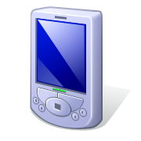
ZigBee SEP2 Smart Grid Application
SEP2 Communication Infrastructure
SEP2 defines a Smart Energy Profile Network by which a variety of devices can communicate with the Energy Services Interface
  Technical Requirements specified by
  ZigBee docs-09-5449-33-0zse
The network consists of
  Local access infrastructure (HAN) with
    Network Access Server
    Network Authentication Server
  Application Trust Center
  Energy Services Interface
  to energy provider
Local access infrastructure can
be based on any technology
enabling IP connectivity to the
Application Trust Center and ESI.
ESI
Application
Trust Server
HAN
Network
Authentication
Server
Network
Access
Server

Slide 25
ZigBee SEP2 Smart Grid Application
OmniRAN Reference Point Mapping
OmniRAN is applicable to the local access infrastructure providing IP connectivity to ESI and Application Trust Server
HAN represents the functions contained in Access and Core function blocks of OmniRAN
R3 allows for easy integration of different link layer technologies with common Network Authentication Server and Network Access Server
R2 provides access authentication for any link technology represented by R1
HAN
Network
Authentication
Server
Application
Trust Server
ESI
Network
Access
Server
Access
R2
R3
Terminal
Access
Core
R1
R3

Slide 26
GAP#2: Network-ID and service indication in wired Ethernet
ZigBee SEP2 requires support for network discovery and selection functions.
IEEE 802.3 explicitly mentioned as technology candidate does not provide network advertisement, network discovery and network selection functions like the IEEE 802 wireless interfaces.

Slide 27
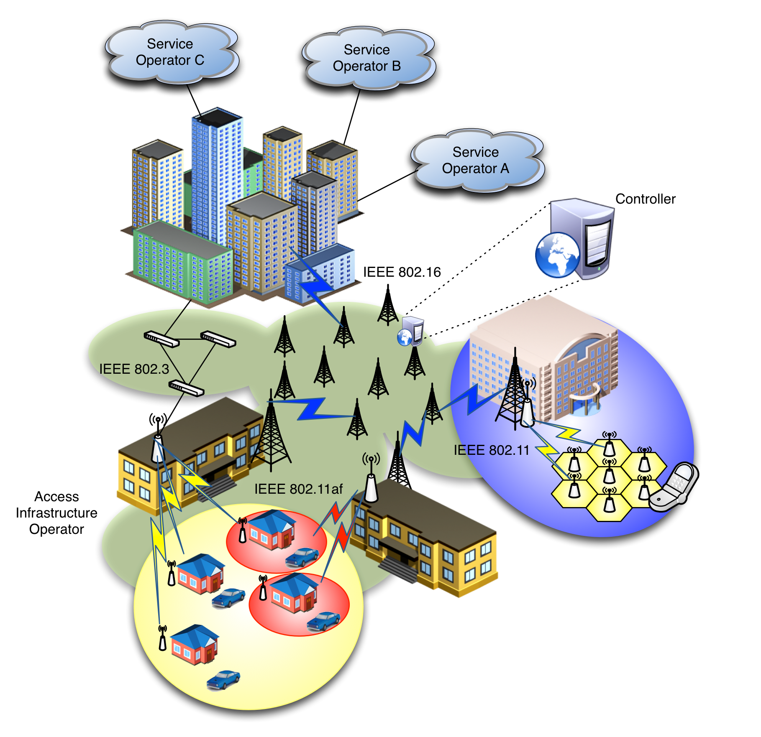
SDN-based OmniRAN Use Cases Scenario
Centrally controlled configuration, from Core to Terminal, of heterogeneous IEEE 802 links
Dynamic creation of data paths with dynamic reconfiguration and mapping to the terminal at flow granularity
Clean separation of data and control planes

Slide 28

SDN-based OmniRAN Use Cases
Reference Point Mappings
Access 1
Access Abstraction
Core
Operator A
Backhaul
R3
R4
R5
Terminal
Access 2
Backhaul Abstraction
R1
Core
Operator B
Internet
Access Abstraction
Access Abstraction
R2
AAA
Multiple Cores sharing Access Network
Access Abstraction
Data and Control plane separation
Central control
SDN
Controller
R5
Core
Operator C
Access 3
Access Abstraction
Access Network
Core Network(s)
Data path
Control path

Slide 29
Functional Requirements
R1: Access link
  SDN-based configuration/interaction between infrastructure and Terminal
    Remote configuration/management mechanisms for 802 radio links, including terminal and access network side.
    SDN-based configuration of 802 links, including QoS, setup, teardown, packet classification
    User plane management of the multiple-interfaced Terminal (e.g. generic 802-based logical interface to present to L3)
R2: User & terminal authentication, subscription & terminal management
  Control path from Terminal to the corresponding Core operator
    Setting up control path between Terminal and AAA Proxy server
    Setting up control path between AAA Proxy server and AAA server of corresponding operator
    Identification and mapping of user’s traffic data paths/flows
    Dynamic modification of control path (e.g. SDN-based actions based on packet content)
    Per-user radio statistics for terminal management

Slide 30
Functional Requirements, cont.
R3: User data connection, service management
  SDN controller configuring user data path (end-to-end forwarding) and mobility update, real-time flow-based counter monitoring, queue control, link connection control, heterogeneous access network control
    Southbound interface for configuration/management of heterogeneous 802 links in the backhaul
    Generalized data plane with common behavior for 802 technologies
    Provisioning of data paths across heterogeneous 802 links with QoS support
    Per-user counters for accounting
R4: Inter-access network coordination and cooperation, fast inter-technology handover
  SDN-based forwarding state updates across different access networks
    SDN-based reconfiguration of data path
R5: Inter-operator roaming control interface
  Inter-operator roaming outside access network
    Subscription information exchange between service operators

Slide 31
GAP#3: Control Interfaces for SDN
Control of data forwarding plane, common to 802 technologies
  Southbound interface enabling the communication between the 802 technologies and the central controller (e.g. access abstraction)
  Clearly defined interfaces, SAPs and behaviors
  Ability to modify data path based on arbitrary but bounded selection parameters
    Packet classification mechanisms based on templates (á la OpenFlow)
    End-to-end packet flow and QoS
Radio configuration mechanism for access and backhaul links
  With defined metrics and reporting
Data plane management of the multiple-interface Terminal
  Notion of 802 logical interface facing L3
Generic 802 access authorization and attachment

Slide 32

Wi-Fi Hotspot Roaming Use case
Roaming is a well know functionality in cellular networks allowing us to use our cellular phones worldwide without hassle.
Roaming among Wi-Fi hotspots belonging to different operators is seen a prerequisite to further develop Wi-Fi access service to a cellular like experience
Roaming
Broker
3GPP
MNO
Users
Wireless ISPs
HLR
3GPP2
MNO
AC
Home
ISP

Slide 33
OmniRAN Architecture Mapping
Home Operator
Terminal
R2
Access
Core
R1
R3
Internet
Access Operator
R3
Access
R5
Other Operator w/ own core
Access
R3
Core
Internet

Slide 34
1. Home operator has roaming agreement with other operator. Traffic is routed via other operator’s core into the Internet
Home Operator
Access
Core
R3
Internet
only control
R2
R5
Other Operator w/ own core
Terminal
R2
Access
Core
R3
R1
Internet

Slide 35
2. Home operator has roaming agreement with other operator. Traffic is routed back to the home operator’s core network.
Home Operator
Access
Core
R3
Internet
R2
R5
Other Operator w/ own core
Terminal
R2
Access
Core
R3
R1
Internet

Slide 36
3. Home operator has Wi-Fi access sharing agreement with other operator allowing to serve customers like by the own access infrastructure
Home Operator
Access
Core
R3
Internet
Access Operator
R3
Terminal
R2
Access
R1

Slide 37
4. Home operator has agreement with roaming consortia which enables to use credentials for access to all other operators’ networks belong to the roaming consortia.
Home Operator
Terminal
R2
Access
Core
R1
R3
Internet
R5
Core
Roaming Consortia
Other Operator w/ own core
R5
Access
R3
Core
Internet

Slide 38
Wi-Fi Hotspot Roaming Use case
Impact on OmniRAN:
All different flavors of Wi-Fi roaming can be handled with just 2 Reference Points of the OmniRAN architecture:
  R3, when terminal is anchored in the home network
    Default router in the home network
  R5, when terminal is anchored in the visited network
    Default router in the visited network
A Roaming Consortium usually deploys R5 for inter-connection of all the involved operators only containing AAA attributes.
As only AAA attributes are in scope of IEEE 802 and link specific attributes on R5 are the same as on R3, there is hardly anything left for IEEE 802 to specify for R5.
The Wi-Fi Roaming use case seems not to add to the normative specification domain of OmniRAN.

Slide 39
Necessary standardization work within IEEE 802
IEEE 802 OmniRAN Results and Proposals

Slide 40
Topics for Standardization in IEEE 802
Establishing a common approach of specifying ‘external’ control into IEEE 802 technologies would require:
  a specification describing the Network Reference Model and listing the DL and PHY control functions required for access networks and SDN
    Addressed by the PAR developped by OmniRAN ECSG
  a specification on the usage of IP protocols for the transport of IEEE 802 attributes
    Topic for the joint IEEE 802 – IETF coordination group
  specifications of the control attributes for the individual IEEE 802 technologies by their working groups
    Should go into annex of related specifications to ensure consistency
Gaps within IEEE 802 technologies may be discovered but should be addressed by the related IEEE 802 WGs

Slide 41
Tribute to ITU
Network Protocol Specification in 3 Stages
For the specification of the Integrated Services Digital Network the ITU-T defined in its Rec. I.130 a sequential 3 stage process,.
This process is nowadays commonly used in most telecommunication network standardization activities.
Some IEEE 802 WGs have successfully followed this model.
Specify requirements
from the user's perspective;
Develop a logical/functional model
to meet those requirements;
Develop a detailed specification
of the protocols and attributes.
More Information:
ETSI: Making Better Standards
  http://docbox.etsi.org/MTS/MTS/10-PromotionalMaterial/MBS-20111118/protocolStandards/stagedApproach.htm

Slide 42
Filling the gap in IEEE 802
Mapping IEEE 802 specifications to service requirements
Direct evaluation of IEEE 802 protocols out of service/deployment requirements is challenging.
A Stage 2 specification provides a mapping of protocols to a functional network model, which facilitates easier evaluation.
‘External’ requirements from the
service/deployment perspective
Develop a logical/functional model
for evaluation of those requirements;
Available IEEE 802 specifications
of protocols and attributes.
?
?

Slide 43
Filling the gap in IEEE 802
Mapping IEEE 802 specifications to service requirements
Direct evaluation of IEEE 802 protocols out of service/deployment requirements is challenging.
A Stage 2 specification provides a mapping of protocols to a functional network model, which facilitates easier evaluation.
‘External’ requirements from the
service/deployment perspective
Develop a logical/functional model
for evaluation of those requirements;
Available IEEE 802 specifications
of protocols and attributes.
?

Slide 44
How does the 3 Stages Process relate to OmniRAN ECSG
Essentially OmniRAN ECSG proposes to develop a Stage 2 document for IEEE 802 network protocol specifications
  Actually re-engineering a Stage 2 to make it fitting to the existing IEEE 802 network protocol specifications (which represent Stage 3).
A Stage 2 specification makes it much more easy to evaluate and qualify ‘service’ requirements,
  and provide a common framework for further enhancements of IEEE 802 protocols

Slide 45
‘Stage 2’ Definition by ITU-T I.130/Q.65
The Stage 2 defines
a functional model using functional entities,
the functional entity actions needed,
information flow or API calls between functional entities
recommendations for the allocation of functional entities to physical locations for a few examples.
The Stage 2 provides
a single functional specification which can be applied in a number of different physical realizations,
a precise definition of functional capabilities and their possible distribution in the network to support the required network capabilities,
a detailed description of what functions, information flows and API calls will be provided, but not how they are to be implemented,
requirements for protocol capabilities as input to Stage 3 of the method.
The output of Stage 2 is used by
protocol designers to specify the protocols between physical entities,
node designers to specify the functional requirements of the nodes,
network planners.

Slide 46
FYI: Usual ‘Stage 2’ Content
ITU-T Rec I.130
WiMAX Forum Stage 2 ToC
Derivation of a functional model
Information flow diagram
SDL diagrams for functional entities (optional)
Functional entity actions
Allocation of functional entities to physical locations
Introduction and Scope
Abbreviations, Definitions, and Conventions
References
Identifiers
Tenets
Network Reference Model
Functional Design and Decomposition
Reference:
http://resources.wimaxforum.org/sites/wimaxforum.org/files/technical_document/2010/12/WMF-T32-001-R016v01_Network-Stage2-Base.pdf

Slide 47
Conclusion
IEEE 802 OmniRAN Results and Proposals

Slide 48
P802.1CF Project Authorization Request
Project Title:
Network Reference Model and Functional Description of IEEE 802 Access Network
Scope:
This Recommended Practice specifies an access network, which connects terminals to their access routers, utilizing technologies based on the family of IEEE 802 Standards by providing an access network reference model, including entities and reference points along with behavioral and functional descriptions of communications among those entities.
Purpose:
Heterogeneous networks may include multiple network interfaces, multiple network access technologies, and multiple network subscriptions. In some cases such heterogeneous functionality must be supported in a single user terminal.
This Recommended Practice supports the design and deployment of access networks based on IEEE 802 technologies, guides the developers of extensions to the existing standards in support of a heterogeneous access network, and enables the use of IEEE 802 standards in new network deployments by specifying the functions of the IEEE 802 technologies when deployed in access networks.

Slide 49
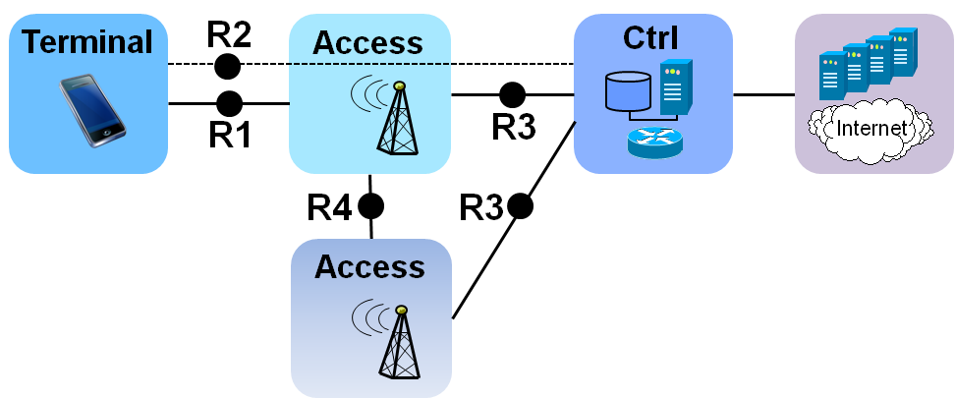
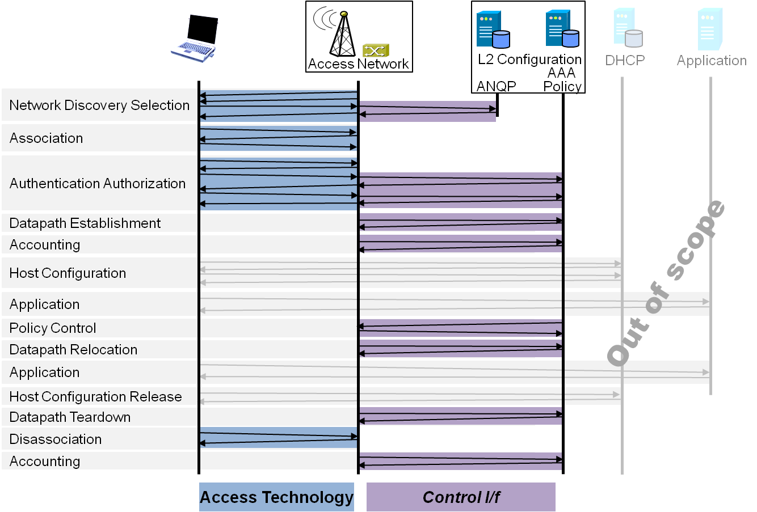
Draft ToC of the proposed specification
Introduction and Scope
Abbreviations, Acronyms, Definitions, and Conventions
References
Identifiers
Tenets for IEEE 802 Access Network Systems
Network Reference Model
  Overview
  Reference Points
  Access Network Control Architecture
    Multiple deployment scenarios
Functional Design and Decomposition
  Network Discovery and
  Selection
  Association
  Authentication and Authorization
  Datapath establishment
  QoS and policy control
  Datapath relocation
  Datapath teardown
  Disassociation
  Accounting

