Slide 1
IEEE 802 OmniRAN Study Group:
SDN Use Case
IEEE 802 OmniRAN
Executive Committee Study Group
2013-08-07

Slide 2
OmniRAN Study Group: Overview
The IEEE 802 Executive Committee (EC) originally chartered the OmniRAN EC Study Group (ECSG) in November 2012
  Currently planning to conclude activities in November 2013
OmniRAN: Open Mobile Network Interface for omni-Range Access Networks
Moving to propose initiation of standardization activity by end of 2013

Slide 3
OmniRAN ECSG
Resources
Website:
http://ieee802.org/OmniRANsg/
Document Archive: https://mentor.ieee.org/omniran/documents
Email reflector:
ecsg-802-omniran@listserv.ieee.org
Email archive: http://ieee802.org/OmniRANsg/email/

Slide 4

Access Network Abstraction by OmniRAN
Terminal
Access Network
Ctrl
Service
OmniRAN Network Reference Model
R2
Terminal
Access Network
Ctrl
Srv
R1
R3
OmniRAN provides a generic model of an access network based on IEEE 802 technologies
Application
Application
Transport
Transport
Network
Network
Network
Network
Data Link
Data Link
Data Link
Data Link
Scope of IEEE 802
Data Link
Data Link
Data Link
Data Link
Physical
Physical
Physical
Physical
Physical
Physical
Physical
Physical
Medium
Medium
Medium
Medium

Slide 5

OmniRAN allows for mapping of complex IEEE 802 network infrastructures
Terminal
R2
Access
Ctrl
R1
R3
Internet
R4
R3
Access
Core
R3
Access
Authentication
Authentication
Authorization
Authorization
R5
Accounting
Accounting
Location
Location
CoA
CoA
Mobility
DataPath
Mobility
Access
R3
Ctrl
Encapsulation
Encapsulation
Transport
Internet
Reference Points represent a bundle of functions between peer entities
  Similar to real network interfaces
Functions are extensible but based on IEEE 802 specific attributes

Slide 6
OmniRAN EC SG Results:
Topics for Standardization in IEEE 802
Discovered gaps in existing IEEE 802 technologies should be addressed by the related IEEE 802 WGs
Establishing a common approach of specifying ‘external’ control into IEEE 802 technologies would require:
  specifications of the control attributes for the individual IEEE 802 technologies by their working groups
    (mostly normative, in annex of related specifications to ensure consistency)
  a specification describing the ‘OmniRAN’ Network Reference Model and listing the DL and PHY control functions demanded for access networks and SDN
    (mostly informative)
  a specification on the usage of protocols for the transport of IEEE 802 attributes and the definition of IEEE 802 attributes for such protocols
    (mostly informative for IEEE 802, probably in cooperation with other SDOs)
The discussions in the July 2013 session addressed partially the progressing of the standardization topics mentioned above.

Slide 7
SDN-based
OmniRAN Use Case

Slide 8
Deployment Domain
SDN-based OmniRAN Use Cases

Slide 9
OmniRAN Architecture
sdf
Access 1
Terminal
Access 2
Core
Access
Internet
Core Operator
Access 3
Access Network Operator

Slide 10
OmniRAN Architecture with multiple Cores
sdf
Core
Access 1
Core Operator A
Terminal
Core
Access 2
Access
Internet
Core Operator B
Access 3
Core
Access Network Operator
Core Operator C

Slide 11
USE Case description
SDN-based OmniRAN Use Case

Slide 12
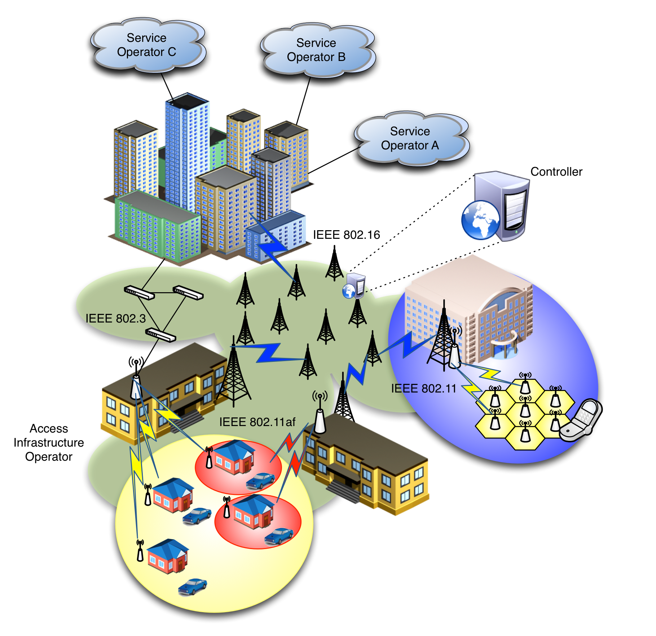
SDN-based OmniRAN Use Cases Scenario
Centrally controlled configuration, from Core to Terminal, of heterogeneous IEEE 802 links
Dynamic creation of data paths with dynamic reconfiguration and mapping to the terminal at flow granularity
Clean separation of data and control planes

Slide 13

SDN-based OmniRAN Architecture
Core
Operator A
Access 1
Access Abstraction
Backhaul
Terminal
Core
Operator B
Access 2
Backhaul Abstraction
Internet
Access Abstraction
Access Abstraction
Multiple Cores sharing Access Network
Access Abstraction
Data and Control plane separation
Central control
SDN
Controller
Core
Operator C
Access 3
Access Abstraction
Access Network Operator
Core Operators
Data path
Control path

Slide 14
Mapping to OmniRAN
SDN-based OmniRAN Use Cases

Slide 15
SDN-based OmniRAN Use Cases
Reference Point Mappings
Access 1
Access Abstraction
Core
Operator A
Backhaul
R3
R4
R5
Terminal
Access 2
Backhaul Abstraction
R1
Core
Operator B
Internet
Access Abstraction
Access Abstraction
R2
AAA
Multiple Cores sharing Access Network
Access Abstraction
Data and Control plane separation
Central control
SDN
Controller
R5
Core
Operator C
Access 3
Access Abstraction
Access Network
Core Network(s)
Data path
Control path

Slide 16
Functional Requirements
R1: Access link
  SDN-based configuration/interaction between infrastructure and Terminal
    Remote configuration/management mechanisms for 802 radio links, including terminal and access network side.
    SDN-based configuration of 802 links, including QoS, setup, teardown, packet classification
    User plane management of the multiple-interfaced Terminal (e.g. generic 802-based logical interface to present to L3)
R2: User & terminal authentication, subscription & terminal management
  Control path from Terminal to the corresponding Core operator
    Setting up control path between Terminal and AAA Proxy server
    Setting up control path between AAA Proxy server and AAA server of corresponding operator
    Identification and mapping of user’s traffic data paths/flows
    Dynamic modification of control path (e.g. SDN-based actions based on packet content)
    Per-user radio statistics for terminal management

Slide 17
Functional Requirements
R3: User data connection, service management
  SDN controller configuring user data path (end-to-end forwarding) and mobility update, real-time flow-based counter monitoring, queue control, link connection control, heterogeneous access network control
    Southbound interface for configuration/management of heterogeneous 802 links in the backhaul
    Generalized data plane with common behavior for 802 technologies
    Provisioning of data paths across heterogeneous 802 links with QoS support
    Per-user counters for accounting
R4: Inter-access network coordination and cooperation, fast inter-technology handover
  SDN-based forwarding state updates across different access networks
    SDN-based reconfiguration of data path
R5: Inter-operator roaming control interface
  Inter-operator roaming outside access network
    Subscription information exchange between service operators

Slide 18
GAPS To EXISTING IEEE 802 Functionality
SDN-based OmniRAN Use Cases

Slide 19
Gaps to existing IEEE 802 technologies
Control of data forwarding plane, common to 802 technologies
  Southbound interface enabling the communication between the 802 technologies and the central controller (e.g. access abstraction)
  Clearly defined interfaces, SAPs and behaviors
  Ability to modify data path based on arbitrary but bounded selection parameters
    Packet classification mechanisms based on templates (á la OpenFlow)
    End-to-end packet flow and QoS
Radio configuration mechanism for access and backhaul links
  With defined metrics and reporting
Data plane management of the multiple-interface Terminal
  Notion of 802 logical interface facing L3
Generic 802 access authorization and attachment

