Slide 1
OmniRAN EC SG
July 2013 Liaison Report
Chair:
Max Riegel, NSN

Slide 2

Access Network Abstraction by OmniRAN
Terminal
Access Network
Ctrl
Service
OmniRAN Network Reference Model
R2
Terminal
Access Network
Ctrl
R1
R3
OmniRAN provides a generic model of an access network based on IEEE 802 technologies
Application
Application
Transport
Transport
Network
Network
Network
Network
Data Link
Data Link
Data Link
Data Link
Scope of IEEE 802
Data Link
Data Link
Data Link
Data Link
Physical
Physical
Physical
Physical
Physical
Physical
Physical
Physical
Medium
Medium
Medium
Medium

Slide 3

OmniRAN allows for mapping of complex IEEE 802 network infrastructures
Terminal
R2
Access
Ctrl
R1
R3
Internet
R4
R3
Access
Core
R3
Access
Authentication
Authentication
Authorization
Authorization
R5
Accounting
Accounting
Location
Location
CoA
CoA
Mobility
DataPath
Mobility
Access
R3
Ctrl
Encapsulation
Encapsulation
Transport
Internet
Reference Points represent a bundle of functions between peer entities
  Similar to real network interfaces
Functions are extensible but based on IEEE 802 specific attributes

Slide 4
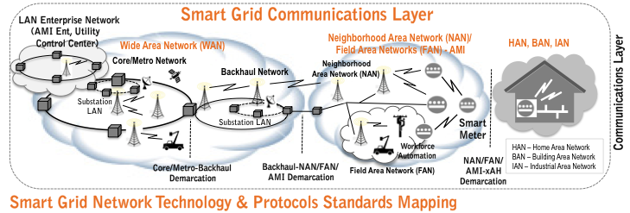

OmniRAN explains IEEE 802 Standards for Smart Grid Communications
Service
Ctrl
R5
Ctrl
R5
Ctrl
R3
R3
R3
R3
R3
R3
R3
Access
R4
Access
Access
Access
Access
Access
Access

Slide 5
OmniRAN EC SG Results:
Topics for Standardization in IEEE 802
Discovered gaps in IEEE 802 technologies, if any, should be addressed by the related IEEE 802 WGs
Establishing a common approach of specifying ‘external’ control into IEEE 802 technologies would require:
  specifications of the control attributes for the individual IEEE 802 technologies by their working groups
    (normative, in annex of related specifications to ensure consistency)
  a specification describing the ‘OmniRAN’ Network Reference Model and listing the DL and PHY control functions demanded for access networks and SDN
    (informative)
  a specification on the usage of IP protocols for the transport of IEEE 802 attributes and the definition of IEEE 802 attributes for such IP protocols
    (informative for IEEE 802, probably in cooperation with IETF)
The discussions in the July 2013 session will mainly address the progressing of the standardization topics mentioned above.

Slide 6
July 2013 OmniRAN F2F Schedule
 | Mon | Tue | Wed | Thu | Fri
08:00 10:00 | EC Opening Session |  | Joint w/ 802.11 ARC
 |  | w/ 802.22
10:30 12:30
 | IEEE 802 Opening Plenary
 | w/ 802.1 |  |  |  | EC Closing Session
13:30 15:30 |  | OmniRAN Opening Meeting | Joint w/ 802.21 | OmniRAN Closing Meeting
 | w/ 802.19
16:00 18:00
 | w/ 802.24

Slide 7
OmniRAN ECSG
Resources
Website:
http://www.ieee802.org/OmniRANsg/
Document Archive on mentor: https://mentor.ieee.org/omniran/documents
Email reflector:
ecsg-802-omniran@listserv.ieee.org
Email archive: http://grouper.ieee.org/groups/802/OmniRANsg/email/
Attendance:
Paper list (normative) + IMAT
  IMAT mandatory for participants seeking attendence credits
  Reciprocal rights for most WGs

