Slide 1
IEEE 802 OmniRAN EC SG Results and Outlook
Date: 2013-07-07
Authors:
Name | Affiliation | Phone | Email
Max Riegel | NSN | +49 173 293 8240 | maximilian.riegel@nsn.com
Juan Carlos Zuniga | Interdigital | +1 (514) 904 6300 | j.c.zuniga@ieee.org
Notice: This document does not represent the agreed view of the OmniRAN EC SG. It represents only the views of the participants listed in the ‘Authors:’ field above. It is offered as a basis for discussion. It is not binding on the contributor, who reserve the right to add, amend or withdraw material contained herein.
Copyright policy: The contributor is familiar with the IEEE-SA Copyright Policy <http://standards.ieee.org/IPR/copyrightpolicy.html>.
Patent policy: The contributor is familiar with the IEEE-SA Patent Policy and Procedures: <http://standards.ieee.org/guides/bylaws/sect6-7.html#6> and <http://standards.ieee.org/guides/opman/sect6.html#6.3>.
Abstract
OmniRAN (Open Mobile Network Interface for omni-Range Access Networks) is an abstraction of access networks based on IEEE 802 technologies to foster interoperability and integration into common control infrastructures. Networking functions and protocol attributes of the PHY and DL layers belong to IEEE 802.
Based on a few sample use cases, gaps were determined in the existing IEEE 802 specifications.
Addressing the gaps would belong to the existing IEEE 802 WGs, however a common framework would be necessary to make the pieces fitting together.

Slide 2
Preface:
OmniRAN EC SG Objectives
When renewing the OmniRAN EC SG on March 22nd the IEEE 802 EC refined the objectives for the OmniRAN EC SG:
  To perform a gap analysis that shows what pieces of work that are relevant to 802 (standards and standards under development) are not covered by existing external SDOs (IETF, 3GPP,...) and internal, and socialize that analysis with those SDOs;
  Having performed that gap analysis, define a crisp scope of the ECSG (target 15 words or less);
  Define what piece(s) of work within that scope (a) fall legitimately within 802's remit and (b) are achievable within an 802 activity.
The slides present the results of the study group of addressing the objectives and add some thoughts on the potential ways forward (no crisp words yet)
  In particular the thoughts on the potential ways forward are for further discussion!

Slide 3
IEEE 802 OmniRAN EC SG
Results and Outlook
OmniRAN within the scope of IEEE 802, gaps and potential ways forward

Slide 4
ToC
OmniRAN within the scope of IEEE 802
  Definition of IEEE 802 specific attributes for IP protocols
Benefits of OmniRAN for IEEE 802
Gaps to existing IEEE 802 standards
  Investigated use cases
    3GPP Trusted WLAN Access to EPC (SaMOG Release 11)
    ZigBee Smart Energy Profile 2 (SEP2)
    Software Defined Networking (SDN)
  Gap#1: Support for point-to-point links and link status indication in bridged access networks
  Gap#2: Network-ID and service indication in wired Ethernet
  Gap#3: Control interfaces for SDN
Necessary specification work within IEEE 802
Conclusion and potential ways forward

Slide 5
OmniRAN WITHIN
The SCOPE of IEEE 802
IEEE 802 OmniRAN Results and Outlook

Slide 6

Access Network Abstraction by OmniRAN
Terminal
Access Network
Core
Service
OmniRAN Network Reference Model
R2
Terminal
Access Network
Core
R1
R3
OmniRAN provides a generic model of an access network based on IEEE 802 technologies
Application
Application
Transport
Transport
Network
Network
Network
Network
Data Link
Data Link
Data Link
Data Link
Scope of IEEE 802
Data Link
Data Link
Data Link
Data Link
Physical
Physical
Physical
Physical
Physical
Physical
Physical
Physical
Medium
Medium
Medium
Medium

Slide 7
Access networks are for dynamic attachment of terminals to networks
Terminal
Access Network
Core
Services
Internet
Communication networks supporting dynamic attachment of terminals are usually structured into
  Access Network
    Distributed infrastructure for aggregation of multiple network access interfaces into a common interface
  Core
    Infrastructure for control and management of network access and end-to-end IP connectivity
  Services
    Infrastructure for providing services over IP connectivity

Slide 8
Functional decomposition of dynamic network access
Access Network
Core
Network advertisement
Pre-association signaling
Authentication, authorization and accounting client
L2 session establishment
  w/ QoS and Policy Enforcement
L2 mobility management inside access networks
Traffic forwarding to core based on L2 addresses
Subscription management
Terminal provisioning
Authentication, authorization and accounting server
IP address management
IP connectivity establishment to Internet and services
Policy & QoS management server (policy decision)
Mobility Anchor
Roaming support to other cores

Slide 9
Access Network Control Plane Functions
Access Network
ANQP
AAA
Policy
Configuration
DHCP
Application
Scanning
Network Selection
Association
Authentication
Authorization
Accounting
Host Configuration
Application
Policy Control
Application
Host Config Release
Disassociation
Accounting
Legend:
L2 Protocol
L2 Attributes
L2 Protocol
L3+ Attributes
L3+ Protocol
L2 Attributes
L3+ Protocol
L3+ Attributes

Slide 10
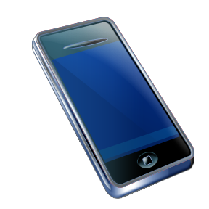
Mapping of OmniRAN Reference Points to IEEE 802 Reference Model
Higher Layers
Higher Layers
Higher Layers Control
Higher Layers Control
R2 R3
R3
Current scope of IEEE 802
Data Link
Data Link
Data Link
Data Link
Data Link
Data Link
Physical
R1
Physical
Physical
Physical
Physical
Physical
Medium
Medium
Medium
Reference Points can be mapped onto the IEEE 802 Reference Model
  R1 represents the PHY and MAC layer functions between terminal and base station
    Completely covered by IEEE 802 specifications
  R2 represents the L2 control protocol functions between terminal and central entities for control and AAA.
  R3 represents the L1 & L2 control interface from a central control entity into the network elements
‘R2’ and ‘R3’ cover IEEE 802 specific attributes
  However IP based protocols are used to carry control information between network elements and core
  Effectively each of IEEE 802 network elements contains an IP communication stack on top of the IEEE 802 data path for the exchange of the control information.

Slide 11
OmniRAN unifies external control of IEEE 802
Access Network
ANQP
AAA
Policy
Configuration
DHCP
Application
Scanning
Network Selection
?
Association
Authentication
Authorization
Accounting
Host Configuration
Application
Policy Control
Application
Host Config Release
Disassociation
Accounting
IEEE 802 Access Technologies
IEEE 802 OmniRAN

Slide 12
Handling IEEE 802 Attributes in IP Protocols
Current handling of IEEE 802 specific attributes for IP protocols:
  IEEE 802 has an established procedure for defining the MIBs of the own technologies
    Now completely in scope for IEEE 802
  Currently IEEE 802 does not deal with other IEEE 802 attribute definitions for IP protocols
    e.g. IEEE 802 specific AAA (RADIUS, DIAMETER) attributes are done by IETF with only some informal review by IEEE 802 WGs
Specification of IEEE 802 related attributes for IP protocols by IETF has cumbersome issues, e.g.:
  delayed availability (completion of RFC may last 2 years after completion of IEEE standard)
  RFC’s can’t cope with revisions and life cycle of IEEE standards
    new RFC required for each amendment and revision of IEEE 802 standard
    new RFC’s have different numbers
    RFCs stay forever, while IEEE 802 standards have limited lifecycle
IEEE 802 should take full responsibility for all its IEEE 802 specific attributes for IP protocols
  like done today for managed objects (MIBs)

Slide 13
Benefits of OmniRAN for IEEE 802
IEEE 802 OmniRAN Results and Outlook

Slide 14
Benefit: Ensure that IEEE 802 technologies properly support important deployments
IEEE 802 technologies should fulfill the requirements of important deployments, e.g.:
  Telecommunication, Smart Grid, ITS, SDN, …
Two main questions have to addressed:
  Which IEEE 802 standards do contribute to the particular deployments?
  Do the IEEE 802 standards provide all required functions?
Some categorization is necessary to make IEEE 802 technologies assessable and comparable, e.g.
  a reference model to compare functionalities
  a reference architecture to show how the IEEE 802 standards are fitting together in the scope of the considered deployment
OmniRAN defines a Network Reference Model which
  maps IEEE 802 technologies into a generic network architecture,
  allows functional evaluation of IEEE 802 access technologies.

Slide 15
OmniRAN defines the interfaces and control functions for IEEE 802 network deployments
Terminal
Access Network
Core
Service
OmniRAN Network Reference Model
R2
Terminal
Access Network
Core
R1
R3
Scanning
Control Plane
Network Selection
Association
Authentication
Host Configuration
Application
Access networks are dynamically controlled Layer 2 network infrastructures.
Different deployments follow the same procedures but might be different in their functional requirements.
OmniRAN provides an notation framework for different requirements.

Slide 16
OmniRAN allows for mapping of complex IEEE 802 network infrastructures
Terminal
R2
Access
Core
R1
R3
Internet
R4
R3
Access
Core
R3
Access
Authentication
Authentication
Authorization
Authorization
R5
Accounting
Accounting
Location
Location
CoA
CoA
Mobility
DataPath
Mobility
Access
R3
Core
Encapsulation
Encapsulation
Transport
Internet
Reference Points represent a bundle of functions between peer entities
  Similar to real network interfaces
Functions are extensible but based on IEEE 802 specific attributes

Slide 17
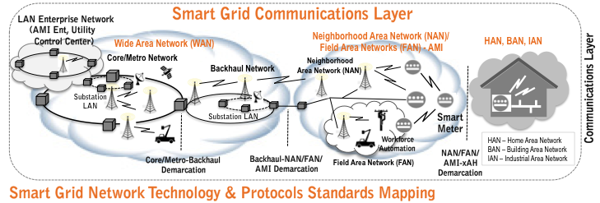
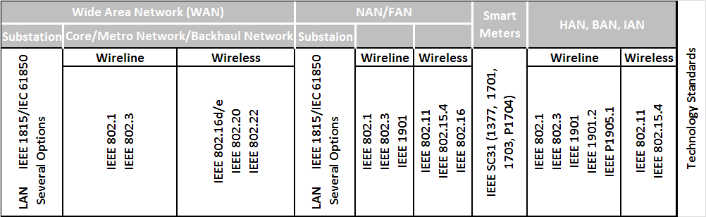
OmniRAN explains IEEE 802 Standards for Smart Grid Communications

Slide 18
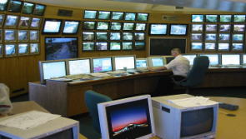
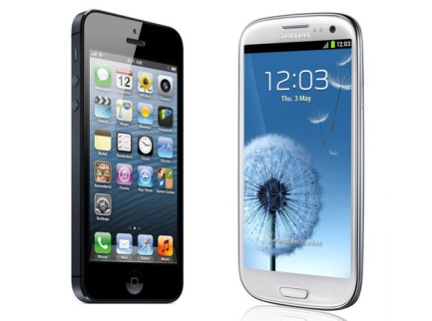
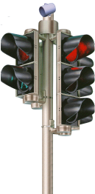


OmniRAN for upcoming topics: IEEE 802 Deployment for ITS Communications
ITS: Intelligent Transportation System Reference: ISO 21217(2013)
Vehicle ITS Station |  | Roadside ITS Station |  |  | Central ITS Station |  | Personal ITS Station
ITS Network Technology & Protocols Standards Mapping
wireline | wireless | wireline | wireless | wireline |  | wireless | wireless
t.b.d., e.g.: IEEE802.1 IEEE802.3 | t.b.d., e.g.: IEEE 802.11 IEEE 802.15 IEEE 802.16 | t.b.d., e.g.: IEEE 802.1 IEEE 802.3 | t.b.d., e.g.: IEEE 802.11 IEEE 802.16 IEEE 802.22 | t.b.d., e.g.: IEEE 802.1 IEEE 802.3 |  | t.b.d., e.g.: IEEE 802.11 IEEE 802.15 | t.b.d., e.g.: IEEE 802.11 IEEE 802.15 IEEE 802.16 IEEE 802.22
Roadside
Gateway
Access
Router
Roadside
Host
Border
Router
t
Facilities
t
Applications
n
n
Facilities
e
y
e
y
m
t
m
t
i
i
e
r
t
e
r
t
g
u
n
g
u
a
N
etworking
c
e
N
etworking
y
a
c
n
n
e
m
t
n
N
etworking
&
e
e
N
etworking
y
i
S
m
t
&
Transport
...
S
e
...
r
a
...
a
g
&
Transport
u
Transport
e
&
Transport
...
i
M
c
M
r
a
e
g
u
n
S
a
c
a
n
e
Access
M
Access
Access
a
Access
S
Technologies
5
.
9
Technologies
Technologies
M
Technologies
Ethernet
CAN bus
GHz
Ethernet
Ethernet
Ethernet
IPv
6
Mobile
Router
Vehicle
Host
Vehicle
Gateway
5.9
Traffic Centre/Service Centre
t
Applications
Applications
Central
Gateway
Central
Host
Border
Router
n
Facilities
e
y
t
Facilities
t
Facilities
m
t
n
n
i
e
y
e
y
e
r
m
t
m
t
u
i
i
e
r
e
r
g
t
u
u
c
n
N
etworking
g
c
g
N
etworking
c
e
y
a
N
etworking
&
e
a
e
a
e
m
...
t
n
...
S
n
...
S
&
Transport
i
a
Transport
a
&
Transport
n
N
etworking
e
r
M
M
S
g
u
a
c
a
n
e
...
a
Access
S
Access
Access
M
&
Transport
M
Technologies
Technologies
Technologies
ECU
ECU
Applications
Access
t
t
Technologies
n
Facilities
n
Facilities
e
y
e
y
m
t
m
t
i
i
e
r
e
r
g
u
g
u
t
a
c
a
c
n
n
N
etworking
e
n
N
etworking
&
e
e
N
etworking
y
a
S
a
S
m
t
&
Transport
...
Transport
...
&
Transport
...
i
M
M
e
r
g
u
a
c
n
e
Access
a
S
Technologies
Technologies
Access
M
Access
Technologies
Ctrl
SENS
Ethernet
CAN bus
Ethernet
Ethernet
IPv
6
Loop Detector
Communication Network

Slide 19
gaps to existing IEEE 802 standards and Procedures
IEEE 802 OmniRAN Results and Outlook

Slide 20
Example use cases investigated for gap analysis
3GPP Trusted WLAN Access to EPC
  GAP#1: Support for point-to-point links and link status indication in bridged access networks
ZigBee SEP2 Smart Grid Use Case
  GAP#2: Network-ID and service indication in wired Ethernet
SDN-based OmniRAN Use Cases Summary
  Gap#3: Control interfaces for SDN

Slide 21
3GPP Trusted WLAN Access to EPC
TS 23.402 V11.6.0 (2013-03)
Support for non-seamless WLAN offload (NSWO) or single PDN connection selected by the network without IP address preservation
S2a bearer creation and deletion based on EAP and AAA signaling
Definition of a WLAN Access Network, a Trusted WLAN AAA Proxy (TWAP) and a Trusted WLAN Access Gateway (TWAG) providing the reference points SWw, Sta and S2a for the Trusted Non-3GPP WLAN Access
Reference Model:

Slide 22

3GPP Trusted WLAN Access to EPC
OmniRAN Reference Point mapping
R1 maps directly to the SWw reference point of 3GPP
R2 and R3 would provide specified interfaces for Trusted WLAN AAA Proxy and Trusted WLAN Access Gateway, which are not addressed by 3GPP by definition
3GPP does not provide details for direct Internet access.
Terminal
Access
R2
Core
R1
R3
Internet

Slide 23

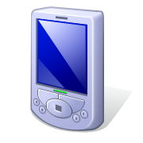
ZigBee SEP2 Smart Grid Application
SEP2 Communication Infrastructure
SEP2 defines a Smart Energy Profile Network by which a variety of devices can communicate with the Energy Services Interface
The network consists of
  Local access infrastructure (HAN) with
    Network Access Server
    Network Authentication Server
  Application Trust Center
  Energy Services Interface
  to energy provider
Local access infrastructure can
be based on any technology
enabling IP connectivity to the
Application Trust Center and ESI.
ESI
Application
Trust Server
HAN
Network
Authentication
Server
Network
Access
Server

Slide 24
ZigBee SEP2 Smart Grid Application
OmniRAN Reference Point Mapping
OmniRAN is applicable to the local access infrastructure providing IP connectivity to ESI and Application Trust Server
HAN represents the functions contained in Access and Core function blocks of OmniRAN
R3 allows for easy integration of different link layer technologies with common Network Authentication Server and Network Access Server
R2 provides access authentication for any link technology represented by R1
HAN
Network
Authentication
Server
Application
Trust Server
ESI
Network
Access
Server
Access
R2
R3
Terminal
Access
Core
R1
R3

Slide 25
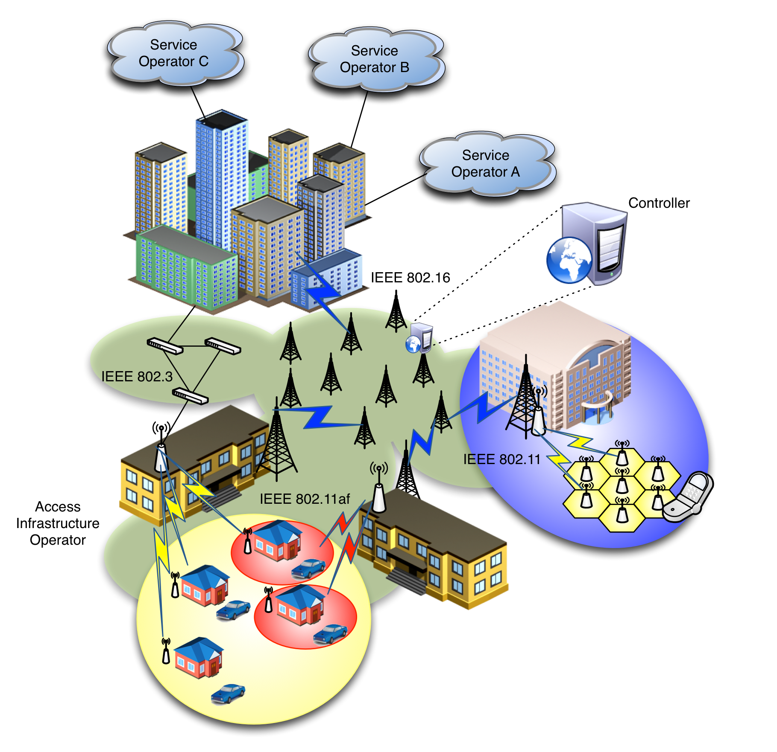
SDN-based OmniRAN Use Cases
Scenario
Centrally controlled configuration, from Core to Terminal, of heterogeneous IEEE 802 links
Dynamic creation of data paths with dynamic reconfiguration and mapping to the terminal at flow granularity
Clean separation of data and control planes

Slide 26

SDN-based OmniRAN Use Cases
Reference Point Mappings
Core
Operator A
Access 1
Access Abstraction
Backhaul
Terminal
Core
Operator B
Access 2
Internet
Access Abstraction
Access Abstraction
Multiple Cores sharing Access Network
Access Abstraction
Data and Control plane separation
Central control
SDN
Controller
Core
Operator C
Access 3
Access Abstraction
Access Network Operator
Core Operators
Data path
Control path

Slide 27
  GAP#1: Support for point-to-point links and link status indication in bridged networks
Setting up and maintaining a point-to-point access link across a bridged infrastructure
  Initializing the point-to-point link under AAA based access control
  Maintaining the point-to-point link when STA roams to another AP
Provider Backbone Bridging may not be the right tool
  missing solution for dynamic VLAN assignment
Link state signaling at the edge of the bridged infrastructure
  3GPP expects an trigger for setting up S2a context when link in IEEE 802 is established

Slide 28
GAP#2: Network-ID and service indication in wired Ethernet
ZigBee SEP2 requires support for network discovery and selection functions.
IEEE 802.3 explicitly mentioned in the SEP2 specification as technology candidate does not provide network advertisement, network discovery and network selection functions like the IEEE 802 wireless interfaces.

Slide 29
Gap#3: Control interfaces for SDN
Control of data forwarding plane, common to 802 technologies
  Southbound interface enabling the communication between the 802 technologies and the central controller (e.g. access abstraction)
  Clearly defined interfaces, SAPs and behaviors
  Ability to modify data path based on arbitrary but bounded selection parameters
    Packet classification mechanisms based on templates (á la OpenFlow)
    End-to-end packet flow and QoS
Radio configuration mechanism for access and backhaul links
  With defined metrics and reporting
Data plane management of the multiple-interface Terminal
  Notion of 802 logical interface facing L3
Generic 802 access authorization and attachment

Slide 30
Necessary standardization work within IEEE 802
IEEE 802 OmniRAN Results and Outlook

Slide 31
Topics for Standardization in IEEE 802
The discovered gaps in IEEE 802 technologies should be addressed by the related IEEE 802 WGs
Establishing a common approach of specifying ‘external’ control into IEEE 802 technologies would require:
  a specification describing the ‘OmniRAN’ Network Reference Model and listing the DL and PHY control functions demanded for access networks and SDN
    (informative)
  a specification on the usage of IP protocols for the transport of IEEE 802 attributes and the definition of IEEE 802 attributes for such IP protocols
    (informative for IEEE 802, probably in cooperation with IETF)
  specifications of the control attributes for the individual IEEE 802 technologies by their working groups
    (normative, in annex of related specifications to ensure consistency)

Slide 32
Conclusion and Potential way forward
IEEE 802 OmniRAN Results and Outlook

Slide 33
Conclusion
OmniRAN establishes a common Network Reference Model for access networks based on IEEE 802 technologies.
  Defining a common framework for deployment of IEEE 802 technologies for network access for various purposes
  Creating unified control interfaces to enable integration of various IEEE 802 access technologies into a common architecture and control infrastructure
  Supporting new developments for networking like SDN
Establishment of a new IEEE 802 ‘OmniRAN’ WG does not seem to be appropriate
  it would ‘only’ create common framework to align activities within the individual WGs
  hardly any ‘normative’ specification content for the WG
  there are already a couple of ‘framework’ activities in IEEE 802
    Can OmniRAN be picky backed to one of the existing framework activities?

Slide 34
Potential way forward
(for discussion!)
Organization of extended architectural work in IEEE 802
  currently IEEE 802.1 hosts the revision of the IEEE 802 architecture and overview specification
  OmniRAN would require bigger efforts and permanent involvement out of the WGs
    and WGs would have to fulfill their duties to define normative attributes for IP protocols in annexes of their specifications
Proposal:
  Each of the WGs should have an ARC SC for handling architectural aspects and issues of particular deployments
    like IEEE 802.11 ARC today
    should take care of definitions of attributes for IP protocols
  IEEE 802 should have one WG with the responsibility for the common architecture specifications and deployment questions
    including the specification framework necessary for ‘OmniRAN’
    ensuring cooperation and exchange among the ARC SCs of the WGs
    handling external communication and deployment questions
      like IEEE 802.24 today for Smart Grid
    avoiding the need to establish new TACs when new deployments of IEEE 802 technologies are coming up

