Slide 1
ZigBee SEP2 Smart Grid Use Case Analysis
Date: 2013-05-15
Authors:
Name | Affiliation | Phone | Email
Max Riegel | NSN | +49 173 293 8240 | maximilian.riegel@nsn.com
Notice: This document does not represent the agreed view of the OmniRAN EC SG. It represents only the views of the participants listed in the ‘Authors:’ field above. It is offered as a basis for discussion. It is not binding on the contributor, who reserve the right to add, amend or withdraw material contained herein.
Copyright policy: The contributor is familiar with the IEEE-SA Copyright Policy <http://standards.ieee.org/IPR/copyrightpolicy.html>.
Patent policy: The contributor is familiar with the IEEE-SA Patent Policy and Procedures: <http://standards.ieee.org/guides/bylaws/sect6-7.html#6> and <http://standards.ieee.org/guides/opman/sect6.html#6.3>.
Abstract
This slideset presents the analysis of the ZigBee Smart Energy Profile 2.0 use case.
It comprises a generic definition of the use case accompanied with an illustrative description of an deployment example, an introduction of the underlying communication architecture as outlined in the SEP2 Technical Requirements Document, a mapping and comparison to the OmniRAN architecture listing the functional requirements and the result of the gap analysis to existing IEEE technologies.
Reference: ZigBee Smart Energy Profile version 2.0 Technical Requirements Document (Feb. 2012)

Slide 2
ZigBee SEP2 Smart Grid
Use Case
Introduction, Architectural Comparison and Functional Requirements

Slide 3
Deployment Domain
3GPP Trusted WLAN Access to EPC

Slide 4
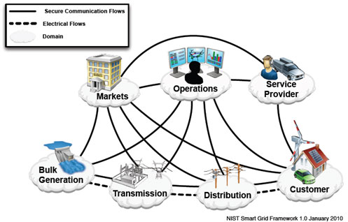
Smart Grid Framework
Functional decomposition of provisioning and control of electrical energy
Requires support of multiple access technologies within the same communication infrastructure
Reference:
  http://www.nist.gov/smartgrid/upload/NIST_Framework_Release_2-0_corr.pdf

Slide 5
Customer perspective of Energy Service Interface (ESI)
NIST model introduces the ESI for utility-to-customer interactions in addition to the utility meter
The ESI is aimed to support multiple different transmission technologies
ZigBee established the SEP 2.0 with support of IEEE 802.15.4 as well as other (IEEE 802) acess technologies

Slide 6
ZigBee Smart Energy Profile 2.0
SEP2 defines an application-layer protocol suite for Smart Grid based on RESTful HTTP
  A collection of protocols for various functions and configurations
Smart Energy Profile information model clearly described in UML
Evolution of ZigBee Smart Energy 1.x for any kind of link layer technology
Agnostic to Link Layer
(MAC/PHY)
  runs over ZigBee,
  HomePlug, Wi-Fi,
  anything with an
  IP stack, …
Figure: SEP2 Trust Model

Slide 7
USE Case description
3GPP Trusted WLAN Access to EPC

Slide 8
DEPLOYMENT ILLUSTRATION
Joe’s smart heater
Joe bought a smart heater in the local hardware store
allowing the utility company to remotely limit the operation.
It provides Joe a better price for electricity used by the heater.
The heater supports ESI communication over IEEE 802.11 and IEEE 802.3 in addition to the ZigBee IEEE 802.15.4 interface.
When switching on in the living room, the smart heater scans for available communication facilities, detects that there is no IEEE 802.15.4 coverage in Joe’s home, however that sufficient IEEE 802.11 coverage is available with the capability to connect to Joe’s utility company.
After establishing secured communication over IEEE 802.11 and Joe’s home network to the utility company the heater requests Joe’s utility contract information to enable managed operation under the terms and conditions of Joe’s contract.
Later the day, Joe has to perform some lengthy maintenance work in the basement of his home, which is quite cold during winter time. Unfortunately IEEE 802.11 coverage does not strech into the remote basement room, however there is an IEEE 802.3 port, which he can use to operate the heater under the favorable conditions of his contract.

Slide 9
DEPLOYMENT ILLUSTRATION, cont.
Joe’s smart heater
After movement the smart heater itself verifies that it
operates still in the same premeses despite change of
network interface and location and reconfirms its operation
under Joe’s contract to the utility company.
A week later Joe’s parents have a breakdown of their heating system. They ask Joe for lenting the smart heater until their heating system is repaired. Joe unplugs his heater and carries it to the parents, who are living in a village served by a different utility company.
When plugging in the smart heater into the power outlet, the heater detects that only IEEE 802.15.4 is available in the new location and the location is served by a different utility company. It queries whether to adopt to the new utility company and to establish communication and control based on another contract number.
Joe enters the contract information of his parents to let the smart heater connect through the IEEE 802.15.4 system in the parents home, which is operated by a local distribution company, to the control servers of the utility company.

Slide 10

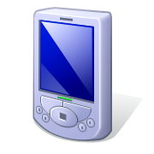
SEP2 Communication Infrastructure
SEP2 defines a Smart Energy Profile Network by which a variety of devices can communicate with the Energy Services Interface
The network consists of
  Local access infrastructure (HAN) with
    Network Access Server
    Network Authentication Server
  Application Trust Center
  Energy Services Interface
  to energy provider
Local access infrastructure can
be based on any technology
enabling IP connectivity to the
Application Trust Center and ESI.
ESI
Application
Trust Server
HAN
Network
Authentication
Server
Network
Access
Server

Slide 11
Mapping to OmniRAN
3GPP Trusted WLAN Access to EPC

Slide 12
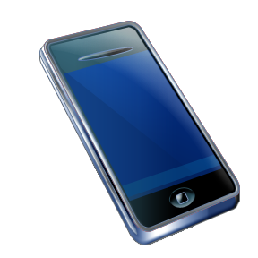
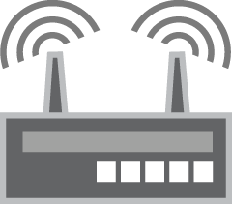
Reference Point Mapping
OmniRAN is applicable to the local access infrastructure providing IP connectivity to ESI and Application Trust Server
HAN represents the functions contained in Access and Core function blocks of OmniRAN
R3 allows for easy integration of different link layer technologies with common Network Authentication Server and Network Access Server
R2 provides access authentication for any link technology represented by R1
HAN
Network
Authentication
Server
Application
Trust Server
ESI
Network
Access
Server
Access
R2
R3
Terminal
Access
Core
R1
R3

Slide 13
Functional Requirements
Detailed functional requirements for the local access infrastructure is provided by ZigBee Specification Technical Requirements Document of Smart Energy Profile 2.0 (ZigBee docs-09-5449-33-0zse)
IEEE 802 technologies like IEEE 802.15.6 and IEEE 802.11 are explicitly mentioned in the ZigBee SEP2 TRD, however also other technologies like IEEE 802.3, IEEE 802.16 or IEEE 802.22 may be used.
  All enabling the establishment of IP connectivity between device and ESI
The following functions are provided over the OmniRAN reference points:
  R1: Access link, technology specific
    Access point discovery, service discovery, location
    Secured, locally authenticated access link from device to access point
  R2: User & terminal authentication
    Access authentication
    Reauthentication after movement
  R3: Authorization, service management, user data connection
    Connection establishment towards Application Trust Server and ESI
A comprehensive analysis of support of the requirements by the current IEEE 802 technologies is provided in document [omniran-13-0037-01-0000-sep2-smart-grid-gap-analysis.docx]

Slide 14
GAPS To EXISTING IEEE 802 Functionality
3GPP Trusted WLAN Access to EPC

Slide 15
Access technologies specific gaps
IEEE 802.3
IEEE 802.16
IEEE 802.22

