Slide 1
IEEE 802 Scope of OmniRAN
Date: 2013-05-13
Authors:
Name | Affiliation | Phone | Email
Max Riegel | NSN | +49 173 293 8240 | maximilian.riegel@nsn.com
Notice: This document does not represent the agreed view of the OmniRAN EC SG. It represents only the views of the participants listed in the ‘Authors:’ field above. It is offered as a basis for discussion. It is not binding on the contributor, who reserve the right to add, amend or withdraw material contained herein.
Copyright policy: The contributor is familiar with the IEEE-SA Copyright Policy <http://standards.ieee.org/IPR/copyrightpolicy.html>.
Patent policy: The contributor is familiar with the IEEE-SA Patent Policy and Procedures: <http://standards.ieee.org/guides/bylaws/sect6-7.html#6> and <http://standards.ieee.org/guides/opman/sect6.html#6.3>.
Abstract
Access networks comprise functions which extend beyond the scope of IEEE 802.
The contribution provides different architectural views on access networks to define the functional pieces of access networks which fall into the scope of IEEE 802.

Slide 2
IEEE 802 Scope of OmniRAN
Architectural models and functional views of OmniRAN in the scope of IEEE 802

Slide 3
Motivation
IEEE 802 Scope of OmniRAN

Slide 4
How and where does OmniRAN fit?
(Informative figure IEEE 802-2001)
OmniRAN comprises the functions of access networks based on IEEE 802 technologies
As IEEE 802 access networks consist of the cooperation of multiple instances of IEEE 802 technologies with a single higher layer control and traffic forwarding function, there is no obvious place for OmniRAN in the IEEE 802-2001 informative figure.
  Like for other IEEE 802 standards, e.g. IEEE 802.21, IEEE 802.1X, …

Slide 5
Really helpful to describe and define OmniRAN scope within IEEE 802?
OmniRAN
R2, R3 R4
The amended figure 5 of 802rev-D1.6 puts OmniRAN into a single box of the higher layer end-point stack aside of the data path
  discussed in the Mar ‘13 Orlando session
The figure may not be completely wrong, however it provides not much guidance on which functional pieces are in scope of OmniRAN and their relation to IP based protocols.

Slide 6
ACCESS NETWORK ArchitecturAL VIEWS
IEEE 802 Scope of OmniRAN

Slide 7

OmniRAN architecture partitioning for dynamic attachment of terminals to networks
Terminal
Access Network
Core
Network
Services
Internet
Communication networks supporting dynamic attachment of terminals are usually structured into
  Access Network
    Distributed infrastructure for aggregation of multiple network access interfaces into a common interface
  Core Network
    Infrastructure for control and management of network access and end-to-end IP connectivity
  Services
    Infrastructure for providing services on top of established IP connectivity

Slide 8
Functions for establishment of end-to-end Connectivity
Access Network
Core Network
Network advertisement
Pre-association signalling
IEEE 802.xx PHY and MAC
Authentication, authorization and accounting client
L2 session establishment
  w/ QoS and Policy Enforcement
L2 mobility management inside and across access networks
Mobility Gateway
Traffic forwarding to core based on L2 addresses
Authentication, authorization and accounting server
IP address management
Policy & QoS management based on a SLA
Mobility among multiple access networks
IP connectivity establishment to Internet and services
Roaming via other core networks

Slide 9
Access Network Architectual Views
Terminal
Access Network
Core
Service
Topology View
R2
R1
R3
R5
Procedural View
Scanning
Network Selection
Association
Authentication
Host Configuration
Application
Layered Protocol View
Application
Application
Transport
Transport
Network
Network
Network
Network
Data Link
Data Link
Data Link
Data Link
Data Link
Data Link
Data Link
Data Link
Physical
Physical
Physical
Physical
Physical
Physical
Physical
Physical
Medium
Medium
Medium
Medium

Slide 10

Topology view on OmniRAN architecture and reference points
Terminal
R2
Access
Core
R1
R3
Internet
R4
R3
Access
Core
R3
Access
Authentication
Authentication
Authorization
Authorization
R5
Accounting
Accounting
Location
Location
CoA
CoA
Mobility
DataPath
Mobility
Access
R3
Core
Encapsulation
Encapsulation
Transport
Internet
Reference Points represent a bundle of protocols between peer entities
  - Similar to real network interfaces

Slide 11
The benefits of the topology view:
Reference points
Reference points denote the interconnections between functional entities in the access network, e.g.
  R1 between terminal and base station:
    Access link, technology specific
  R2 between terminal and core network:
    User & terminal authentication, subscription & terminal management
  R3 between access network and core network:
    Authorization, service management, user data connection, mobility support, accounting, location
  R4 between access networks:
    Inter-access network coordination and cooperation, fast inter-technology handover
  R5 between core networks:
    Inter-operator roaming control interface
Reference points build an excellent foundation for realizing interoperability between real world network equipment.
However reference points usually do not reflect nor match the scope of IEEE 802.

Slide 12
Procedural view on OmniRAN
ANQP
AAA
DHCP
Application
Scanning
Network Selection
Association
Authentication
Authorization
Accounting
Host Configuration
Application
Policy Control
Application
Host Config Release
Disassociation
Accounting
Legend:
L2 Protocol
L2 Attributes
L3+ Protocol
L2 Attributes
L3+ Protocol
L3+ Attributes
L2 Protocol
L3+ Attributes

Slide 13
The benefit of the procedural view:
Getting insights into protocols
Scanning: Finding out about the existence of potential communication peers
  Scope of individual IEEE 802.xx specifications
Network selection: Finding the most appropriate network access
  IEEE 802.xx protocol for higher layer information
Association: Setting up the access link
  Scope of individual IEEE 802.xx specifications
Authentication
  Security framework, based on IEEE 802.1X
Authorization: Setting up the IEEE 802 communication link
  Attributes and functions depending on particular IEEE 802.xx technologies
Accounting: Usage and inventory reporting
  Attributes depending on particular IEEE 802.xx technologies
Policy Control: Adjustment of the user data connection
  Attributes depending on particular IEEE 802.xx technologies
Host Configuration: Getting the IP communication parameters
  IP protocol for IP configuration parameters
Application: Making productive use of the communication infrastructure
  IP protocol for application parameters
Host Config Release: Releasing the IP communication parameters
  IP protocol for IP configuration parameters
Disassociation: Releasing the access link
  Scope of individual IEEE 802.xx specifications

Slide 14
The benefit of the layered protocol view:
Detailed representation of the data path
Terminal
Access Network
Core
Application
Application
Transport
Transport
Network
Network
Current scope of IEEE 802
Data Link
Data Link
Data Link
Data Link
Data Link
Data Link
Physical
Physical
Physical
Physical
Physical
Physical
Medium
Medium
Medium
IEEE 802 is dealing with packet transport functions in the Data Link and Physical layers.
More fine-grain layering models are used by IEEE 802 to describe the architecture of its work.

Slide 15
IEEE 802 Architecture
IEEE 802 Scope of OmniRAN

Slide 16
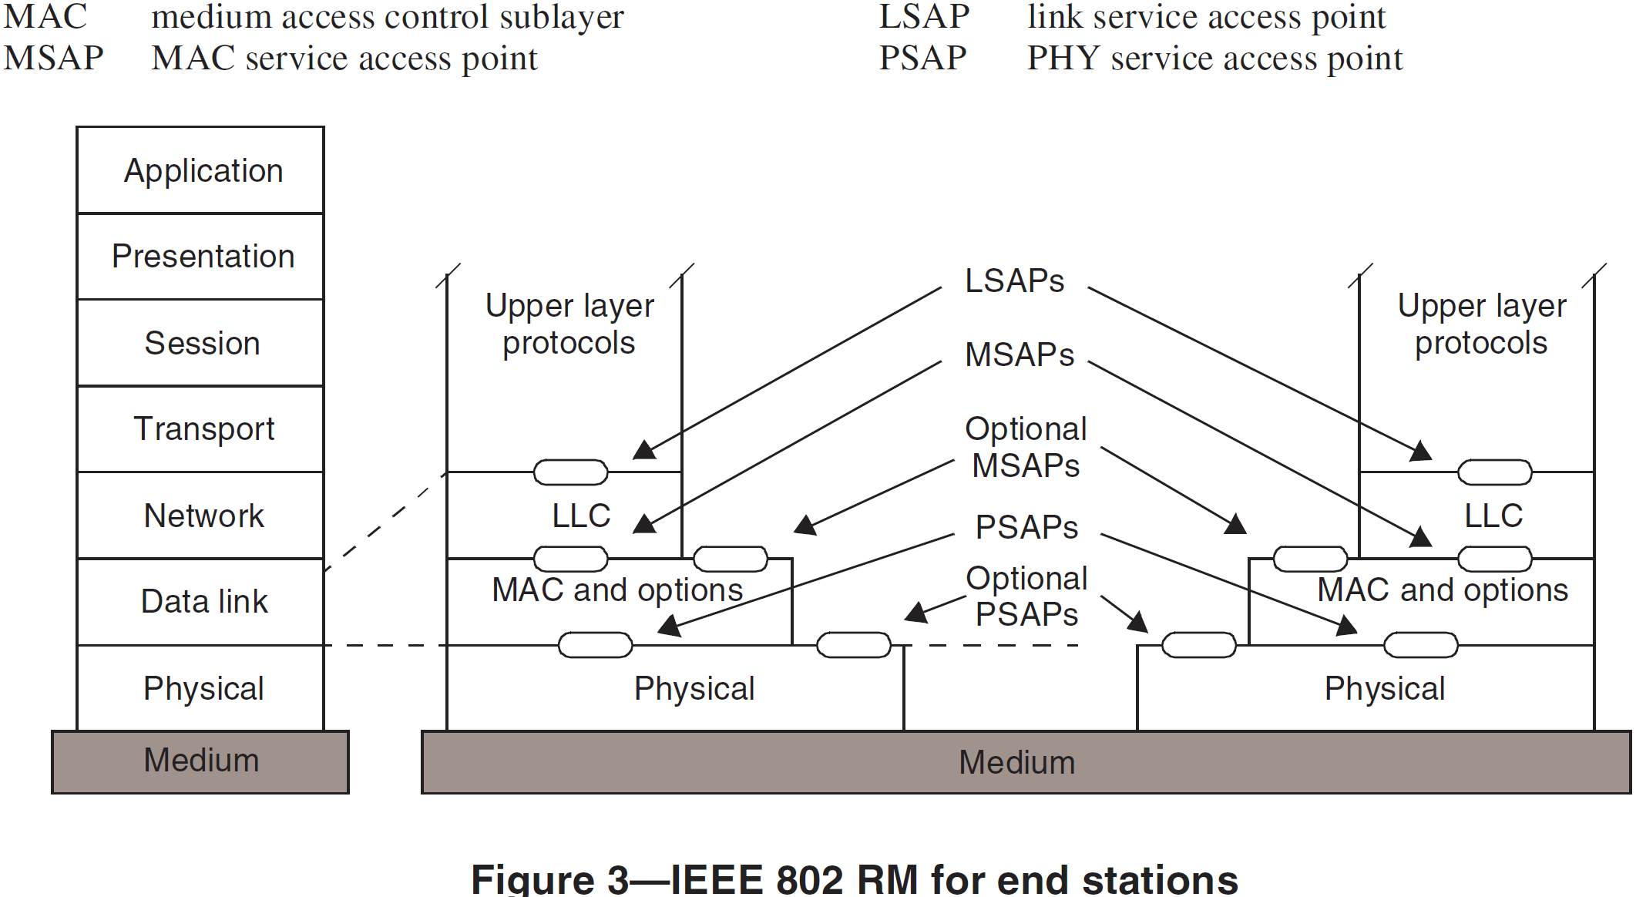
IEEE 802 Reference Model for End-Stations
(802rev-D1.6)
Reference Model within the 7 layer ISO-OSI model
Reference Model exposing specific IEEE 802 functions
IEEE 802 provides link layer connectivity to the overall communication architecture
It covers the Physical and the Data link layer of the ISO-OSI 7 layer model
Data link layer is represented in IEEE 802 by MAC and LLC sub-layers
Functionality above Data link layer is considered as ‘higher layer’.
The IEEE 802 connectivity stack is supplemented by a management plane and a plane representing IEEE 802.21 MIH.
MIH comprises a number of control SAPs into each of the layer of the IEEE 802 reference model
The network management model of IEEE 802 is aligned with the ITU TMN framework and provides the definition of managed objects for each of the layers of the IEEE 802 architecture
IEEE 802 allows for special purpose network management protocols when the usual network management approach with managed objects is not sufficient.

Slide 17
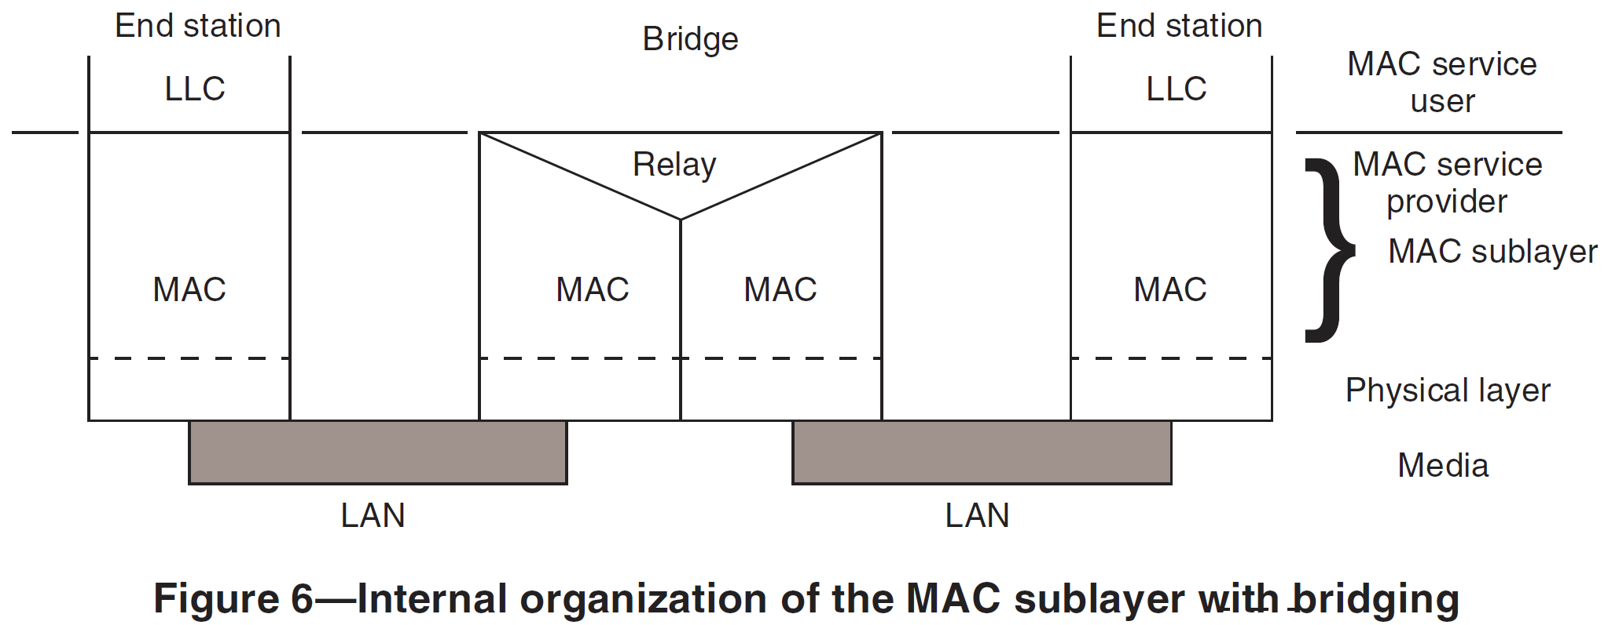
IEEE 802 Reference Model for Bridges
IEEE 802 provides a bridging model for interconnection of multiple network segments based on data link layer functionality
Different bridging protocols can handle the issues of various topologies including avoidance of data loops and establishment of ‘optimized’ filtering and forwarding decisions.
Bridging protocols have been extended to cope with multiple operational domains of an hierarchical provider structure.

Slide 18
OmniRAN Architecture WITHIN SCOPE of IEEE 802
IEEE 802 Scope of OmniRAN

Slide 19
OmniRAN Reference Points in the layered protocol view
Application
Application
Application
Application
Transport
Transport
Transport
Transport
Network
Network
Network
Network
Current scope of IEEE 802
Data Link
Data Link
Data Link
Data Link
Data Link
Data Link
Physical
Physical
Physical
Physical
Physical
Physical
Medium
Medium
Medium
OmniRAN reference points describe interfaces into IEEE 802 network functions.
  Most of the Reference Points mainly comprise signaling information.
Signaling information configures functionalities in the PHY and DataLink layer of IEEE 802 functions.
The signaling information is carried by IP protocols from a central database server to the IEEE 802 functions
  Similar to the definition and processing of network management information in IEEE 802
Effectively each of IEEE 802 network elements contains an IP communication stack on top of the IEEE 802 data path for the exchange of the control information.

Slide 20
Mapping of OmniRAN Reference Points to IEEE 802 Reference Model
Higher Layers
Higher Layers
Higher Layers Control
Higher Layers Control
R2/R3 Control
R3 Control
R3 Data
Current scope of IEEE 802
Data Link
Data Link
Data Link
Data Link
Data Link
Data Link
Physical
R1
Physical
Physical
Physical
Physical
Physical
Medium
Medium
Medium
R1, R2, R3 Reference Points can be mapped onto the IEEE 802 Reference Model
  R1 represents the PHY and MAC layer functions between terminal and base station
    Completely covered by IEEE 802 specifications
  R2 represents the L2 control protocol functions between terminal and central entities for control and AAA.
  R3 represents the L1 & L2 control interface from a central control entity into the network elements
  ‘R2’ and ‘R3 Control’ may comprise only definitions of attributes
    However IP based protocols to carry control information elements are out of scope of IEEE 802
  ‘R3 Data’ may define a special kind of Data Link SAP

Slide 21
Further considerations
Key issue is the handling of IEEE 802 specific attributes of IP protocols within the activities of IEEE P802
IEEE P802 has an established routine for defining the MIBs of IEEE 802 technologies
  Partly done by itself and partly within the IETF
Processes for defining other IEEE 802 related attributes in IETF vary depending of protocol
  e.g. AAA attributes are mainly done by IETF with some informal review by IEEE 802 WGs
Cooperation between IEEE 802 and IETF is currently reviewed and refined in [draft-iab-rfc4441rev-04.txt]
  More details on next slide.

Slide 22
[draft-iab-rfc4441rev-04.txt]
Appendix A. Current examples of IEEE 802 and IETF
Work Item Collaboration
A.1. MIB Review
Historically the MIB modules for IEEE 802.1 and IEEE 802.3 were
developed in the IETF Bridge MIB and Hub MIB Working Groups
respectively. With travel budgets under pressure, it has become
increasingly difficult for companies to fund employees to attend both
IEEE 802 and IETF meetings. As a result, an alternative was found to
past arrangements that involved chartering MIB work items within an
IETF WG by transferring the work to IEEE 802 with expert support for
MIB review from the IETF. In order to encourage wider review of MIBs
developed by IEEE 802 WGs, it is recommended that MIB modules
developed in IEEE 802 follow the MIB guidelines [RFC4181]. An IEEE
802 group may request assignment of a 'MIB Doctor' to assist in a MIB
review by contacting the IETF Operations and Management Area
Director.
By standardizing IEEE 802 MIBs only within IEEE 802 while utilizing
the SNMP quality control process, the IETF and IEEE 802 seek to
ensure quality while decreasing overhead. The process of transfer of
the MIB work from the IETF Bridge MIB WG to IEEE 802.1 WG is
documented in [RFC4663].

Slide 23
[draft-iab-rfc4441rev-04.txt]
Appendix A. Current examples of IEEE 802 and IETF
Work Item Collaboration
A.2. AAA Review
IEEE 802 WGs requiring new AAA applications should send a liaison
request to the IETF. Where merely new attributes definitions are
sufficient rather than defining a new authentication, authorization
and accounting logic/procedures, an Internet-Draft can be submitted
and review can be requested from AAA-related WGs such as the RADEXT
or DIME WGs. For attributes of general utility, and particularly
those useful in multiple potential applications, allocation from the
IETF standard attribute space is preferred to creation of IEEE 802
Vendor-Specific Attributes (VSAs). As noted in [RFC3575]: "RADIUS
defines a mechanism for Vendor-Specific extensions and the use of
that should be encouraged instead of allocation of global attribute
types, for functions specific only to one vendor's implementation of
RADIUS, where no interoperability is deemed useful".
Where allocation of VSAs are required, it is recommended that IEEE
802 create a uniform format for all of IEEE 802, rather than having
each IEEE 802 group create their own VSA format. The VSA format
defined in [IEEE80211F] is inappropriate for this, since the Type
field is only a single octet, allowing for only 255 attributes. It
is recommended that IEEE groups read and follow the recommendations
in "RADIUS Design Guidelines" [BCP158] and the "Protocol Extensions"
ID [RADEXT] when designing and reviewing new extensions and
attributes.

Slide 24
Conclusion
IEEE 802 Scope of OmniRAN

Slide 25
Conclusion
OmniRAN Reference Points can be mapped into the IEEE 802 Reference Model
  R1 is completely covered by IEEE 802 specifications
  R2 and R3 are related to attributes for control of IEEE 802 functions and the definition of a DL SAP for the transport of user payload
  R4 is not considered by this contribution
    IEEE 802.21 may provide some ideas for its representation in the IEEE 802 views.
  R5 may be completely out of scope of IEEE 802
    However attributes of R3 may be copied over to R5
IP protocols used for OmniRAN are out of scope of IEEE 802
OmniRAN Specification in the scope of IEEE 802 would consist of
  an normative part defining control attributes and a DL SAP for the user payload
  an informative part outlining the overall architecture
  an informative part proposing the usage of particular IP protocols and the mapping of the IEEE 802 attributes into the IP protocols.
BTW: The approach seems to be aligned as well with the SDN use cases.

