Slide 1
IEEE 802.21™: An Overview and Current WG Status
21-13-0054-00 omniran-13-0023-00-0000
Charles E. Perkins
For OmniRAN
ECSG

Slide 2
IEEE 802.21 Base Standard
Media Independent Handover (MIH) Services
  A framework that helps improving the user experience of mobile device by facilitating handover between heterogeneous access networks
Features
    A shim layer that enables the transparent service continuity
    Provide link layer intelligence to upper layers to optimize handovers with network discovery and handover command capabilities
    Does not define policies and inference engine required to optimize user experience during a handover

Slide 3
Functional Overview

Slide 4
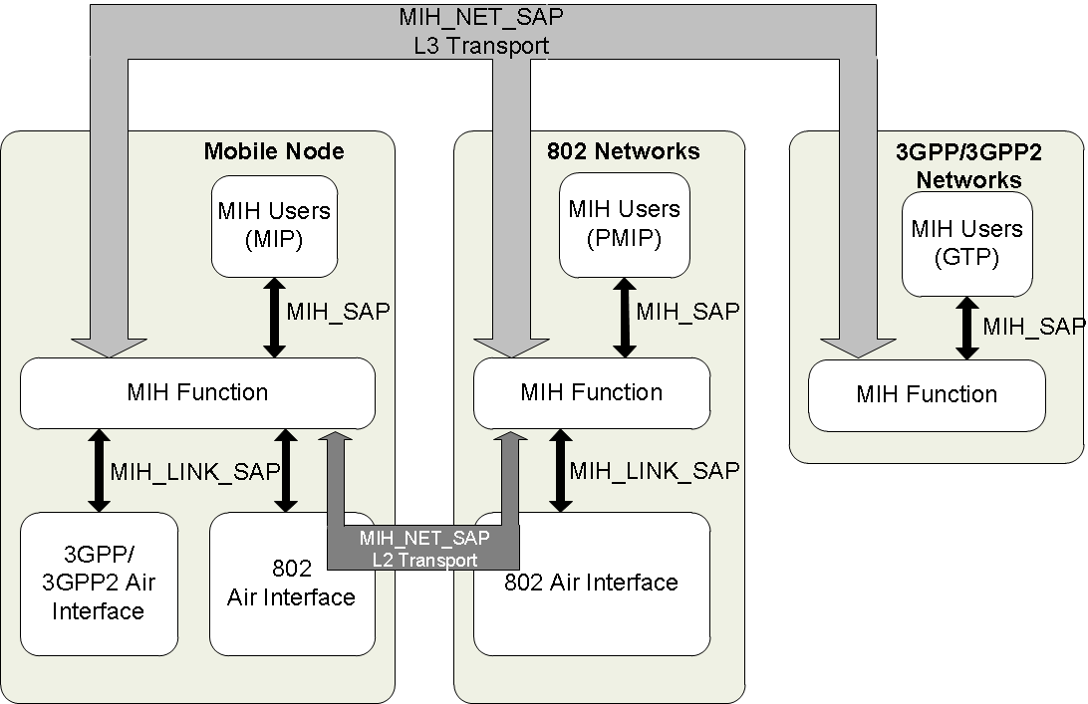
IEEE 802.21 Services(Logical Diagram)

Slide 5
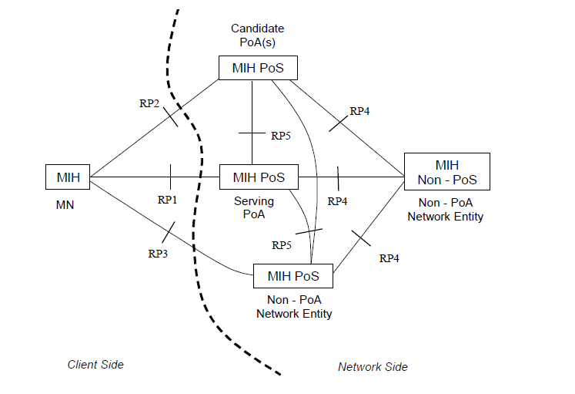
Communication Model

Slide 6
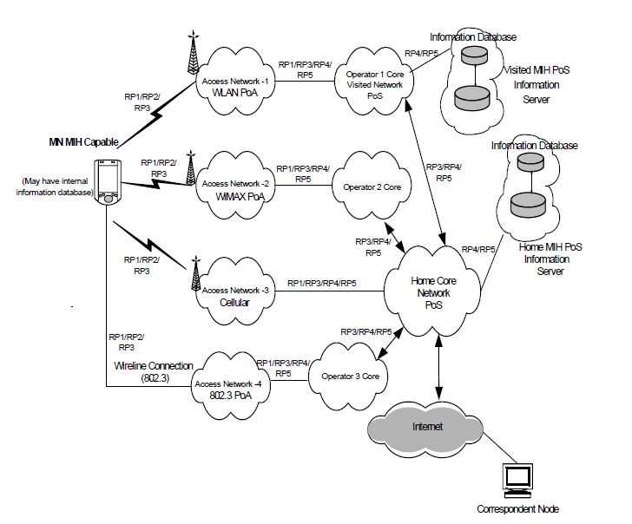
Example Network Model using MIH Services

Slide 7
MIH in IETF
Through MIPSHOP WG, Internet Area
Several RFCs are published to support L3 transport of MIH protocol DHCP and DNS Discovery of Information Server
RFC 5677 - IEEE 802.21 Mobility Services Framework Design (MSFD) 2009-12 RFC 5677 (Proposed Standard)
RFC 5679 - Dynamic Host Configuration Protocol (DHCPv4 and DHCPv6) Options for IEEE 802.21 Mobility Services (MoS) Discovery 2009-12 RFC 5678 (Proposed Standard)
RFC 5679 - Locating IEEE 802.21 Mobility Services Using DNS 2009-12 RFC 5679 (Proposed Standard)

Slide 8
IEEE 802.21 Current Projects

Slide 9
Amendment Projects
Completed amendment Projects (in 2012)
  802.21a (TGa): Amendment for Security Extensions to Media Independent Handover Services and Protocol
  802.21b (TGb): Amendment for Handovers with Downlink Only Technologies
Current amendment Projects
  802.21c (TGc): Amendment for Optimized Single Radio Handovers
  802.21d (TGd): Amendment for Multicast Group Management

Slide 10
IEEE 802.21a - 2012
Defines mechanisms to reduce the latency during authentication and key establishment for handovers between heterogeneous access networks that support IEEE 802.21
Provides data integrity, replay protection, confidentiality and data origin authentication to IEEE 802.21 MIH (Media-Independent Handover) protocol exchanges and enable authorization for MIH services

Slide 11
Preregistration / Roaming

Slide 12
New Projects
Two new PARs are approved in February 2013
  IEEE 802.21-2008 revision
  IEEE 802.21.1- Media Independent Services

Slide 13
802.21.1
2.1 Title: Standard for Local and metropolitan area networks
-- Part 21.1: Media Independent Services
5.2 Scope: This standard defines extensible IEEE 802(R) handover and other services (e.g., discovery) that are used in conjunction with the Media Independent Services Framework.

Slide 14
Conclusion
IEEE 802.21 and its amendments can support the Wi-Fi use cases that are currently discussed in OmniRAN ECSG
If additional work is required, it can be done within 802.21-2008-Rev and 802.21.1 work items

Slide 15
IEEE 802.21 Information
http://www.ieee802.org/21
http://mentor.ieee.org/802.21/documents

Slide 16
Thank you!!
Q &A

Slide 17
MIH in IEEE 802.11
802.11 Architectural Extension for MIH
  SAP extension to support the link events
Mobile Node can detect whether 802.11 Network supports MIH Function through GAS (Generic Advertisement Service ) defined by 802.11u
Generic Advertisement Service (GAS) provides a non-AP STA access to an information server (e.g. an IEEE 802.21 IS)
802.11u supports MIH query in state 1 using Action Frame
  802.11u has a media specific mechanism (information are stored in AP)
  For higher layers, 802.21 IS Service is the only mechanism supported

Slide 18
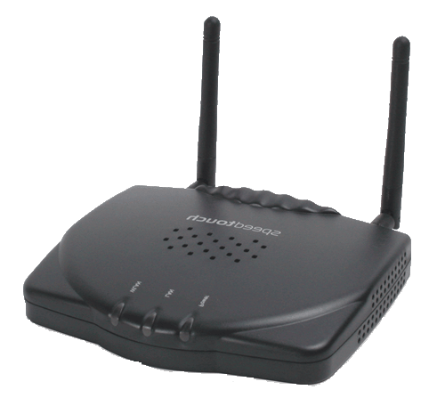
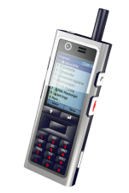

A System Architecture [802.11+802.21]
Core network
MIH [ANQP(IE)]
Response
MIH Information Server
Access network
MIH [ANQP(IE)]
Request
Network Map
GAS/ANQP response
List of Available Networks
802.11
Server assisted Network Discovery
GAS/ANQP request
R3- (?)
802.21 Standard
802.11 Standard

Slide 19
GAS/ANQP with MIH call Flow
STA
Provisioned Home Realm; FQDN
AP
Configured SSID
MIH Information Server
Scan Request
Scan Response
Build the scan list;
Analyze SSIDs,
No AP to associate
Generated ANQP
GAS Init Req (bundled ANQP NAI + WAN…)
GAS Init Resp (Comeback Delay=1000TU …)
MIH [ANQP (IE) Request
MIH[ANQP(IE)] Response
GAS Comeback Req
GAS Comeback Resp
GAS Comeback Req
Use of 802.21 MIH
GAS Comeback Resp
Defrag ANQP;
Consolidate all inputs from all networks
Analyze ANQP;
Discover & select network
Association Req

