Slide 1
An SDN-based approach for OmniRAN
Date: [2013-03-20]
Authors:
Name | Affiliation | Phone | Email
Antonio de la Oliva | UC3M | +34657079687 | aoliva@it.uc3m.es
Juan Carlos Zúñiga | InterDigital |  | j.c.zuniga@ieee.org
Charles E. Perkins | Futurewei |  | charles.perkins@earthlink.net
Notice: This document does not represent the agreed view of the OmniRAN EC SG. It represents only the views of the participants listed in the ‘Authors:’ field above. It is offered as a basis for discussion. It is not binding on the contributor, who reserve the right to add, amend or withdraw material contained herein.
Copyright policy: The contributor is familiar with the IEEE-SA Copyright Policy <http://standards.ieee.org/IPR/copyrightpolicy.html>.
Patent policy: The contributor is familiar with the IEEE-SA Patent Policy and Procedures: <http://standards.ieee.org/guides/bylaws/sect6-7.html#6> and <http://standards.ieee.org/guides/opman/sect6.html#6.3>.
Abstract
This presentation shows a Use Case introducing some SDN concepts to the OMNIRAN framework

Slide 2
An SDN-based approach for OmniRAN
OmniRAN use case contribution

Slide 3
OMNIRAN and SDN
Software defined networking provides mechanisms for:
  Applying software to the operation of the network
    Installing rules on switches, providing smart brains to the network
  Dividing the network on infrastructure and operation
    SDN provides mechanisms for sharing a network between operators
OMNIRAN is a good opportunity to make a coherent use of all 802 technologies, providing the glue between them in order to build up carrier-grade 802-networks
OMNIRAN+SDN can be used to reduce the CAPEX+OPEX of the offloading infrastructure by sharing infrastructure while providing flexible per-operator configuration

Slide 4
Comparison with current managed WiFi architectures
Current managed deployments use centralized architectures with coupled data and control paths
Radio configuration and forwarding to the appropriate AP is performed at a central point
This has clear scalability issues
  Centralized point of failure
  Centralized point of configuration and aggregation of traffic
  Forwarding bottleneck

Slide 5
How can OMNIRAN improve it?
Split between control and data path
Unified controller for radio configuration and data path control
Use of packet templates to identify UE traffic
  Provide dedicated link between the UE and the gateways for different types of traffic
Configure Access Network for data path forwarding
  Data path can use standard L2 switches, line speed forwarding
Mobility can be supported within the Access Network
Flexible forwarding within the Access Network in a scalable by splitting control and data plane
Infrastructure as a service, sharing of the same infrastructure by multiple providers

Slide 6
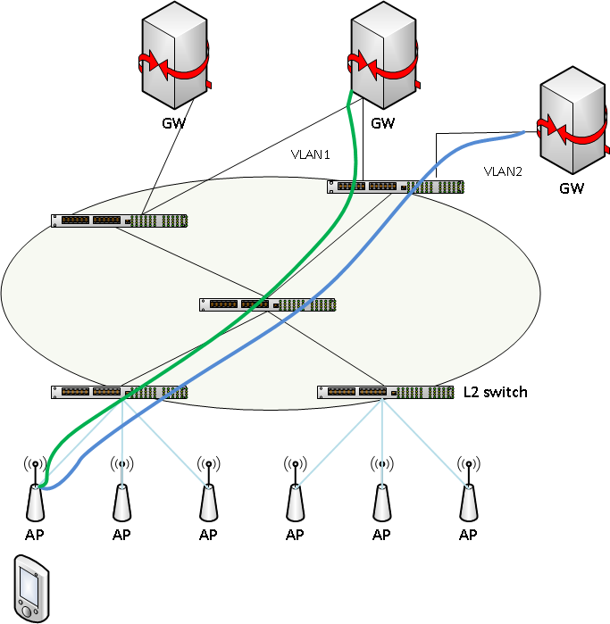
Example (data path)

Slide 7
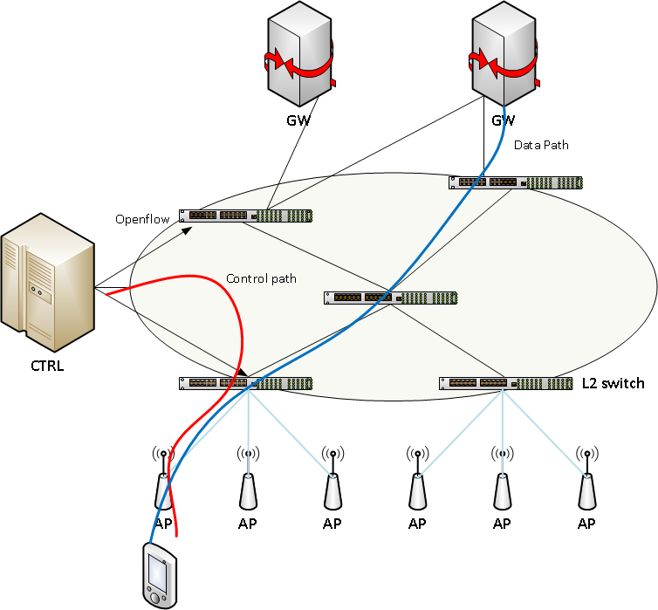
Example (control/data path split)

Slide 8
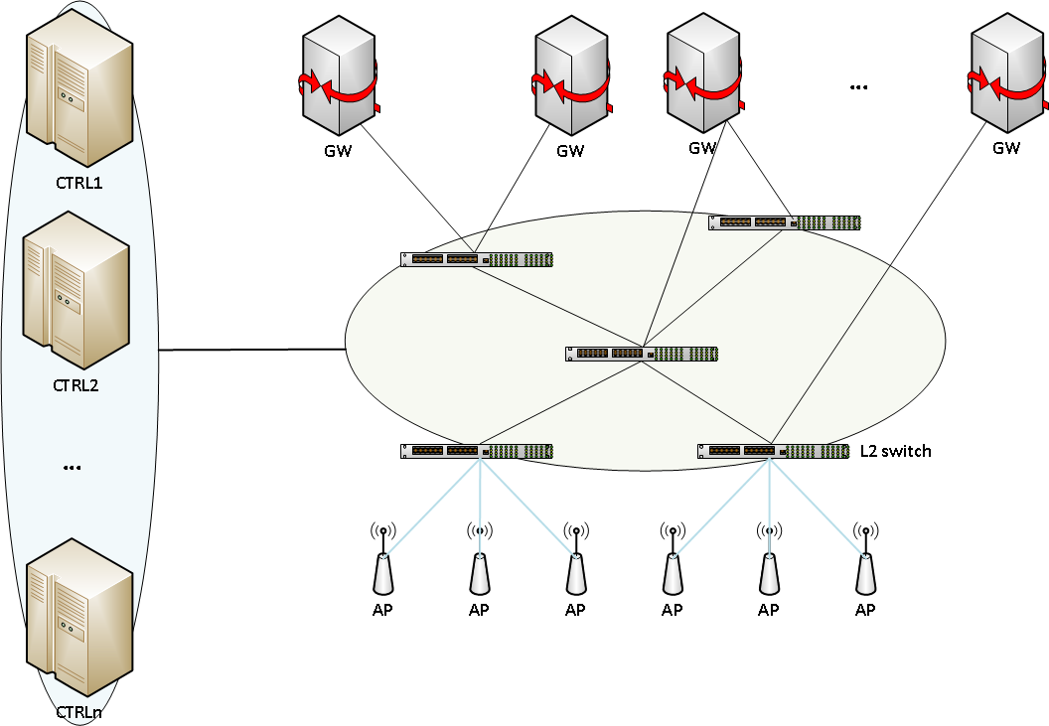
And we can even go multi-operator!

Slide 9
Applicability

Slide 10
Multi-802 technology applicability
The access network configuration is independent of the access technology that is being used
  For instance with 802.11, upon reaching the AP, traffic is managed independently of the access technology used
Leverage on one of the advantages of IEEE 802 technologies, such as common 802.1 layer

Slide 11
SaMOG applicability
Although the different solutions for SaMOG phase 2 propose different ways to encapsulate the traffic up to the Gateway, none of them propose how to distribute information in the TWAN
  E.g., VLAN tagging, how do we assure consistency of VLAN tags across all TWAN if the MN moves?

Slide 12
Summary
OMNIRAN is a good opportunity to integrate SDN capabilities in IEEE 802 networks
The integration of SDN and 802 technologies enables new use cases and business opportunities
  Complement current operator networks
  All building blocks are here, it is just a matter of gluing everything together!

Slide 13
Background

Slide 14
Summary of SaMOG solutions for phase 2
New SaMOG working document (TR 23.852-v1.4) focuses on providing three main functionalities
  Transport of multiple PDN connections between UE and GW
    VLAN Tags + MAC address differentiation
    PPPoE-based approach
  Multi-PDN connection control protocol
    Control of creation/remove of PDN connection
    Signal if it is a handover or a new attachment
    Service signaling (NSWO, new PDN to EPC..)
    Solutions vary but mostly all try to extend ANQP/GAS/SLAAC/DHCP or create a new L2 protocol
  Service discovery
    Need to know what services (IP continuity, NSWO, local breakout, multiple-PDN connections) are available in the TWAN
    Mostly all proposals are based on extending EAP-AKA signaling or ANQP/GAS (most prevalent EAP)

