Slide 1
802.24 Vertical Applications TAG
Agenda and Meeting Presentation
May 2024 Interim Meeting
Warsaw, Poland

Slide 2
802.24 Overview
802.24 Vertical Applications TAG
802.24.1 Smart Grid TG
802.24.2 IoT TG
Officers
  TAG Chair: Tim Godfrey
  Secretary & TAG Vice Chair: Ben Rolfe
Task Groups
  802.24.1 Smart Grid TG Tim Godfrey
  802.24.2 IoT TG Chris DiMinico
25 Voting Members

Slide 3
802.24 May Wireless Interim - Meeting Plan
Registration is required
Two slots:
  Tuesday May 14, PM2 4PM CEST
  Wednesday May 15, PM2 4PM CEST
Accredited Hybrid Meeting with Remote Participation
PM2: May 15, PM2 4PM CEST
  Join WebEx meeting
  Meeting number: 2430 443 5396
  Password: MBcyaApw483
  Join by phone
  +1-855-797-9485 US Toll free
  +1-415-655-0002 US Toll
PM2: May 14, PM2 4PM CEST
  Join WebEx meeting
  Meeting number: 2424 825 3064
  Meeting password: PUn3dbhP8Y2
  Join by phone
  +1-855-797-9485 US Toll free
  +1-415-655-0002 US Toll

Slide 4
Agenda
Call session to order / “Guidelines for IEEE SA meetings”
Review of Agenda / Approval of Agenda / Approve Minutes
Liaison Updates / Regulatory
AFV Infrastructure communications white paper: Review contributions and white paper draft
Continue resolving comments on draft for “Low Latency White Paper”
IoT white paper Development and Contributions
Development of update for Smart Grid White paper.

Slide 5
Guidelines for IEEE-SA Meetings
All IEEE-SA standards meetings shall be conducted in compliance with all applicable laws, including antitrust and competition laws.
Don’t discuss the interpretation, validity, or essentiality of patents/patent claims.
Don’t discuss specific license rates, terms, or conditions.
  Relative costs, including licensing costs of essential patent claims, of different technical approaches may be discussed in standards development meetings.
    Technical considerations remain primary focus
Don’t discuss or engage in the fixing of product prices, allocation of customers, or division of sales markets.
Don’t discuss the status or substance of ongoing or threatened litigation.
Don’t be silent if inappropriate topics are discussed… do formally object.
---------------------------------------------------------------
If you have questions, contact the IEEE-SA Standards Board Patent Committee Administrator at patcom@ieee.org or visit http://standards.ieee.org/about/sasb/patcom/index.html
See IEEE-SA Standards Board Operations Manual, clause 5.3.10 and “Promoting Competition and Innovation: What You Need to Know about the IEEE Standards Association's Antitrust and Competition Policy” for more details.
This slide set is available
at https://development.standards.ieee.org/myproject/Public/mytools/mob/preparslides.ppt
IEEE 802 Executive Committee

Slide 6
IEEE SA Copyright Policy
By participating in this activity, you agree to comply with the IEEE Code of Ethics, all applicable laws, and all IEEE policies and procedures including, but not limited to, the IEEE SA Copyright Policy.
  Previously Published material (copyright assertion indicated) shall not be presented/submitted to the Working Group nor incorporated into a Working Group draft unless permission is granted.
  Prior to presentation or submission, you shall notify the Working Group Chair of previously Published material and should assist the Chair in obtaining copyright permission acceptable to IEEE SA.
  For material that is not previously Published, IEEE is automatically granted a license to use any material that is presented or submitted.

Slide 7
IEEE SA Copyright Policy
    The IEEE SA Copyright Policy is described in the IEEE SA Standards Board Bylaws and IEEE SA Standards Board Operations Manual
      IEEE SA Copyright Policy, see
      Clause 7 of the IEEE SA Standards Board Bylaws
      https://standards.ieee.org/about/policies/bylaws/sect6-7.html#7
      Clause 6.1 of the IEEE SA Standards Board Operations Manual
      https://standards.ieee.org/about/policies/opman/sect6.html
    IEEE SA Copyright Permission
      https://standards.ieee.org/content/dam/ieee-standards/standards/web/documents/other/permissionltrs.zip
    IEEE SA Copyright FAQs
      http://standards.ieee.org/faqs/copyrights.html/
    IEEE SA Best Practices for IEEE Standards Development
      http://standards.ieee.org/develop/policies/best_practices_for_ieee_standards_development_051215.pdf
    Distribution of Draft Standards (see 6.1.3 of the SASB Operations Manual)
      https://standards.ieee.org/about/policies/opman/sect6.html

Slide 8
Participant behavior in IEEE-SA activities is guided by the IEEE Codes of Ethics & Conduct
All participants in IEEE-SA activities are expected to adhere to the core principles underlying the:
  IEEE Code of Ethics
  IEEE Code of Conduct
The core principles of the IEEE Codes of Ethics & Conduct are to:
  Uphold the highest standards of integrity, responsible behavior, and ethical and professional conduct
  Treat people fairly and with respect, to not engage in harassment, discrimination, or retaliation, and to protect people's privacy.
  Avoid injuring others, their property, reputation, or employment by false or malicious action
The most recent versions of these Codes are available at
  http://www.ieee.org/about/corporate/governance

Slide 9
Participants in the IEEE-SA “individual process” shall act independently of others, including employers
The IEEE-SA Standards Board Bylaws require that “participants in the IEEE standards development individual process shall act based on their qualifications and experience”
This means participants:
  Shall act & vote based on their personal & independent opinions derived from their expertise, knowledge, and qualifications
  Shall not act or vote based on any obligation to or any direction from any other person or organization, including an employer or client, regardless of any external commitments, agreements, contracts, or orders
  Shall not direct the actions or votes of other participants or retaliate against other participants for fulfilling their responsibility to act & vote based on their personal & independently developed opinions
By participating in standards activities using the “individual process”, you are deemed to accept these requirements; if you are unable to satisfy these requirements then you shall immediately cease any participation

Slide 10
IEEE-SA standards activities shall allow the fair & equitable consideration of all viewpoints
The IEEE-SA Standards Board Bylaws (clause 5.2.1.3) specifies that “the standards development process shall not be dominated by any single interest category, individual, or organization”
  This means no participant may exercise “authority, leadership, or influence by reason of superior leverage, strength, or representation to the exclusion of fair and equitable consideration of other viewpoints” or “to hinder the progress of the standards development activity”
This rule applies equally to those participating in a standards development project and to that project’s leadership group
Any person who reasonably suspects that dominance is occurring in a standards development project is encouraged to bring the issue to the attention of the Standards Committee or the project’s IEEE-SA Program Manager

Slide 11
Administration
Attendance take on IMAT – This meeting will be accredited to attendance
  Reciprocal rights for most WGs
Web page
  http://www.ieee802.org/24
Mailing list
  stds-802-24@listserv.ieee.org
  802-24-voters@listserv.ieee.org (voters list)
Document archive
  http://mentor.ieee.org/802.24/documents
IEEE 802 announcement reflector, stds-802-all@listserv.ieee.org
  Send email to listserv@listserv.ieee.org with no subject and with the
  following 2 lines appearing first in the body of the message
Subscribe stds-802-all
end

Slide 12
802.24 TAG Opening
Approve March 2024 TAG minutes
  802.24-24-0007r0
Action Items from March
Opening Notes

Slide 13
Liaison Updates
Wi-Fi Alliance (Informal) <vacant>
CSA / Matter (Informal) Clint Powell Active
FiRa (UWB ranging based on 15.4) Clint Powell
CCC (access control and automotive key based on NFC, next gen will be UWB) (new – liaison needed)
TIA-TR42 IoT Entity Chris DiMinico
  ISO IEC WG3
Wi-SUN Alliance (informal) Phil Beecher
802.18 Edward Au
ATIS TOPS <vacant>
Chris D – will identify a point of contact or potential liaison for automotive (Steve Carlson). Also check with Jim Lansford.

Slide 14
Liaison Updates
802.18 RR TAG

Slide 15
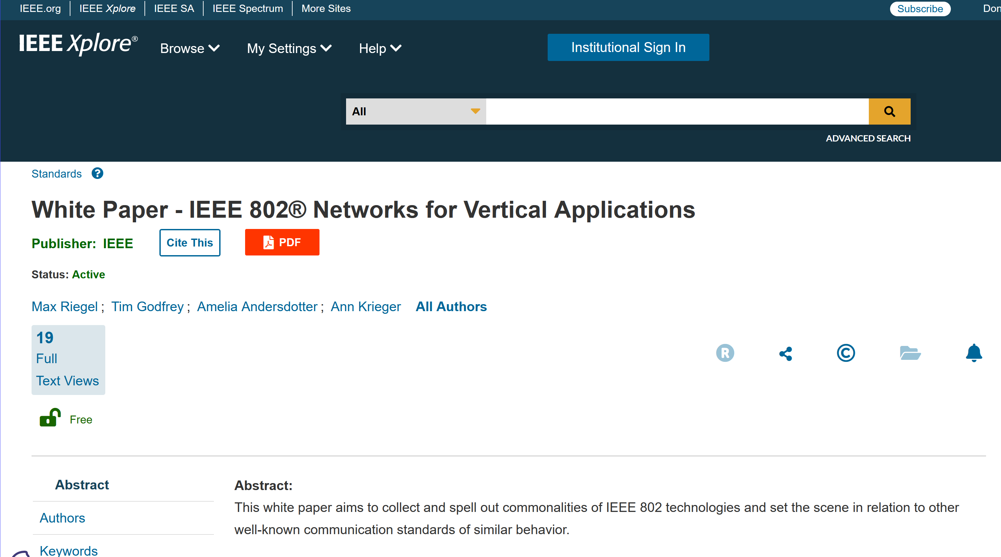
"IEEE 802 Solutions for Vertical Applications"
Published April 5, 2024

Slide 16
AFV Communications - White Paper
Types of AFV sites: residential, commercial vehicle depot, public transport site, long haul freight transportation. (Public parking facilities)
Communications requirements: data volume, resilience, reliability.
  Ancillary communication to vehicles (maps, firmware and software updates for vehicles, inventory tracking, logistics, media, etc)
Relate to the use of IEEE 802 technologies as the solution

Slide 17
Contributions related to AFV White Paper
13-May-2024 ET | 2023 | 7 | 5 | TAG documents | AFV White Paper | Craig Rodine (Sandia National Laboratories)

Slide 18
AFV Discussion (March 2024)
802.24-24-0005r0 WBMS (Wireless Battery Management System) for EV (Electrical Vehicle) Hyeong Ho Lee (Seoul National University of Science & Technology/Netvision Telecom Inc.), Jin Seek Choi (Hanyang University)
802.24-23-0007r4 AFV White Paper Craig Rodine (Sandia National Laboratories)
  Comments and feedback are requested to Craig Rodine
  A new section will be added for the WBMS use case (also cyber security considerations for WBMS)

Slide 19
IoT White Paper Strategy
Existing WP draft 24-22-11r2
SPE (Chris DiMinico) 24-23-0013-00-IoTg-802-24-2-iot-10base-t1l-spe-switches-and-adapters.pdf
Contributions for 24-22-0011-02-IoTg-internet-of-things-white-paper are requested.
Contributions on merging SPE concept into overall document are requested.

Slide 20
IoT White Paper Discussion
Latest Version Internet of Things White Paper 24-22-0011-03-IoTg-internet-of-things-white-paper
Updated during April Teleconference
Discussions on how to proceed
  Disambiguate the general poor state of available information on IoT, and highlight the IEEE 802 solutions that address them.
  Need to distinguish “Internet” public vs private. OT network for highly secure, isolated networks.

Slide 21
Review on Low Latency White Paper
24-23-0033-03-0000-low-latency-communication-white-paper_forreview.docx
with edits from January Interim
Reviewed in March, no comments or revisions. Forwarded to IEEE for publication.

Slide 22
Smart Grid white paper revision
Update of first Smart Grid white paper to address latest amendments of 802.15.4 u, v, w, x, y, Rev-me, and new organization of documents to clarify UWB vs Narrowband
Last version before IEEE publication:
  24-14-0028-03-sgtg-802.24 white paper (2014-11-revision)
This is the last version in an editable form per the IEEE editors – will be the baseline for the update.

Slide 23
Smart Grid White Paper Revision Plan
New Standards
  Amendments of 802.15.4 (SUN) u, v, x, y, ac, ad/NG, (4me revision) Phil Beecher, Gary Stuebing, Don Sturek, Jeorg
  LECIM/LPWAN 802.15.4w Jeorg
  802.15.9 Tero
  802.1 TSN Reference to the TSN White Paper (Janos)
  802.11ah and 11ax (Dave Halasz)
  802.16s, 16t (Tim, Harry)
  802.19.3 sub-1 GHz coexistence (Ben)
New topics
  Integration of Gas/Water into electric metering
  Battery leaf nodes for low power
  Sensors
  Situational Awareness
  Physical Security
  Wildfire detection and prevention
  Any others identified by contributors.
Complementary role of IEEE 802 with cellular technologies
Reach out to individuals and request contributions.

Slide 24
Future TAG Activity Planning
A whitepaper/document for application-specific use cases of Sub 1GHz standards 802.15.4g and 802.11ah. How use mechanisms in 802.19.3 and new amendment 802.19.3a
  Can this also include applying 802.15.4s-2018 (Spectrum Resource Measurement Capability) in sub-1GHz spectrum?
  New activities in Sub-1GHz. Update to 11ah possible in 802.11-rev, also changes in 802.15.
  Aspect of unique communications requirements for DER integration- dispatch/provisioning vs protection.
TSN – movement of 802.1 and 802.3 towards specific profiles (related to vertical applications) AVB, Industrial Automation, Automotive, Aerospace. Select features out of base standards. TSN is a toolbox, profiles provide interoperability. Integration of TSN into 802.11 and high availability, could affect TSN profiles.

Slide 25
Vertical Applications – Industry Standards Outreach
802.24 serving as an opportunity for vertical markets and stakeholders (transportation, oil/gas, etc) engage with IEEE 802 and identify relevant “standards gaps” that we result in new projects.
  Identify the people connected with new market sectors.
  802.24 would function as an all-802 TIG for identifying and clarifying standardization needs for vertical markets
  Initiate activities to collaborate with WNG activities in Working Groups
Action Plan
  Promote 802.24 as a venue for vertical stakeholders to initiate standardization
  Partner with public visibility SC – further outreach to industry alliances and advocates. Close the loop from external specs back into IEEE 802. Document success stories to motivate.
  Participate in any IEEE 802 Showcase events to bring in industry people who are not interested in being a standards developer, but want to know about standards, and how to get them initiated.
  Engage and bring in new verticals at specific industry events and conferences

Slide 26
802.24 TAG closing
Action Items
Any New Business?
Next Meeting
    July 2024, Montral, QC, Canada Plenary
    September 2024 – Waikoloa, Hawaii, USA
Adjourn

