Slide 1
802.24 Vertical Applications TAG
Meeting Report
January 2024 Interim Meeting
Panama City, Panama

Slide 2
802.24 Overview
802.24 Vertical Applications TAG
802.24.1 Smart Grid TG
802.24.2 IoT TG
Officers
TAG Chair: Tim Godfrey
Secretary & TAG Vice Chair: Ben Rolfe
Task Groups
802.24.1 Smart Grid TG Tim Godfrey
802.24.2 IoT TG Chris DiMinico
25 Voting Members

Slide 3
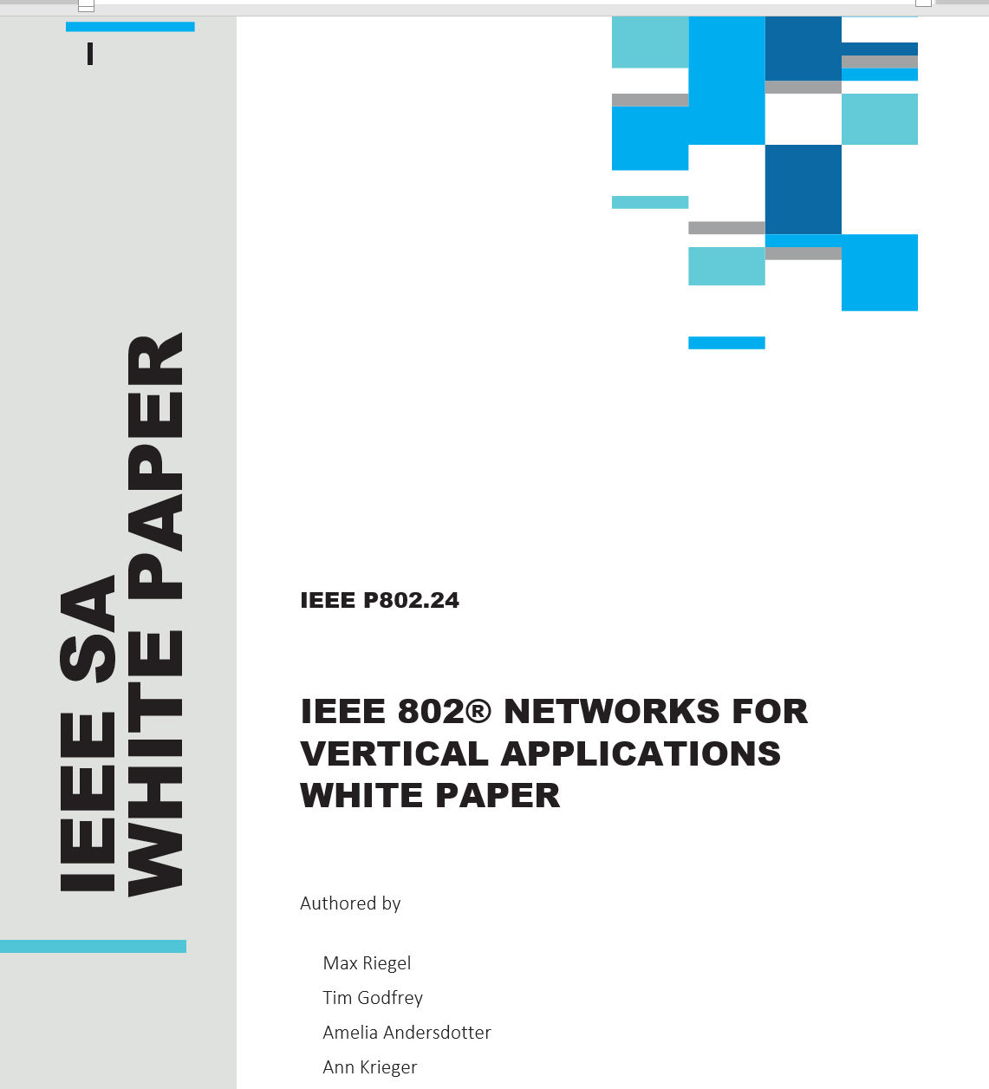
"IEEE 802 Solutions for Vertical Applications"
Version sent to IEEE for publication
24-23-0031-01-0000-802-networks-for-vertical-applications_forreview.docx
Review a publication-ready proof in March

Slide 4
Low Latency White Paper
24-23-0033-03-0000-low-latency-communication-white-paper_forreview.docx
edits from January Interim
Request Review and feedback before March 2024.
Target to complete at March Plenary.

Slide 5
802.24.2 IoT White Paper
Describes the broad scope and various sub-markets of IoT, and highlights how IEEE 802 standards support the various use cases
Internet of Things White Paper 24-22-0011-02-IoTg-internet-of-things-white-paper
Contributions are requested.

Slide 6
AFV Communications - White Paper
Types of Alternative Fuel Vehicles sites: residential, commercial vehicle depot, public transport site, long haul freight transportation. (Public parking facilities)
Communications requirements: data volume, resilience, reliability
Draft white paper 802.24-23-0007r3

Slide 7
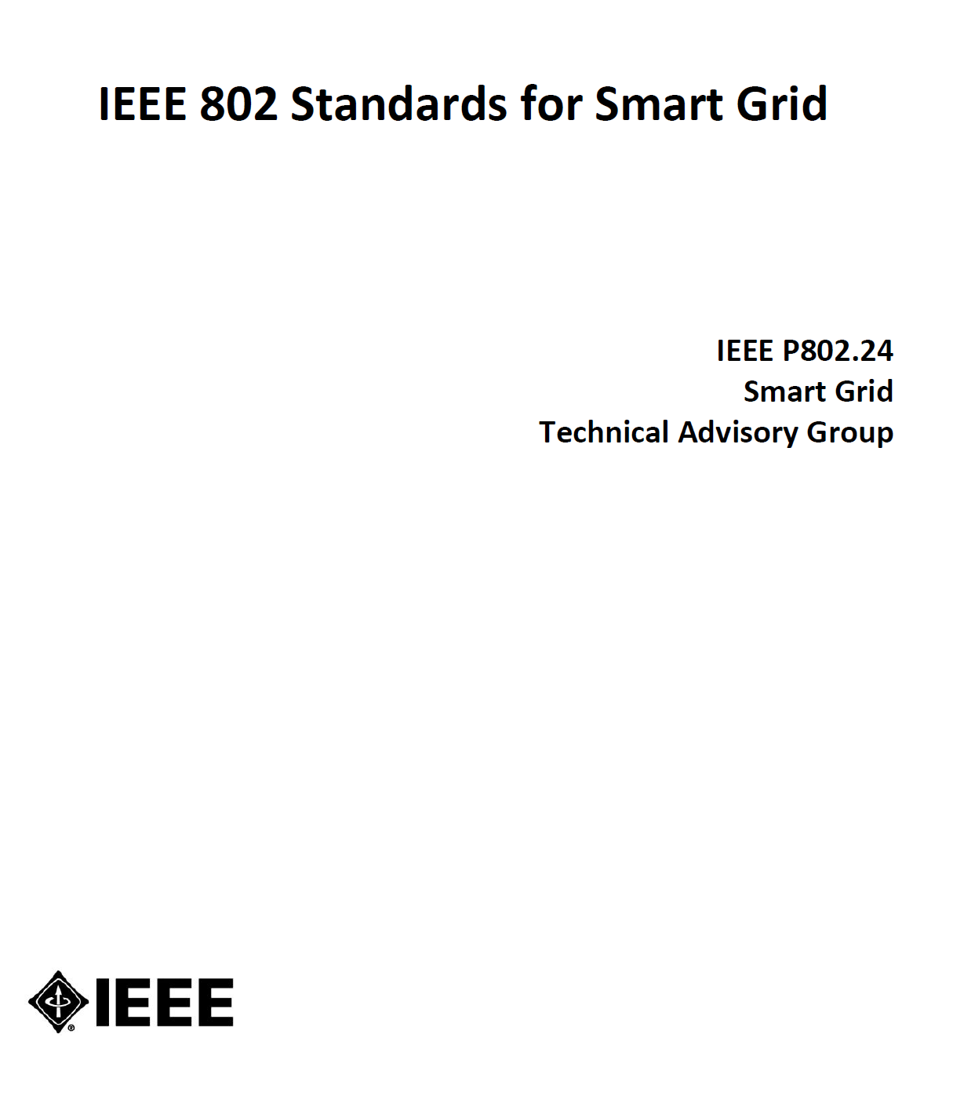
Revision of 2014 Smart Grid White Paper
New Standards
Amendments of 802.15.4 u, v, w, x, y, ac, ad, (4me revision)
802.15.9
802.1 TSN
802.11ah and 11ax
802.16s, 16t
802.19.3 sub-1 GHz coexistence
New topics
Integration of Gas/Water into electric metering
Battery leaf nodes for low power
Sensors
Situational Awareness
Physical Security
Wildfire detection and prevention
Complementary role of IEEE 802 with cellular technologies

Slide 8
Vertical Applications – Industry Standards Outreach
802.24 provides an entry point for vertical markets and stakeholders (transportation, oil/gas, etc) engage with IEEE 802 and identify relevant “standards gaps” that may result in new projects.
Identify the people connected with new market sectors.
802.24 can function as an all-802 TIG for identifying and clarifying standardization needs for vertical markets
Seek opportunities to collaborate with WNG activities in Working Groups as appropriate

Slide 9
How to participate
802.24 meets PM2 on Tuesday and Wednesday during IEEE 802 sessions
Reciprocal attendance credit is offered

