Slide 1
802.24 Vertical Applications TAG
Agenda and Meeting Presentation
July 2023 Plenary Meeting
Berlin, Germany

Slide 2
802.24 Overview
802.24 Vertical Applications TAG
802.24.1 Smart Grid TG
802.24.2 IoT TG
Officers
  TAG Chair: Tim Godfrey
  Secretary & TAG Vice Chair: Ben Rolfe
Task Groups
  802.24.1 Smart Grid TG Tim Godfrey
  802.24.2 IoT TG Chris DiMinico
25 Voting Members

Slide 3
July Plenary - Meeting Plan
Registration is required
Two slots:
  Tuesday July 11, PM2 4PM CET
  Wednesday July 12, PM2 4PM CET
Accredited Hybrid Meeting with Remote Participation
PM2: 4 PM CET, Tuesday July 11, 2023
  Join WebEx meeting
  Meeting number: 2420 913 6121 Meeting password: stVMXtxH566
  Join by phone
  +1-855-797-9485 US Toll free
  +1-415-655-0002 US Toll
  Access code: 2420 913 6121
  Global call-in numbers | Toll-free calling restrictions
PM2: 4 PM CET, Wednesday July 12, 2023
  Join WebEx meeting
  Meeting number: 2421 303 8265 Meeting password: 9irW7JPgc4y
  Join by phone
  +1-855-797-9485 US Toll free
  +1-415-655-0002 US Toll
  Access code: 2421 303 8265
  Global call-in numbers | Toll-free calling restrictions

Slide 4
Agenda
Call session to order / “Guidelines for IEEE SA meetings”
Review of Agenda / Approval of Agenda / Approve Minutes
Liaison Updates / Regulatory
"IEEE 802 Solutions for Vertical Applications" White Paper Comment Review
IoT white paper Development and Contributions
Low Latency White Paper - Comment Review
AFV Infrastructure communications white paper: Review contributions and white paper draft

Slide 5
Guidelines for IEEE-SA Meetings
All IEEE-SA standards meetings shall be conducted in compliance with all applicable laws, including antitrust and competition laws.
Don’t discuss the interpretation, validity, or essentiality of patents/patent claims.
Don’t discuss specific license rates, terms, or conditions.
  Relative costs, including licensing costs of essential patent claims, of different technical approaches may be discussed in standards development meetings.
    Technical considerations remain primary focus
Don’t discuss or engage in the fixing of product prices, allocation of customers, or division of sales markets.
Don’t discuss the status or substance of ongoing or threatened litigation.
Don’t be silent if inappropriate topics are discussed… do formally object.
---------------------------------------------------------------
If you have questions, contact the IEEE-SA Standards Board Patent Committee Administrator at patcom@ieee.org or visit http://standards.ieee.org/about/sasb/patcom/index.html
See IEEE-SA Standards Board Operations Manual, clause 5.3.10 and “Promoting Competition and Innovation: What You Need to Know about the IEEE Standards Association's Antitrust and Competition Policy” for more details.
This slide set is available
at https://development.standards.ieee.org/myproject/Public/mytools/mob/preparslides.ppt
IEEE 802 Executive Committee

Slide 6
IEEE SA Copyright Policy
By participating in this activity, you agree to comply with the IEEE Code of Ethics, all applicable laws, and all IEEE policies and procedures including, but not limited to, the IEEE SA Copyright Policy.
  Previously Published material (copyright assertion indicated) shall not be presented/submitted to the Working Group nor incorporated into a Working Group draft unless permission is granted.
  Prior to presentation or submission, you shall notify the Working Group Chair of previously Published material and should assist the Chair in obtaining copyright permission acceptable to IEEE SA.
  For material that is not previously Published, IEEE is automatically granted a license to use any material that is presented or submitted.

Slide 7
IEEE SA Copyright Policy
    The IEEE SA Copyright Policy is described in the IEEE SA Standards Board Bylaws and IEEE SA Standards Board Operations Manual
      IEEE SA Copyright Policy, see
      Clause 7 of the IEEE SA Standards Board Bylaws
      https://standards.ieee.org/about/policies/bylaws/sect6-7.html#7
      Clause 6.1 of the IEEE SA Standards Board Operations Manual
      https://standards.ieee.org/about/policies/opman/sect6.html
    IEEE SA Copyright Permission
      https://standards.ieee.org/content/dam/ieee-standards/standards/web/documents/other/permissionltrs.zip
    IEEE SA Copyright FAQs
      http://standards.ieee.org/faqs/copyrights.html/
    IEEE SA Best Practices for IEEE Standards Development
      http://standards.ieee.org/develop/policies/best_practices_for_ieee_standards_development_051215.pdf
    Distribution of Draft Standards (see 6.1.3 of the SASB Operations Manual)
      https://standards.ieee.org/about/policies/opman/sect6.html

Slide 8
Participant behavior in IEEE-SA activities is guided by the IEEE Codes of Ethics & Conduct
All participants in IEEE-SA activities are expected to adhere to the core principles underlying the:
  IEEE Code of Ethics
  IEEE Code of Conduct
The core principles of the IEEE Codes of Ethics & Conduct are to:
  Uphold the highest standards of integrity, responsible behavior, and ethical and professional conduct
  Treat people fairly and with respect, to not engage in harassment, discrimination, or retaliation, and to protect people's privacy.
  Avoid injuring others, their property, reputation, or employment by false or malicious action
The most recent versions of these Codes are available at
  http://www.ieee.org/about/corporate/governance

Slide 9
Participants in the IEEE-SA “individual process” shall act independently of others, including employers
The IEEE-SA Standards Board Bylaws require that “participants in the IEEE standards development individual process shall act based on their qualifications and experience”
This means participants:
  Shall act & vote based on their personal & independent opinions derived from their expertise, knowledge, and qualifications
  Shall not act or vote based on any obligation to or any direction from any other person or organization, including an employer or client, regardless of any external commitments, agreements, contracts, or orders
  Shall not direct the actions or votes of other participants or retaliate against other participants for fulfilling their responsibility to act & vote based on their personal & independently developed opinions
By participating in standards activities using the “individual process”, you are deemed to accept these requirements; if you are unable to satisfy these requirements then you shall immediately cease any participation

Slide 10
IEEE-SA standards activities shall allow the fair & equitable consideration of all viewpoints
The IEEE-SA Standards Board Bylaws (clause 5.2.1.3) specifies that “the standards development process shall not be dominated by any single interest category, individual, or organization”
  This means no participant may exercise “authority, leadership, or influence by reason of superior leverage, strength, or representation to the exclusion of fair and equitable consideration of other viewpoints” or “to hinder the progress of the standards development activity”
This rule applies equally to those participating in a standards development project and to that project’s leadership group
Any person who reasonably suspects that dominance is occurring in a standards development project is encouraged to bring the issue to the attention of the Standards Committee or the project’s IEEE-SA Program Manager

Slide 11
Administration
Attendance take on IMAT – This meeting will be accredited to attendance
  Reciprocal rights for most WGs
Web page
  http://www.ieee802.org/24
Mailing list
  stds-802-24@listserv.ieee.org
  802-24-voters@listserv.ieee.org (voters list)
Document archive
  http://mentor.ieee.org/802.24/documents
IEEE 802 announcement reflector, stds-802-all@listserv.ieee.org
  Send email to listserv@listserv.ieee.org with no subject and with the
  following 2 lines appearing first in the body of the message
Subscribe stds-802-all
end

Slide 12
802.24 TAG Opening
Approve May 2023 TAG wireless interim minutes
  802.24-23-0014r0
Action Items from May
  Start Whitepaper Review poll
  Allan and Ben to coordinate on IoT White Paper and set date for ad-hoc teleconference.

Slide 13
Liaison Updates
Wi-Fi Alliance (Informal) <vacant>
CSA / Matter (Informal) Clint Powell Active
FiRa (UWB ranging based on 15.4) Clint Powell
CCC (access control and automotive key based on NFC, next gen will be UWB) (new – liaison needed)
TIA-TR42 Chris DiMinico
Wi-SUN Alliance (informal) Phil Beecher
802.18 Edward Au
ATIS TOPS Farrokh Khatibi (unknown)
Chris D – will identify a point of contact or potential liaison for automotive. Also check with Jim Lansford.

Slide 14
"IEEE 802 Solutions for Vertical Applications"
The 802 Solutions for Verticals could be a reason why 3GPP should care about IEEE 802
Start review of entire document 12r5 – ask 802.1, 802.3, 802.11, 802.15,
  Set up an epoll on mentor
  Save review documents as PDF to get stable line numbers
For comment:
  24-23-0012-00-0000-ieee-802-networks-for-vertical-applications-PDF-for-comment.pdf
18-May-2023 ET | 2023 | 12 | 0 | TAG documents | IEEE 802 Networks for Vertical Applications White Paper (PDF-for-comment) | 802.24 TAG | 18-May-2023 17:39:07 ET

Slide 15
"IEEE 802 Solutions for Vertical Applications"
Comment Review

Slide 16
802.24.2 IoT White Paper
New Internet of Things White Paper 24-22-0011-01-IoTg-internet-of-things-white-paper

Slide 17
IoT White Paper
Contributions for July:
  2023-0013r0 IoT Task Group 802.24.2 IOT-10BASE-T1L SPE Switches and Adapters Christopher DiMinico – SenTekse

Slide 18
IoT White Paper Discussion
Plan of action
  Action Chris D. Incorporate parts of Single Pair Ethernet
    Now included in 802.3-2022 Clause 146.
    IEC TS 63444 based on SPE with intrinsic safety application with and without POE.
  Expand with Wireless 802 standards highlights. (from low latency WP and original smart grid WP) show where they fit.
    Re-use rate-vs range diagram?
    Which standards are optimized for specific markets or applications?
  Discussion on what IoT means today as the term has lost a specific meaning. Iot is deploying, but only partially conforming to standards.
  White paper could address remaining issues to be solved. Raise awareness of vertical applications and relation to IEEE802.
Target Audience
  Architects or engineering leaders in vertical industries responsible for defining communications solutions for their IoT devices
Focus on use-cases, where there is less content elsewhere. Define an outline, set boundaries for scope.
Co owners – Allen Jones and Ben Rolfe – will hold ad-hoc call
Recruit Volunteers:
  Chris DiMinico - wired
  Phil Beecher
  Ask Dave Halasz
  Jim Lansford (automotive)

Slide 19
“Low latency” White Paper
Finalize and move into IEEE Editors
Comment Collection Initiated
  Open Issues: more details in section on standards
16-May-2023 ET | 2023 | 11 | 1 | TAG documents | Low Latency Communications White Paper (PDF-for-comment) | 802.24 TAG | 17-May-2023 17:04:26 ET
16-May-2023 ET | 2023 | 10 | 1 | TAG documents | Low Latency Communication White Paper to Publication | 802.24 TAG | 16-May-2023 20:32:18 ET

Slide 20
“Low latency” White Paper
Review of submitted comments

Slide 21
AFV Communications - White Paper
Types of AFV sites: residential, commercial vehicle depot, public transport site, long haul freight transportation. (Public parking facilities)
Long dwell / short dwell
High power / lower power
Communications requirements: data volume, resilience, reliability.
  Ancillary communication to vehicles (maps, firmware and software updates for vehicles, inventory tracking, logistics, media, etc)
Relate to the use of IEEE 802 technologies as the solution

Slide 22
Contributions related to AFV White Paper
2023 | 15 | 0 | TAG documents | Proposed Texts and Figures of Clause 4.1.4 in the draft-afv-whitepaper | Jin Seek Choi (Hanyang University)

Slide 23
AFV White Paper
Draft white paper 802.24-23-0007r0
Notes:
  Considering using DSRC 5.9 spectrum (independent of WAVE protocol stack)
  Privacy aspects of charging infrastructure – apply 802.11bh and 802.11bi?

Slide 24
Vertical Applications – Industry Standards Outreach
802.24 serving as an opportunity for vertical markets and stakeholders (transportation, oil/gas, etc) engage with IEEE 802 and identify relevant “standards gaps” that we result in new projects.
  Identify the people connected with new market sectors.
  802.24 would function as an all-802 TIG for identifying and clarifying standardization needs for vertical markets
  Initiate activities to collaborate with WNG activities in Working Groups
Action Plan
  Promote 802.24 as a venue for vertical stakeholders to initiate standardization
  Partner with public visibility SC – further outreach to industry alliances and advocates. Close the loop from external specs back into IEEE 802. Document success stories to motivate.
  Participate in any IEEE 802 Showcase events to bring in industry people who are not interested in being a standards developer, but want to know about standards, and how to get them initiated.
  Engage and bring in new verticals at specific industry events and conferences

Slide 25
Future TAG Activity Planning
Update of first Smart Grid white paper to address latest amendments of 802.15.4 u, v, w, x, y, Rev-me, (eventual) transition to 802.15.15 (new organization of documents to separate UWB from Narrowband)
  New topics – integration of Gas/Water into electric metering, battery leaf nodes for low power.
A whitepaper/document for application-specific use cases of Sub 1GHz standards 802.15.4g and 802.11ah. How use mechanisms in 802.19.3
  Can this also include applying 802.15.4s-2018 (Spectrum Resource Measurement Capability) in sub-1GHz spectrum?
  New activities in Sub-1GHz. Update to 11ah possible in 802.11-rev, also changes in 802.15.
IETF: Reliable and Available Wireless – see if there is any opportunity as it evolves? Is anyone involved in this? If there is no involvement or knowledge, we’ll drop. (check the IETF updates in .11 and .15 first).
  Ask Tero, coordinate with 802.15 IETF SC (Attend Tutorial in May 2023 on RAW and DETNET)
  Ann will report back from next IETF
TSN – movement of 802.1 and 802.3 towards specific profiles (related to vertical applications) AVB, Industrial Automation, Automotive, Aerospace. Select features out of base standards. TSN is a toolbox, profiles provide interoperability. Integration of TSN into 802.11 and high availability, could affect TSN profiles.

Slide 26
802.24 TAG closing
Action Items
Any New Business?
Next Meeting
    September 2023, Atlanta, GA, USA
Adjourn

Slide 27
Backup

Slide 28
Comment Collection on 802.24 “Low Latency White Paper”
The 802.24 TAG requests review and comments from IEEE 802 Working Groups and TAGs on the Low Latency White Paper document 802.24-23-0010r1
  https://mentor.ieee.org/802.24/dcn/23/24-23-0011-01-0000-low-latency-communications-white-paper-pdf-for-comment.pdf
The poll is of type “ePoll with Vote and Comments” to use the comment collection. The vote will not be used.

Slide 29
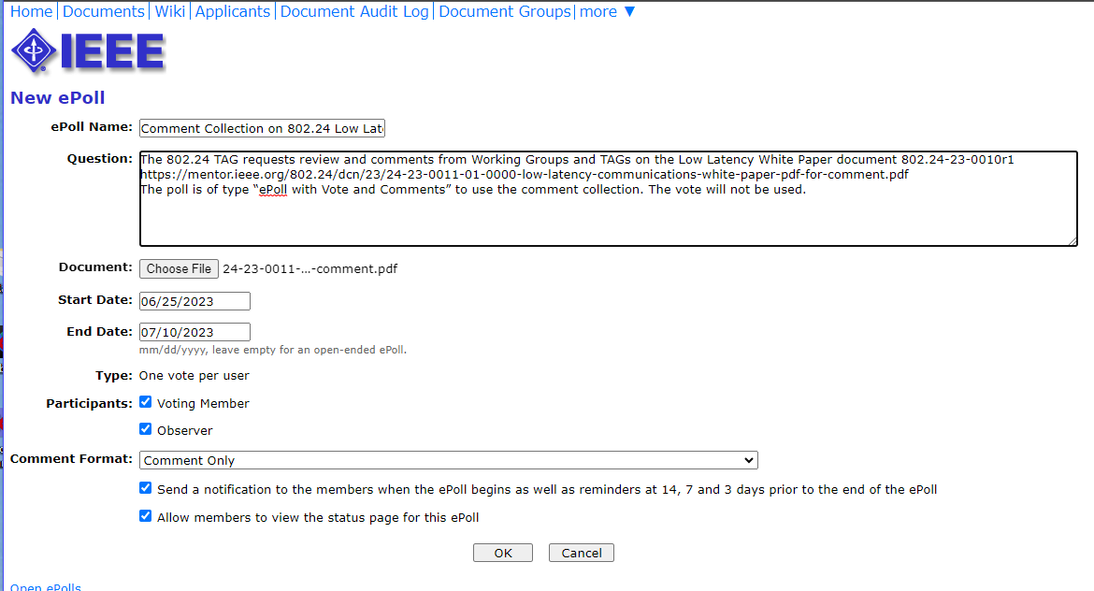

Slide 30
Comment Collection on 802.24 “IEEE 802 Networks for Vertical Applications White Paper”
The 802.24 TAG requests review and comments from IEEE 802 Working Groups and TAGs on the “IEEE 802 Networks for Vertical Applications White Paper” document 802.24-23-0012r0
  https://mentor.ieee.org/802.24/dcn/23/24-23-0012-00-0000-ieee-802-networks-for-vertical-applications-white-paper-pdf-for-comment.pdf
The poll is of type “ePoll with Vote and Comments” to use the comment collection. The vote will not be used.

Slide 31
