Slide 1
802.24 Vertical Applications TAG
Cross-cutting vertical opportunity for EV Charging AFV* (EV and H₂V) Fueling
Craig Rodine
Renewable and Distributed Systems Integration
Sandia National Laboratories Albuquerque, NM, USA
Nov 2022 IEEE 802 Plenary Session
Bangkok, Thailand (and remote)
* Alternative Fuel Vehicle
Sandia National Laboratories is a multimission laboratory managed and operated by National Technology & Engineering Solutions of Sandia, LLC, a wholly owned subsidiary of Honeywell International Inc., for the U.S. Department of Energy’s National Nuclear Security Administration under contract DE-NA0003525.

Slide 2
Agenda
Summary of 24-22-0016-01-0000 (Sept 2022)
Summary of the opportunities for IEEE 802
Example w/less use cases for EV charging (one new)
A brief look at Hydrogen Surface Vehicle fueling
Preview: discussion with 802.1 TSN (Thu 11/17 AM2)
Discussion and next steps

Slide 3
Opportunity for IEEE 802 vertical application
Explore a ‘Secure L2 EV charging comms fabric’
Develop LAN architecture/s supporting site-level (depot, public fuleing) operations
Towards a secure, cohesive, extensible ‘EV charging AFV fueling edge’
Draw on existing and coming 802.1/.3/.11 standards
Explore how 802 services for e.g. TSN, location, and privacy could enhance site operations and systems integration
Example next-generation (esp. fleet) EV charging uses cases
Use Wi-Fi for transactions, robotics, AV control
Use SPE for control and management of high-power EV charging, integrating building/site DERs and the electrical utility edge
Use VLANs to provide security and QOS for high-data-volume EV/AV applications, e.g. GIS data, route and schedule optimization, media services, trusted vehicle ECU/DCU FW/SW updates

Slide 4
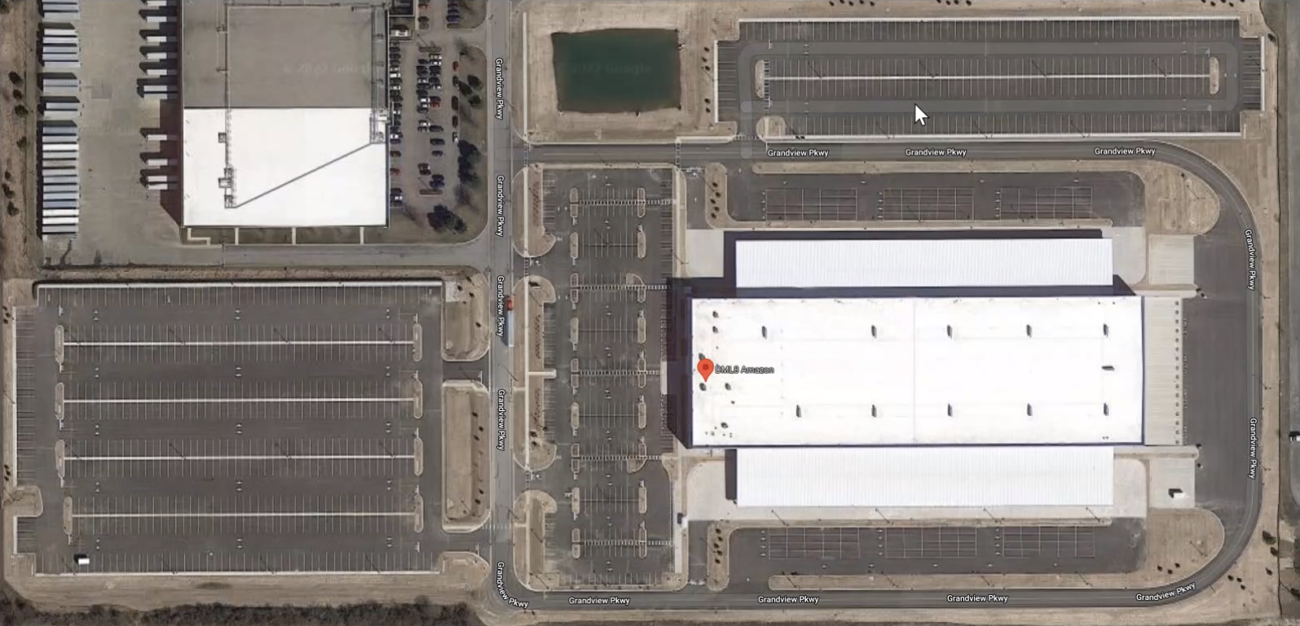
Concrete, near-term example #1 (new)
Use Wi-Fi® for large-scale EV (AC) charging
800 parking spots, 400 AC charging stations (6.6 kW)
Medium/long dwell (4-10 hour) charging
Obvious opportunities
Replace PLC (L1/L2)
Managed charging
Data (logistics & tracking)
EV (ECU) maintenance

Slide 5
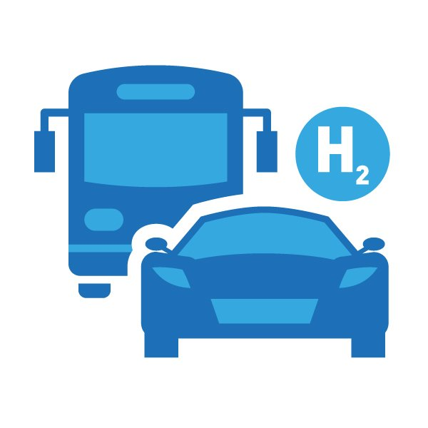
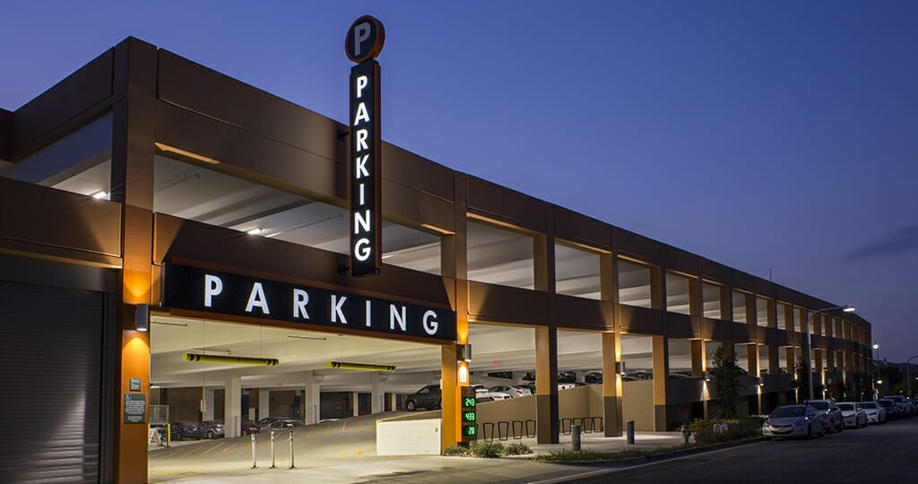
Concrete, near-term example #2 (expanded)
Use Wi-Fi for “over-the-top” transaction services
EV joins site Wi-Fi network, negotiates fueling service parameters
On-site edge (+cloud) services platform directs AFV to fueling bay
Coupling to fueling device could be robotic, controlled via Wi-Fi
Fueling control could be via Wi-Fi as well

Slide 6
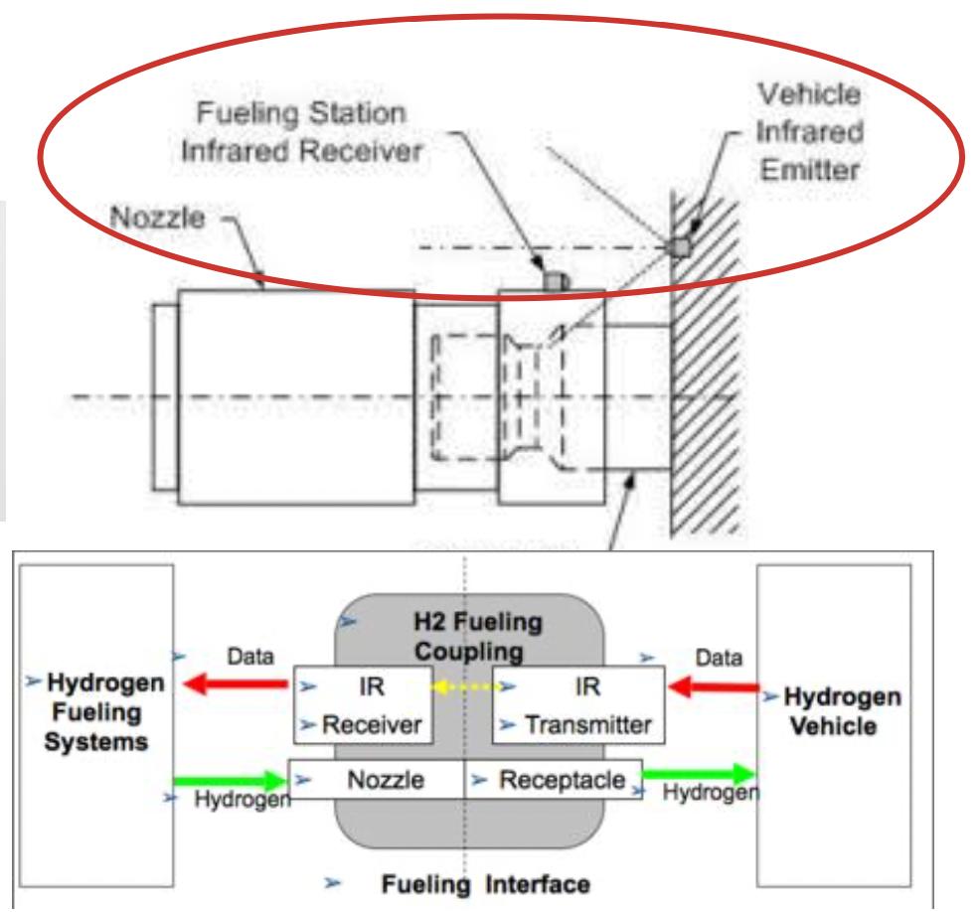
A brief look at H₂ (HSV) fueling
Current system uses IrDA standards for one-way communication
SAE J2799/J2600/J2601
Vehicle sends fixed fueling parameters (V, T, p)
Dispenser performs accordingly (“parameter-driven”)
Overly large margins for physical and functional safety
Doesn’t support higher fill rates, tank temp ranges
IrDA not very reliable (sunlight, fogging); easily damaged
Opening for standards-based w/less comms
2-way: tank characteristics; pre-cooling; dynamic control
Needed for higher-speed fueling (larger tank HSVs)
EU Project Prhyde -> ISO 19885-2/-3 (TC 297)
Contemplating transactional services (e.g. payment, loyalty points) and fleet management (fueling logs, maintenance)
Developing requirements for trust and security (PKI)
Interested in using Secure Layer 2 (802.1/802.11)

Slide 7
Preview: discussion with 802.1 TSN (Thu 11/17 AM2)
How could 802.1 and 802.3 standards support AFV fueling?
Convergence/concentration of energy & data for transportation
Support for fueling, power/energy distribution, logistics, operations
Sites/locale: depots, ‘truck stops’, public transport hubs (LAN/MAN)
Architecture
Distributed energy, computing, control
Coordinated security contexts
Fueling: vehicle, dispenser, energy sources and sinks; safety-critical?
Data: public/private, site/region, cooperating entities; trust domains
Orchestration of workloads between edge/cloud
Applications:
SPE in EV charging cables/couplers, for sensors (situational awareness)
Power system controls (e.g. protection, UPS, load management)
Data services (Internet/media, goods tracking, mobility services)
Inspiration: Nendica Reports (Flex Factory IOT, Intelligent LDCN)

Slide 8
Discussion, next steps
Thank you very much!
c.rodine@ieee.org
crrodin@sandia.gov

