Slide 1
802.24 Vertical Applications TAG
Cross-cutting vertical opportunity for EV Charging
Craig Rodine
Principal Member, Technical Staff: Cybersecurity R&D
Renewable and Distributed Energy Systems Integration
Sandia National Laboratories
Albuquerque, NM, USA
Sept 2022 IEEE 802 Wireless Interim Meeting
Waikoloa, Hawaii, USA (and remote)
Sandia National Laboratories is a multimission laboratory managed and operated by National Technology & Engineering Solutions of Sandia, LLC, a wholly owned subsidiary of Honeywell International Inc., for the U.S. Department of Energy’s National Nuclear Security Administration under contract DE-NA0003525.

Slide 2
Agenda
Overview of present-day public EV charging
  System architecture, open standards-based systems
  Focus on charging comms (lack of) cybersecurity
Potential project in IEEE 802.24 TF
  Describe secure L2 (wired+w/less) ‘EV edge’ comms fabric
  Supporting mission critical & data/comms-centric applications
  Supporting integration of DERs, building/site energy mgmt
Discussion and next steps

Slide 3
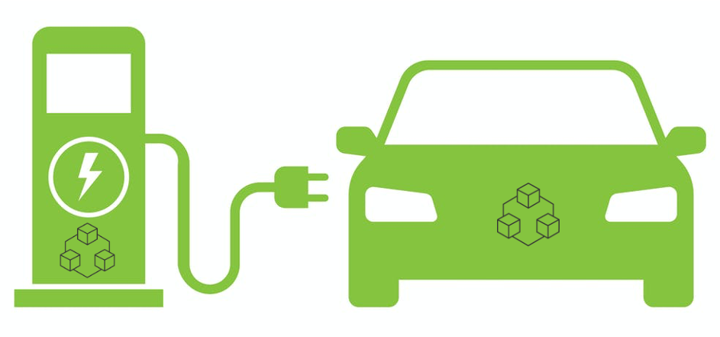


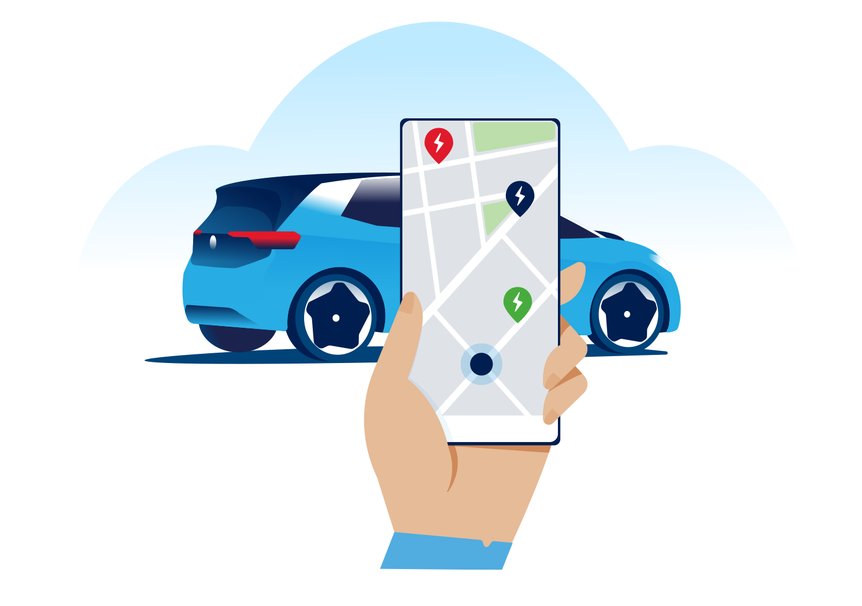
Overview of EV Charging (systems, services)
CNO₂ cloud
MSP₂ cloud
OEM₂ cloud
Reseller/Self
Partner/Self
Roaming
Reseller
CNO₁ cloud
Reseller
MSP₁ cloud
OEM₁ cloud
Reseller
Partner
Reseller/Self
Partner/Self
Foundation: safe energy exchange via coupler (connector+inlet), controlled by communication between state machines in EV and EVSE.

Slide 4
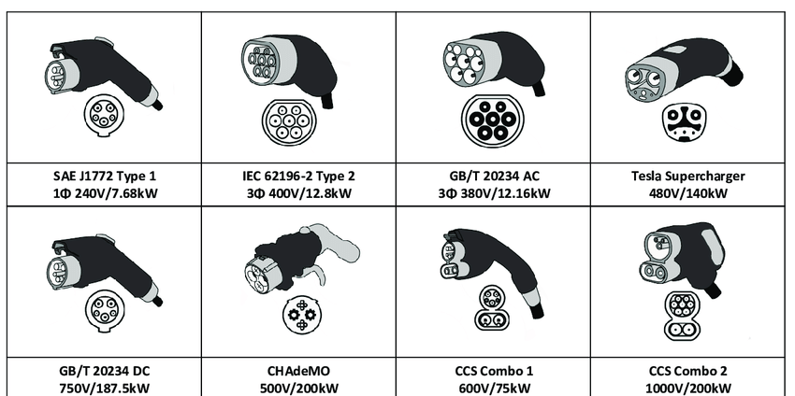
Overview of EV Charging (couplers, comms)
AC charging: analog control (so far*)
DC charging: digital signaling between EV-EVSE
EV-EVSE Communications
CHAdeMO, GB/T:
CAN bus / packets
CCS:
BPLC / IP / TCP / [TLS**] / XML (EXI)
Tesla:
SW-CAN / packets
* AC charging using messages over TCP/IP is defined in ISO 15118-2 but not yet implemented, since analog control plus CSP service logic works just fine.
** ISO 15118-2 and -20 define Certificate Profiles for TLS endpoints (EV and EVSE) but no PKI requirements. An industry group is developing those in SAE Intn’l.

Slide 5
Overview of EV Charging (cybersecurity)
Focus on EV-EVSE communication link
  Critical function: must be operational and resilient
  Almost no apparent protection = attractive attack surface
  Everything “northward” is M2M (secure 4G) & cloud2cloud
    Acknowledging other obvious, well-understood attack vectors (RFID/CC readers, attainable ETH & USB ports, etc.)
Summary of the two variants (details next slide)
  CAN bus: presents less ‘interesting’ opportunities
  BPLC: has been hacked and remains vulnerable

Slide 6
Overview of EV Charging (cybersecurity)
CAN bus stack (CHAdeMO, GB/T)
  Differential signaling in cable (UTP) is hard to sniff, disturb
  State machines are limited to energy transfer, no “higher level services” (such as AAA, payment transactions)
BPLC/IP/TCP stack
  Cable radiates 2-28 MHz energy (HomePlug Green PHY)
    Readily sniff-able from 10+m distance, Wireshark interception: 99% of packets
    DoS attack has been disclosed (Brokenwire, Univ. Oxford cybersecurity research team)
  Almost all DC charging in NA (CCS) must utilize the DIN 70121 protocol
    A very small % of EV models can use TLS (v1.2, one-way per ISO 15118-2)
    Only one CSP in NA currently supports the TLS handshake (per ISO 15118-2)
    So almost all EV models and almost all stations use unprotected TCP/IP per DIN 70121
  Mitigations being explored, but wide-scale deployment would be very challenging
I believe IEEE 802 could provide a superior (secure LAN) foundation

Slide 7
Opportunity for IEEE 802 vertical application
Explore a ‘Secure L2 EV charging comms fabric’
  Develop LAN architecture/s supporting site-level (depot) operations
  Towards a secure, cohesive, extensible ‘EV charging edge’
  Draw on existing and coming 802.1/.3/.11 standards
Explore how 802 services for TSN, location, and privacy could enhance site operations and systems integration
Example next-generation (fleet) EV charging uses cases
  Use Wi-Fi for transactional services, robotics, and AV control
  Use SPE for end-to-end control and management of high-power EV charging systems, integrating building/site DERs and the electrical utility edge
  Use VLANs to provide security and QOS for high-volume EV/AV data applications, e.g. GIS data refresh, route and schedule optimization, media services, trusted vehicle ECU FW/SW updates, etc.

Slide 8
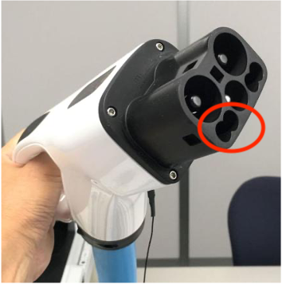
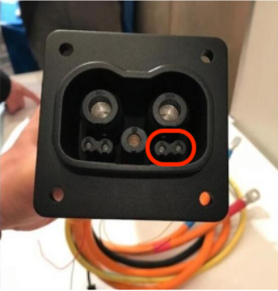
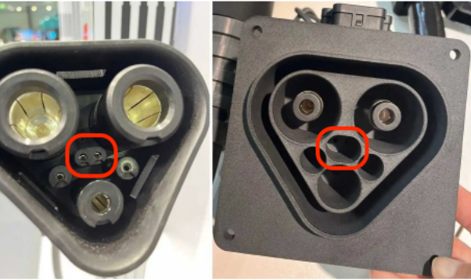
Concrete, near-term example #1
Use 802.3 (SPE?) for control and management of high-power EV charging systems
Both couplers have 2x pins with ~8mm spacing for comms
CHAdeMO/ChaoJi are now testing “Two-wire Ethernet” over these pins
MCS group is exploring alternatives to BPLC (CAN bus, 10Base-T1S)
CHAdeMO 3.0 aka ChaoJi
Megawatt Charging System (MCS)

Slide 9
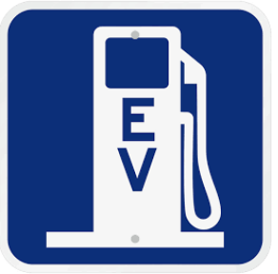
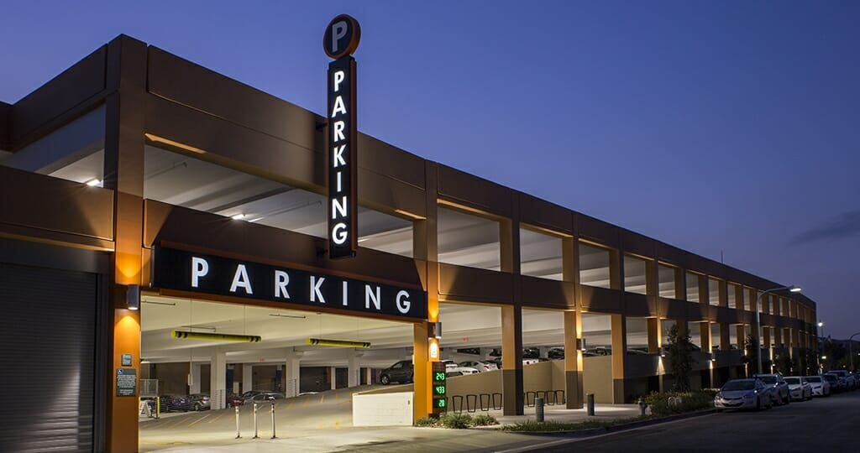

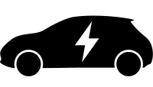
Concrete, near-term example #2
Use Wi-Fi for “over-the-top” transaction services, e.g.
EV joins site Wi-Fi network, negotiates service parameters
On-site/cloud services platform directs EV to EVSE
Conductive coupling can be robotic, controlled over Wi-Fi
Charging control (conductive or inductive) can be Wi-Fi messages as well

Slide 10
Discussion, next steps
Thank you very much!
c.rodine@ieee.org
crrodin@sandia.gov

